Slide 1
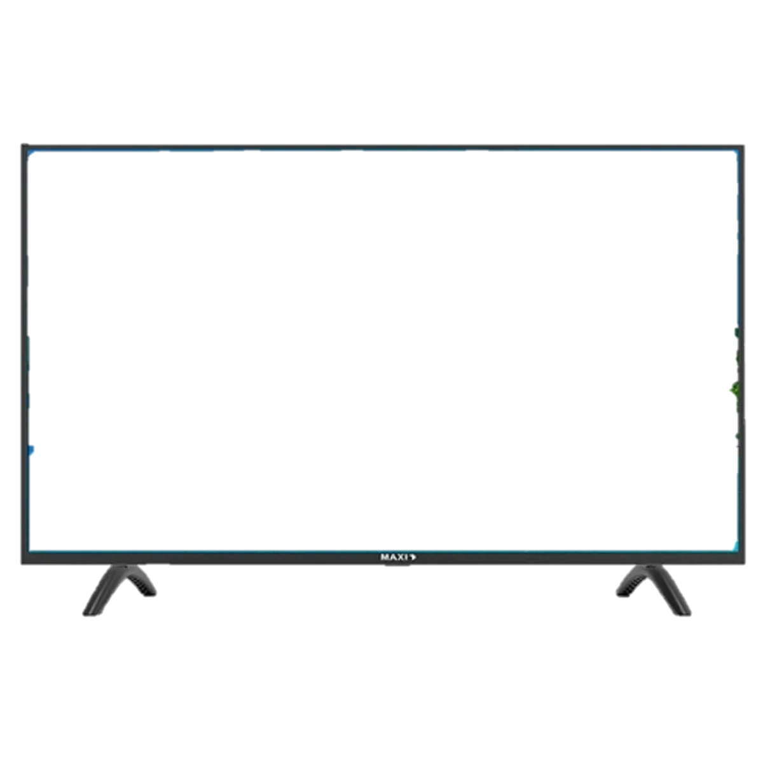
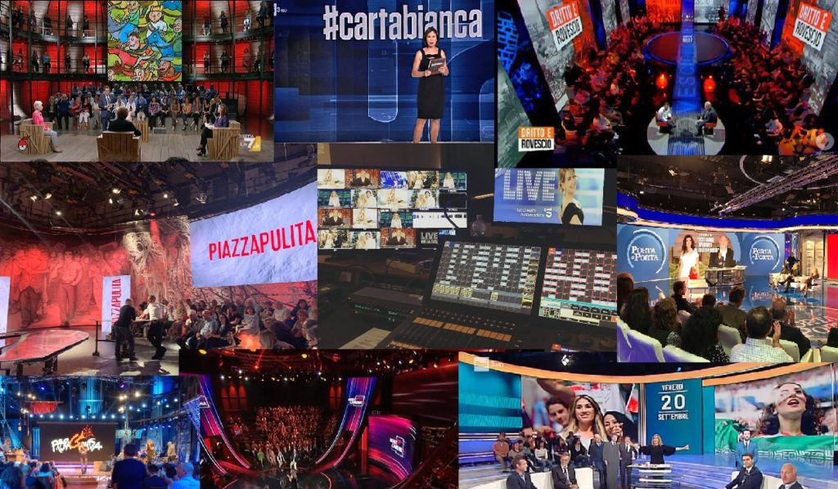
Data, Trends, and Biases of Television Political Talk Shows: Evidence from Italy
Gabriele Pinto Sapienza University Department of Social Science and Economics
Dipartimento di Economia e Management (DEM) Seminars, University of Pisa 23/05/2024

Slide 2
INTRO
This is a work in progress project!
Gabriele Pinto
Data, Trends and Biases of Television Political Talk Show: Evidence from Italy

Slide 3
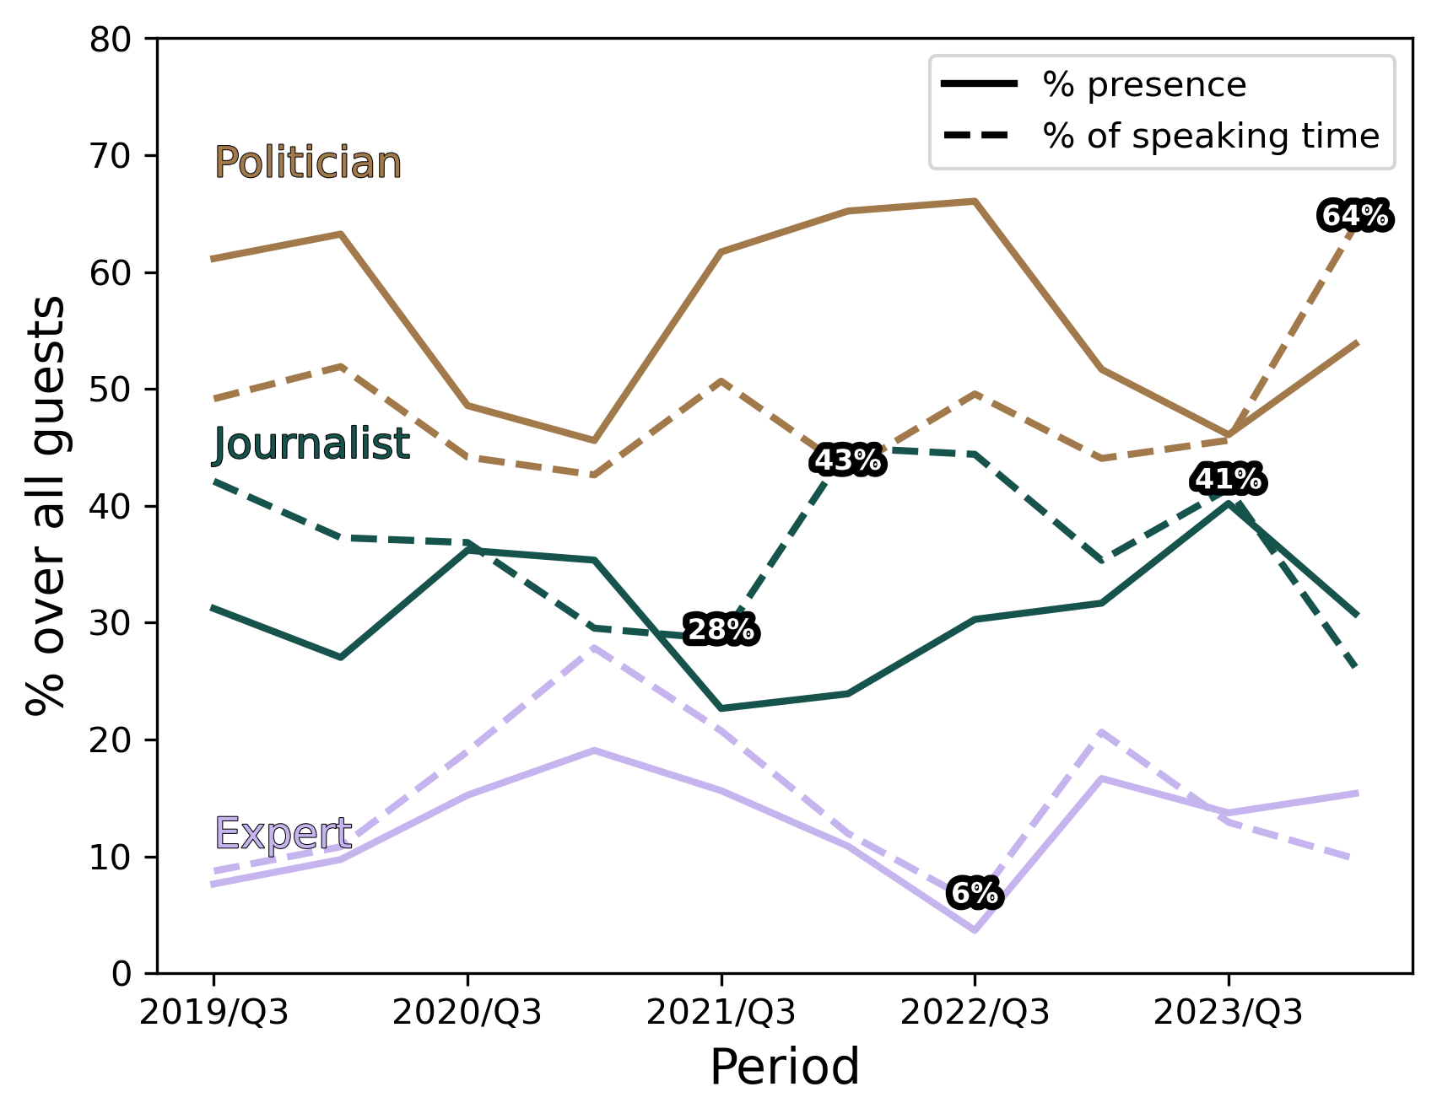
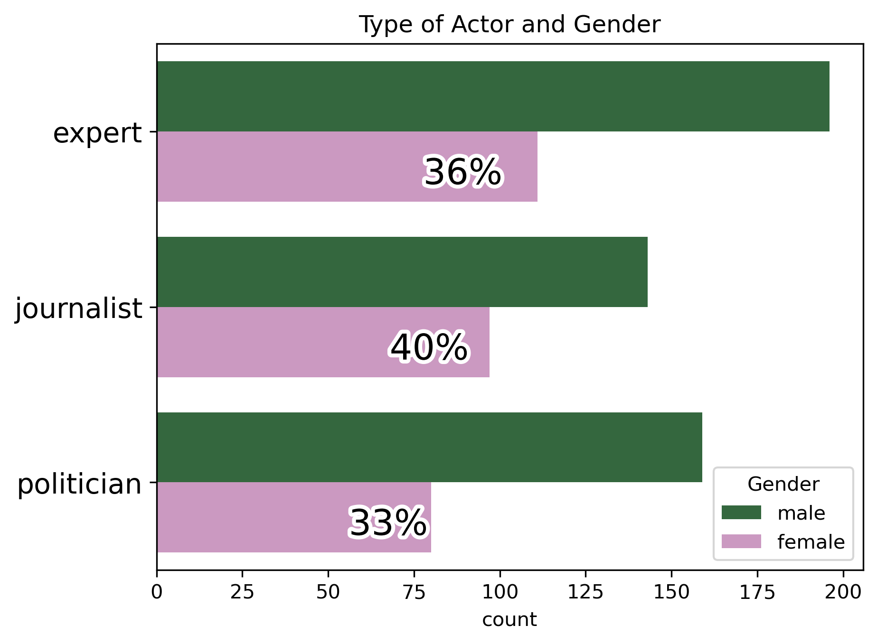
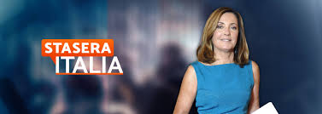
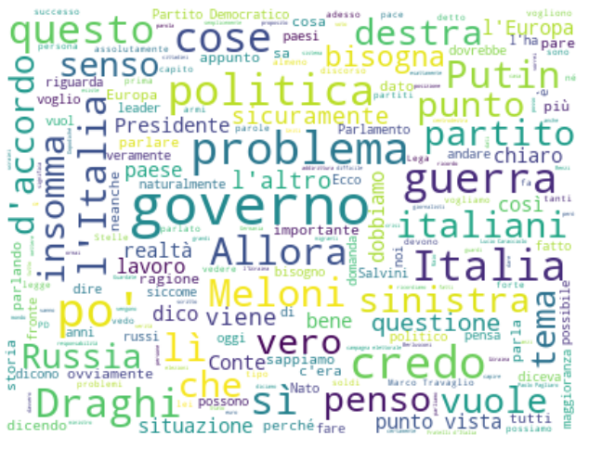
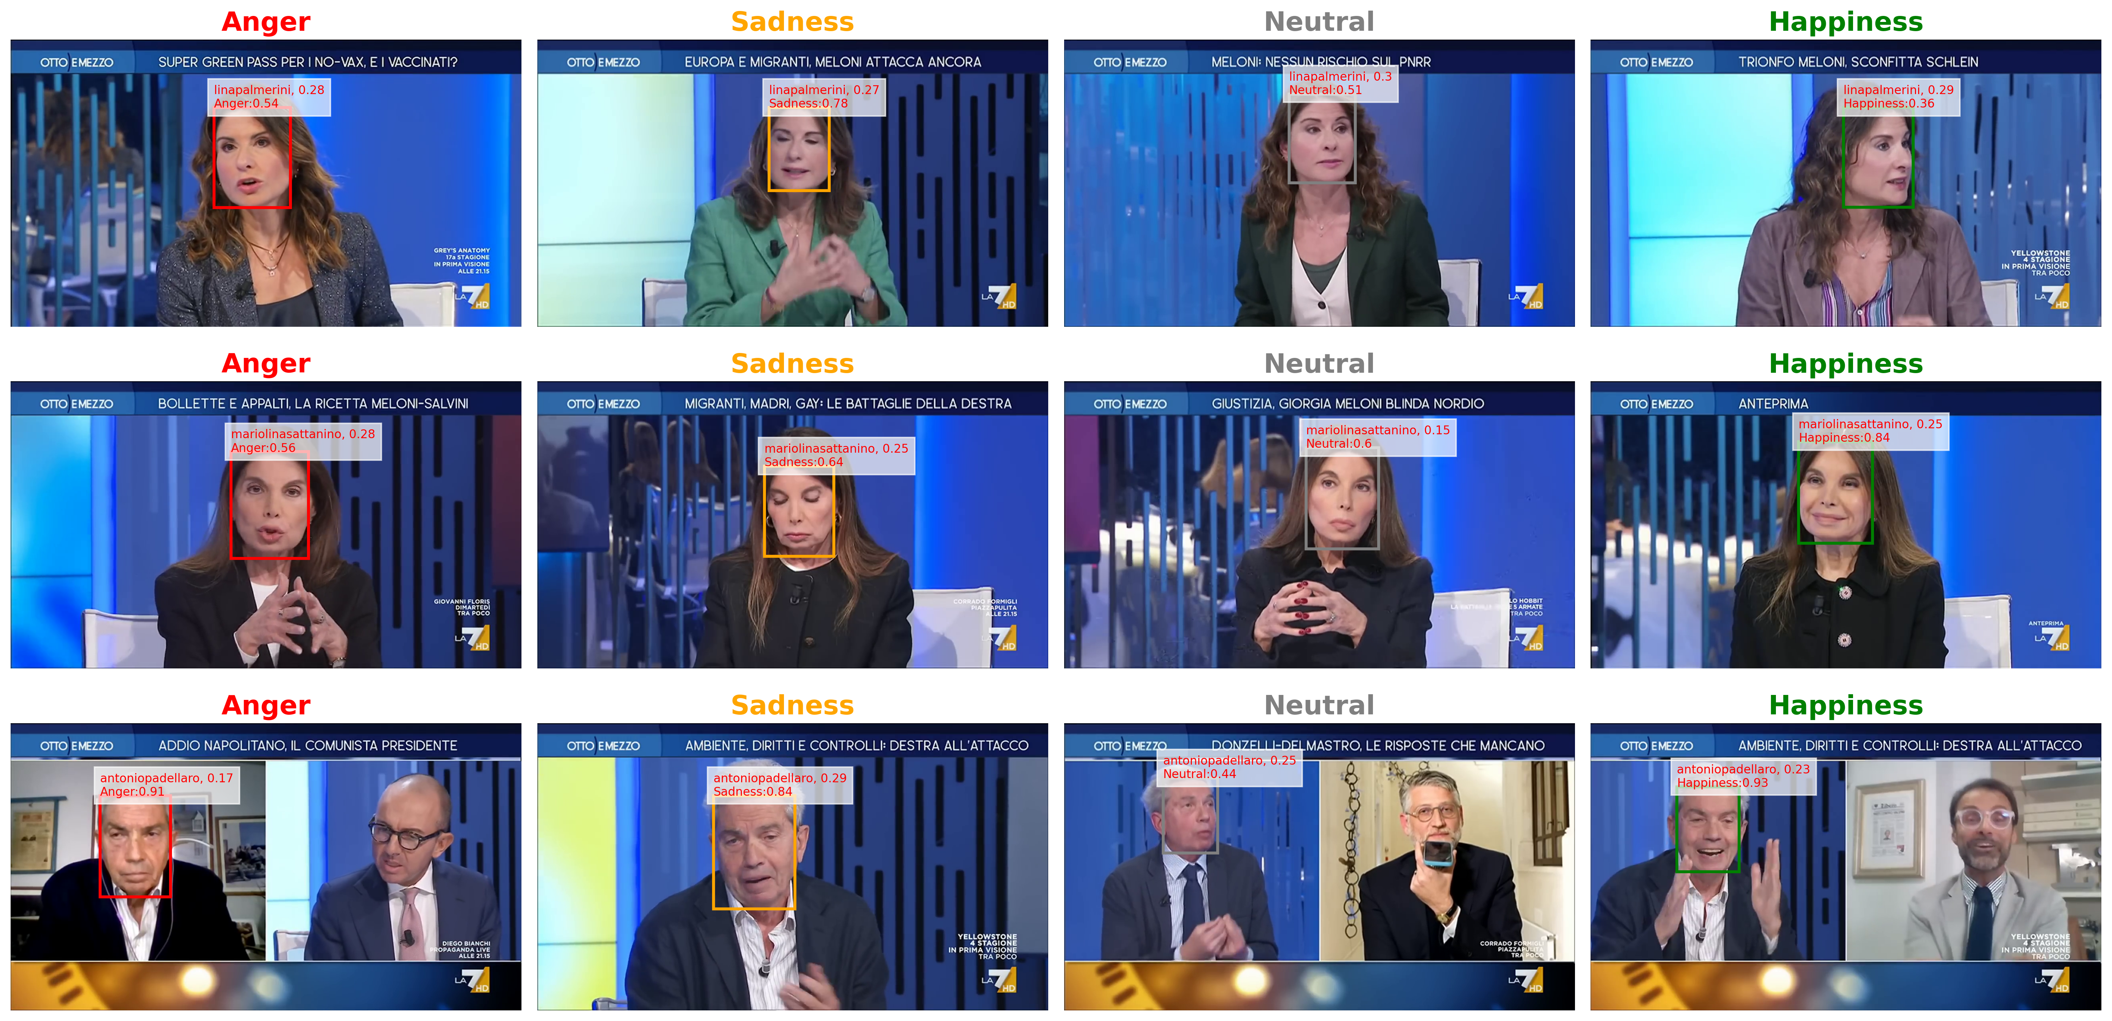
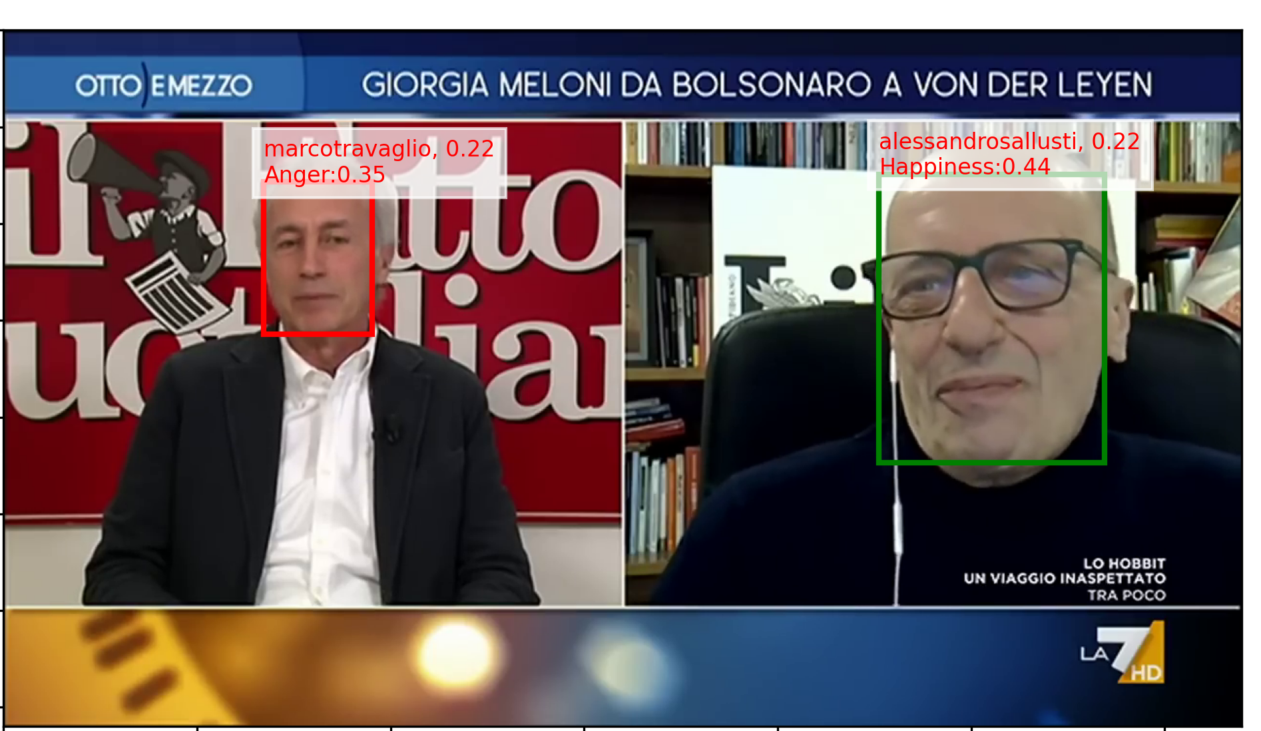
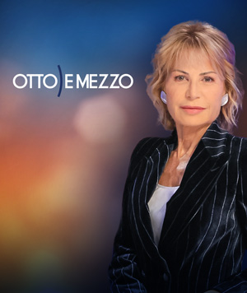
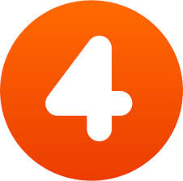
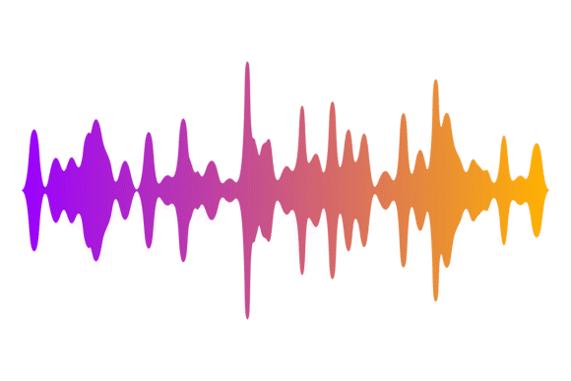
In a nutshell 1/2
INTRO
We collect 5 years (2018-2023) of video episodes of two major Italian Political Talk Show (“Otto e mezzo” & “Stasera Italia”)
We apply Machine Learning Tools to construct a huge (million of rows) second-by-second dataset of:
Who is talking
Male or female?
Journalist or Expert?
Etc..
When
Speaking time
Presence
What are they saying (complete transcriptions)
Tone of the Voice & Emotion of the Faces
Angry? Happy? Surprised? Aggressive?
Gabriele Pinto
Data, Trends and Biases of Television Political Talk Show: Evidence from Italy

Slide 4
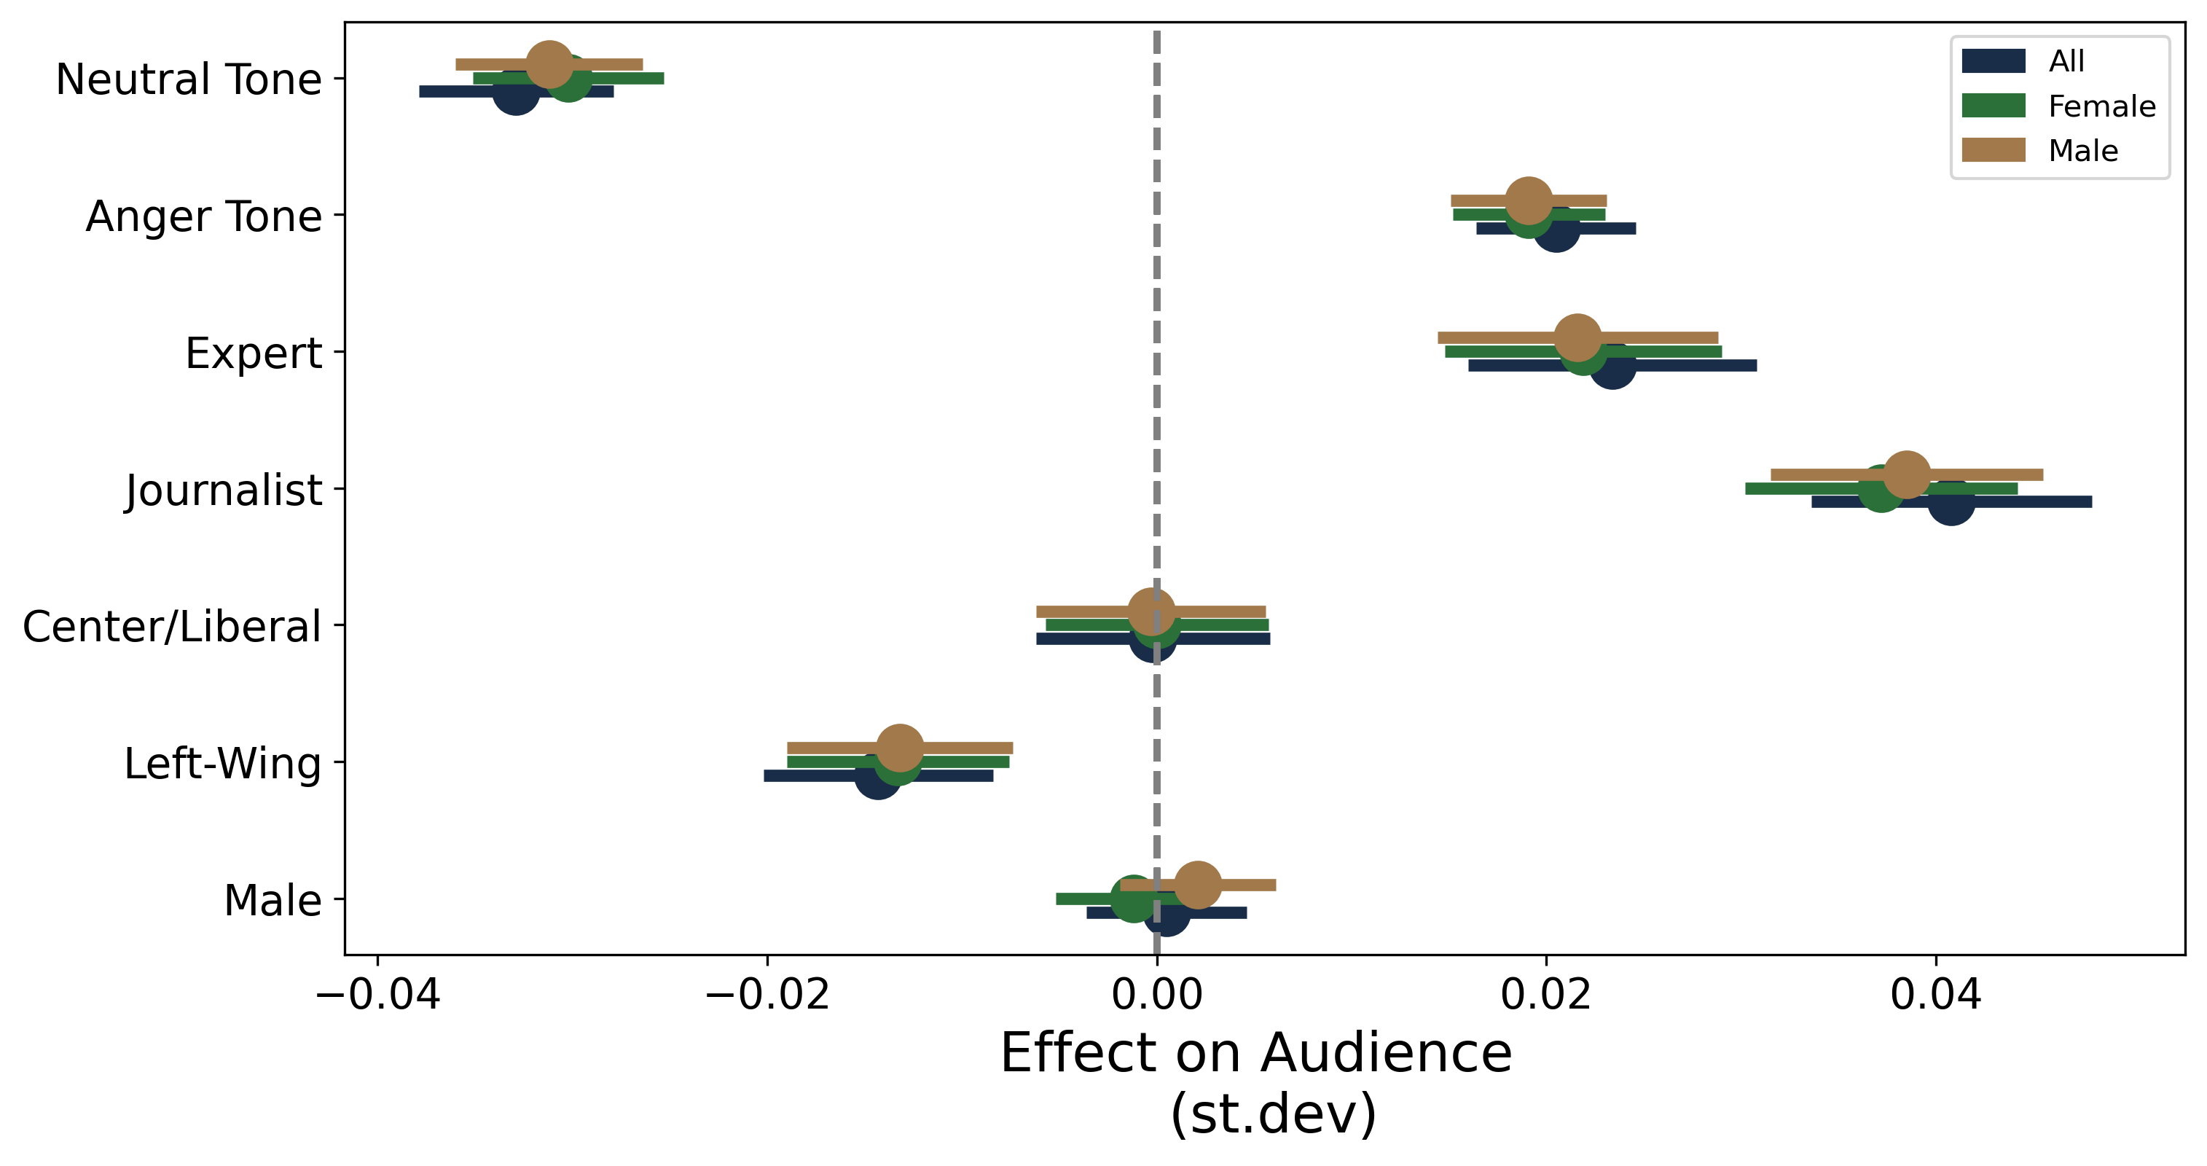
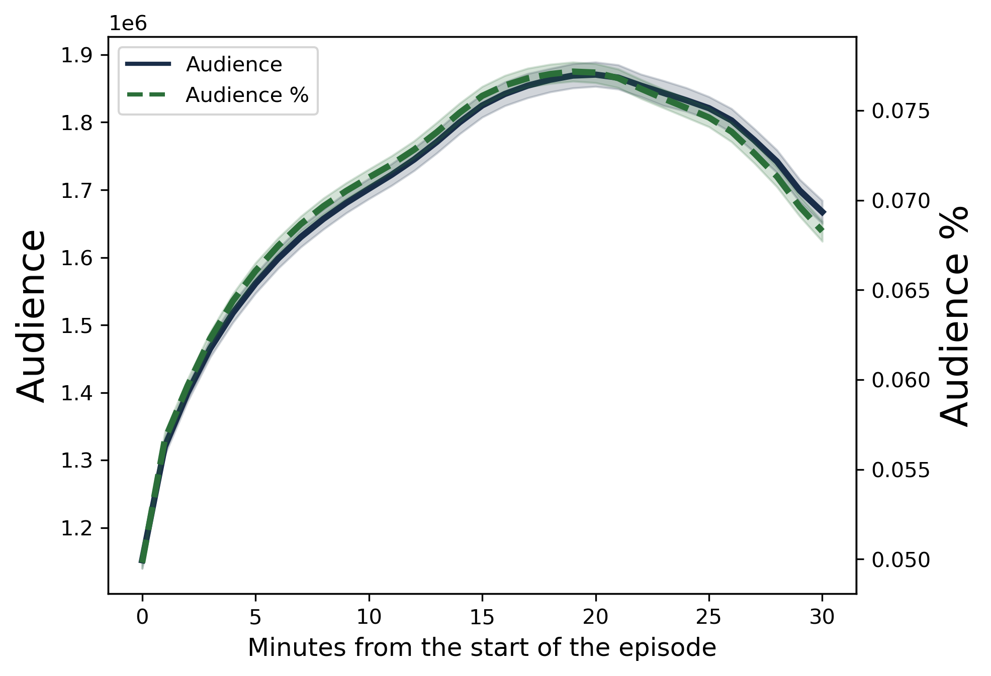
In a nutshell 2/2
INTRO
We match these data with minute-by-minute Auditel TV audience share to analyze:
the response of the audience to different settings (gender, type of speakers etc…)
Data, Trends and Biases of Television Political Talk Show: Evidence from Italy
Gabriele Pinto
Data, Trends and Biases of Television Political Talk Show: Evidence from Italy
Gabriele Pinto

Slide 5
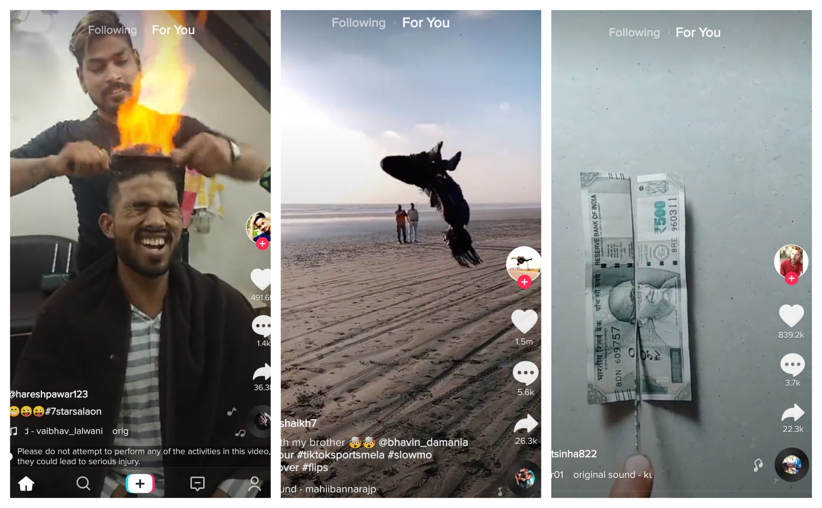
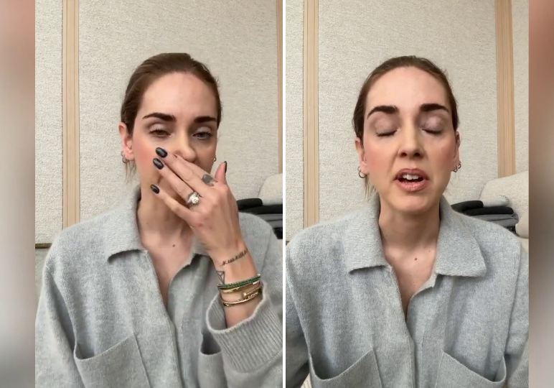
Why Video
MOTIVATION
Video is becoming more and more an important tool of communication (just look at the format of «new» social media like tik-tok, instagram reel, etc..)
Data, Trends and Biases of Television Political Talk Show: Evidence from Italy
Gabriele Pinto
Data, Trends and Biases of Television Political Talk Show: Evidence from Italy
Gabriele Pinto

Slide 6
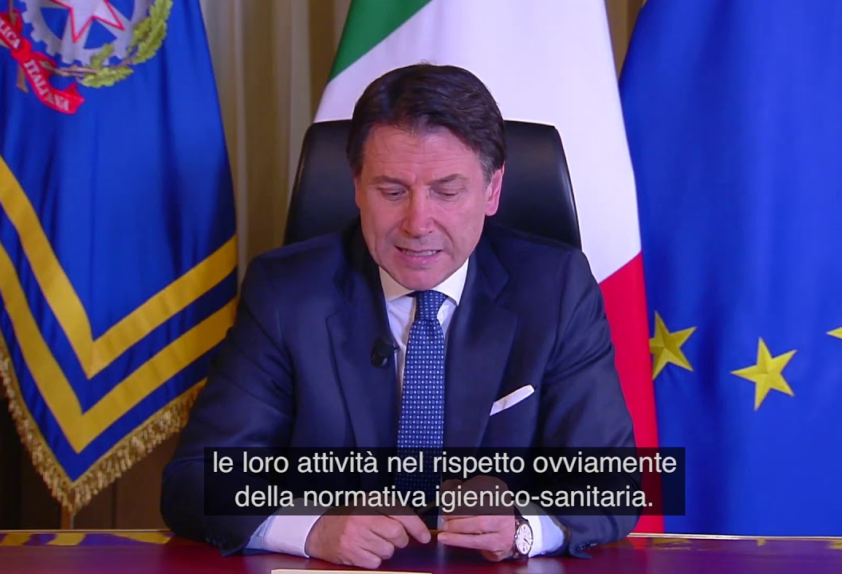
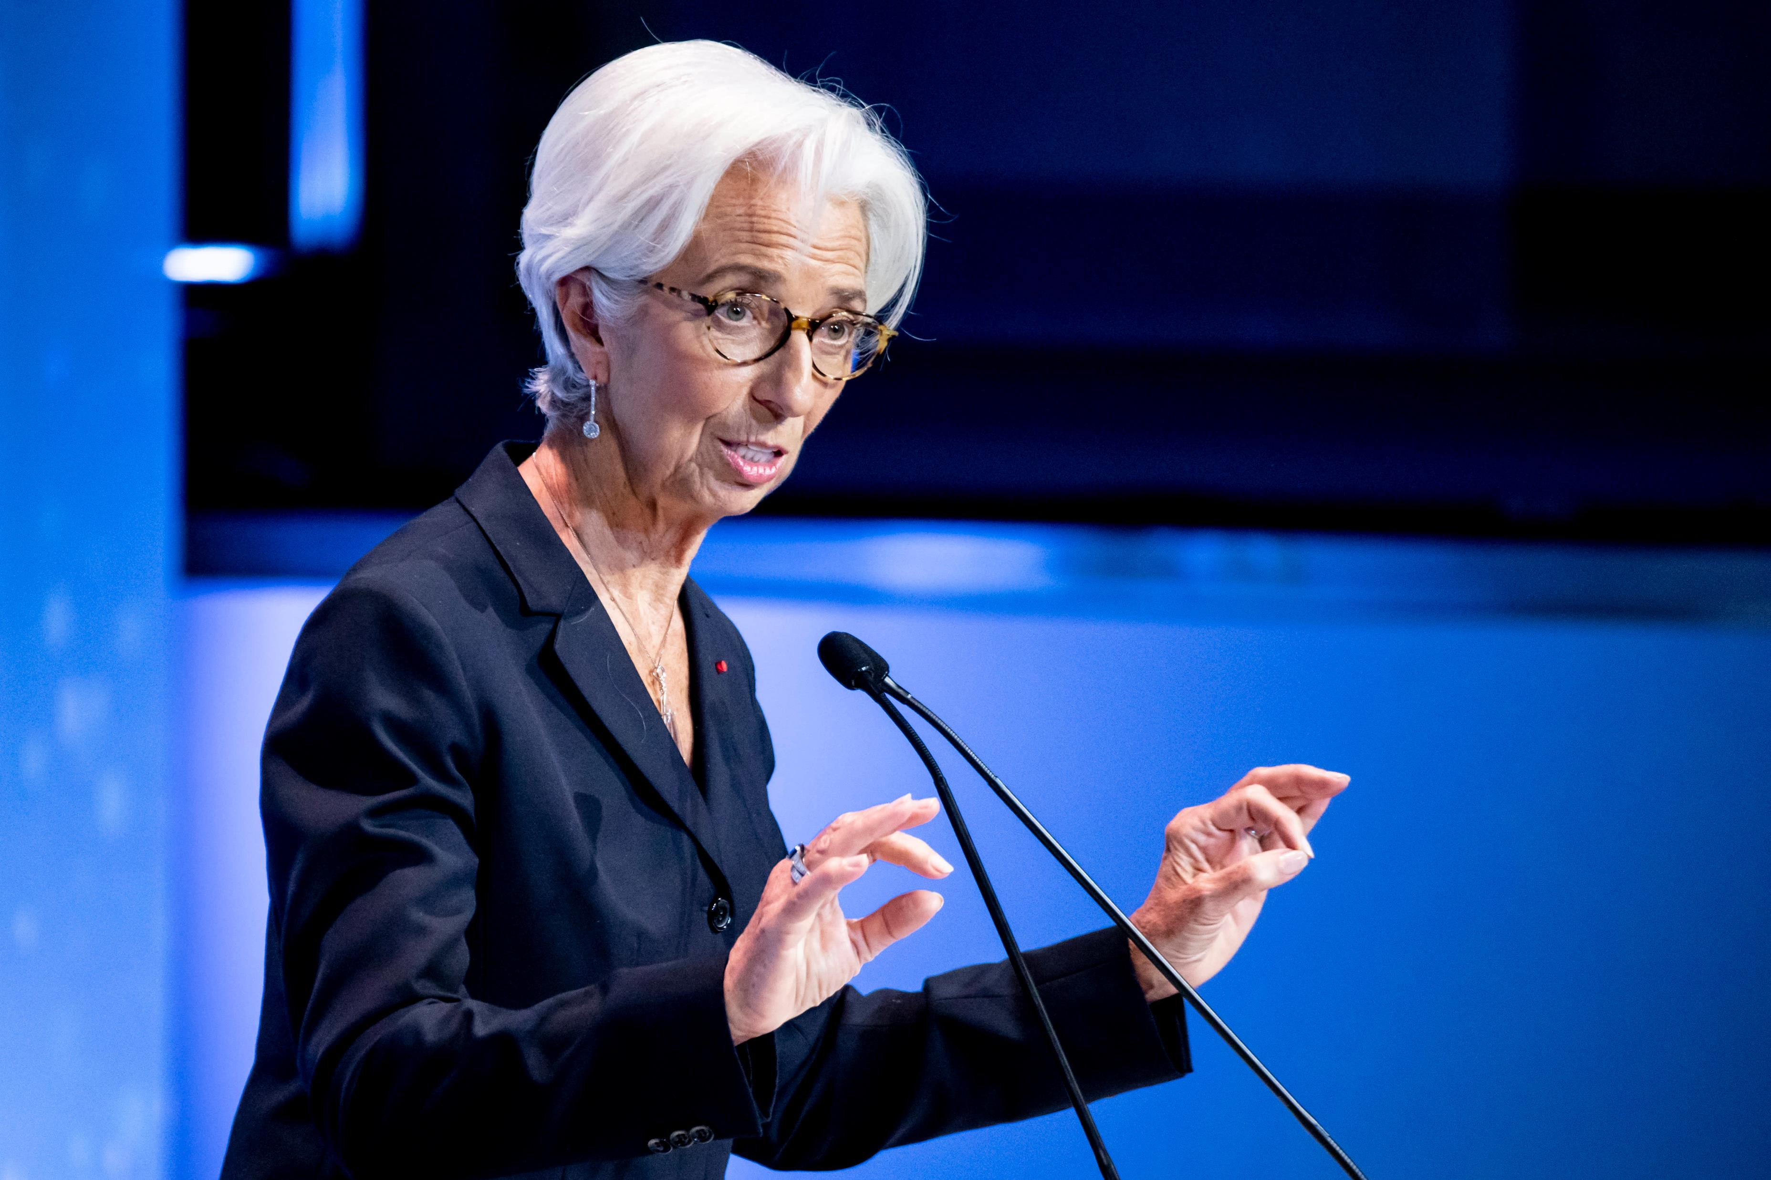
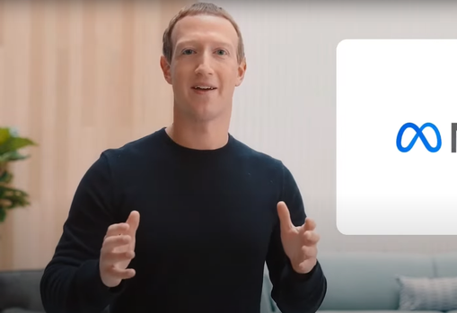
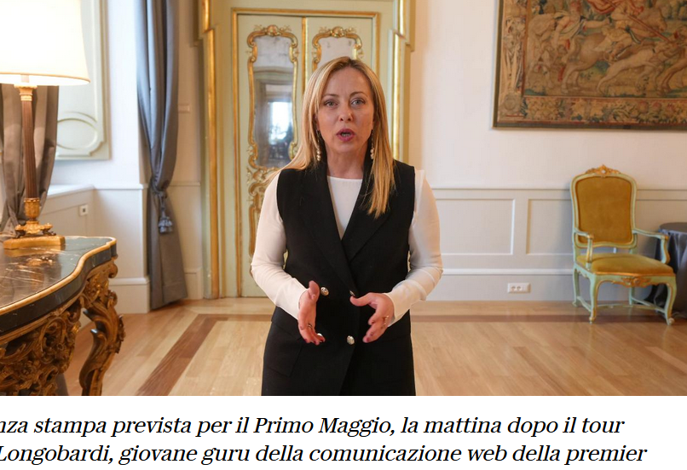
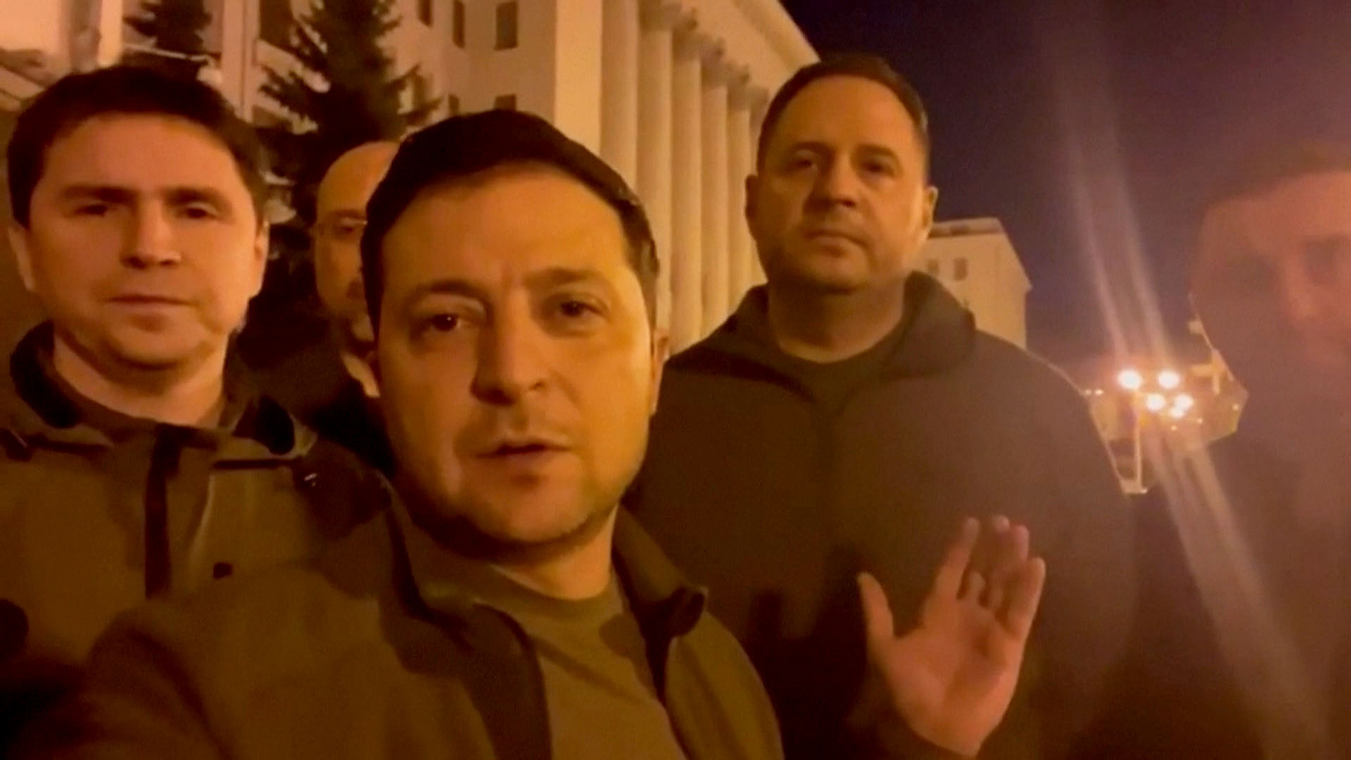
Why Video
MOTIVATION
The tools and methodologies presented here can be applied also to other video-sources different from television
Data, Trends and Biases of Television Political Talk Show: Evidence from Italy
Gabriele Pinto
Data, Trends and Biases of Television Political Talk Show: Evidence from Italy
Gabriele Pinto

Slide 7
Video is an effective medium of communication
MOTIVATION
7-55-38
Mehrabian Rule (Myth) of communication
Words convey only 7 percent of a message..
7%
Text
Tone
Tone account for 38 percent of the message..
38%
Expression
The rest (55 percent) is accounted by the Body language (gestures and facial expression)
55%
Data, Trends and Biases of Television Political Talk Show: Evidence from Italy
Gabriele Pinto
Data, Trends and Biases of Television Political Talk Show: Evidence from Italy
Gabriele Pinto

Slide 8
…and can be a rich source of data
MOTIVATION
Text (transcriptions)
Topic modelling & Text Analysis
Audio
Text sentiment
Tone
Audio sentiment
Image
Face sentiment
Expression
Speakers Characteristics
Video
Time
Characters
Attention
Sequence
Data, Trends and Biases of Television Political Talk Show: Evidence from Italy
Gabriele Pinto
Data, Trends and Biases of Television Political Talk Show: Evidence from Italy
Gabriele Pinto

Slide 9
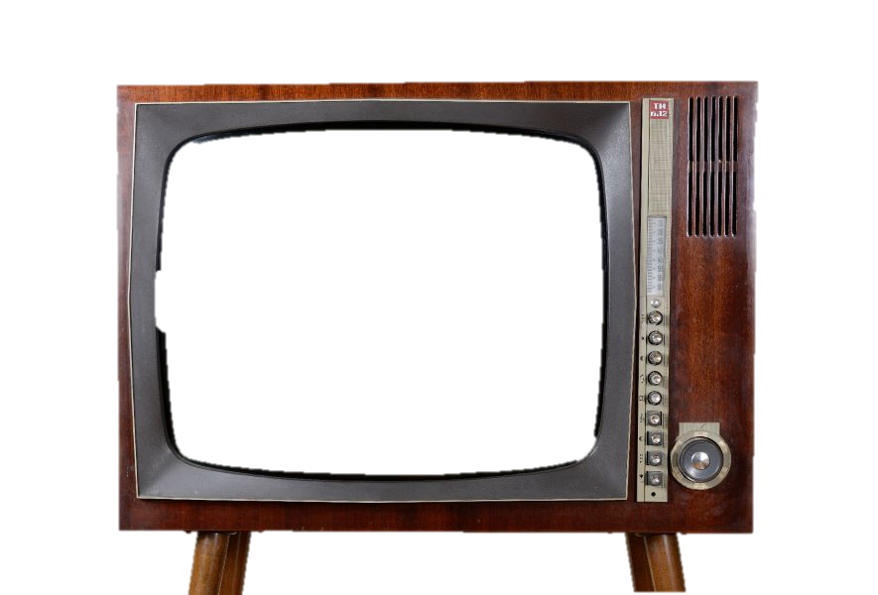
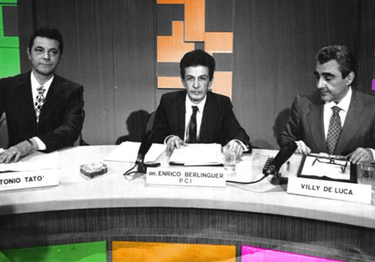
Why Television
MOTIVATION
Data, Trends and Biases of Television Political Talk Show: Evidence from Italy
Gabriele Pinto
Data, Trends and Biases of Television Political Talk Show: Evidence from Italy
Gabriele Pinto

Slide 10
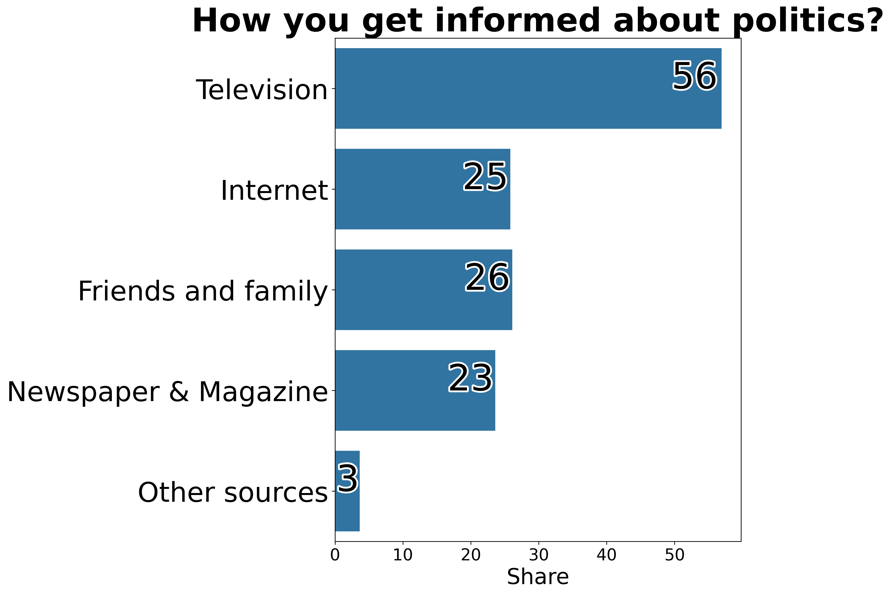
Despite the widespread use of Internet (and social networks), Television has remained the main and undisputed primary source of (political) information.
MOTIVATION
ISTAT – “Aspetti della Vita Quotidiana”, 2019 multiple choice question
ITANES (Italian Election Study), 2022 single choice question
Data, Trends and Biases of Television Political Talk Show: Evidence from Italy
Gabriele Pinto
Data, Trends and Biases of Television Political Talk Show: Evidence from Italy
Gabriele Pinto

Slide 11
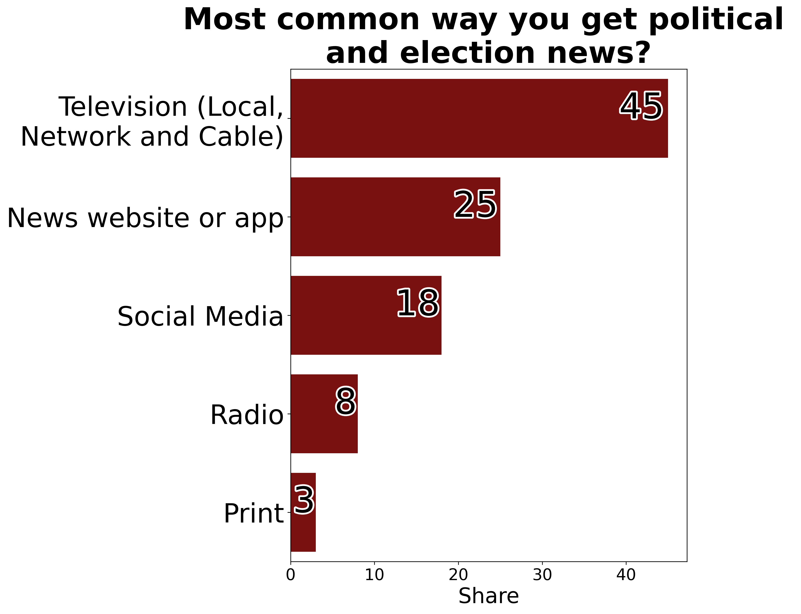
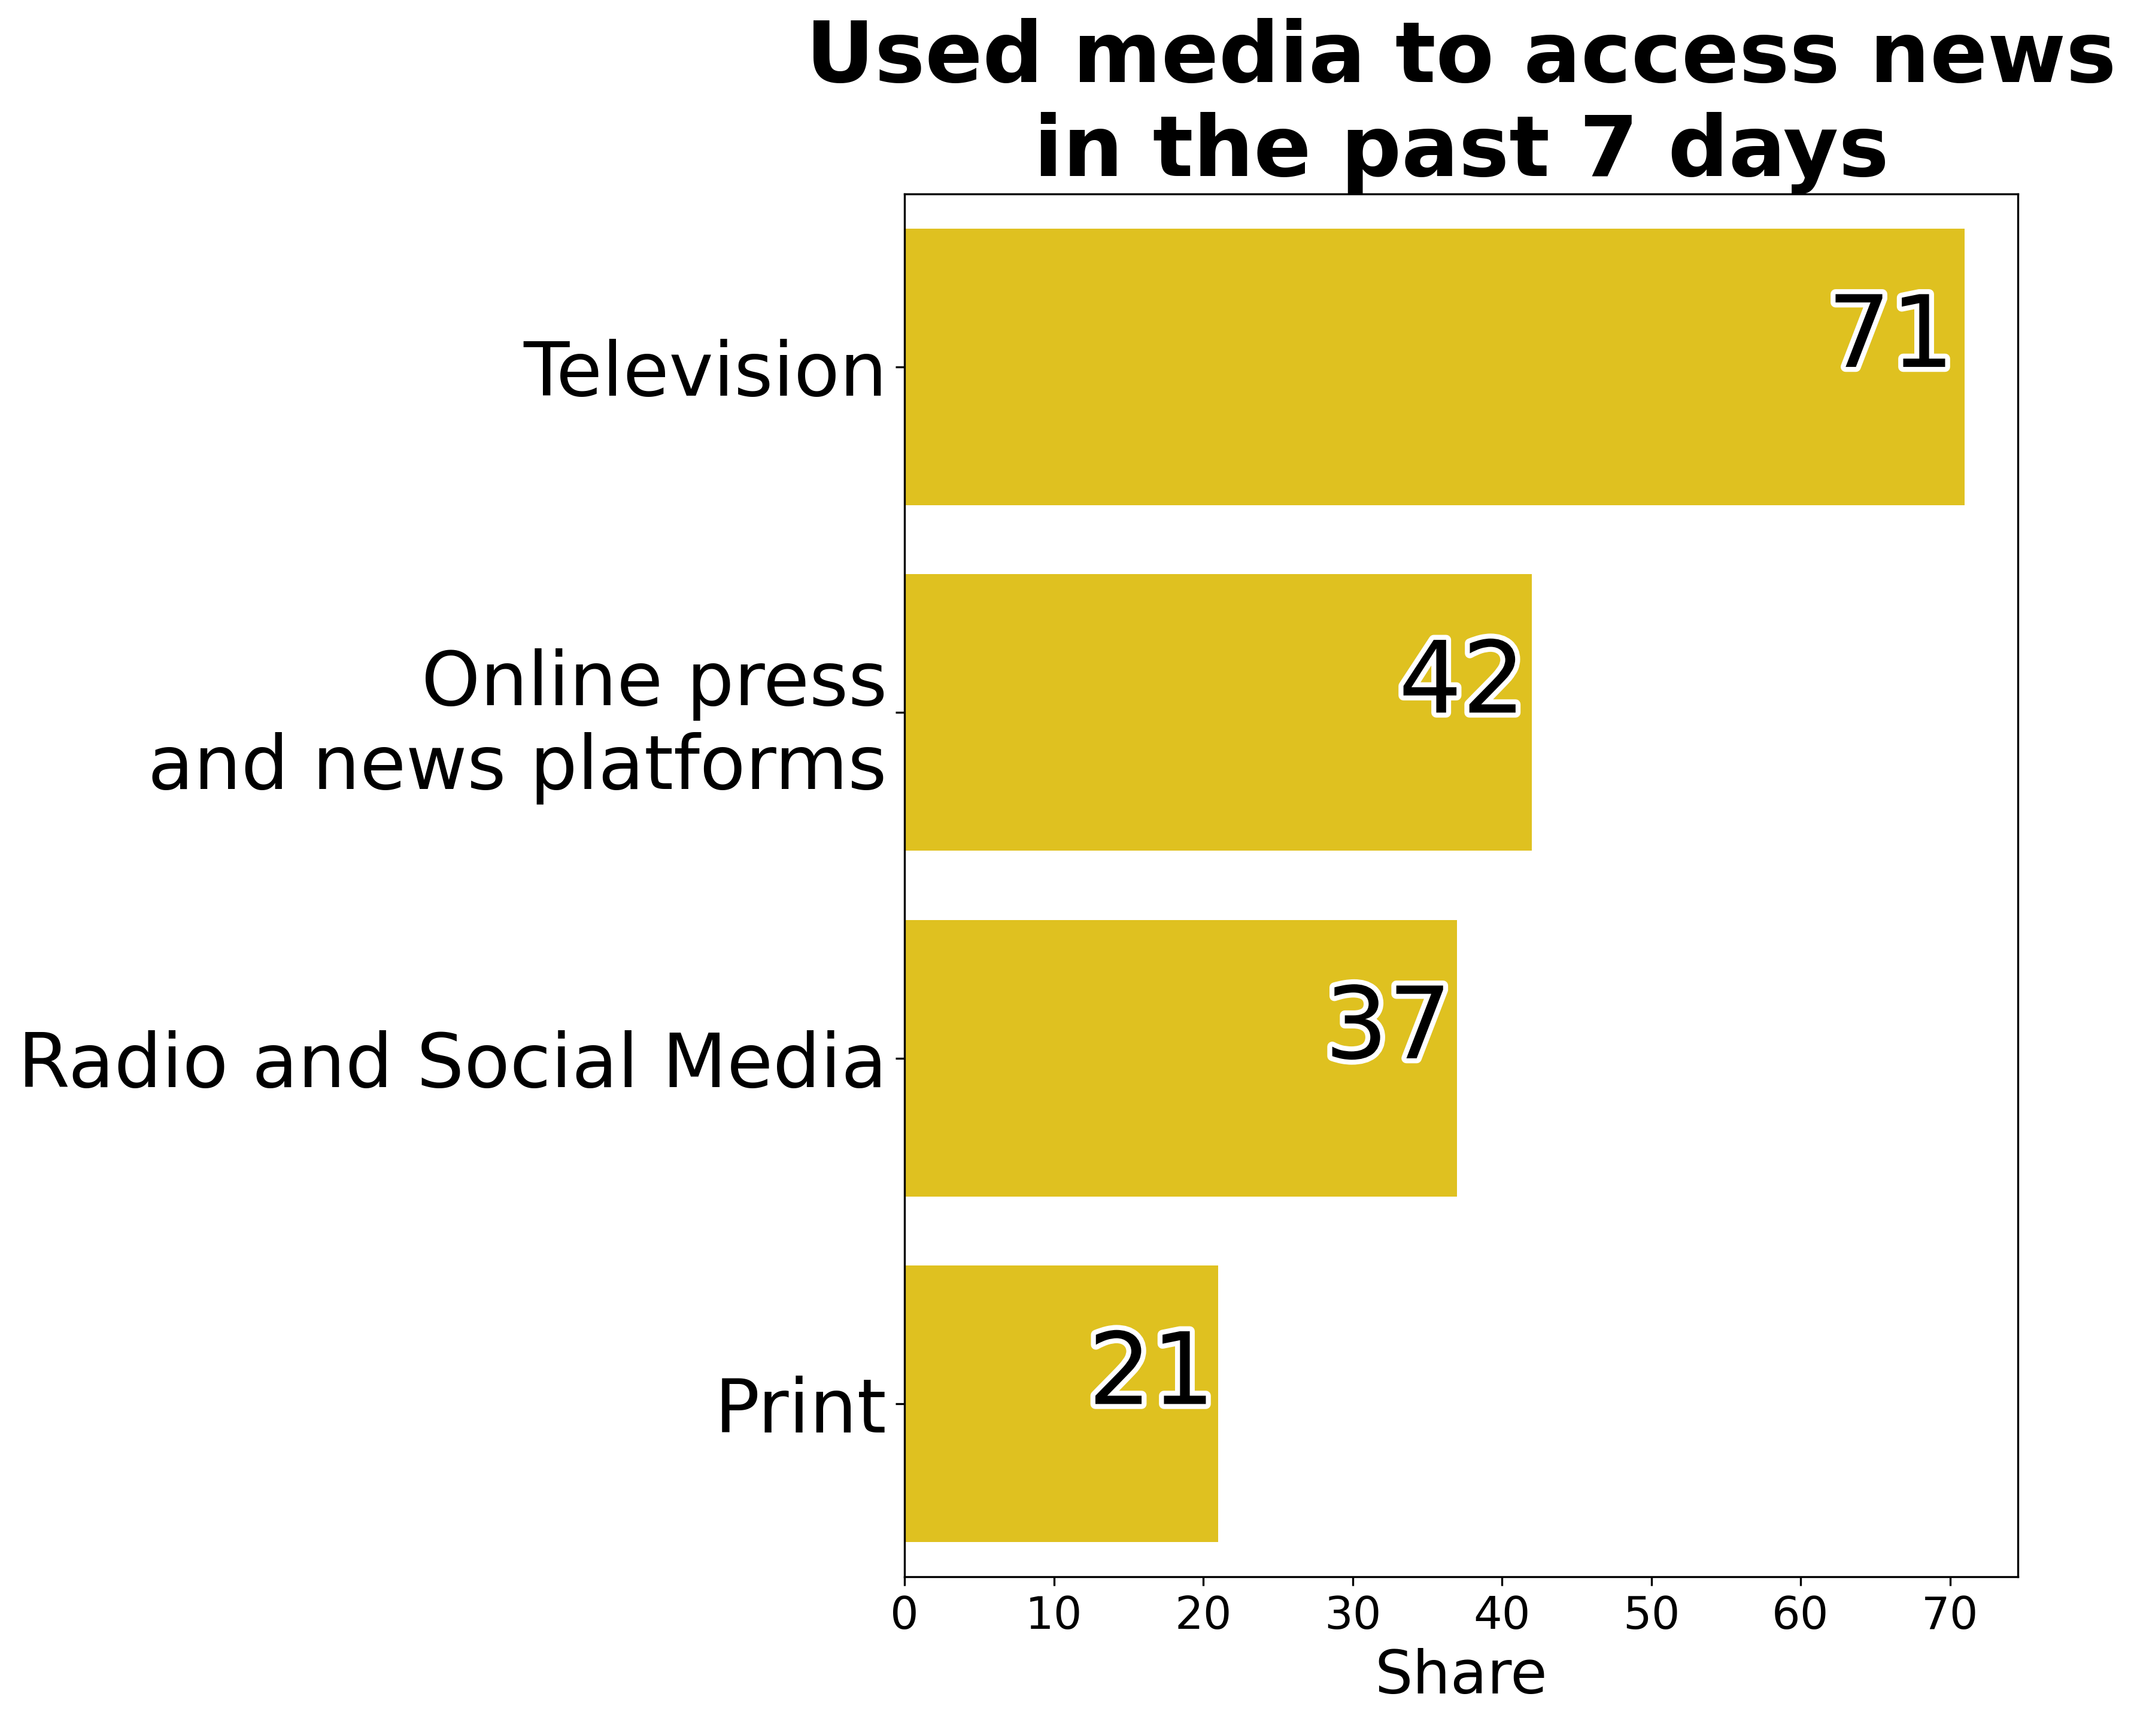
Similar in US and Europe
MOTIVATION
Data from PEW Research Center, 2020
Eurobarometer, Media & News Survey, 2023
Data, Trends and Biases of Television Political Talk Show: Evidence from Italy
Gabriele Pinto
Data, Trends and Biases of Television Political Talk Show: Evidence from Italy
Gabriele Pinto

Slide 12
Television usage in Italy vs EU
MOTIVATION
Eurobarometer, Media & News Survey, 2023
Data, Trends and Biases of Television Political Talk Show: Evidence from Italy
Gabriele Pinto
Data, Trends and Biases of Television Political Talk Show: Evidence from Italy
Gabriele Pinto

Slide 13
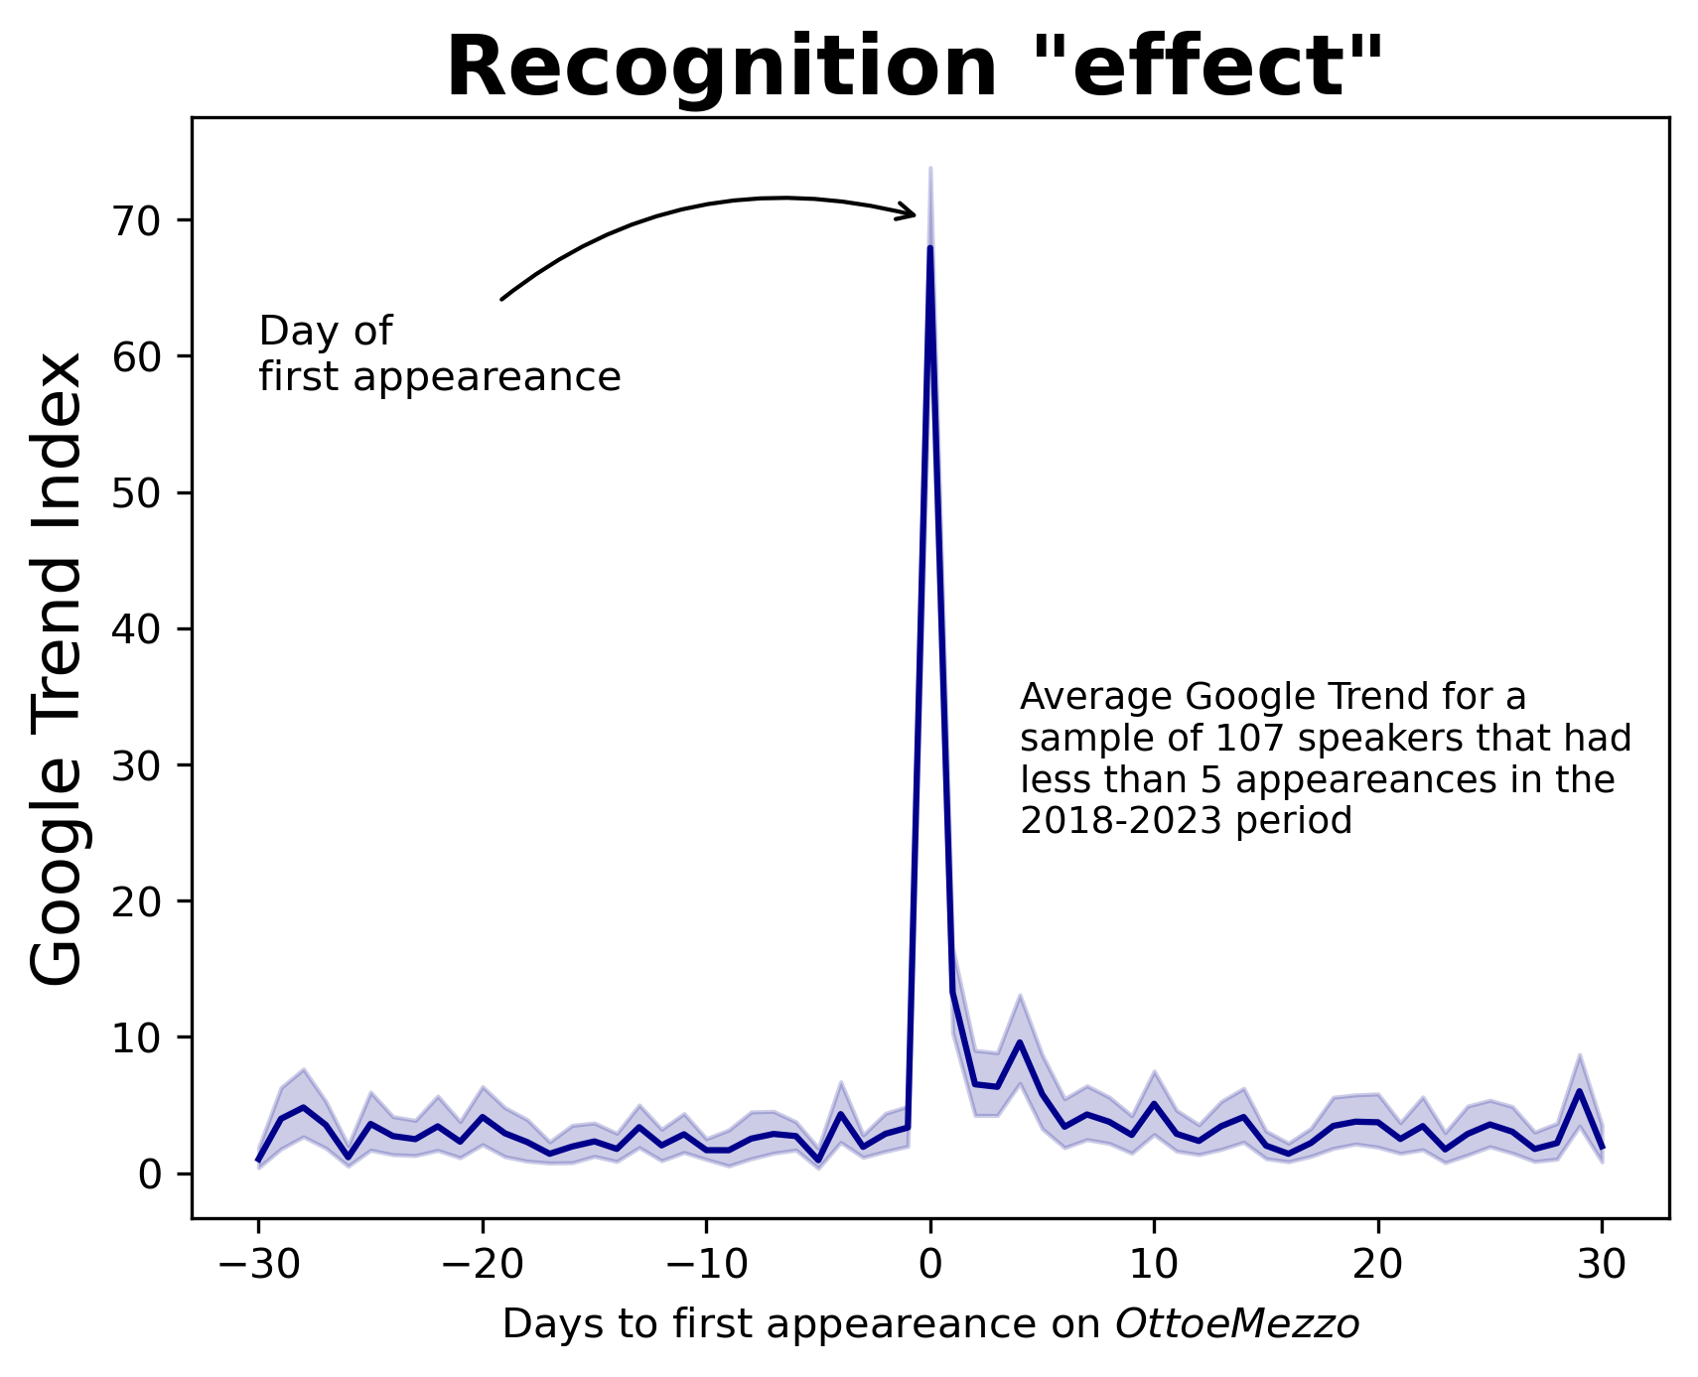
Why television so important
MOTIVATION
Accessibility
Recognition (Kam and Zechmeister 2013)
Reputation
Data, Trends and Biases of Television Political Talk Show: Evidence from Italy
Gabriele Pinto
Data, Trends and Biases of Television Political Talk Show: Evidence from Italy
Gabriele Pinto

Slide 14
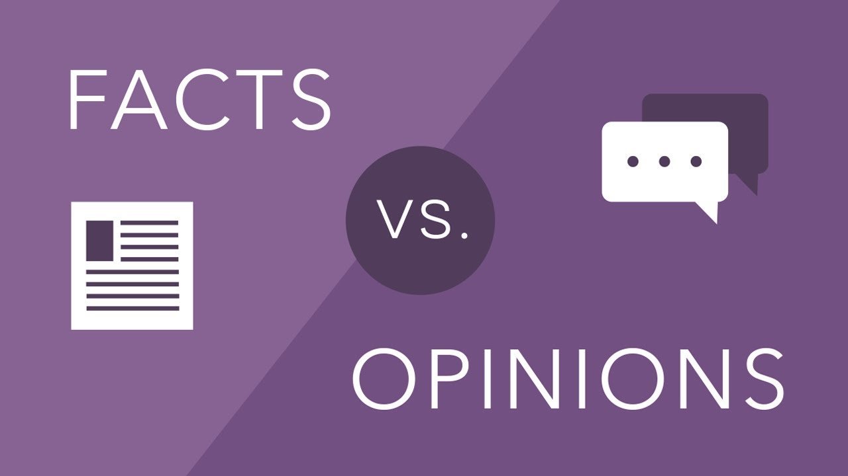
Why Political Talk Show, and Why Italy
MOTIVATION
Rise and importance of “opinion TV” vs “straight news and facts” (Burstzyn et al. 2023; Lazer et al. 2018)
While PTT are common around the world, Italy is probably the country where this type of format has been more successful (Novelli 2016) .
PTT are broadcasted all days from the morning to the night collecting a significant and important share of the total audience (Novelli 2013).
PTT can thus be considered the primary platform from which Italian voters forms or confront their political opinion with the position of leaders and opinion-makers, and virtually constitute the most important gateway to the national debate.
Data, Trends and Biases of Television Political Talk Show: Evidence from Italy
Gabriele Pinto
Data, Trends and Biases of Television Political Talk Show: Evidence from Italy
Gabriele Pinto

Slide 15
Why Political Talk Show, and Why Italy
MOTIVATION
As of October 2023, five out of the seven most important TV channels, have a PTT in their Prime Time schedule. At the peak of the Prime Time, between 20.30 and 21.30, it is estimated that almost 40% of the audience are watching a PTT (almost 9 million people out of a total of 60 million of Italian).
Channel | Time schedule | Name of the show | Presenter | Share (%) | Spectators (million)
Rai 1 | 20.30 - 20.35 | Cinque Minuti | Bruno Vespa | 21% | 4.4
Rai 2 | 21.00 - 21.30 | Tg2 post | Francesca Romana Elisei | 3% | 0.7
Rai 3 | 20.40 - 20.50 | Il cavallo e la Torre | Marco Damilano | 6% | 1.3
Rete 4 | 20.30 - 21.20 | Stasera Italia | Stefania Cavallaro | 4% | 0.8
La 7 | 20.35 - 20.15 | Otto e Mezzo | Lilli Gruber | 8% | 1.8
 |  |  | Total | 42% | 9.05
Auditel data for Prime Time Political Talk show broadcasted on October 23, 2023. The selection of the shows has been restricted to those of a short length (less than hour) that are broadcasted between 20.30 and 21.30, and that have a format that is comparable to Otto e Mezzo. Source of data: Auditel data retrieved from online news source.
Data, Trends and Biases of Television Political Talk Show: Evidence from Italy
Gabriele Pinto
Data, Trends and Biases of Television Political Talk Show: Evidence from Italy
Gabriele Pinto

Slide 16
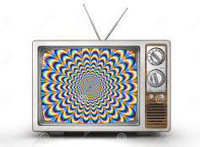
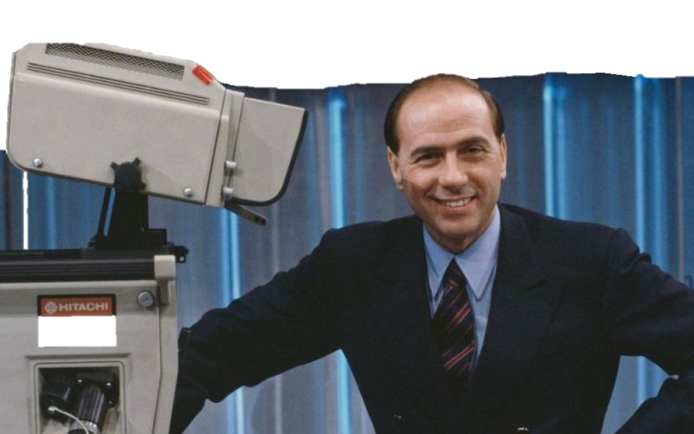
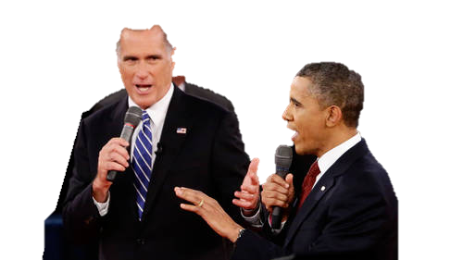
Related literature
CONTRIBUTION
Media Bias (on text of newspapers)
Gentzkow & Shapiro (JPE, 2006), Druckman & Parkin (JOP, 2005)
Economics literature on TV propaganda
Enikolopov et al. (AER, 2011) (independent TV channel and support for govt.)
Burstzyn et al (REStud, 2023) (influence of “Opinion” TV vs “Straight News”)
Martin & Yurukoglu (AER, 2017) (fox news and vote for rep.)
Berlusconi Television Effect
Barone et al. (AEJ:EconPol, 2015) Introduction of Digital TV and support for Forza Italia
Durante et al. (AER, 2019) Mediaset and support for Forza Italia
Data, Trends and Biases of Television Political Talk Show: Evidence from Italy
Gabriele Pinto
Data, Trends and Biases of Television Political Talk Show: Evidence from Italy
Gabriele Pinto

Slide 17
Is there a “gap” in the study of videos and television content?
Currently, television and videos are seldom employed as primary data sources by social scientists utilizing a quantitative approach. The data collection process heavily relies on human coders.
Since human-coding can be quite expensive, while television content is extremely “large”, available datasets are often restricted to very small samples.
Data, Trends and Biases of Television Political Talk Show: Evidence from Italy
Gabriele Pinto
Data, Trends and Biases of Television Political Talk Show: Evidence from Italy
Gabriele Pinto

Slide 18
Related literature: content analysis (transcripts)
CONTRIBUTION
Analysis of Transcriptions
Ouss et al. (NBER, 2023) How television discuss Police Killings
Hirsch et al (EjPE 2024) Tonality of TV-NEWS and government bond yelds
Gambaro et al. (CESIFO 2023) Demand for soft VS bad news with auditel data
Caprini (JpubEcon, 2023) Pope Breaking News and support for Forza Italia
Psy & Political Communication
Dumitrescu (AmBehSci, 2016), Bucy (2010), Bousallis & Coan (PolComm, 2021)Senior et al. (Front Psychol., 2022), Joo & Steinert-Threlkeld (2022)
Data, Trends and Biases of Television Political Talk Show: Evidence from Italy
Gabriele Pinto
Data, Trends and Biases of Television Political Talk Show: Evidence from Italy
Gabriele Pinto

Slide 19
Why we construct our data from scratch
MOTIVATION
Dataset of television content exists, also in Italy (e.g. Osservatorio di Pavia)
Often limited in terms of sampling and granularity
Some of these data are even available (on the AGCOM website), however, they often regards only prominent political figures, and not as granular compared to what we can obtain starting from scratch.
Data, Trends and Biases of Television Political Talk Show: Evidence from Italy
Gabriele Pinto
Data, Trends and Biases of Television Political Talk Show: Evidence from Italy
Gabriele Pinto

Slide 20
Related literature: content analysis (audio analysis)
CONTRIBUTION
Audio Tone Analysis
Gorodnichenko et al. (AER, 2023) after controlling for the FED actions and the sentiment in the texts, a positive tone in the voices of FED chairs leads to significant increases in share prices
Handlan & Sheng (mimeo 2023) Gender and Tone in Recorded Economics Presentations: Audio Analysis with Machine Learning
Data, Trends and Biases of Television Political Talk Show: Evidence from Italy
Gabriele Pinto
Data, Trends and Biases of Television Political Talk Show: Evidence from Italy
Gabriele Pinto

Slide 21
Related literature: content analysis (image and video)
CONTRIBUTION
Image analysis: politicians
Tarr et al. (Political Analysis, 2023) Automated coding of Political Video Campaign
Girbau et al. (Political Analysis, 2024) Face Detection, Tracking, and Classification from Large-Scale News Archives (US & Japan)
Caprini (mimeo, 2024) Visual Bias, Analysis of image preview of US news articles
Image analysis: gender and minorities
Donggwan Kim et al. (mimeo, 2023) TV Advertising Effectiveness with Racial Minority Representation: Evidence from the Mortgage Market
Goli & Mummalaneni (mimeo, 2023) women Vs men in CNN, Fox News and MSNBC
Data, Trends and Biases of Television Political Talk Show: Evidence from Italy
Gabriele Pinto
Data, Trends and Biases of Television Political Talk Show: Evidence from Italy
Gabriele Pinto

Slide 22
Methodological contribution
CONTRIBUTION
Analysis of “opinion TV” content – not “straight news” (i.e. Burstzyn et al. 2023) – “discussion” NOT “unilateral messages”
Tracking of ALL speakers (without depending on “Celebrities API”)
Combine Audio, Image and Transcript features
Methodology to build your data from virtually any semple (provided that videos are available)
Data, Trends and Biases of Television Political Talk Show: Evidence from Italy
Gabriele Pinto
Data, Trends and Biases of Television Political Talk Show: Evidence from Italy
Gabriele Pinto

Slide 23
The Sample
SPEAKING TIME
5 years of episodes (2018-2023), covering the COVID-19 pandemic, the Ukraine Invasion, the Palestine-Israel conflict, and two national elections.
Data, Trends and Biases of Television Political Talk Show: Evidence from Italy
Gabriele Pinto
Data, Trends and Biases of Television Political Talk Show: Evidence from Italy
Gabriele Pinto

Slide 24
The Sample
SPEAKING TIME
 |  | Otto e Mezzo | Stasera Italia
Broadcast time |  | 20:35-21:10 (35 mins) | 20:30-21:20 (50 mins)
Channel |  | La 7 (Cairo Editore) | Rete 4 (Mediaset, i.e. Berlusconi)
2 -3 million daily viewers (share 8% and 5%)
Data, Trends and Biases of Television Political Talk Show: Evidence from Italy
Gabriele Pinto
Data, Trends and Biases of Television Political Talk Show: Evidence from Italy
Gabriele Pinto

Slide 25
The Format
SPEAKING TIME
A topic
Guests (in the studio from home)
Host guides discussion and speaking times
"Stasera Italia" also has monologues from the host and connections with external correspondents. These moments are excluded from the analysis.
Data, Trends and Biases of Television Political Talk Show: Evidence from Italy
Gabriele Pinto
Data, Trends and Biases of Television Political Talk Show: Evidence from Italy
Gabriele Pinto

Slide 26
The tools
SPEAKING TIME
Speaker Diarization and Recognition
Speaker Identification (audio and video)
Speech to Text
Tone emotion
Face emotion
Data, Trends and Biases of Television Political Talk Show: Evidence from Italy
Gabriele Pinto
Data, Trends and Biases of Television Political Talk Show: Evidence from Italy
Gabriele Pinto

Slide 27
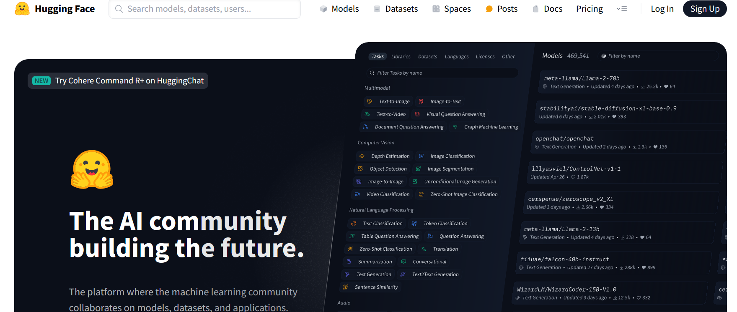
What we use
SPEAKING TIME
We mostly use Pre-Trained models.
These models are very easy to use, and can also be fine-tuned (but we don’t for most of our applications)
Open Access and Open Source (FREE $)
Compared to expensive API’s
Few lines of codes
(in fact thousands..)
Download the model
Data input
Predictions
Data, Trends and Biases of Television Political Talk Show: Evidence from Italy
Gabriele Pinto
Data, Trends and Biases of Television Political Talk Show: Evidence from Italy
Gabriele Pinto

Slide 28
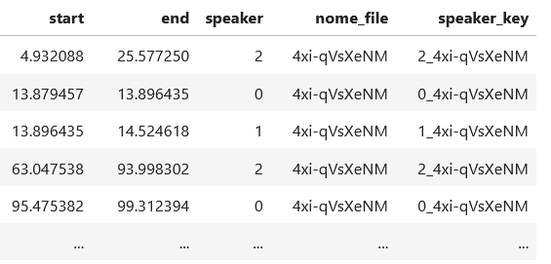
Speaker Diarization
SPEAKING TIME
We use Pyannote 3.0 (Plaquet & Bredin 2023)
Extract audio from video
Pass to the model
Return timestamps and speaker “id”, for each episodes
Who speaker 2 is? Is he/she the same of speaker 4 in episode “dscda_xy”?
Data, Trends and Biases of Television Political Talk Show: Evidence from Italy
Gabriele Pinto
Data, Trends and Biases of Television Political Talk Show: Evidence from Italy
Gabriele Pinto

Slide 29
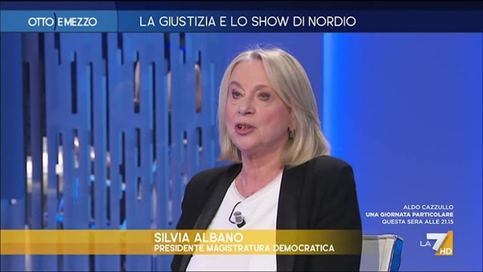
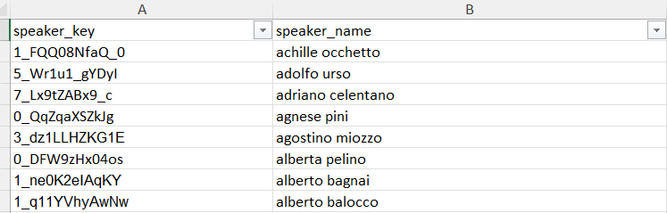
Speaker “Identification”
SPEAKING TIME
Who is speaker 1? and speaker 2?
First we identify “lower third” in the speaking time of each group. We pass it to a an OCR (Optical Character Recognition) and we get the names.
This way we are able to cover ~50% of the time…
For the rest of speakers we have to do it by “hand”….
Data, Trends and Biases of Television Political Talk Show: Evidence from Italy
Gabriele Pinto
Data, Trends and Biases of Television Political Talk Show: Evidence from Italy
Gabriele Pinto

Slide 30
Type of speakers (e.g. speakers)
SPEAKING TIME
Journalists
With details of the journal (i.e. La Repubblica, Il Giornale, L’Espresso, etc..)
Politicians
With details of the party (i.e. Forza Italia, Partito Democratico, ..and “independent” – es: sardine)
Expert (i.e. all the others)
With details of the profession (i.e. Entreprenneur, University Professors, practitioners)
Data, Trends and Biases of Television Political Talk Show: Evidence from Italy
Gabriele Pinto
Data, Trends and Biases of Television Political Talk Show: Evidence from Italy
Gabriele Pinto

Slide 31
For each type of speaker
SPEAKING TIME
Gender
Nationality
Political leaning (Left, Right, and Central/Liberal)
How we do this for more than 1k speakers?
We do it manually for the first 100 speakers and then we instruct ChatGPT to do the same (see Le Mens & Gallego 2023). Plus, “manual” review of the output of ChatGpt.
Data, Trends and Biases of Television Political Talk Show: Evidence from Italy
Gabriele Pinto
Data, Trends and Biases of Television Political Talk Show: Evidence from Italy
Gabriele Pinto

Slide 32
Example prompt for classifying TV speakers
SPEAKING TIME
Ciao,
ho una lista di personaggi famosi che hanno partecipato negli ultimi anni al programma "otto e mezzo" sul canale televisivo La7. Si tratta perlopiù di giornalisti, scrittori, virologi, politici, imprenditori etc... Per ognuno di questi personaggi, avrei bisogno di recuperare alcune informazioni.
In particolare, mi servono queste informazioni:
L'orientamento politico: i valori possibili sono "left", "right", "center" e "m5s", ovviamente questi valori stanno per "sinistra", "destra", "centro" e "m5s". dove "m5S" sta per movimento 5 stelle.
Il tipo di personaggio: che può avere i seguenti valori "journalist","expert" e "politician". Dove i "politician" sono tutti quelli che fanno politica professionalmente. E gli "expert" sono tutti quelli che non sono nè politici di professione ne giornalisti (come i virologi, gli imprenditori, etc...).
Testata: è la testata giornalistica. Questo valore deve essere riempito solo se il personaggio in questione è di tipo journalist, altrimenti devi lasciare questo campo vuoto. Alcuni esempi possono essere "il fatto quotidiano", "il giornale","corriere della sera", etc..
Partito: è il partito del personaggio. Questo valore deve essere riempito solo se il personaggio in questione è di tipo "politician", altrimenti devi lasciare questo campo vuoto. Alcuni esempi possono essere "fratelli d'italia", "partito democratico", etc...
Professione: è la professione del personaggio. Questo valore deve essere riempito solo se il personaggio in questione è di tipo "expert", altrimenti devi lasciare questo campo vuoto. Alcuni esempi di questo valore possono essere "entreprenneur", "phisician", etc...
Solo se sei fortemente indeciso, ti chiedo di lasciare al posto del valore un punto interrogativo "?".
Questo è un esempio:
nome personaggio;orientamento politico;tipo personaggio;partito;testata;professione
lilli gruber;left;journalist;;la7;
paolo pagliaro;left;journalist;;la7;
marco travaglio;left;journalist;;il fatto quotidiano;
massimo giannini;left;journalist;;la stampa;
andrea scanzi;left;journalist;;il fatto quotidiano;
beppe severgnini;center;journalist;;corriere della sera;
massimo cacciari;left;expert;;;philosopher
antonio padellaro;left;journalist;;il fatto quotidiano;
We instruct ChatGPT trough an example and ask it to do the rest of the job for us
We manually review all the classification
Data, Trends and Biases of Television Political Talk Show: Evidence from Italy
Gabriele Pinto
Data, Trends and Biases of Television Political Talk Show: Evidence from Italy
Gabriele Pinto

Slide 33
Political leaning classification
SPEAKING TIME
Classify political leanings based on text analysis of what speakers say.
Train a classifier on labelled data (i.e. parliament speech, twitter, and/or television speech), to predict political leaning of journalist/expert speech. While this approach is less arbirtrary, it does not work well (especially cross-domain)!
Data, Trends and Biases of Television Political Talk Show: Evidence from Italy
Gabriele Pinto
Data, Trends and Biases of Television Political Talk Show: Evidence from Italy
Gabriele Pinto

Slide 34
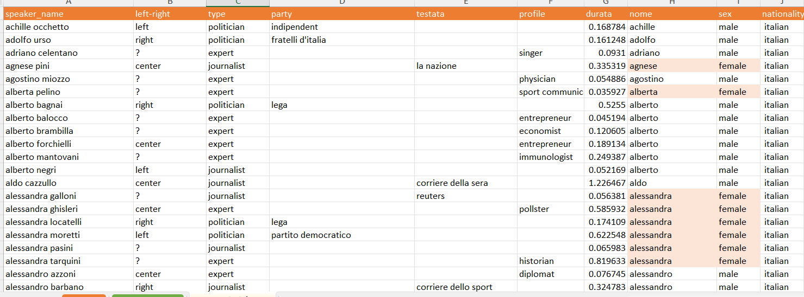
Example of speakers
SPEAKING TIME
1057 speakers in total! (605 in Otto e Mezzo, 588 in Stasera Italia, 136 in both)
Data, Trends and Biases of Television Political Talk Show: Evidence from Italy
Gabriele Pinto
Data, Trends and Biases of Television Political Talk Show: Evidence from Italy
Gabriele Pinto

Slide 35
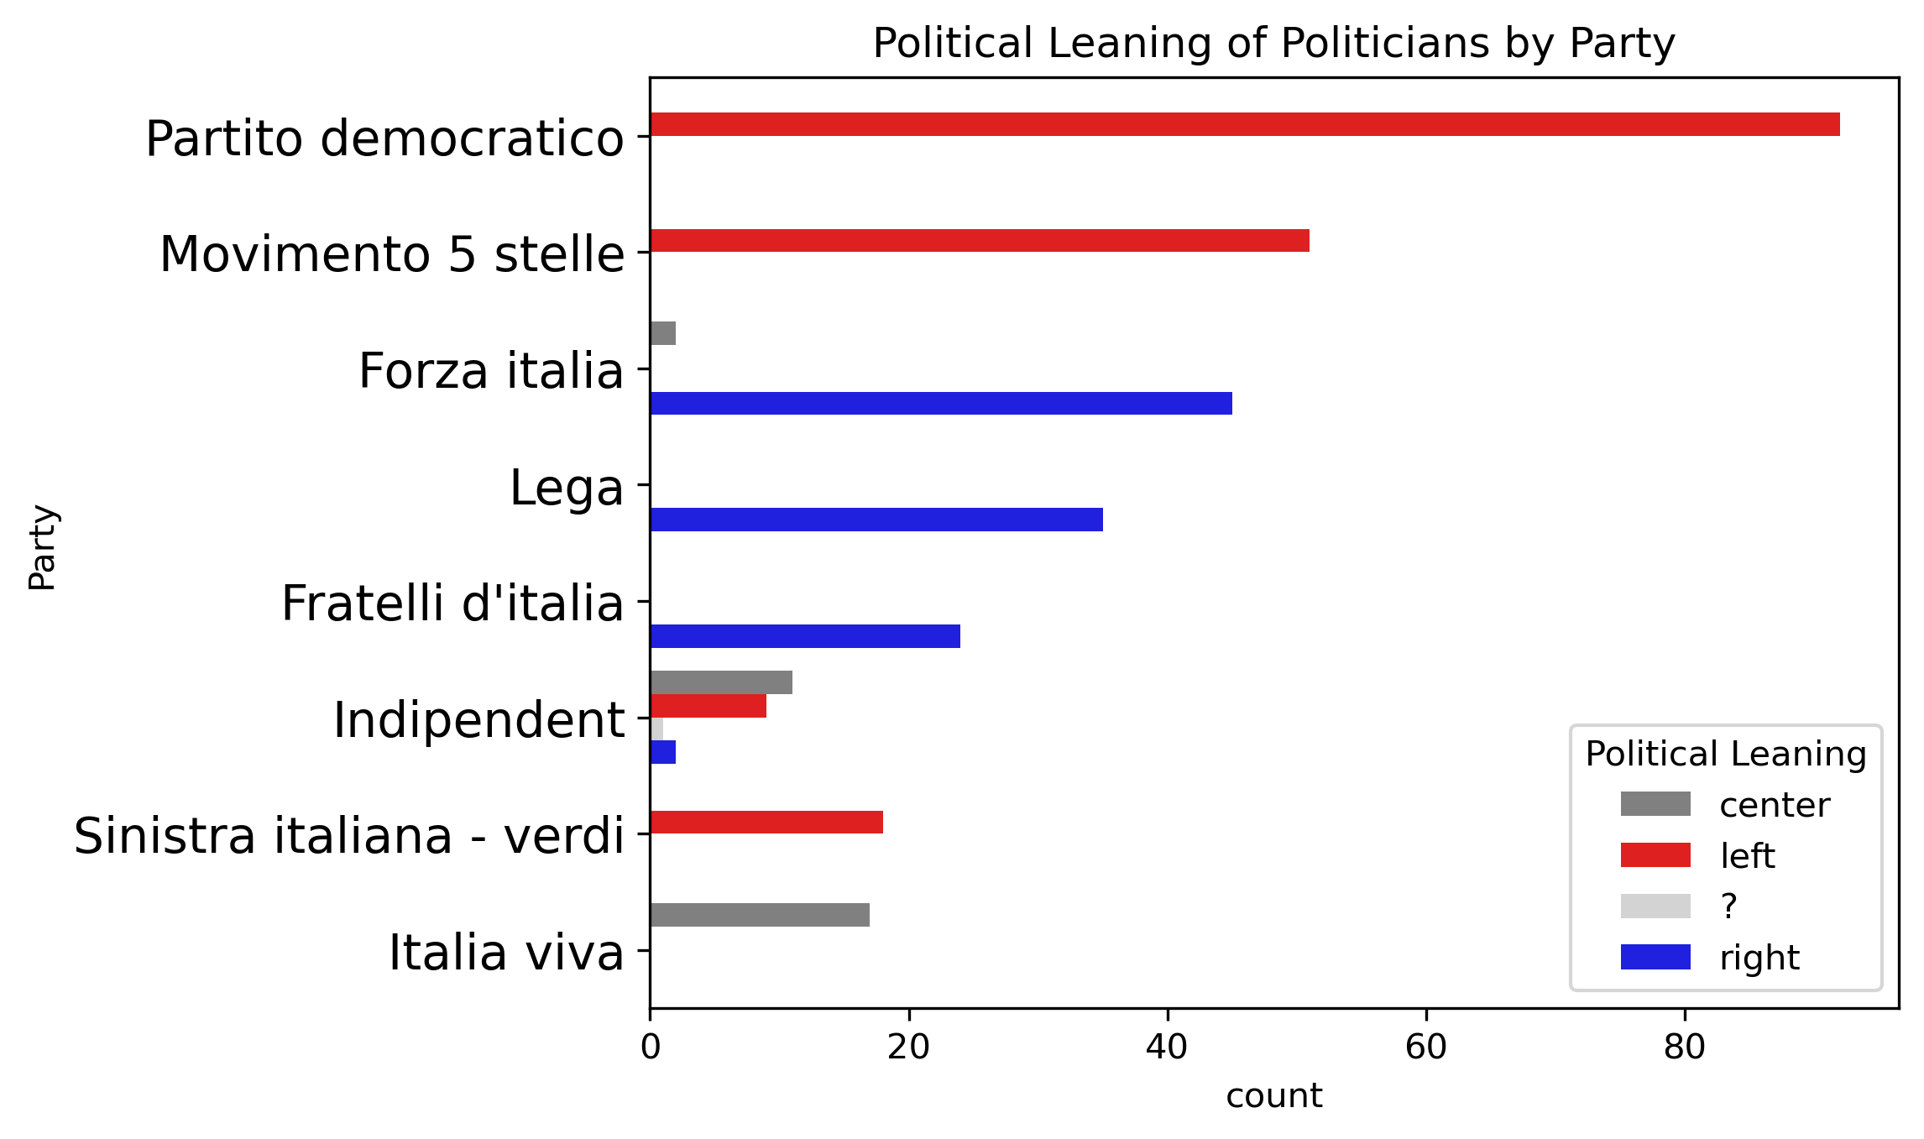
Political leaning by type of speaker: Politicians
SPEAKING TIME
This is pretty much in line with standard international classification (party manifesto, etc..), where left-wing parties are:
Partito democratico
Movimento 5 Stelle
Sinistra Italiana –Verdi
And right-wing parties are:
Forza Italia
Lega
Fratelli d’Italia
And center-wing parties are:
Italia Viva and Azione
Data, Trends and Biases of Television Political Talk Show: Evidence from Italy
Gabriele Pinto
Data, Trends and Biases of Television Political Talk Show: Evidence from Italy
Gabriele Pinto

Slide 36
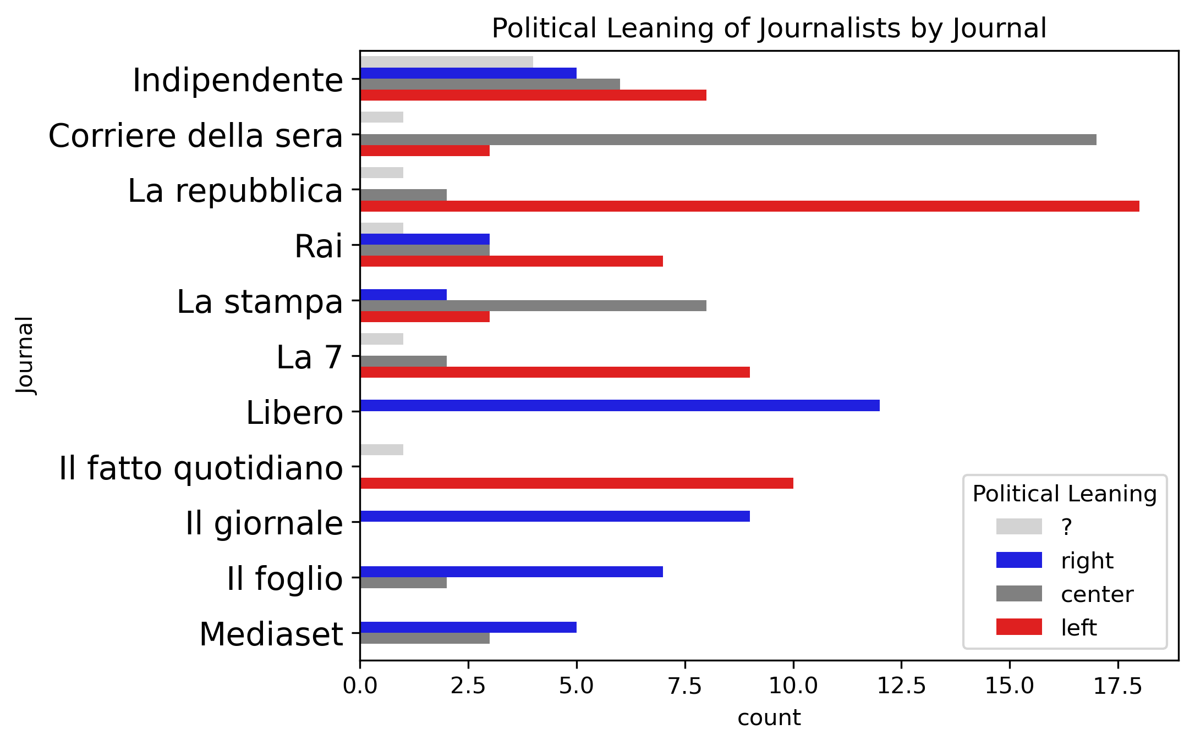
Political leaning by type of speaker: Journalists
SPEAKING TIME
Il Fatto Quotidiano
La Repubblica
La 7
Corriere Della Sera
La Stampa
Rai
Il Foglio
Mediaset
Il giornale
Libero
left
center
right
Data, Trends and Biases of Television Political Talk Show: Evidence from Italy
Gabriele Pinto
Data, Trends and Biases of Television Political Talk Show: Evidence from Italy
Gabriele Pinto

Slide 37
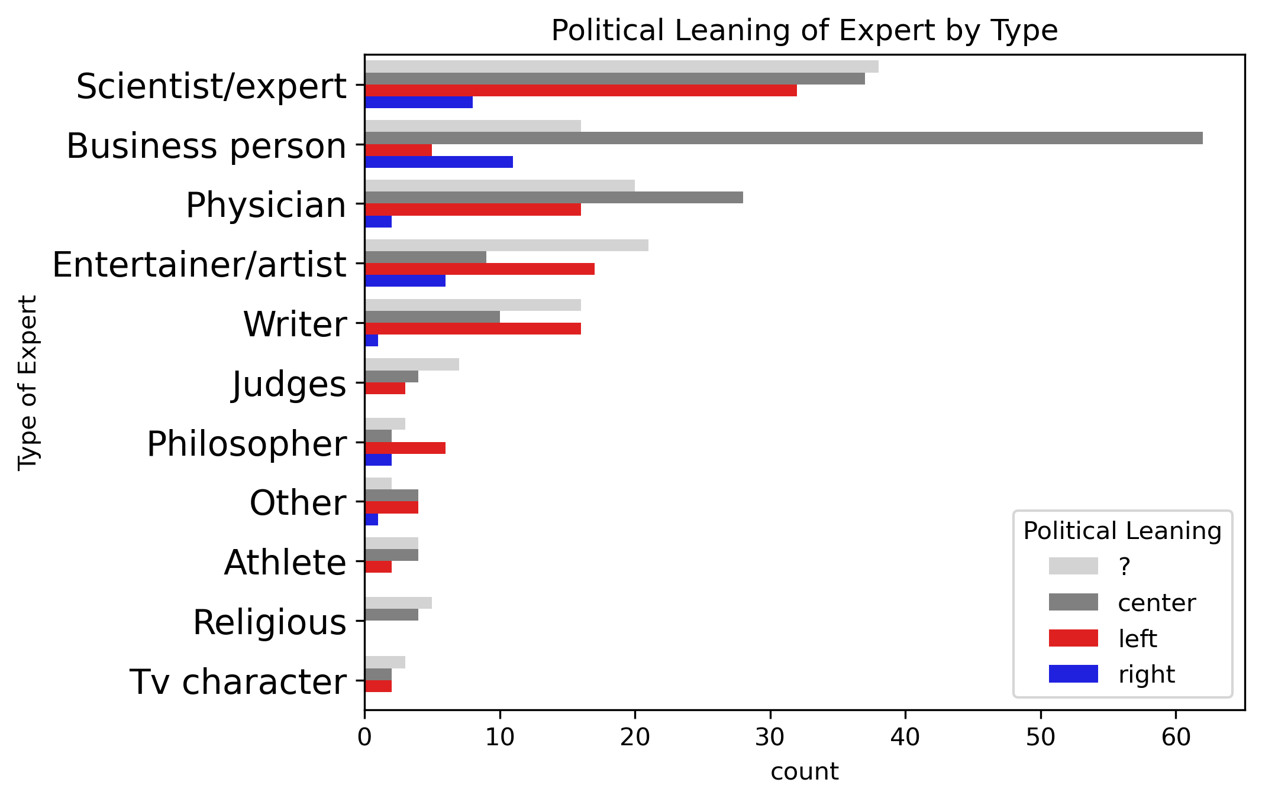
Political leaning by type of speaker: Experts
SPEAKING TIME
left
Writer
Judges
Phisician
Philosopher
Entertainer/artist
Scientist Expert
Religious
Business Person
right
e.g. some example of “left-wing” experts are Carlo rovelli, Emiliano Brancaccio, Nadia Urbinati. Some example of “right-wing” experts are Paolo Scaroni, Gianfranco Vissani and Paola Tommasi
Data, Trends and Biases of Television Political Talk Show: Evidence from Italy
Gabriele Pinto
Data, Trends and Biases of Television Political Talk Show: Evidence from Italy
Gabriele Pinto

Slide 38
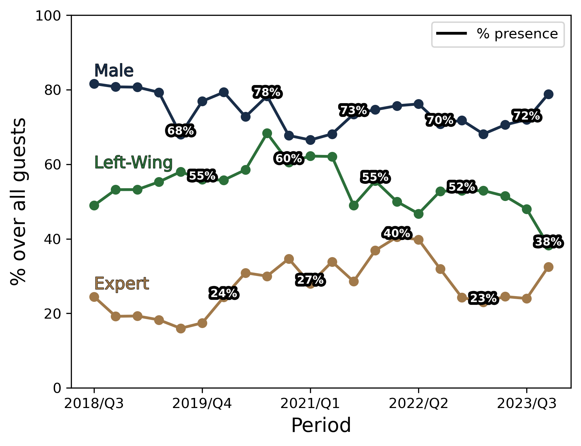
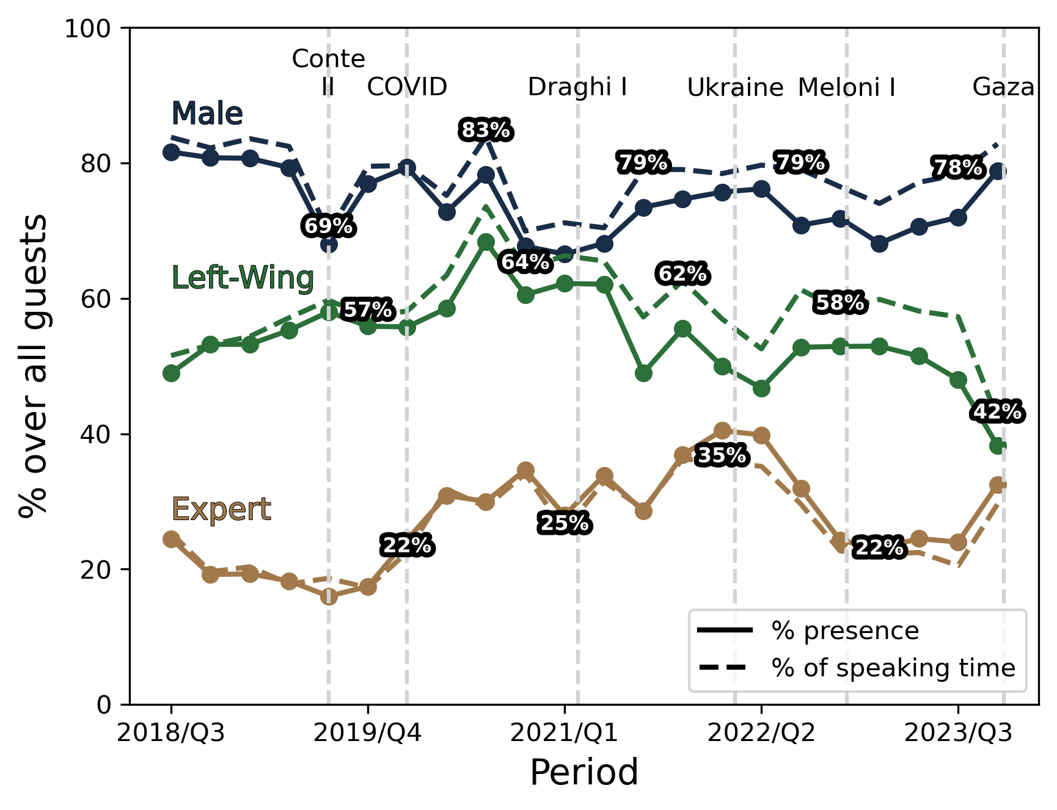
Summary statistics – Otto e Mezzo
SPEAKING TIME
Males tend to be more present and speak more
A decline of Left-Wing speakers after the Draghi government
The rise of experts during the COVID-1 pandemic (with fair speaking time)
Males in Italian Parliament = 70%
Data, Trends and Biases of Television Political Talk Show: Evidence from Italy
Gabriele Pinto
Data, Trends and Biases of Television Political Talk Show: Evidence from Italy
Gabriele Pinto

Slide 39
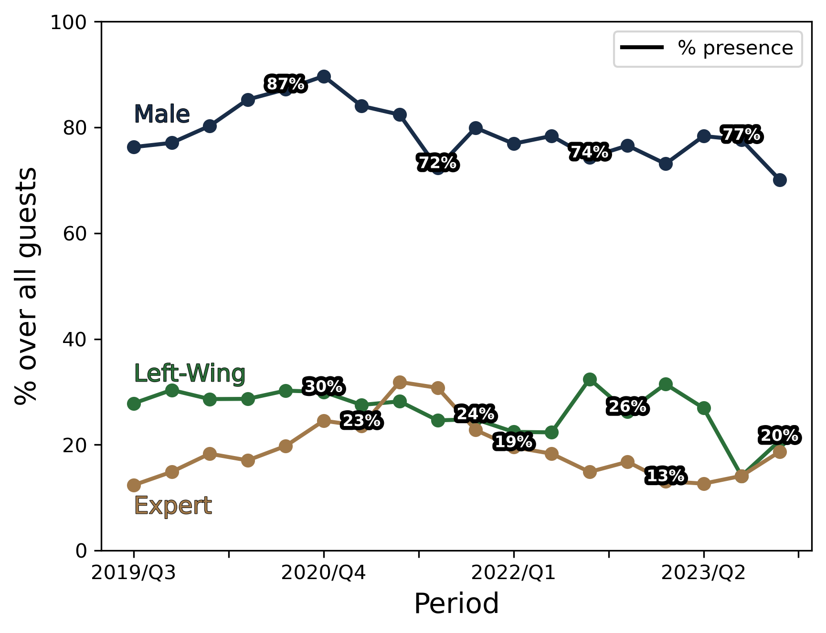
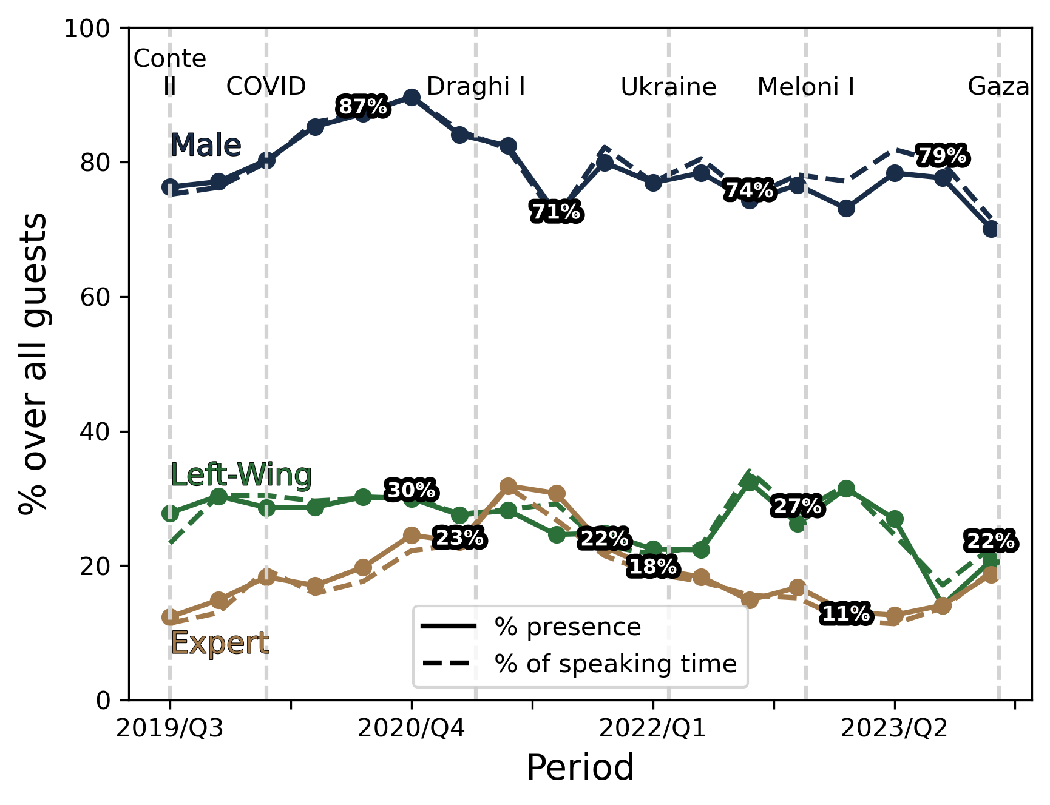
Summary statistics – Stasera Italia
SPEAKING TIME
Males tend to be more present and speak more (although less than in 8 e mezzo)
Left-Wing have much less share
The rise of experts during the COVID-1 pandemic (with higher speaking time)
Data, Trends and Biases of Television Political Talk Show: Evidence from Italy
Gabriele Pinto
Data, Trends and Biases of Television Political Talk Show: Evidence from Italy
Gabriele Pinto

Slide 40
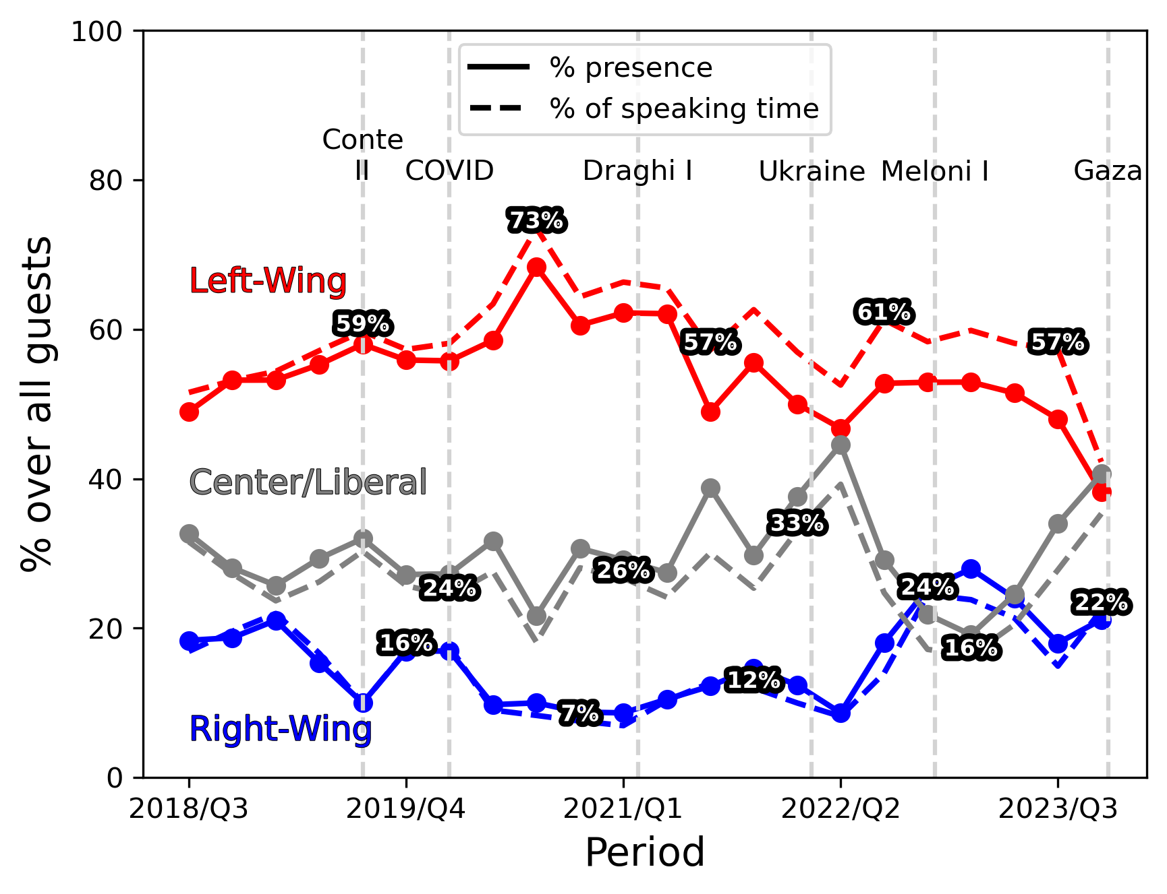
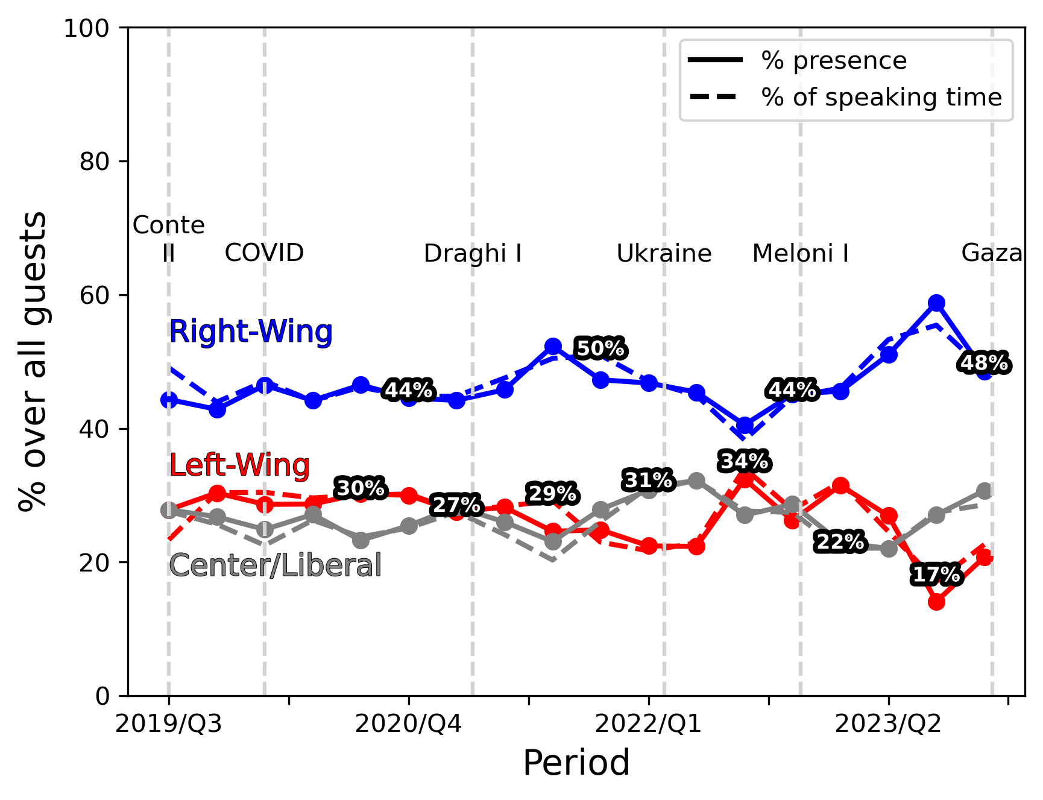
Partishanship – Otto e Mezzo VS Stasera Italia
SPEAKING TIME
Rise of Right-Wing Speakers
Data, Trends and Biases of Television Political Talk Show: Evidence from Italy
Gabriele Pinto
Data, Trends and Biases of Television Political Talk Show: Evidence from Italy
Gabriele Pinto

Slide 41
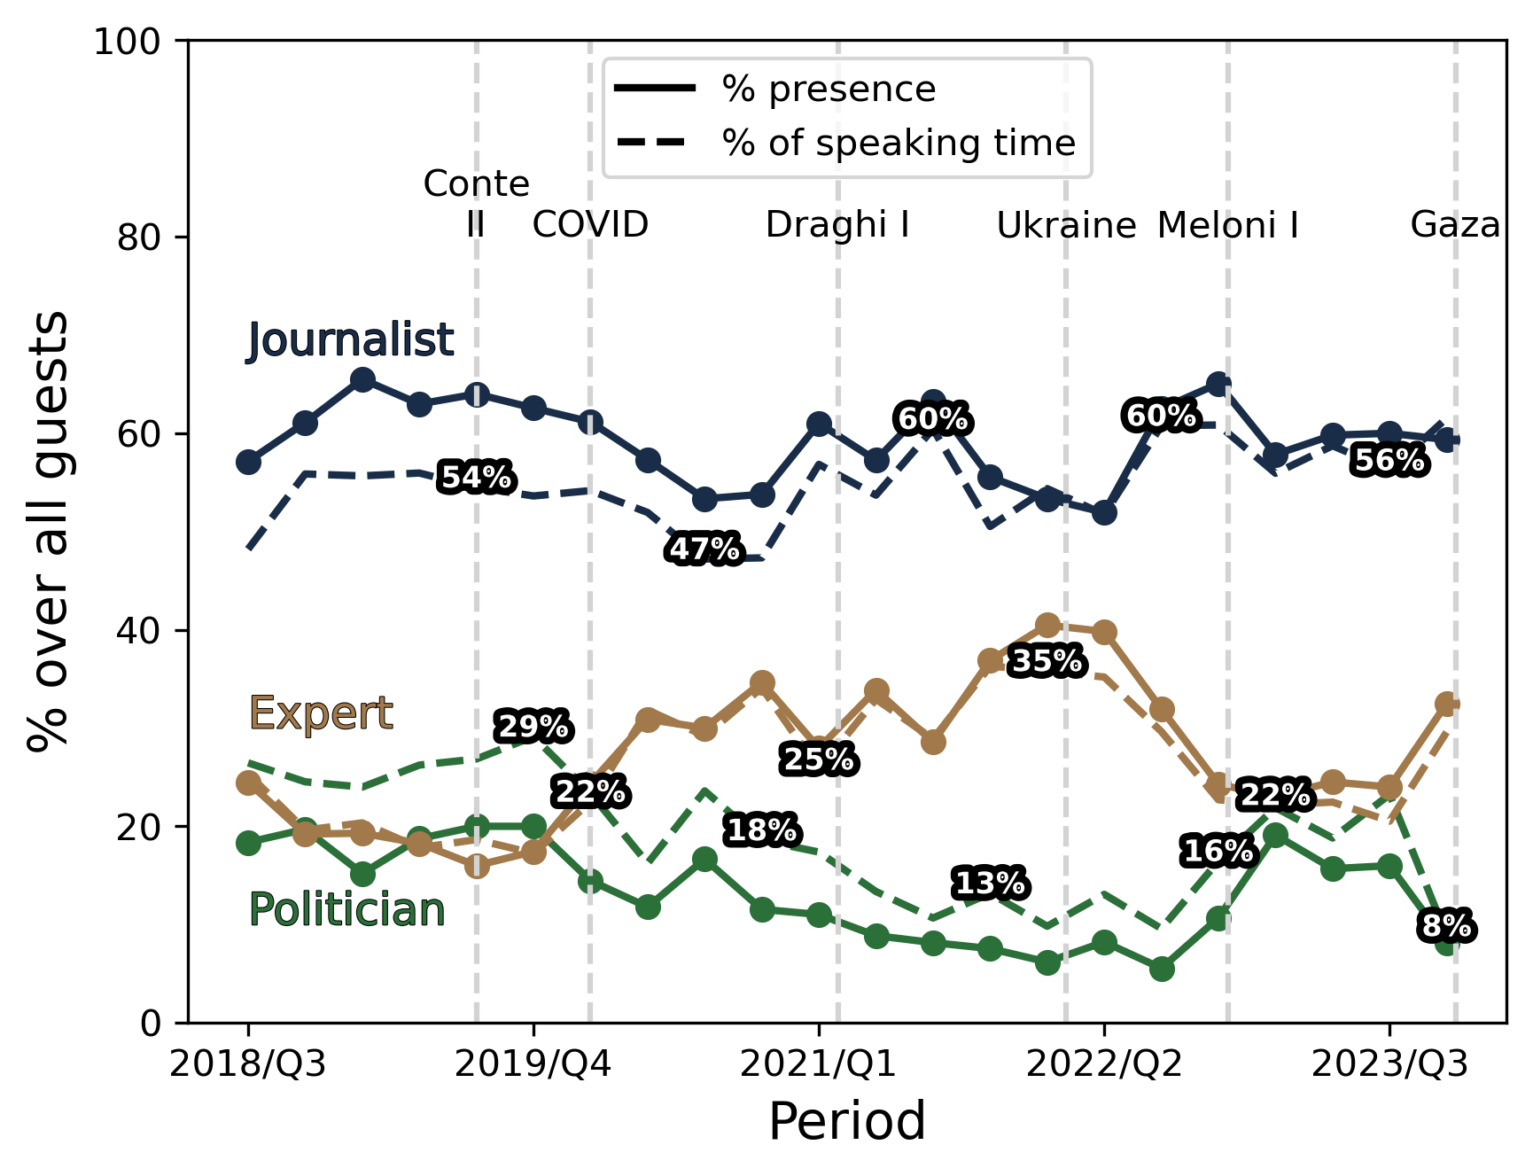
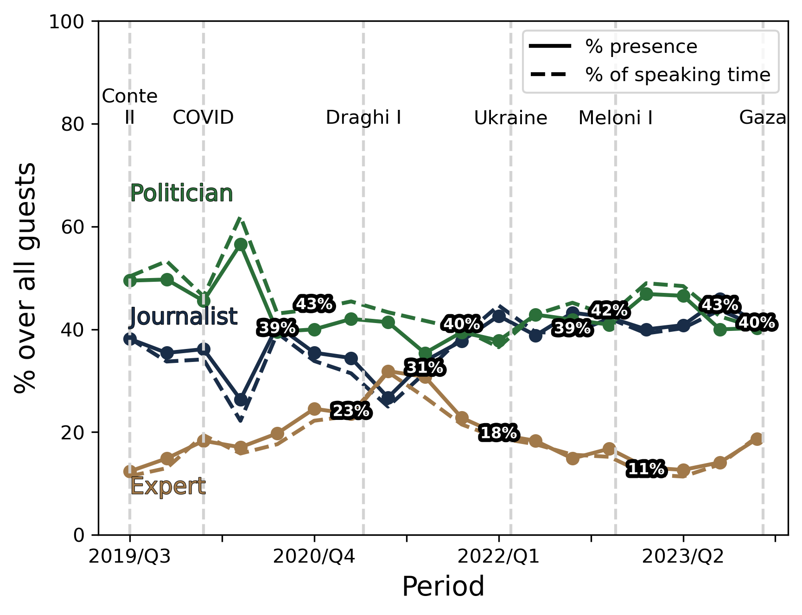
Speaker Type – Otto e Mezzo VS Stasera Italia
SPEAKING TIME
Rise of experts at the expense of politician
Data, Trends and Biases of Television Political Talk Show: Evidence from Italy
Gabriele Pinto
Data, Trends and Biases of Television Political Talk Show: Evidence from Italy
Gabriele Pinto

Slide 42
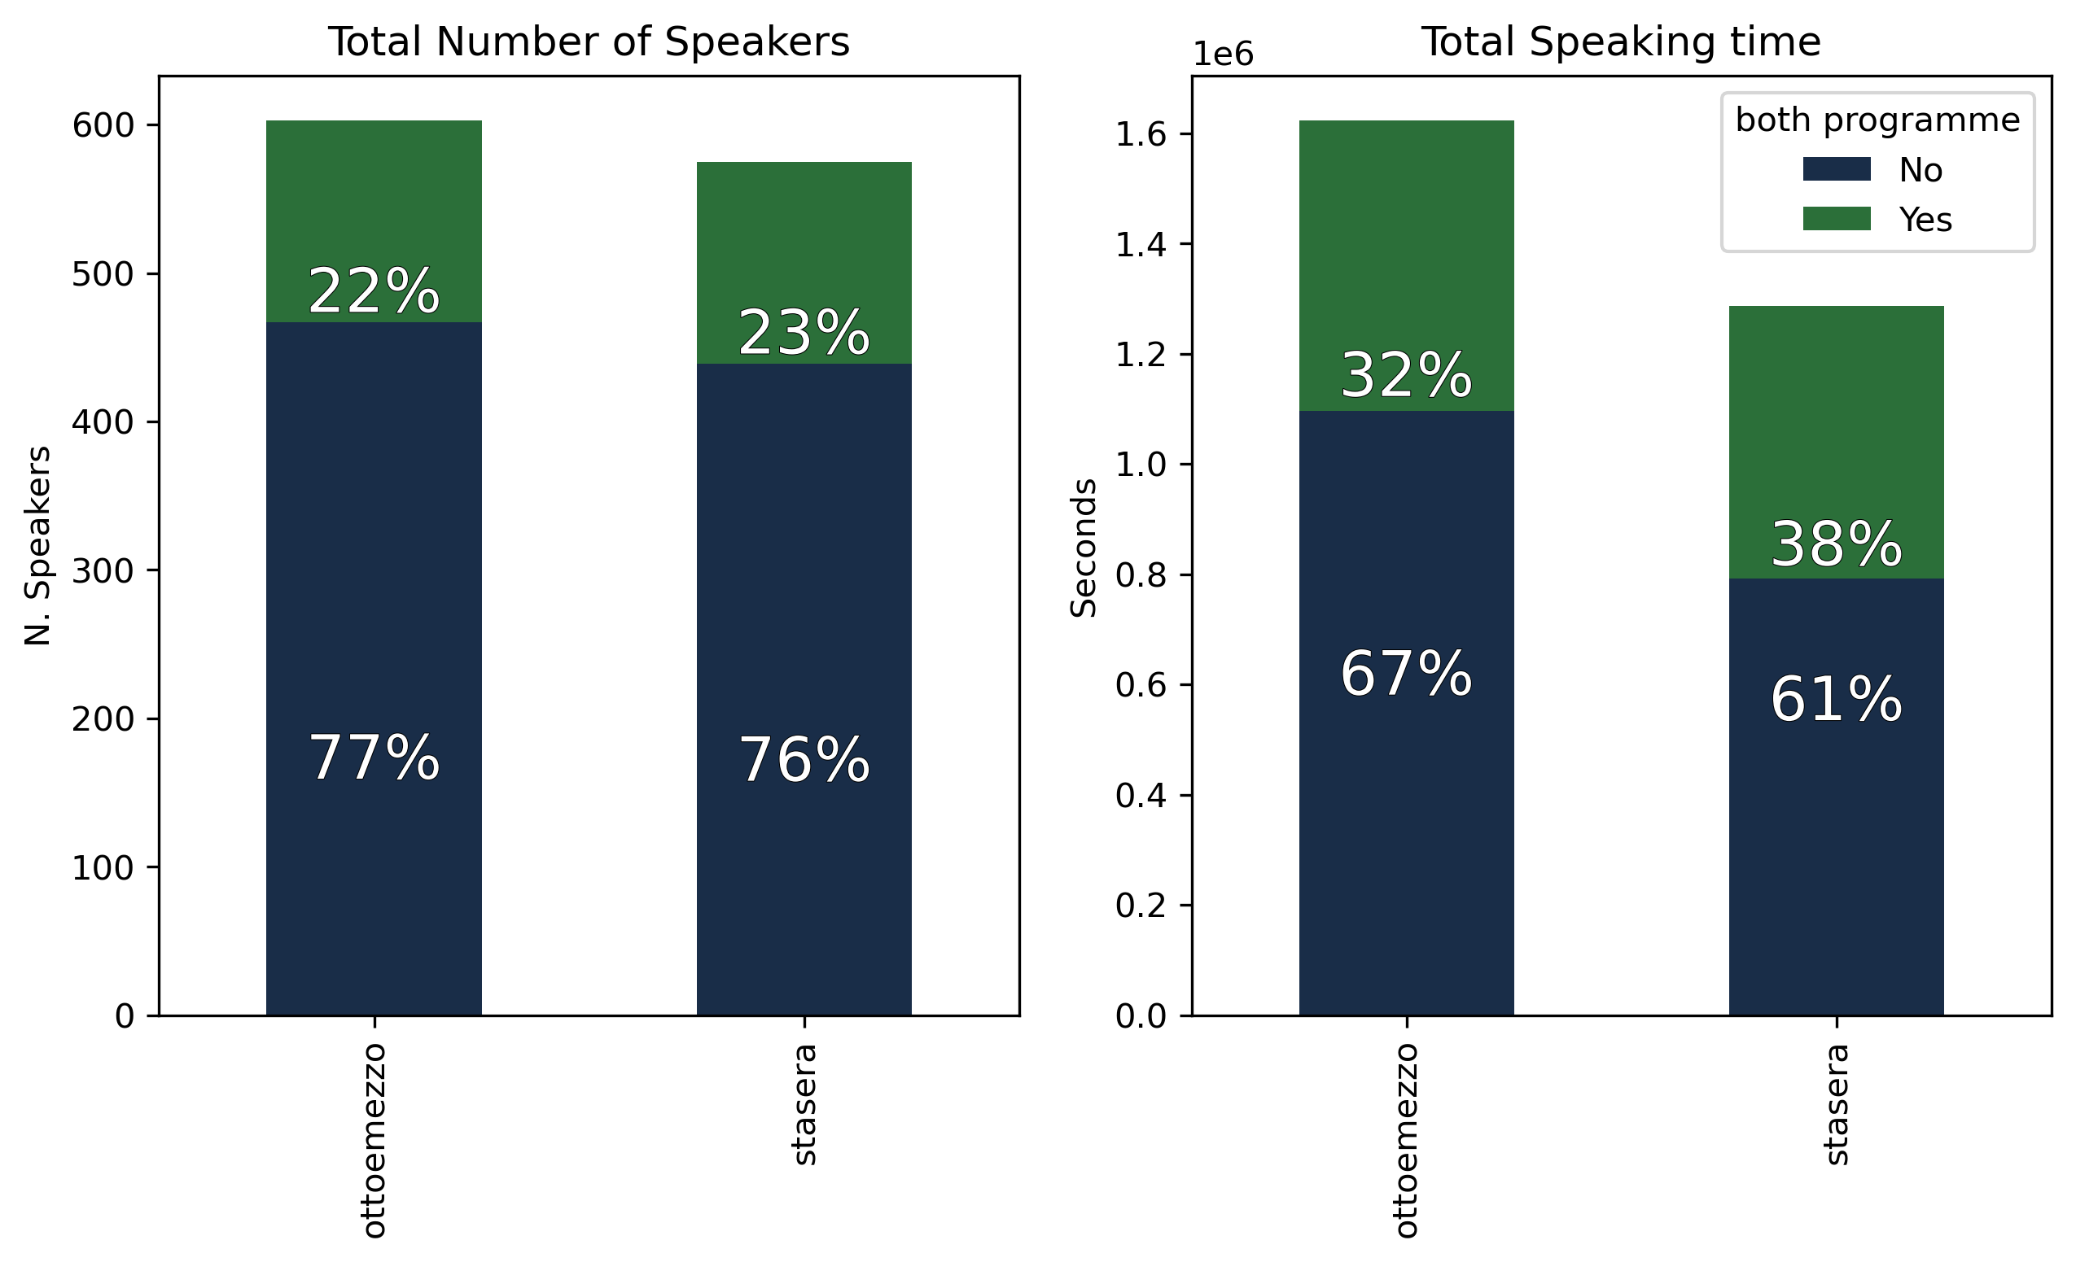
Competition – Speakers
SPEAKING TIME
A group of 136 speakers are present in BOTH programme and occupy 1/3 of the space.
Data, Trends and Biases of Television Political Talk Show: Evidence from Italy
Gabriele Pinto
Data, Trends and Biases of Television Political Talk Show: Evidence from Italy
Gabriele Pinto

Slide 43
Transcripts
TOPICS
We use emotion recognition Whisper-large-V3 from OpenAI (Radford et al. 2022)
Pass it to the model
Return dataframe with transcript and timestamps
Audio
Data, Trends and Biases of Television Political Talk Show: Evidence from Italy
Gabriele Pinto
Data, Trends and Biases of Television Political Talk Show: Evidence from Italy
Gabriele Pinto

Slide 44
Who speaks about what? – Topics Dictionary
TOPICS
Data, Trends and Biases of Television Political Talk Show: Evidence from Italy
Gabriele Pinto
Data, Trends and Biases of Television Political Talk Show: Evidence from Italy
Gabriele Pinto

Slide 45
Who speaks about what?
TOPICS
Summer breaks
Data, Trends and Biases of Television Political Talk Show: Evidence from Italy
Gabriele Pinto
Data, Trends and Biases of Television Political Talk Show: Evidence from Italy
Gabriele Pinto

Slide 46
Topics trends: Labour
TOPICS
Minimum Wage Proposal
Data, Trends and Biases of Television Political Talk Show: Evidence from Italy
Gabriele Pinto
Data, Trends and Biases of Television Political Talk Show: Evidence from Italy
Gabriele Pinto

Slide 47
Topics trends: Immigration
TOPICS
Cutro
Data, Trends and Biases of Television Political Talk Show: Evidence from Italy
Gabriele Pinto
Data, Trends and Biases of Television Political Talk Show: Evidence from Italy
Gabriele Pinto

Slide 48
Topics Trends: War
TOPICS
Ukraine Invasion
Israel-Palestine conflict
Data, Trends and Biases of Television Political Talk Show: Evidence from Italy
Gabriele Pinto
Data, Trends and Biases of Television Political Talk Show: Evidence from Italy
Gabriele Pinto

Slide 49
Topics Trends: Health
TOPICS
Data, Trends and Biases of Television Political Talk Show: Evidence from Italy
Gabriele Pinto
Data, Trends and Biases of Television Political Talk Show: Evidence from Italy
Gabriele Pinto

Slide 50
Topics Trends: Economics
TOPICS
Data, Trends and Biases of Television Political Talk Show: Evidence from Italy
Gabriele Pinto
Data, Trends and Biases of Television Political Talk Show: Evidence from Italy
Gabriele Pinto

Slide 51
Topics Trends: Justice
TOPICS
Data, Trends and Biases of Television Political Talk Show: Evidence from Italy
Gabriele Pinto
Data, Trends and Biases of Television Political Talk Show: Evidence from Italy
Gabriele Pinto

Slide 52
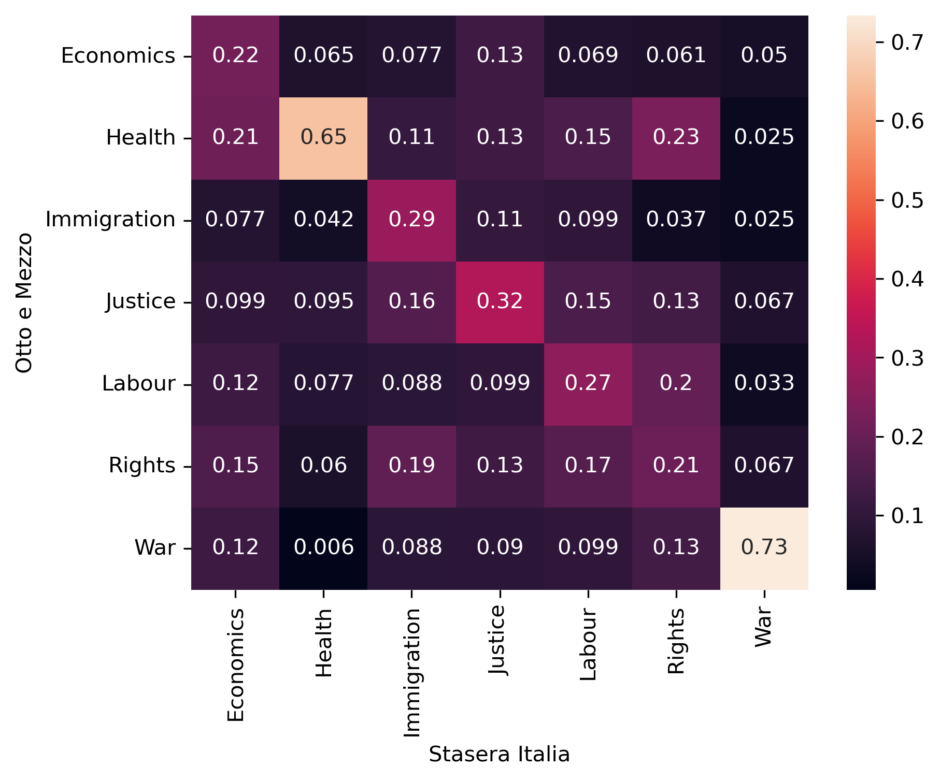
Topics Competition
TOPICS
Data, Trends and Biases of Television Political Talk Show: Evidence from Italy
Gabriele Pinto
Data, Trends and Biases of Television Political Talk Show: Evidence from Italy
Gabriele Pinto

Slide 53
Who speaks about what?
TOPICS
Data, Trends and Biases of Television Political Talk Show: Evidence from Italy
Gabriele Pinto
Data, Trends and Biases of Television Political Talk Show: Evidence from Italy
Gabriele Pinto

Slide 54
Who speaks about what?
TOPICS
Data, Trends and Biases of Television Political Talk Show: Evidence from Italy
Gabriele Pinto
Data, Trends and Biases of Television Political Talk Show: Evidence from Italy
Gabriele Pinto

Slide 55
Who speaks about what?
TOPICS
Data, Trends and Biases of Television Political Talk Show: Evidence from Italy
Gabriele Pinto
Data, Trends and Biases of Television Political Talk Show: Evidence from Italy
Gabriele Pinto

Slide 56
Who speaks about what?
TOPICS
Data, Trends and Biases of Television Political Talk Show: Evidence from Italy
Gabriele Pinto
Data, Trends and Biases of Television Political Talk Show: Evidence from Italy
Gabriele Pinto

Slide 57
Who speaks about what?
TOPICS
Data, Trends and Biases of Television Political Talk Show: Evidence from Italy
Gabriele Pinto
Data, Trends and Biases of Television Political Talk Show: Evidence from Italy
Gabriele Pinto

Slide 58
Who speaks about what?
TOPICS
Data, Trends and Biases of Television Political Talk Show: Evidence from Italy
Gabriele Pinto
Data, Trends and Biases of Television Political Talk Show: Evidence from Italy
Gabriele Pinto

Slide 59
Who speaks about what?
TOPICS
Data, Trends and Biases of Television Political Talk Show: Evidence from Italy
Gabriele Pinto
Data, Trends and Biases of Television Political Talk Show: Evidence from Italy
Gabriele Pinto

Slide 60
Who speaks about what?
TOPICS
Data, Trends and Biases of Television Political Talk Show: Evidence from Italy
Gabriele Pinto
Data, Trends and Biases of Television Political Talk Show: Evidence from Italy
Gabriele Pinto

Slide 61
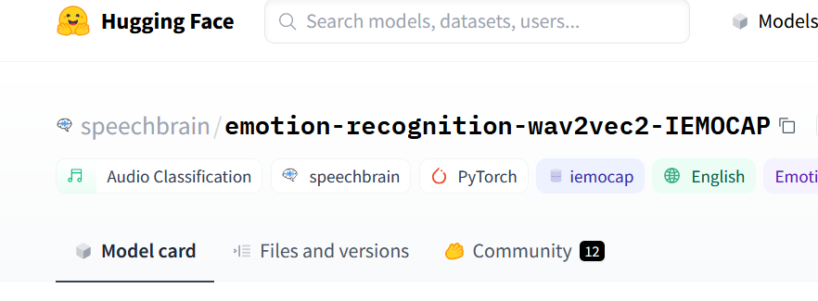
Tone
TONE
We use emotion recognition from SpeechBrain (Ravanelli et al. 2021), trained on IEMOCAP (accuracy 78%)
Cut audio segment from the Diarization
Pass it to the model
Return emotional classes
Happy
Neutral
Anger
Sad
Data, Trends and Biases of Television Political Talk Show: Evidence from Italy
Gabriele Pinto
Data, Trends and Biases of Television Political Talk Show: Evidence from Italy
Gabriele Pinto

Slide 62
Tone
TONE
AudioWaves
Spectrograms
Emotions
Data, Trends and Biases of Television Political Talk Show: Evidence from Italy
Gabriele Pinto
Data, Trends and Biases of Television Political Talk Show: Evidence from Italy
Gabriele Pinto

Slide 63
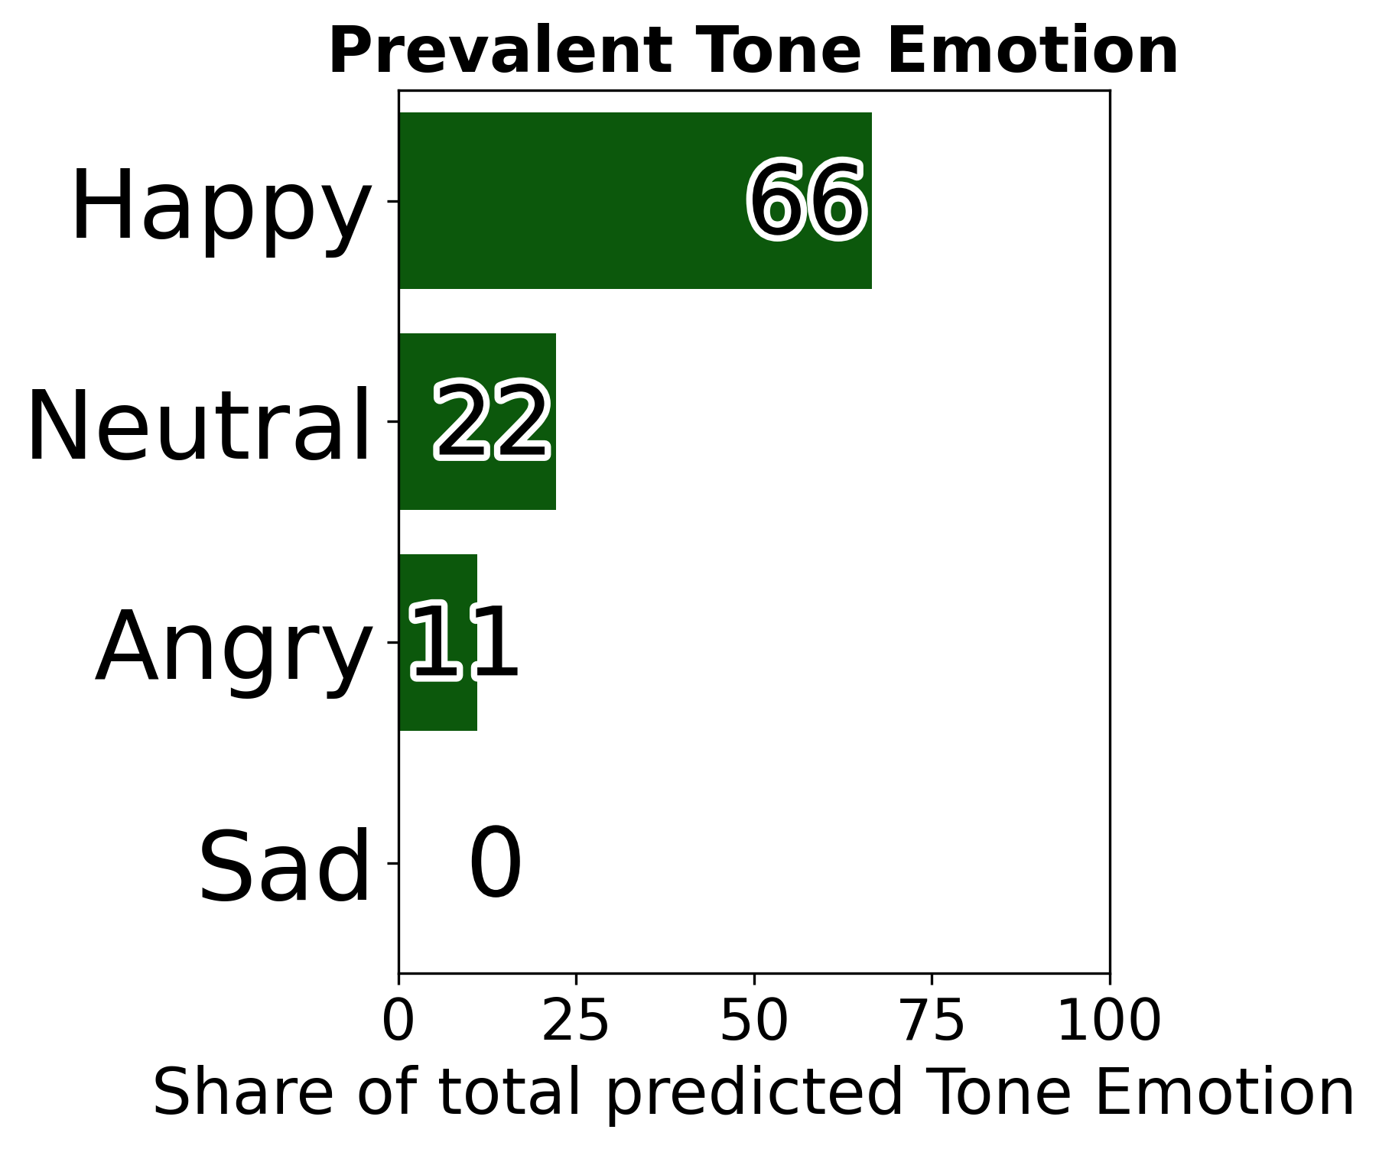
Audio Tone Distribution
TONE
Gabriele Pinto
Data, Trends and Biases of Television Political Talk Show: Evidence from Italy

Slide 64
Tone matters
TONE
Gabriele Pinto
Data, Trends and Biases of Television Political Talk Show: Evidence from Italy

Slide 65
Tone Examples Happy
TONE
Gabriele Pinto
Data, Trends and Biases of Television Political Talk Show: Evidence from Italy

Slide 66
Tone Examples Neutral
TONE
Gabriele Pinto
Data, Trends and Biases of Television Political Talk Show: Evidence from Italy

Slide 67
Tone Examples Anger
TONE
Gabriele Pinto
Data, Trends and Biases of Television Political Talk Show: Evidence from Italy

Slide 68
Tone Examples Sad
TONE
Gabriele Pinto
Data, Trends and Biases of Television Political Talk Show: Evidence from Italy

Slide 69
Tone and Topics
TONE
Gabriele Pinto
Data, Trends and Biases of Television Political Talk Show: Evidence from Italy

Slide 70
Tone and Topics
TONE
Gabriele Pinto
Data, Trends and Biases of Television Political Talk Show: Evidence from Italy

Slide 71
Tone and Topics
TONE
Gabriele Pinto
Data, Trends and Biases of Television Political Talk Show: Evidence from Italy

Slide 72
Tone and Topics
TONE
Gabriele Pinto
Data, Trends and Biases of Television Political Talk Show: Evidence from Italy

Slide 73
Tone and Topics
TONE
Gabriele Pinto
Data, Trends and Biases of Television Political Talk Show: Evidence from Italy

Slide 74
Tone and Topics
TONE
Gabriele Pinto
Data, Trends and Biases of Television Political Talk Show: Evidence from Italy

Slide 75
Tone and Topics
TONE
Gabriele Pinto
Data, Trends and Biases of Television Political Talk Show: Evidence from Italy

Slide 76
Auditel Data
VIEWERSHIPS
Proprietary data from Auditel^{tm} , a consortium of Italian Network that traces TV viewership on a representative sample (16k families) of Italian citizens. Tracking is made using a “meter” connected to the device (i.e. it’s not a survey)
Minute by Minute data
Breakdown by Gender
Used also in Gambaro et al. (2023, NBER), Castriota et al. (2023, Int.Journ.HealtEconMana)
Gabriele Pinto
Data, Trends and Biases of Television Political Talk Show: Evidence from Italy

Slide 77
Audience Summary statistics – Otto e Mezzo
VIEWERSHIPS
Gabriele Pinto
Data, Trends and Biases of Television Political Talk Show: Evidence from Italy

Slide 78
Minutes-by-Minute Audience data
VIEWERSHIPS
21:00 adv break
There is clearly a curve (because of the schedule timing, presence of advertising).
Gabriele Pinto
Data, Trends and Biases of Television Political Talk Show: Evidence from Italy

Slide 79
Audience Regression
VIEWERSHIPS
Break Stasera – Time Trend
Episode fix effect
Quadratic Time trend
$${Audience}_{e,t}=β_{0}+β_{1}{Gender}_{e,t}+{β_{2}Left}_{e,t}+{SpeakerType}_{e,t}+{Minute}_{t}^{}{+Minute}_{t}^{2}+{Break}_{t}∗\left({Minute}_{t}^{}{+Minute}_{t}^{2}\right)+\sum_{i}^{i−1}{γ_{i}{Episode}_{e}^{i}}$$
Gabriele Pinto
Data, Trends and Biases of Television Political Talk Show: Evidence from Italy

Slide 80
Baseline Descriptive Result
VIEWERSHIPS
Anger Tone → Higher Audience
Expert and Journalists (vs. Politiciains) → Higher Audience
Left-Wing → Lower audience
Male Speaker → Higher Audience
Gabriele Pinto
Data, Trends and Biases of Television Political Talk Show: Evidence from Italy

Slide 81
A quasi-natural experiment
VIEWERSHIPS
Short opening (sigla)
Guest introduction
Commercial break
Start of the programme
5 sec
35-45 sec
~3 minutes
~ 3 minutes
Analysis before after Advertisment Breaks shows very similar results
Gabriele Pinto
Data, Trends and Biases of Television Political Talk Show: Evidence from Italy

Slide 82
Face Recognition
FACES
bounding boxes with associated probabilities that there is a face in each box
Face detection model
We use the facenet-pythorch implementation of MTCNN (Multi-Task Cascaded Convolutional Networks) (originally proposed in Zhang et al. 2016) for detection.
Gabriele Pinto
Data, Trends and Biases of Television Political Talk Show: Evidence from Italy

Slide 83
Face Detection
FACES
This model has a LFW (Labeled Faces in the Wild) accuracy of 0,99 (AUC curve)… but…
Gabriele Pinto
Data, Trends and Biases of Television Political Talk Show: Evidence from Italy

Slide 84
Face Detection When it works fine..
FACES
Gabriele Pinto
Data, Trends and Biases of Television Political Talk Show: Evidence from Italy

Slide 85
Face Detection When not 1/2
FACES
Faces that are not referred to speakers…
Gabriele Pinto
Data, Trends and Biases of Television Political Talk Show: Evidence from Italy

Slide 86
Face Detection –tools – When not 2/2
FACES
Background images…
Gabriele Pinto
Data, Trends and Biases of Television Political Talk Show: Evidence from Italy

Slide 87
Face Recognition
FACES
Face detection model
Face recognition model
Gabriele Pinto
Data, Trends and Biases of Television Political Talk Show: Evidence from Italy

Slide 88
Face Recognition
FACES
To do that, we need a dataset of labelled pictures of the speakers
We construct the dataset by first scraping image from google images (by typing name and surname of the speakers)
And then we “reinforce” this dataset by using faces detected in videos only below a very low threshold
We use the deepface python package (VGG-face) for embedding of images (Serengil & Opzinar 2021)
Gabriele Pinto
Data, Trends and Biases of Television Political Talk Show: Evidence from Italy

Slide 89
Face Recognition
FACES
Baseline truth (google images)
[only those we know are in the episode (from Audio Dataset)]
“Reinforced” Truth Collection
Vector Embeddings
Add the frame to the Truth Collection
Compute distance (e.g. probability they are the same)
If Prob is VERY HIGH
Vector Embeddings
Gabriele Pinto
Data, Trends and Biases of Television Political Talk Show: Evidence from Italy

Slide 90
Face Detection – solution to obstacles
FACES
We apply the following filters:
The image has to pass a “size” threshold.
The face identified (see next step) must be a speaker in that episode (as identified by the audio).
Only use identification below a certain threshold.
Gabriele Pinto
Data, Trends and Biases of Television Political Talk Show: Evidence from Italy

Slide 91
Face Recognition – does it work?
FACES
…after manually inspecting a sample of 100 frames:
 | Face Detected | Face Recognized
True | 142 (95%) | 140 (98%)
False | 7 | 2
Total | 149 | 142
Gabriele Pinto
Data, Trends and Biases of Television Political Talk Show: Evidence from Italy

Slide 92
Face Emotion
FACES
We use HSEmotion (High-Speed face Emotion recognition) from Savchenko (2023) , accuracy ~60-65% on AffectNet (8-7 classes)
Identified face
Pass it to the model
Return emotional classes
Anger
Neutral
Sadness
Happiness
Disgust
Surprise
Contempt
Fear
Data, Trends and Biases of Television Political Talk Show: Evidence from Italy
Gabriele Pinto
Data, Trends and Biases of Television Political Talk Show: Evidence from Italy
Gabriele Pinto

Slide 93
Face Emotions
FACES
Note the differences…
Gabriele Pinto
Data, Trends and Biases of Television Political Talk Show: Evidence from Italy

Slide 94
Face Emotions
FACES
Gabriele Pinto
Data, Trends and Biases of Television Political Talk Show: Evidence from Italy

Slide 95
Face emotion of the “others”
FACES
Gabriele Pinto
Data, Trends and Biases of Television Political Talk Show: Evidence from Italy

Slide 96
Facial expression of those who are not speaking (all types)
FACES
speaker
other
Less “Neutral”
left
right
More “Happy”
More “Disgust”
right
right
right
left
left
left
Gabriele Pinto
Data, Trends and Biases of Television Political Talk Show: Evidence from Italy

Slide 97
Summing up
CONCLUSIONS
Videos are an extremely rich (and meaningful) source of data
We have some (correlational) results on the preference of the audience towards more «active» tones, journalists and experts (vs politicians) and male speakers.
We have some results on:
partisanship of programmes, with trends over time.
heterogeneity of tone and type of speakers w/ respect to the topics discussed.
facial expression convey «comments» on the speakers.
Gabriele Pinto
Data, Trends and Biases of Television Political Talk Show: Evidence from Italy

Slide 98
CONCLUSIONS
Thank you!
gabriele.pinto@uniroma1.it
slides: www.gabrielepinto.com/presentations
Gabriele Pinto
Data, Trends and Biases of Television Political Talk Show: Evidence from Italy

Slide 99
APPENDIX
APPENDIX
Gabriele Pinto
Data, Trends and Biases of Television Political Talk Show: Evidence from Italy

Slide 100
Validation of speaking time
APPENDIX
SPEAKING TIME
We compare our data with those of the AGCOM (produced by private companies)
Those are the data that are also used to verify compliance with par condicio
Note that in the AGCOM data we only have 105 speakers (out of 795 we tracks)
Data, Trends and Biases of Television Political Talk Show: Evidence from Italy
Gabriele Pinto
Data, Trends and Biases of Television Political Talk Show: Evidence from Italy
Gabriele Pinto

Slide 101
Validation of speaking time
APPENDIX
SPEAKING TIME
Each dot is one speaker in one episode of Otto e Mezzo
We inspected those outliers that resulted to be errors in the AGCOM data!
Our data seems to be reliable!
Data, Trends and Biases of Television Political Talk Show: Evidence from Italy
Gabriele Pinto
Data, Trends and Biases of Television Political Talk Show: Evidence from Italy
Gabriele Pinto

