Slide 1
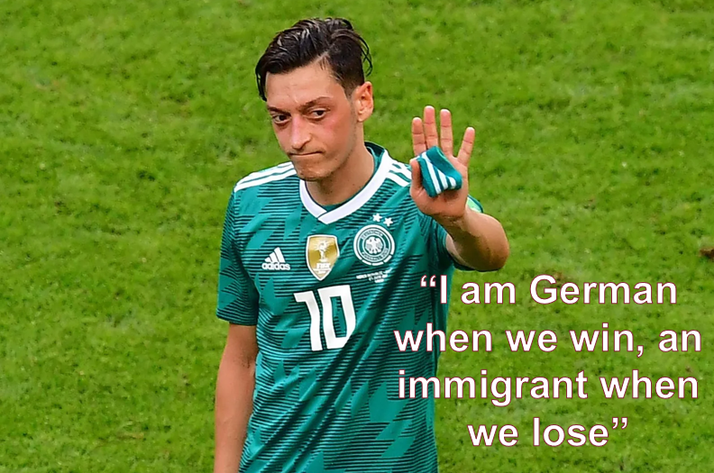
Sports nationalism and xenophobia: when cheering turns into violence
Gabriele Pinto Post-Doc Research Fellow Sapienza University of Rome Department of Social Sciences and Economics
Rome, Italy, May 27, 2024
VI Riunione Scientifica del Dipartimento di Scienze Sociali ed Economiche
Gabriele Pinto
Sports Nationalism and xenophobia: when cheering turns into violence

Slide 2
United By Football. United in the heart of Europe
Gabriele Pinto
Sports Nationalism and xenophobia: when cheering turns into violence

Slide 3
“It seems that soccer tournaments create those relationships: people gathered together in pubs and living rooms, a whole country suddenly caring about the same event. A World Cup is the sort of common project that otherwise barely exists in modern societies.” Simon Kuper
Gabriele Pinto
Sports Nationalism and xenophobia: when cheering turns into violence

Slide 4
“Serious sport has nothing to do with fair play. It is bound up with hatred, jealousy, boastfulness, disregard of all rules and sadistic pleasure in witnessing violence: in other words it is war minus the shooting.” George Orwell 1945, The Sporting Spirit
Gabriele Pinto
Sports Nationalism and xenophobia: when cheering turns into violence

Slide 5
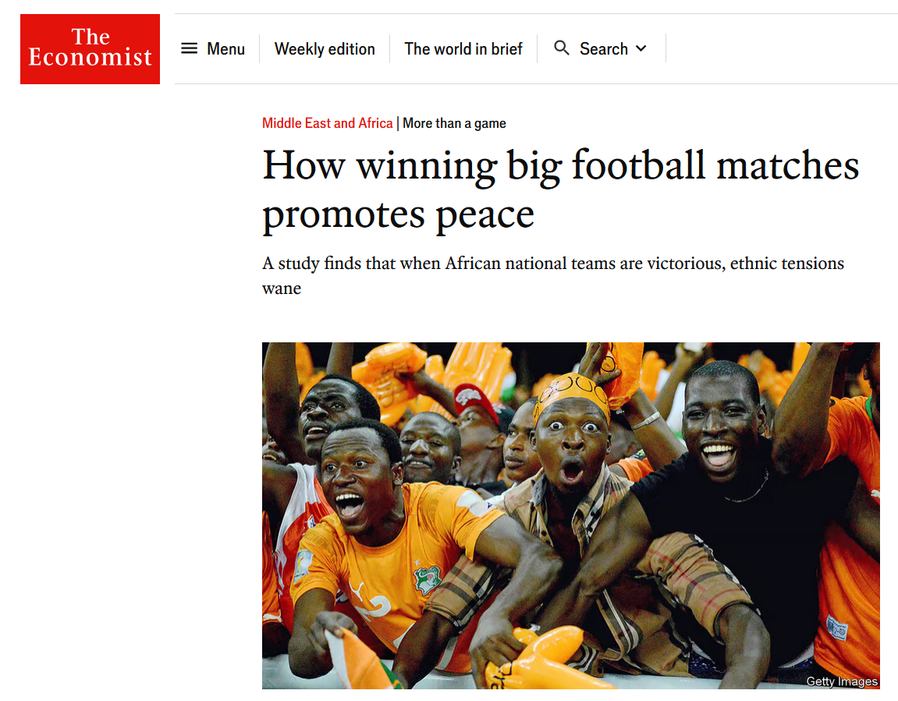
Empirical evidence
A boost in Sport Nationalism:
increases aggression between states (Bertoli, 2017) [increase inter-group frictions]
reduce aggression within states (E Depetris-Chauvin, R Durante, F Campante , 2020) [decrease intra-group frictions]
Takeaway → Sports Nationalism might boost national unity at the cost of animosity toward foreigners.
what about immigrants ? Are they considered part of the “group” or not ?...depends on the type of nationalism (Heinrich 2018)
Gabriele Pinto
Sports Nationalism and xenophobia: when cheering turns into violence

Slide 6
The Contribution
A conceptual framework to understand the relationship between nationalism and attitude against immigrants
An empirical evidence of the relationship between sports nationalism and attacks against immigrants
nationalism
Anti-immigrant attitudes
Hate crimes
Nationalis moods, football and attacks against immigrants: evidence from Germany – University of Turin – SIE 2022
Gabriele Pinto
Sports Nationalism and xenophobia: when cheering turns into violence
Gabriele Pinto

Slide 7
Conceptual Framework
nationalism
Anti-immigrant attitudes
Hate crimes
Nationalis moods, football and attacks against immigrants: evidence from Germany – University of Turin – SIE 2022
Gabriele Pinto
Sports Nationalism and xenophobia: when cheering turns into violence
Gabriele Pinto

Slide 8
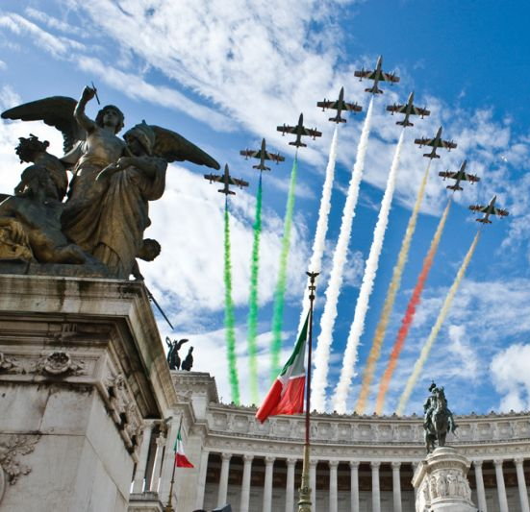
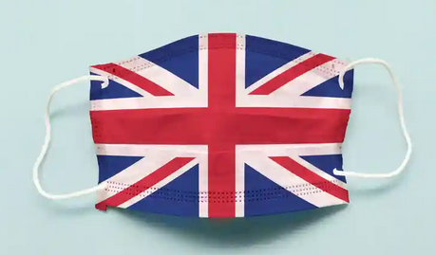
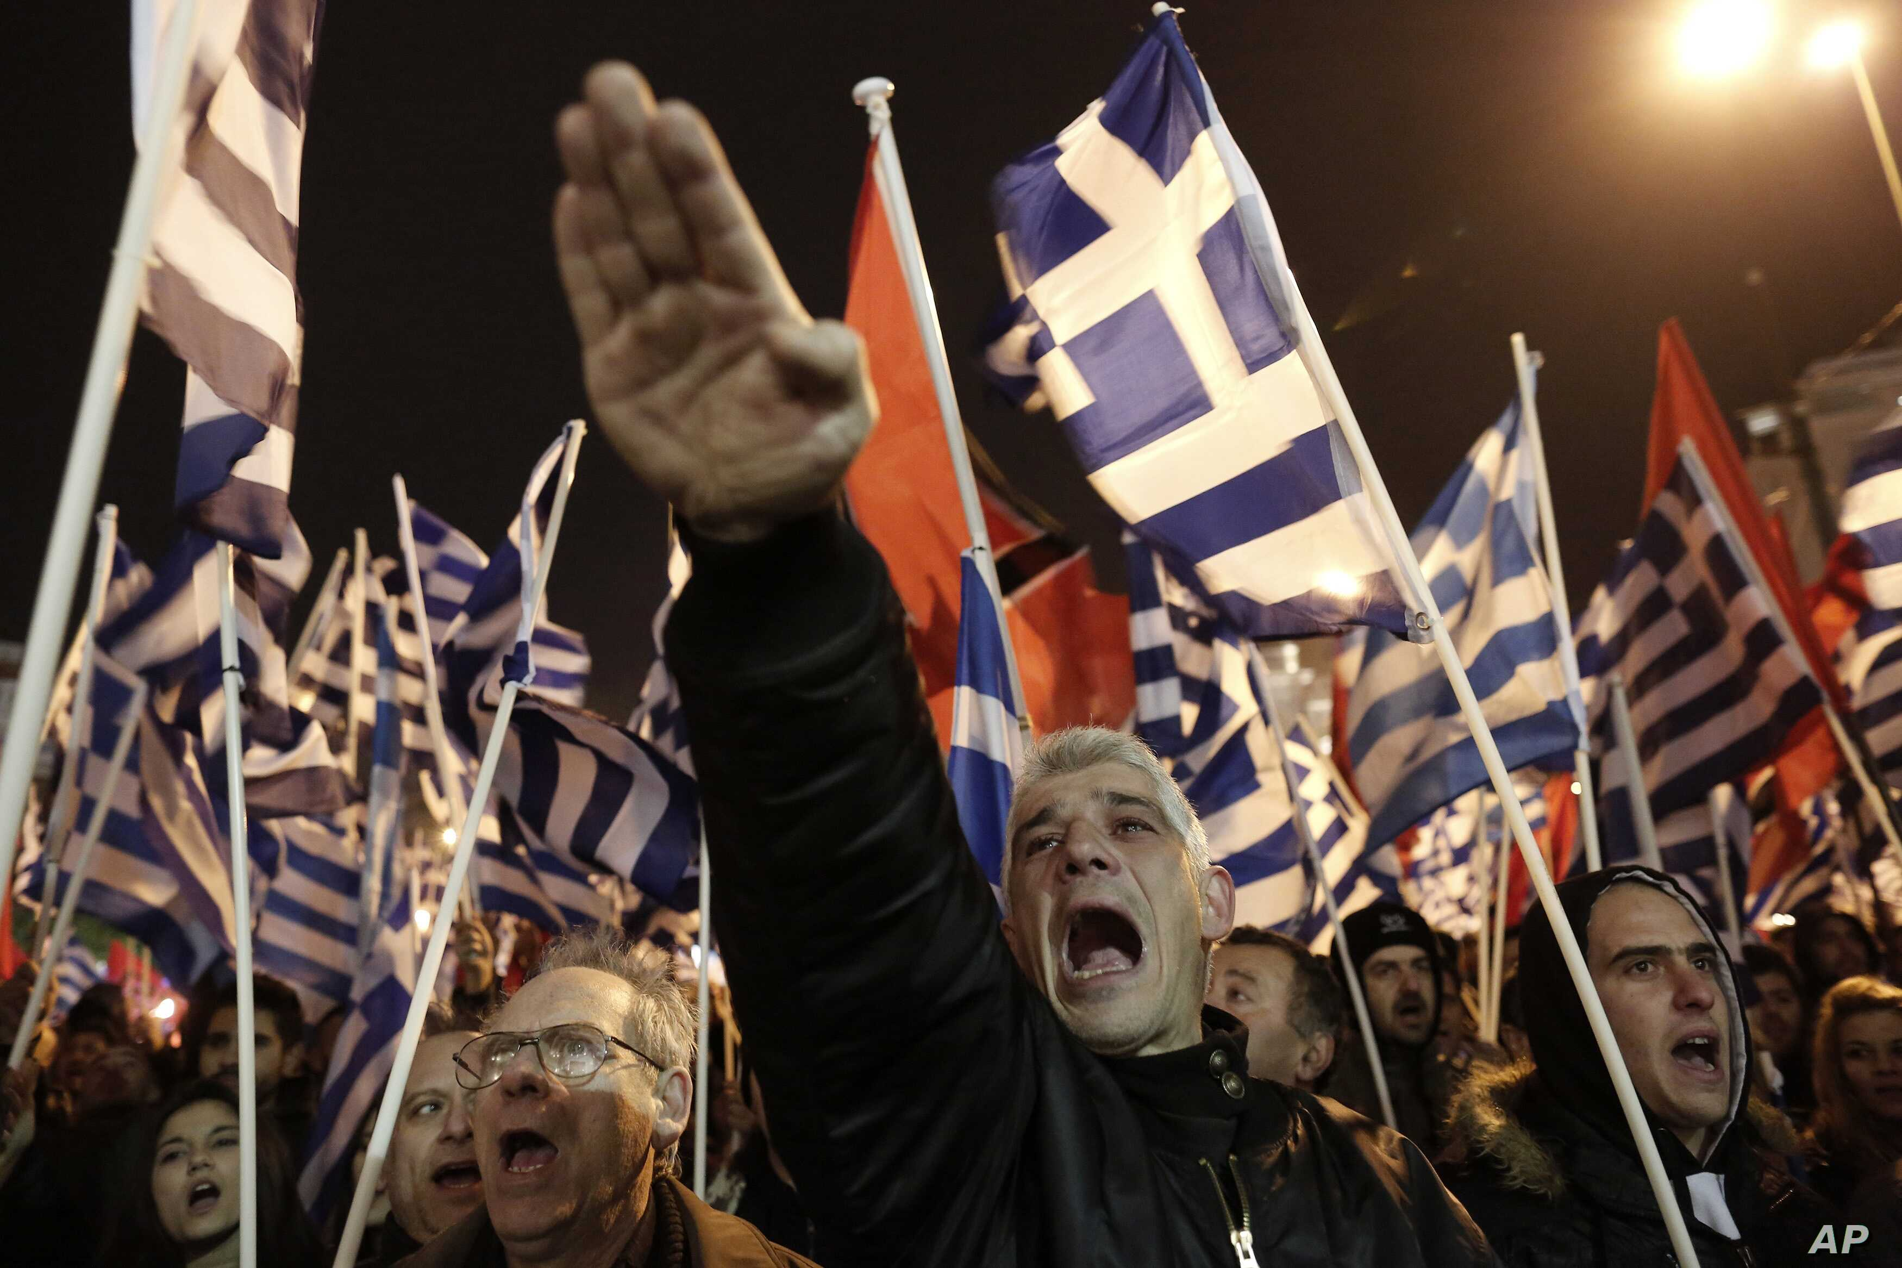
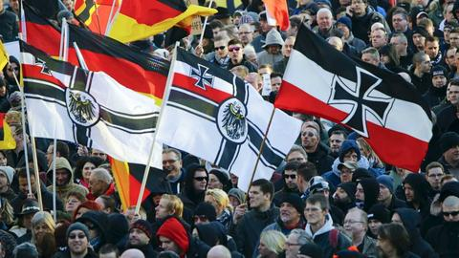
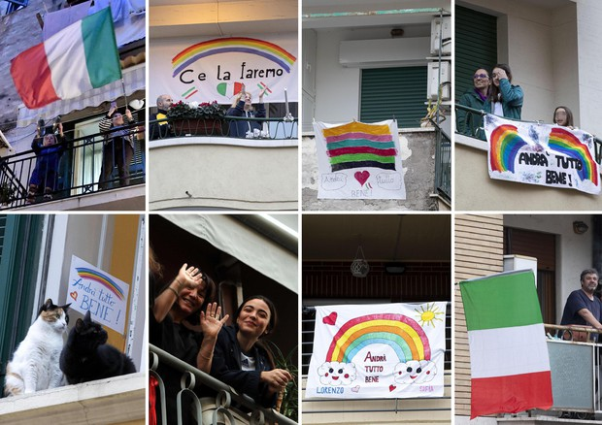
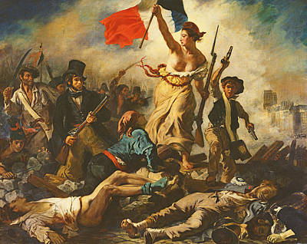
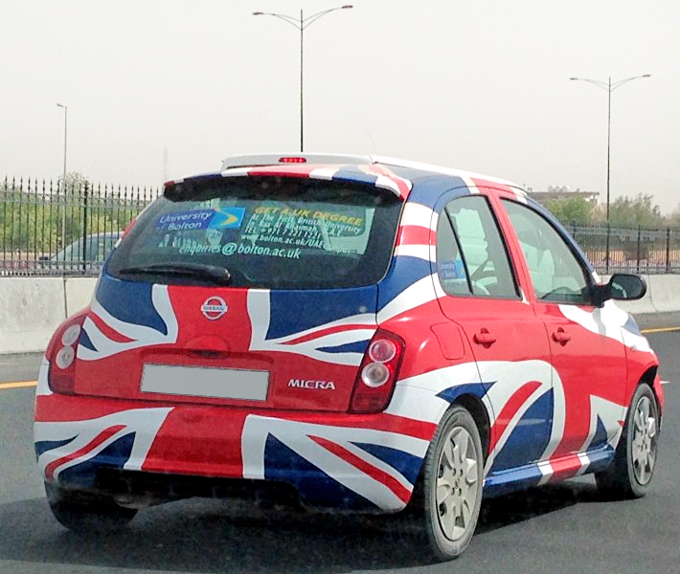
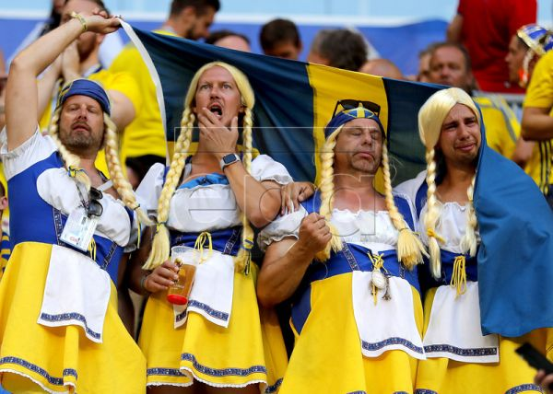
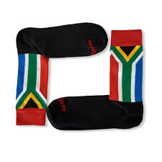
Conventional explanation: there are different types of nationalism
Healthy Nationalism
(Patriotic, Constitutional, etc…)
Morbid Nationalism
(Ethnic, Defensive, etc..)
Banal Nationalism
Nationalis moods, football and attacks against immigrants: evidence from Germany – University of Turin – SIE 2022
Gabriele Pinto
Sports Nationalism and xenophobia: when cheering turns into violence
Gabriele Pinto

Slide 9
Conceptual framework
Nationalism
Attitude against immigrants
Attacks against immigrants
Healthy Patriotic nationalism
positive
decreases
?
Sports
Morbid, Ethnic nationalism
negative
increases
Nationalis moods, football and attacks against immigrants: evidence from Germany – University of Turin – SIE 2022
Gabriele Pinto
Sports Nationalism and xenophobia: when cheering turns into violence
Gabriele Pinto

Slide 10
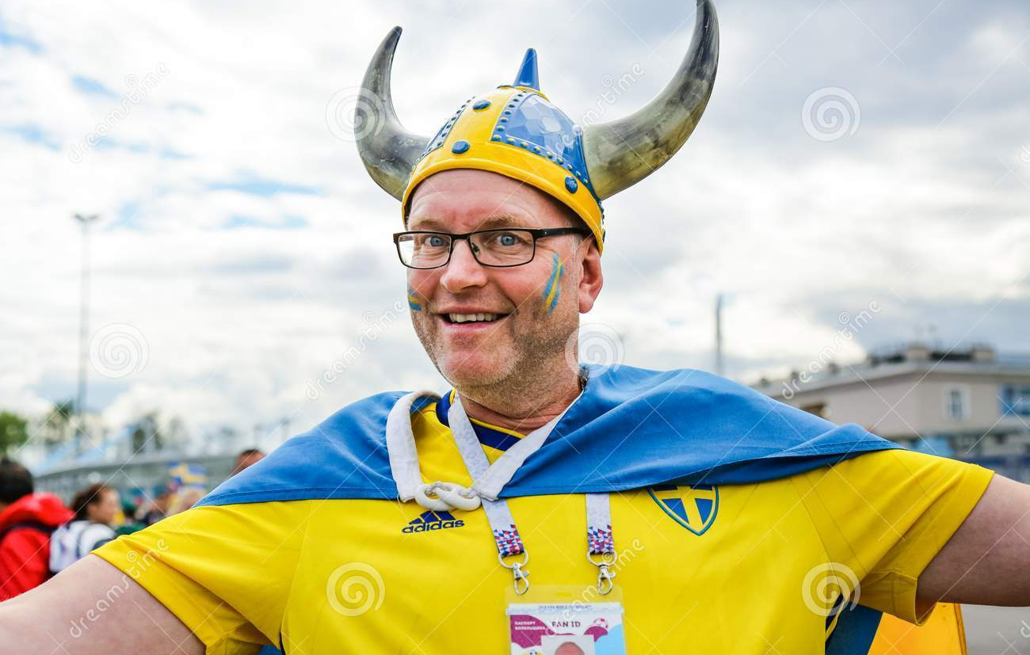
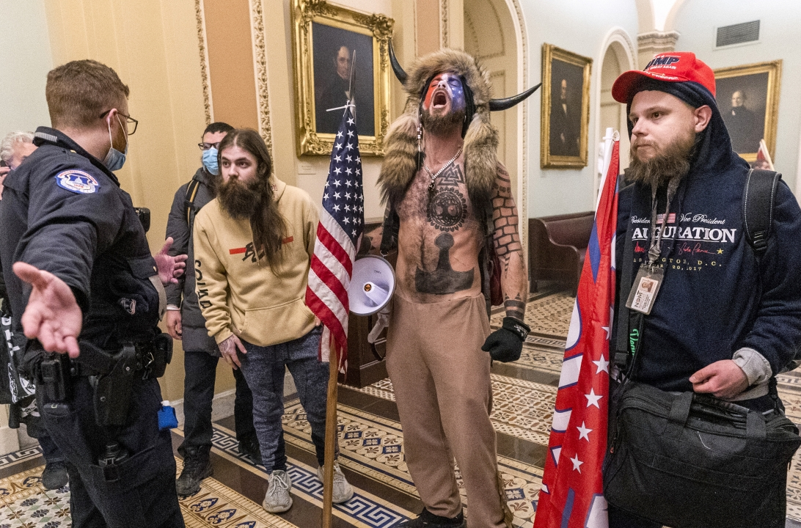
Argument 1: is there a difference?
Healthy and Morbid Nationalisms are brothers rather than distant cousins
(Wimmer 2019, Foreign Affairs)
Nationalis moods, football and attacks against immigrants: evidence from Germany – University of Turin – SIE 2022
Gabriele Pinto
Sports Nationalism and xenophobia: when cheering turns into violence
Gabriele Pinto

Slide 11
Argument 2: mood component of nationalism
Happy mood enhances satisfaction with national issues (Schwarz and al. 1987)
“Feel-good” factor (Kavetsos 2011, Kavetsos and Szymanski 2012, Hallman et al. 2013, Stieger et al. 2015, Heere 2016, Meier 2018)
Anger enhances stereotyping and discrimination (Fiske 1998)
Fear, Anger and voting for the far-right and attitude against immigrants (Mc Dermott 2016, Vasilopoulous 2018)
Mood states affects attitude against immigrants and xenophobia (
Nationalis moods, football and attacks against immigrants: evidence from Germany – University of Turin – SIE 2022
Gabriele Pinto
Sports Nationalism and xenophobia: when cheering turns into violence
Gabriele Pinto

Slide 12
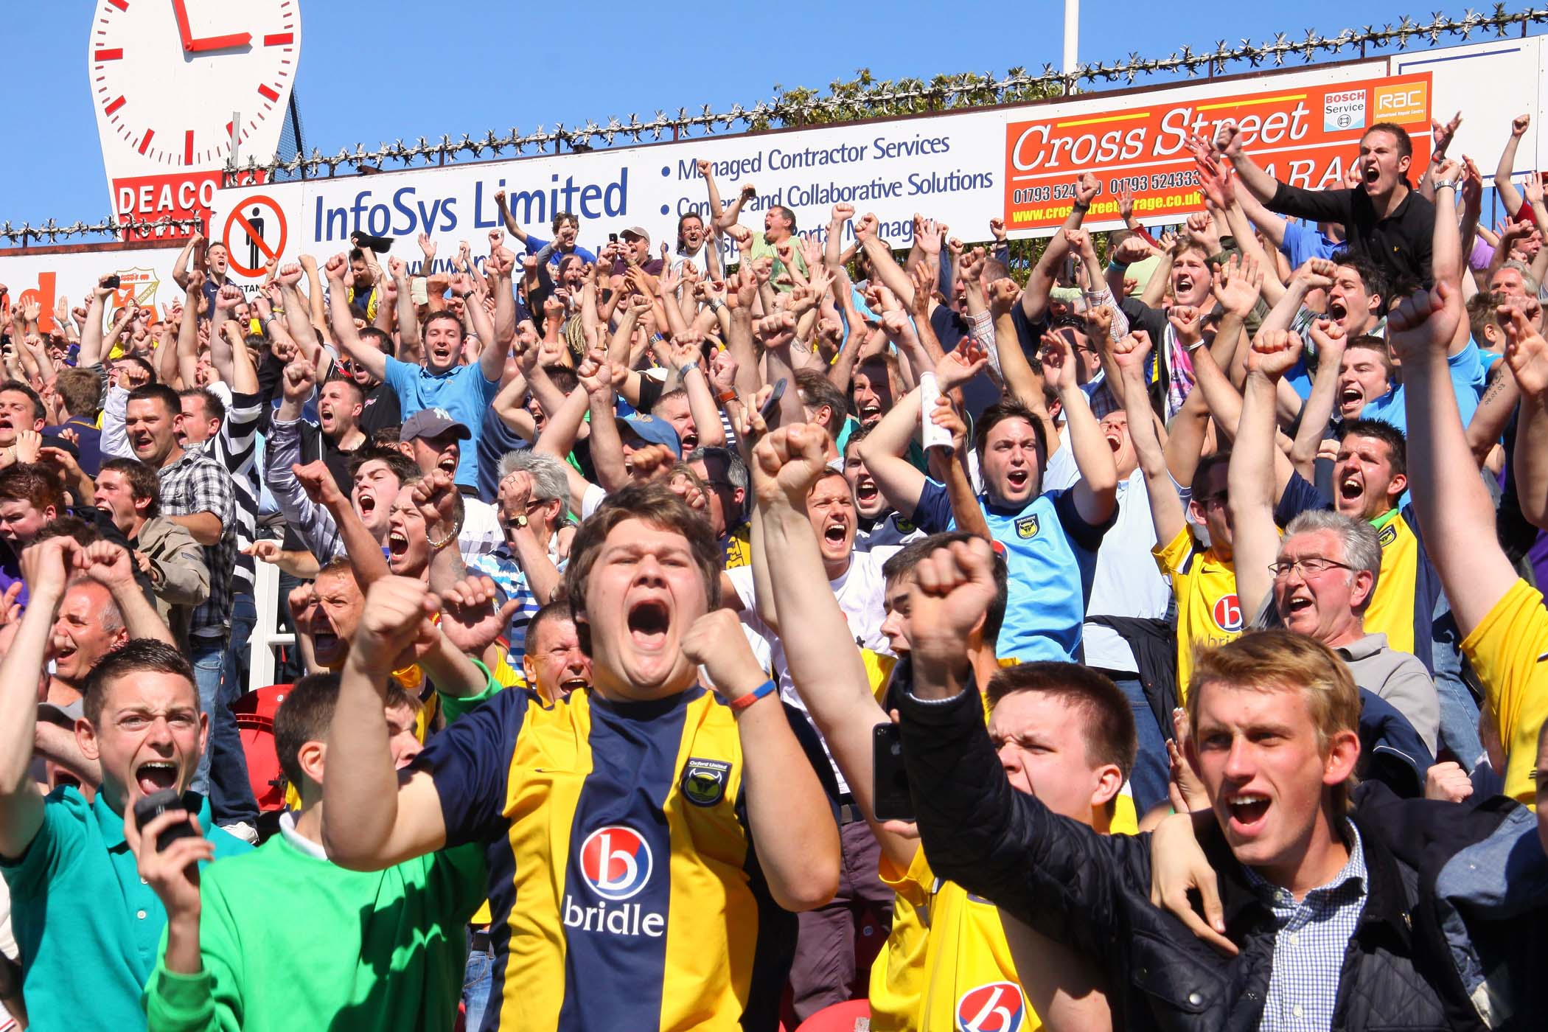
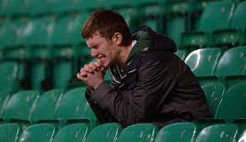
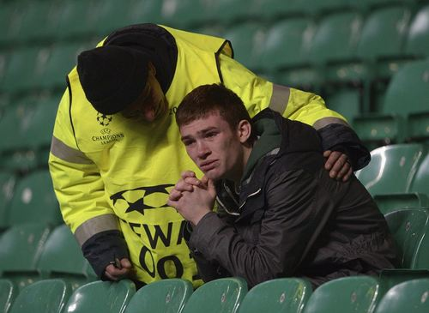
Argument 3: mood component of sports
Sport events can affect mood (positively and negatively) and individual behaviors
The impact of sports on mood has been showed to affect electoral behaviors, stock prices, domestic violence (among others). ((Joiner 2006, Edmans 2007, Card and Dahl 2011, Healy et al 2010, Fowler and Montagnes 2015, Busby et al. 2017, Potosky and Urbatsch 2016)
Nationalis moods, football and attacks against immigrants: evidence from Germany – University of Turin – SIE 2022
Gabriele Pinto
Sports Nationalism and xenophobia: when cheering turns into violence
Gabriele Pinto

Slide 13
Conceptual framework
Nationalism
Attitude against immigrants
Attacks against immigrants
Healthy Patriotic nationalism
positive
decreases
?
Sports
Morbid, Ethnic nationalism
negative
increases
Nationalis moods, football and attacks against immigrants: evidence from Germany – University of Turin – SIE 2022
Gabriele Pinto
Sports Nationalism and xenophobia: when cheering turns into violence
Gabriele Pinto

Slide 14
Conceptual framework
Interaction between mood and ideologies
Sports
Mood
Nationalism
Attitude against immigrants
Attacks against immigrants
Healty Patriotic nationalism
Win
Positive
Patriotic, Inclusive, unitarian nationalist mood
positive
decreases
Loose
Identitarian, Exclusive, Nationalist mood
negative
Morbid, Ethnic nationalism
negative
increases
Nationalis moods, football and attacks against immigrants: evidence from Germany – University of Turin – SIE 2022
Gabriele Pinto
Sports Nationalism and xenophobia: when cheering turns into violence
Gabriele Pinto

Slide 15
Empirical Application
Nationalis moods, football and attacks against immigrants: evidence from Germany – University of Turin – SIE 2022
Gabriele Pinto
Sports Nationalism and xenophobia: when cheering turns into violence
Gabriele Pinto

Slide 16
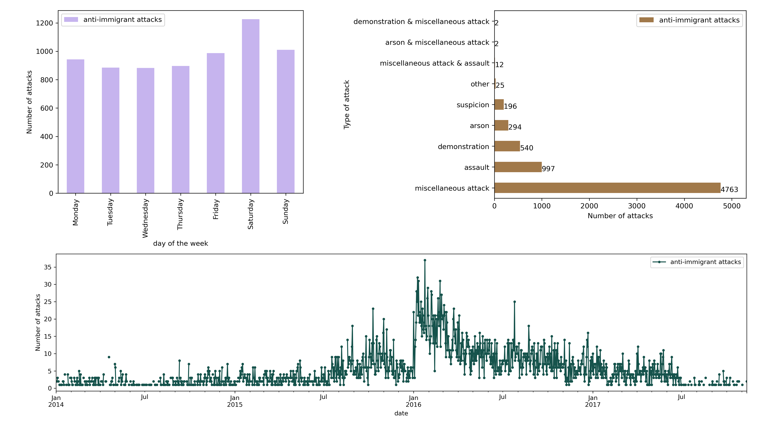
Data
Benček, D., & Strasheim, J. (2016). Refugees welcome? A dataset on anti-refugee violence in Germany. Research & Politics, 3(4), 2053168016679590.
Arvig Dataset
Nationalis moods, football and attacks against immigrants: evidence from Germany – University of Turin – SIE 2022
Gabriele Pinto
Sports Nationalism and xenophobia: when cheering turns into violence
Gabriele Pinto

Slide 17
Data
Figure 2: Germany National team Soccer matches
Nationalis moods, football and attacks against immigrants: evidence from Germany – University of Turin – SIE 2022
Gabriele Pinto
Sports Nationalism and xenophobia: when cheering turns into violence
Gabriele Pinto

Slide 18
Empirical Strategy
A Poisson count model (with all days in the sample)
An Event-Study Analysis (only looking at days closest to the match)
In short → we compare the outcome variables before and after football matches with different results!
Nationalis moods, football and attacks against immigrants: evidence from Germany – University of Turin – SIE 2022
Gabriele Pinto
Sports Nationalism and xenophobia: when cheering turns into violence
Gabriele Pinto

Slide 19
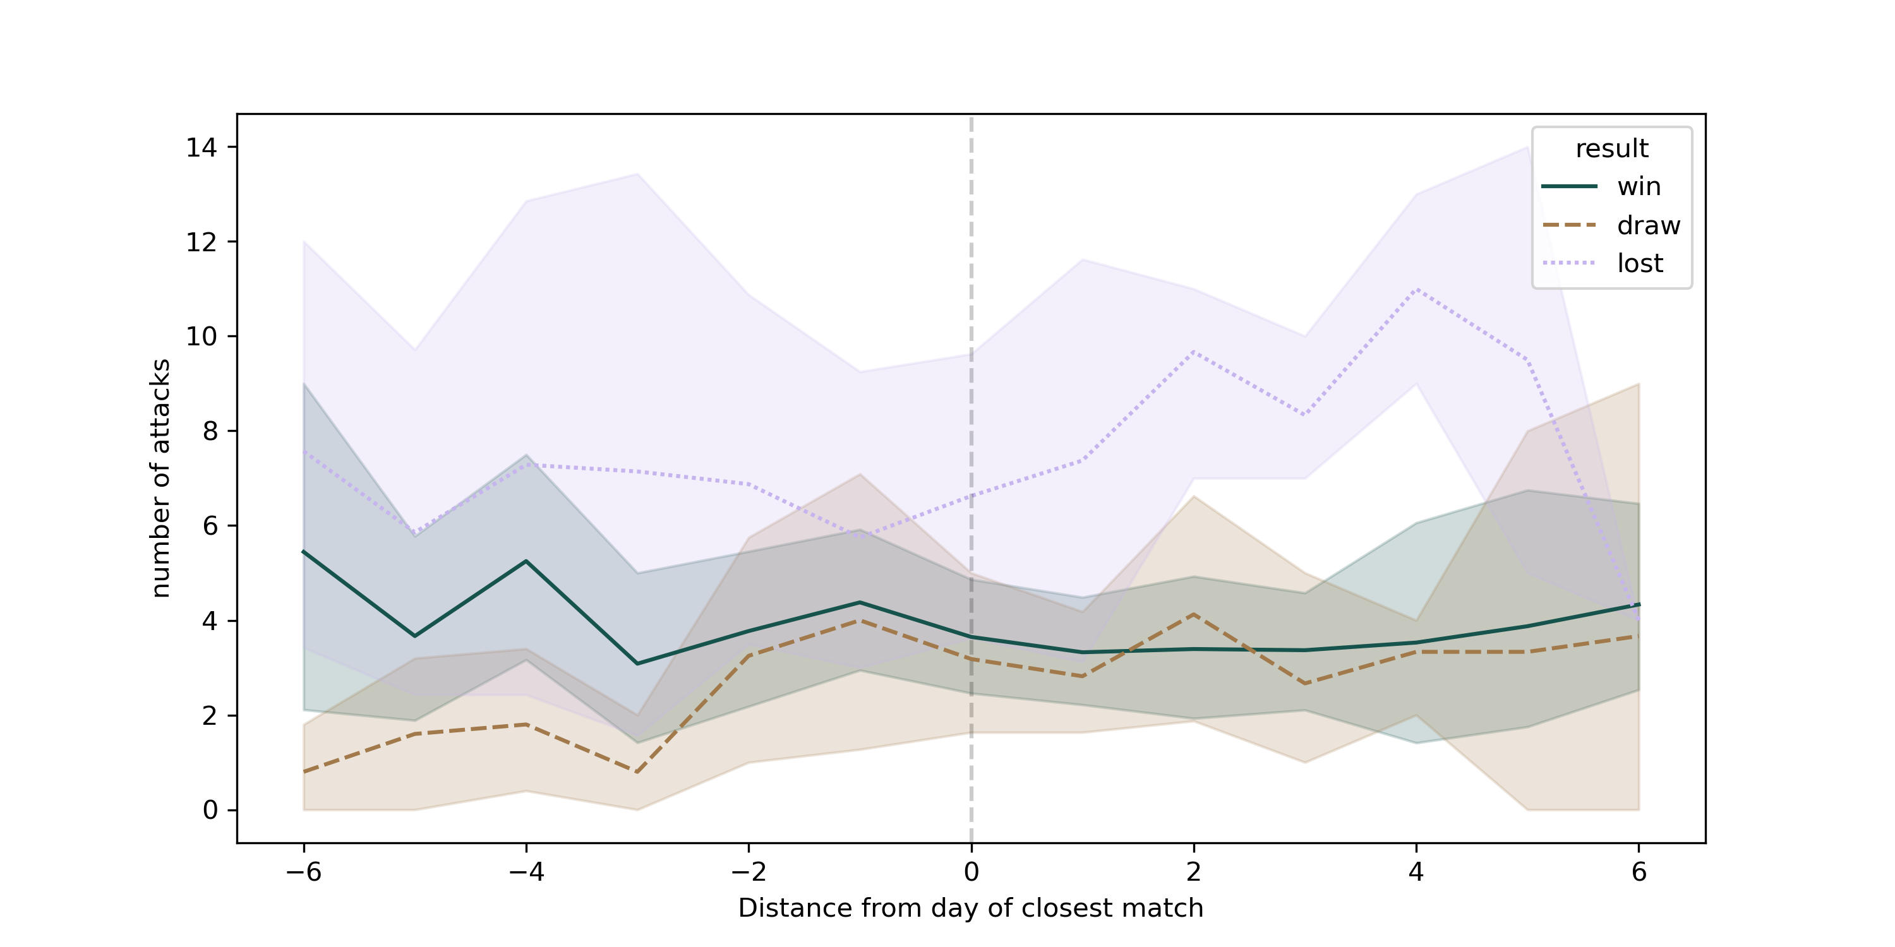
Event-Study Analysis
…Before the match
…After the match
Nationalis moods, football and attacks against immigrants: evidence from Germany – University of Turin – SIE 2022
Gabriele Pinto
Sports Nationalism and xenophobia: when cheering turns into violence
Gabriele Pinto

Slide 20
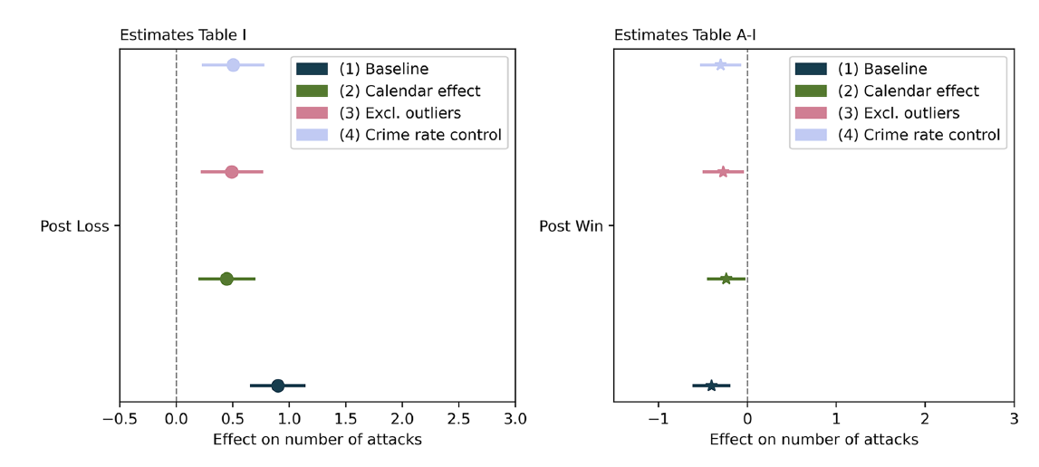
Coefficient Plots
Translating the coefficient (diff in log expected counts) shows that when Germany loose we expect an average of 7-8 attacks (compared to a mean of 4,8).
Nationalis moods, football and attacks against immigrants: evidence from Germany – University of Turin – SIE 2022
Gabriele Pinto
Sports Nationalism and xenophobia: when cheering turns into violence
Gabriele Pinto

Slide 21
Robustness and Mechanisms
Excluding demonstration
Alchool consumption and controlling for other crimes
City of attacks
Nationalis moods, football and attacks against immigrants: evidence from Germany – University of Turin – SIE 2022
Gabriele Pinto
Sports Nationalism and xenophobia: when cheering turns into violence
Gabriele Pinto

Slide 22
Mechanisms
nationalism
Anti-immigrant attitudes
Hate crimes
Nationalis moods, football and attacks against immigrants: evidence from Germany – University of Turin – SIE 2022
Gabriele Pinto
Sports Nationalism and xenophobia: when cheering turns into violence
Gabriele Pinto

Slide 23
Relationship between Nationalism and Immigrants
Sports
Mood
Nationalism
Attitude against immigrants
Attacks against immigrants
Win
Positive
Patriotic, Inclusive, unitarian nationalist mood
positive
decreases
Loose
Identitarian, Exclusive, Nationalist mood
negative
negative
increases
Nationalis moods, football and attacks against immigrants: evidence from Germany – University of Turin – SIE 2022
Gabriele Pinto
Sports Nationalism and xenophobia: when cheering turns into violence
Gabriele Pinto

Slide 24
Mechanisms
European Social Survey
Attitude against immigrants
Is (country) made a worse or a better place to live by people coming to live here from other countries? Score from 0 (worse place to live) to 10 (better place to live)
2. Mood
Taking all things together, how happy would you say you are ? (on a scale from 0 to 10)
We don’t find strong statistical evidence for the relevance of these channels (although there are some statistical limitations because of the sample)
We compare answers of different respondents before and after matches of their national team.
Nationalis moods, football and attacks against immigrants: evidence from Germany – University of Turin – SIE 2022
Gabriele Pinto
Sports Nationalism and xenophobia: when cheering turns into violence
Gabriele Pinto

Slide 25
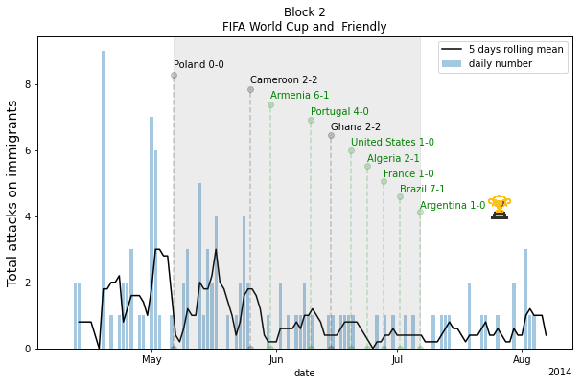
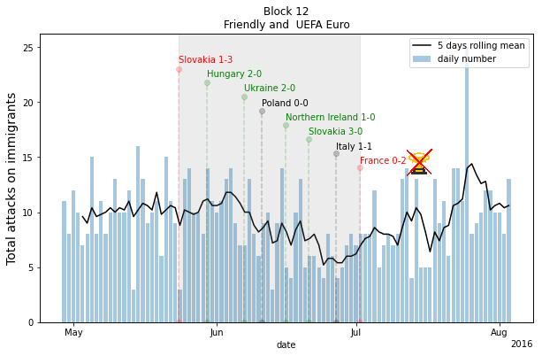
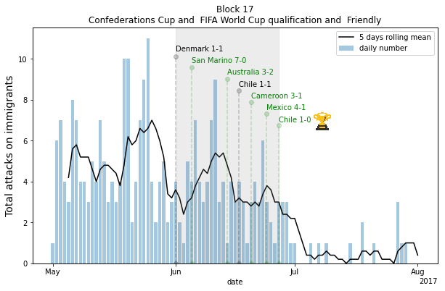
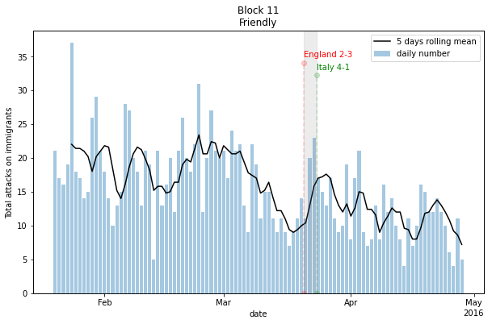
Longer term
We have only looked at the effects in the 2 days after the match. What about cumulative effect and more longer term effect ?
Figure 9
Nationalis moods, football and attacks against immigrants: evidence from Germany – University of Turin – SIE 2022
Gabriele Pinto
Sports Nationalism and xenophobia: when cheering turns into violence
Gabriele Pinto

Slide 26
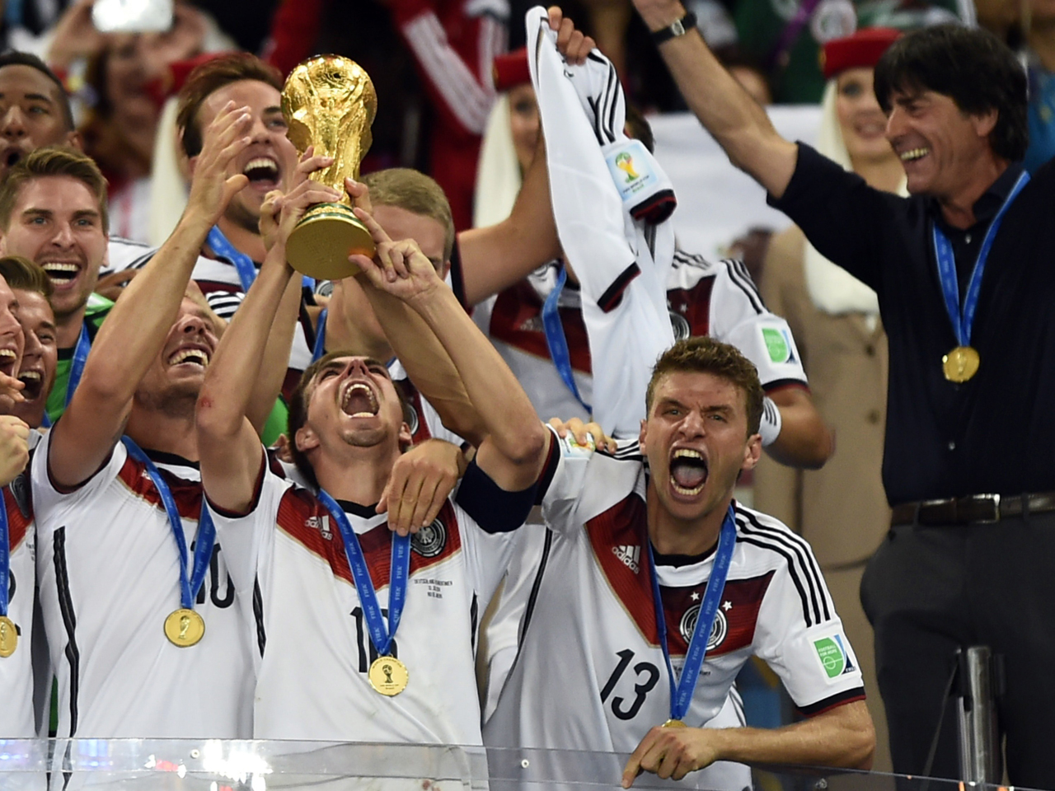
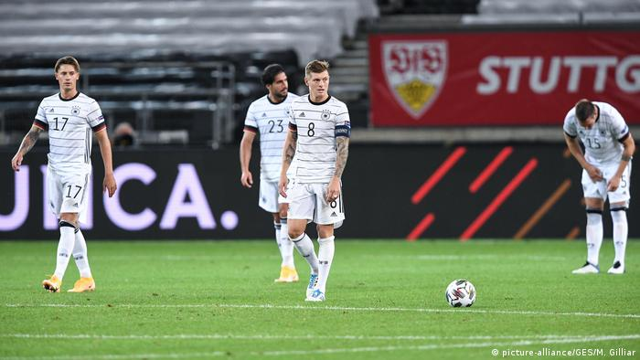
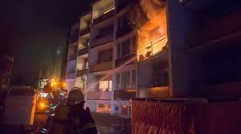
Empirical results
…In the days after a match of the German National team, if
Germany wins
Germany loose
Attacks on immigrants decreases
Attacks on immigrants increases
Nationalis moods, football and attacks against immigrants: evidence from Germany – University of Turin – SIE 2022
Gabriele Pinto
Sports Nationalism and xenophobia: when cheering turns into violence
Gabriele Pinto

Slide 27
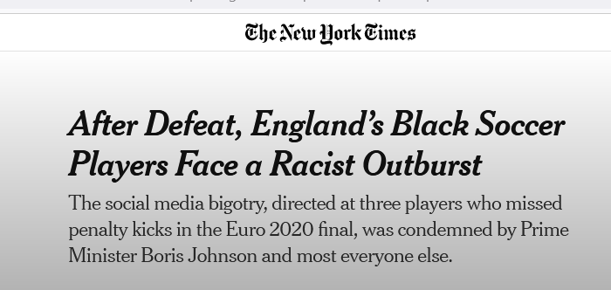
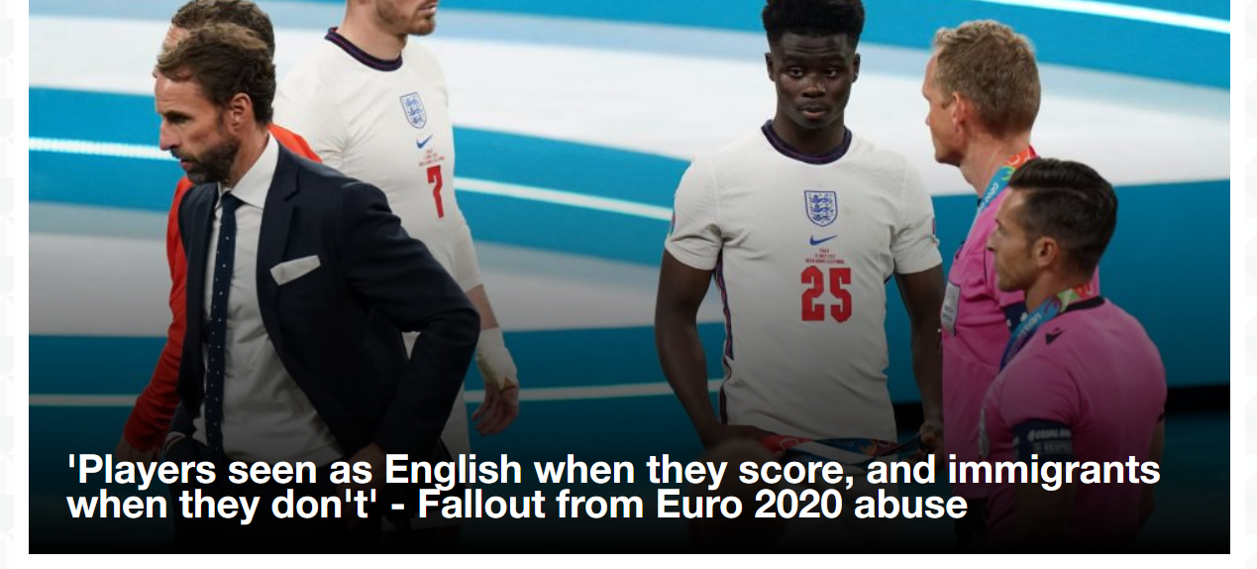
Gabriele Pinto
Sports Nationalism and xenophobia: when cheering turns into violence

Slide 28
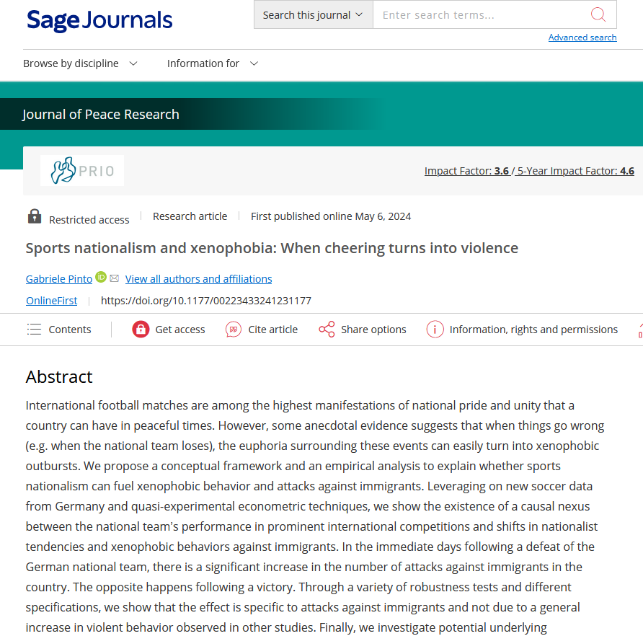
Pinto, G. (2024). Sports nationalism and xenophobia: When cheering turns into violence. Journal of Peace Research, 0(0). https://doi.org/10.1177/00223433241231177

Slide 29
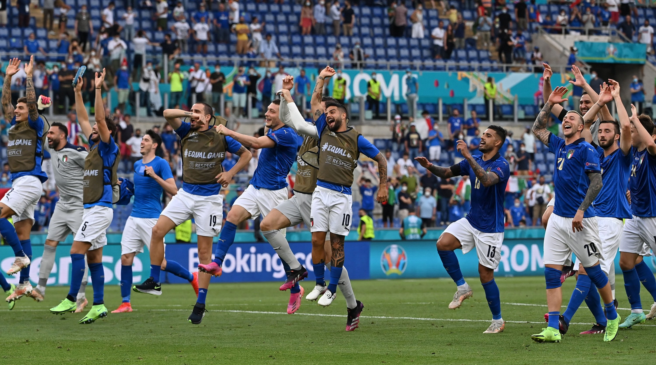
Conclusion
Thanks for your attention!
Banal Sports nationalism matters.
The impact of sports nationalism on anti-immigrant attitudes (and behaviors) depends on the result of matches.
Implications for the governance of these events and the narratives trough which those events are reported
Email: gabriele.pinto@uniroma1.it
Twitter: @gabrieleaopinto
Slides: www.gabrielepinto.com
Nationalis moods, football and attacks against immigrants: evidence from Germany – University of Turin – SIE 2022
Gabriele Pinto
Sports Nationalism and xenophobia: when cheering turns into violence
Gabriele Pinto

Slide 30
Effect on attitudes against immigrants
Is (country) made a worse or a better place to live by people coming to live here from other countries? Score from 0 (worse place to live) to 10 (better place to live)
Nationalis moods, football and attacks against immigrants: evidence from Germany – University of Turin – SIE 2022
Gabriele Pinto
Sports Nationalism and xenophobia: when cheering turns into violence
Gabriele Pinto

Slide 31
Effect on reported mood
Taking all things together, how happy would you say you are ? (on a scale from 0 to 10)
Nationalis moods, football and attacks against immigrants: evidence from Germany – University of Turin – SIE 2022
Gabriele Pinto
Sports Nationalism and xenophobia: when cheering turns into violence
Gabriele Pinto

