Slide 1
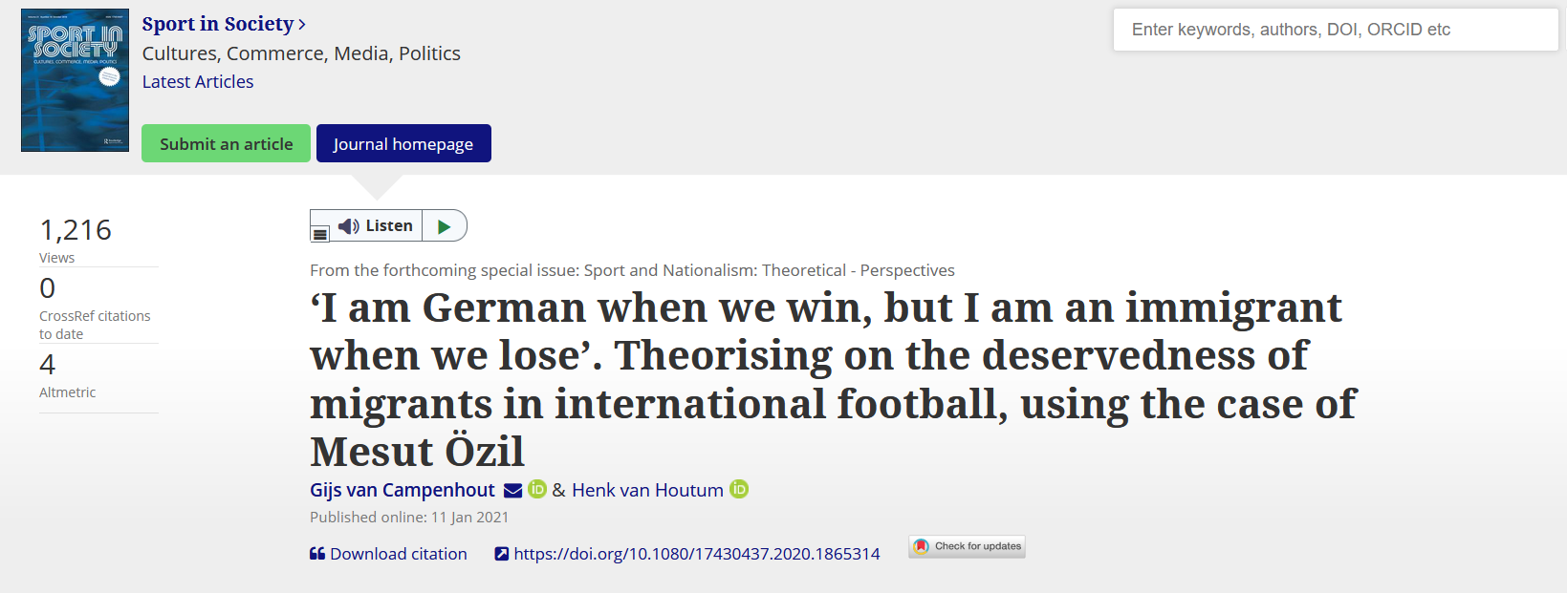
Gabriele Pinto
Nationalis moods, football and attacks against immigrants: evidence from Germany – University of Turin – SIE 2022

Slide 2
Nationalist moods, football, and attacks against immigrants: evidence from Germany
Gabriele Pinto, PhD student Sapienza University of Rome Department of Social Sciences and Economics
Turin, Italy, 21 October 2022, University of Turin
Riunione Scientifica Annuale Società Italiana dell’Economia

Slide 3
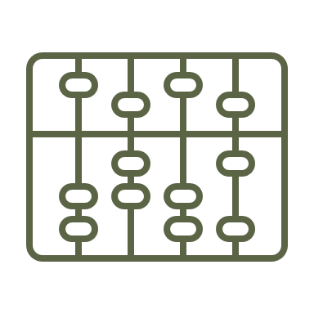
The Contribution
A conceptual framework to understand the relationship between nationalism and attitude against immigrants
An empirical evidence of the relationship between sports nationalism and attacks against immigrants
nationalism
Anti-immigrant attitudes
Hate crimes
Gabriele Pinto
Nationalis moods, football and attacks against immigrants: evidence from Germany – University of Turin – SIE 2022

Slide 4
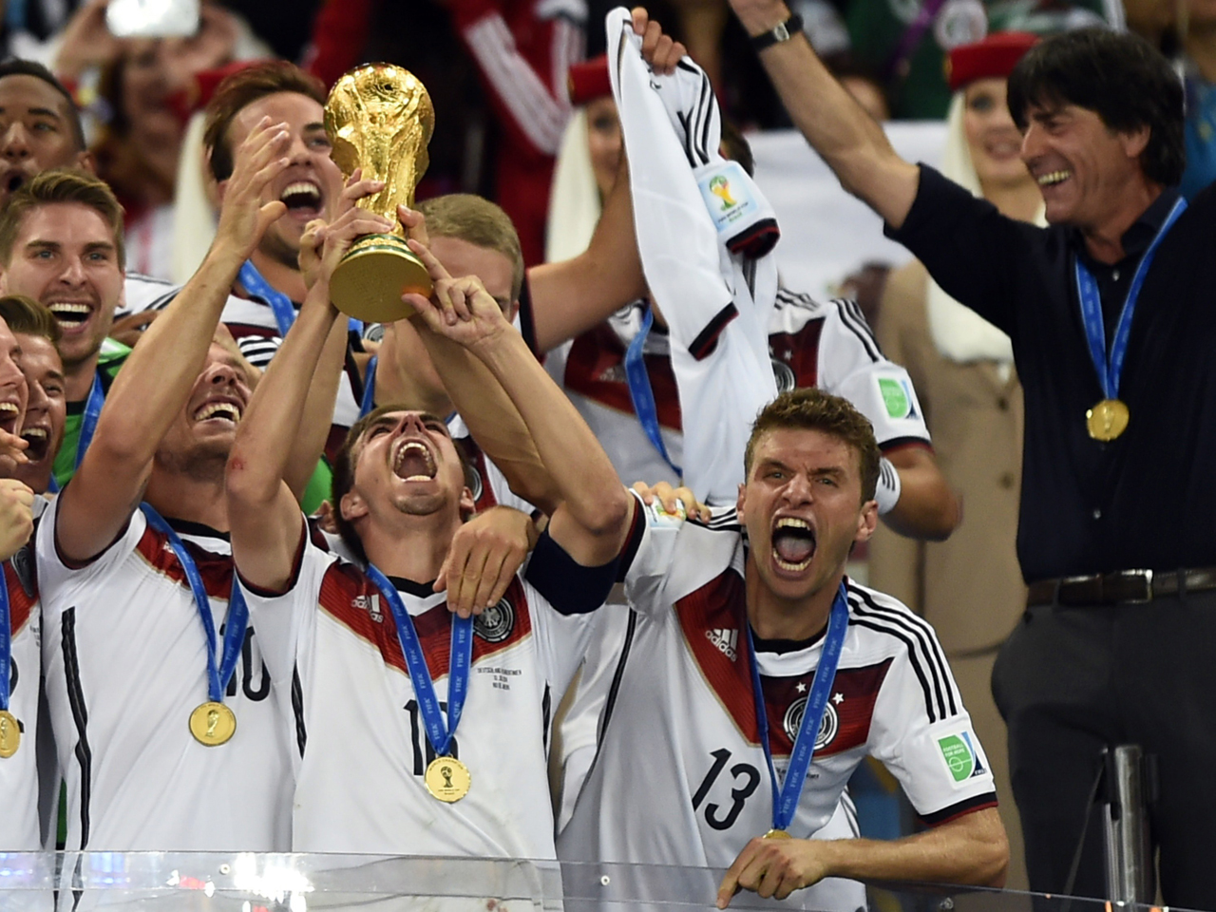
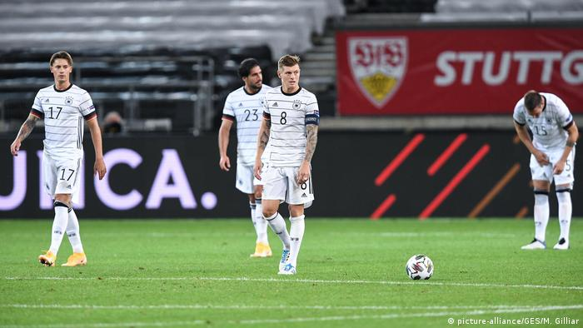
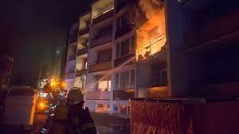
Empirical results
…In the days after a match of the German National team, if
Germany wins
Germany loose
Attacks on immigrants decreases
Attacks on immigrants increases
Gabriele Pinto
Nationalis moods, football and attacks against immigrants: evidence from Germany – University of Turin – SIE 2022

Slide 5
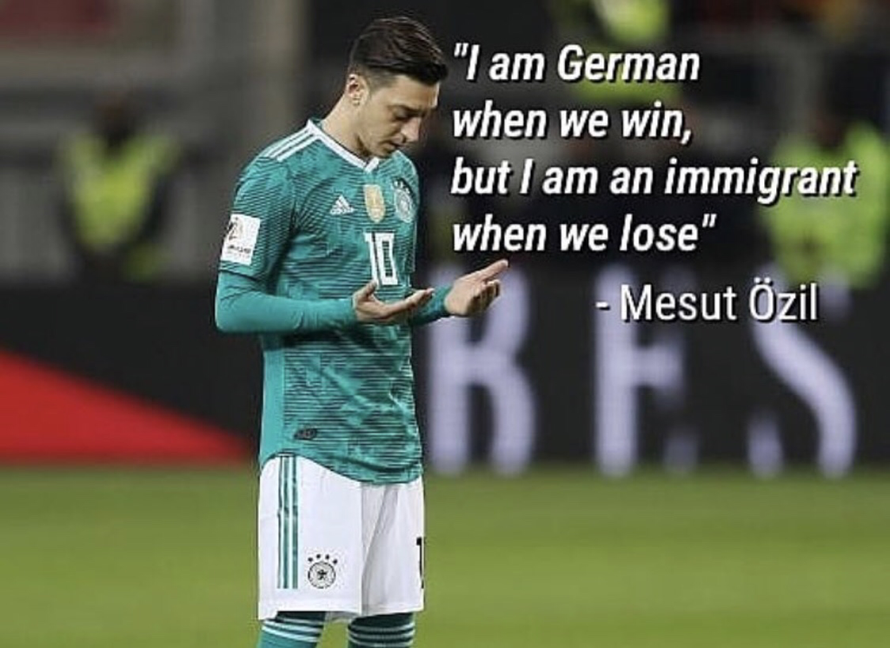
Gabriele Pinto
Nationalis moods, football and attacks against immigrants: evidence from Germany – University of Turin – SIE 2022

Slide 6
Conceptual Framework
nationalism
Anti-immigrant attitudes
Hate crimes
Gabriele Pinto
Nationalis moods, football and attacks against immigrants: evidence from Germany – University of Turin – SIE 2022

Slide 7
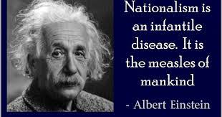
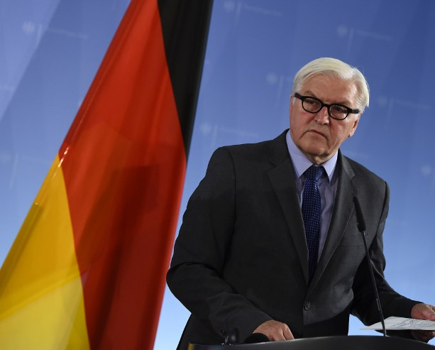
Nationalism has a bad reputation…
Nationalism is an ideological poison. F.W.Steinmeier (President of Germany)
…the big problems of nationalism is that it fuels discrimination, xenophobia, conflicts and even wars!
Gabriele Pinto
Nationalis moods, football and attacks against immigrants: evidence from Germany – University of Turin – SIE 2022

Slide 8
why we still have nationalism?
…We need something to feel “we are all in this together”
(Derbyshire 2019, Financial times)
…In the end “we are all nationalist today” (Wimmer 2019, Foreign Affairs)
And …“we cannot defeat nationalism”
(Walt 2019, Foreign Policy)
Gabriele Pinto
Nationalis moods, football and attacks against immigrants: evidence from Germany – University of Turin – SIE 2022

Slide 9
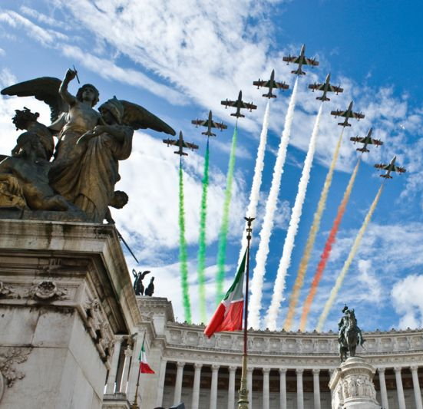
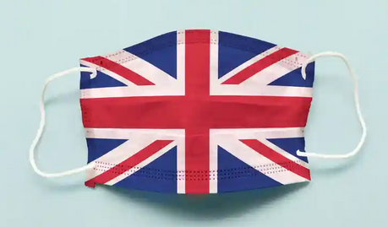
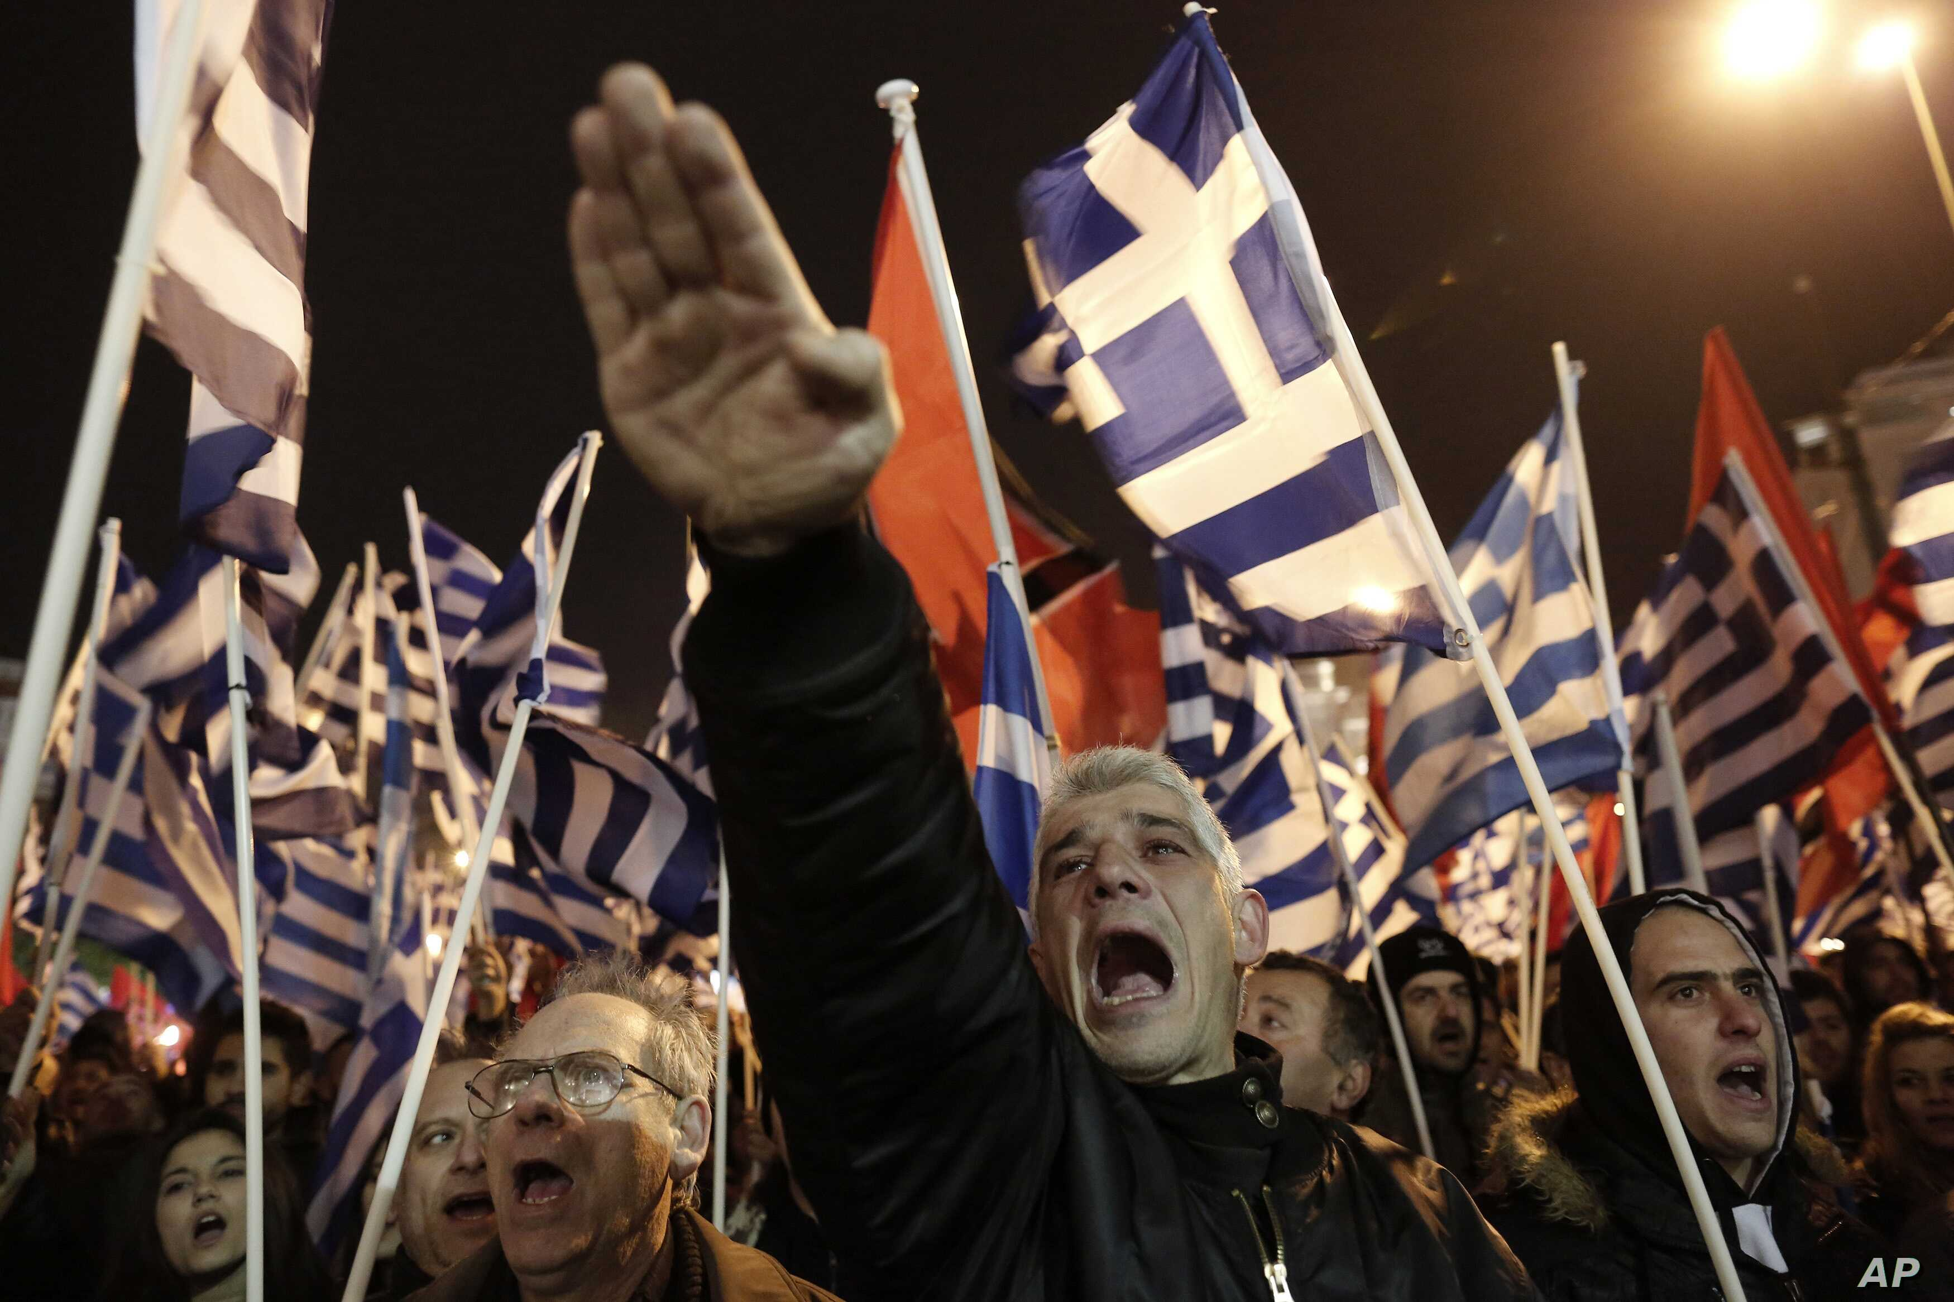
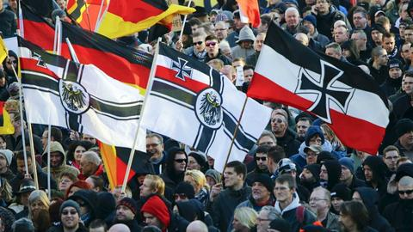
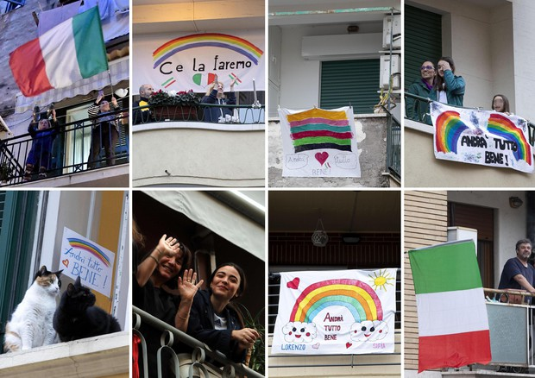
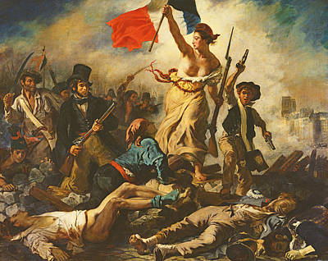
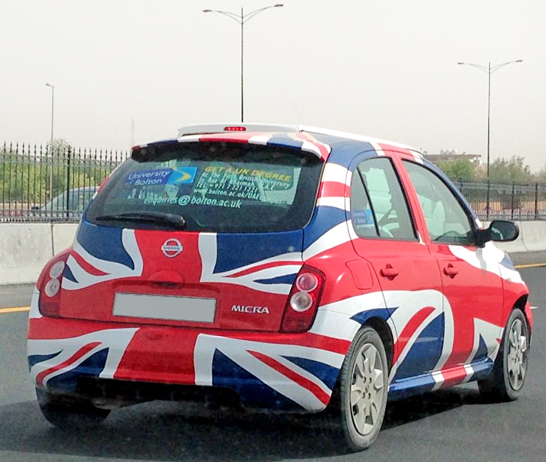
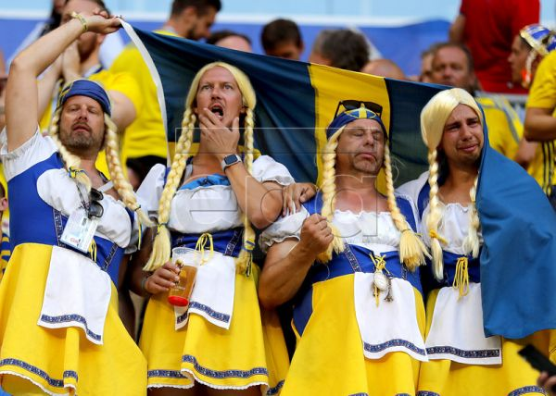
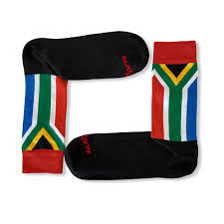
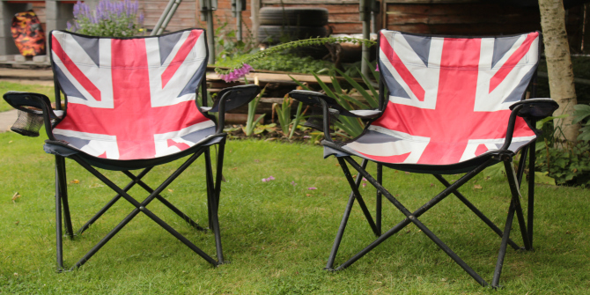
Conventional explanation: there are different types of nationalism
Healthy Nationalism
(Patriotic, Constitutional, etc…)
Morbid Nationalism
(Ethnic, Defensive, etc..)
Banal Nationalism
Gabriele Pinto
Nationalis moods, football and attacks against immigrants: evidence from Germany – University of Turin – SIE 2022

Slide 10
But… sports nationalism is a “serious”thing
“…It seems that soccer tournaments create those relationships: people gathered together in pubs and living rooms, a whole country suddenly caring about the same event. A World Cup is the sort of common project that otherwise barely exists in modern societies…” Simon Kuper
Gabriele Pinto
Nationalis moods, football and attacks against immigrants: evidence from Germany – University of Turin – SIE 2022

Slide 11
Sport Nationalism
…decreases ethnic identification and violence within African countries
(Depetris-Chauvin et al. 2020; AER)
…increases aggression between countries
(Bertoli 2017; ISQ)
Increase inter-group frictions
Decrease intra-group frictions…but…
TAKEAWAY
sports nationalism might boost national unity at the cost of animosity towards foreigners
Puzzle: what about immigrants ? Are they considered part of the “group” or not ?...depends on the type of nationalism (Heinrich 2018)
Gabriele Pinto
Nationalis moods, football and attacks against immigrants: evidence from Germany – University of Turin – SIE 2022

Slide 12
Conceptual framework
Nationalism
Attitude against immigrants
Attacks against immigrants
Healthy Patriotic nationalism
positive
decreases
?
Sports
Morbid, Ethnic nationalism
negative
increases
Gabriele Pinto
Nationalis moods, football and attacks against immigrants: evidence from Germany – University of Turin – SIE 2022

Slide 13
Conceptual framework
Nationalism
Attitude against immigrants
Attacks against immigrants
Healthy Patriotic nationalism
positive
decreases
?
Sports
Morbid, Ethnic nationalism
negative
increases
Gabriele Pinto
Nationalis moods, football and attacks against immigrants: evidence from Germany – University of Turin – SIE 2022

Slide 14
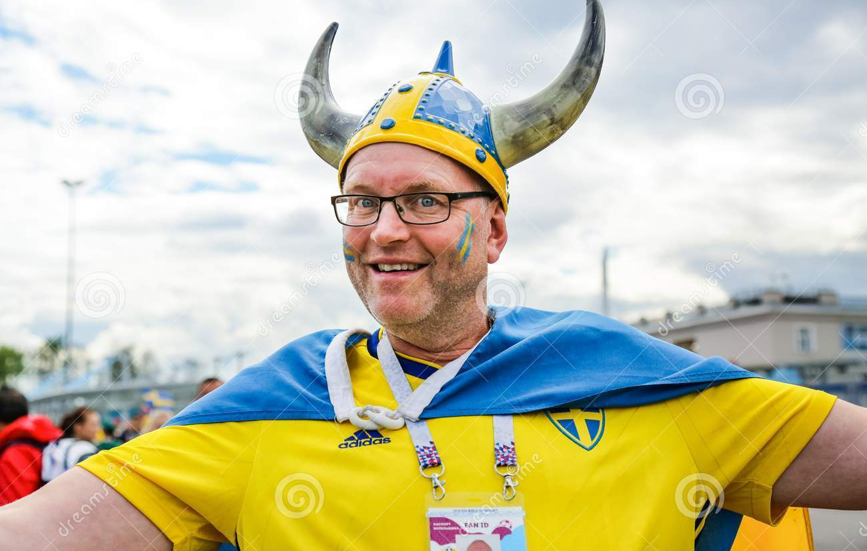
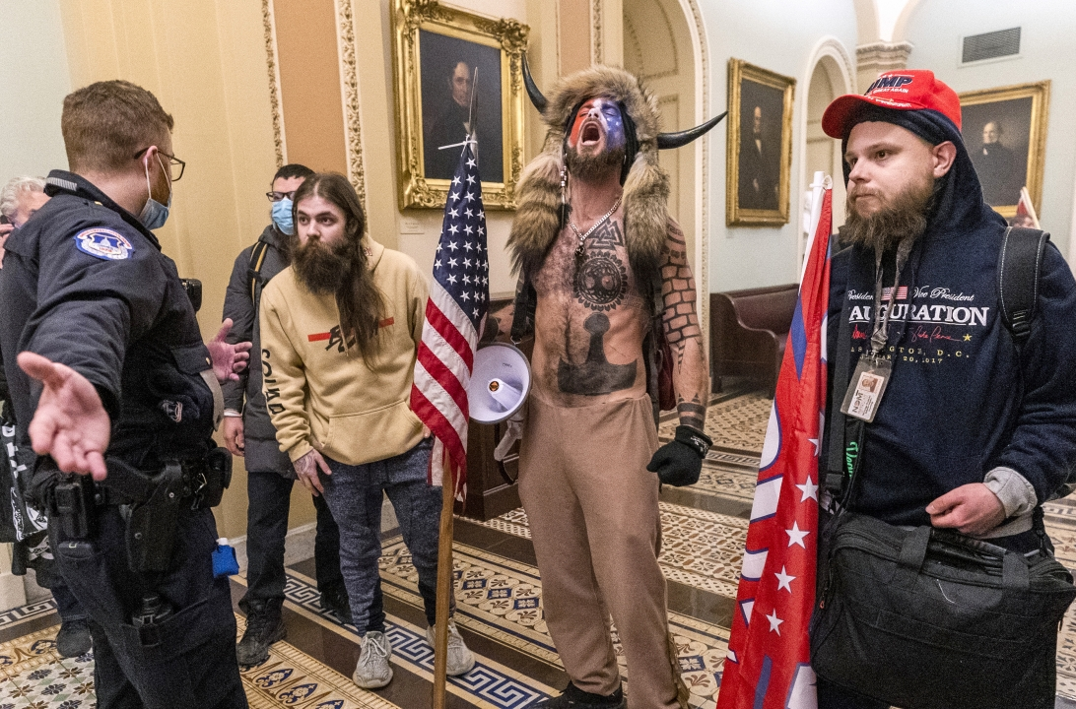
Argument 1: is there a difference?
Healthy and Morbid Nationalisms are brothers rather than distant cousins
(Wimmer 2019, Foreign Affairs)
Gabriele Pinto
Nationalis moods, football and attacks against immigrants: evidence from Germany – University of Turin – SIE 2022

Slide 15
Argument 2: mood component of nationalism
Happy mood enhances satisfaction with national issues (Schwarz and al. 1987)
“Feel-good” factor (Kavetsos 2011, Kavetsos and Szymanski 2012, Hallman et al. 2013, Stieger et al. 2015, Heere 2016, Meier 2018)
Anger enhances stereotyping and discrimination (Fiske 1998)
Fear, Anger and voting for the far-right and attitude against immigrants (Mc Dermott 2016, Vasilopoulous 2018)
Mood states affects attitude against immigrants and xenophobia (
Gabriele Pinto
Nationalis moods, football and attacks against immigrants: evidence from Germany – University of Turin – SIE 2022

Slide 16
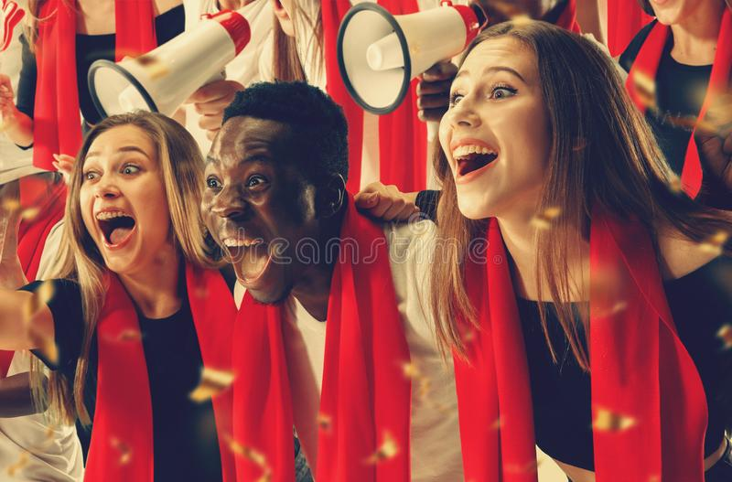
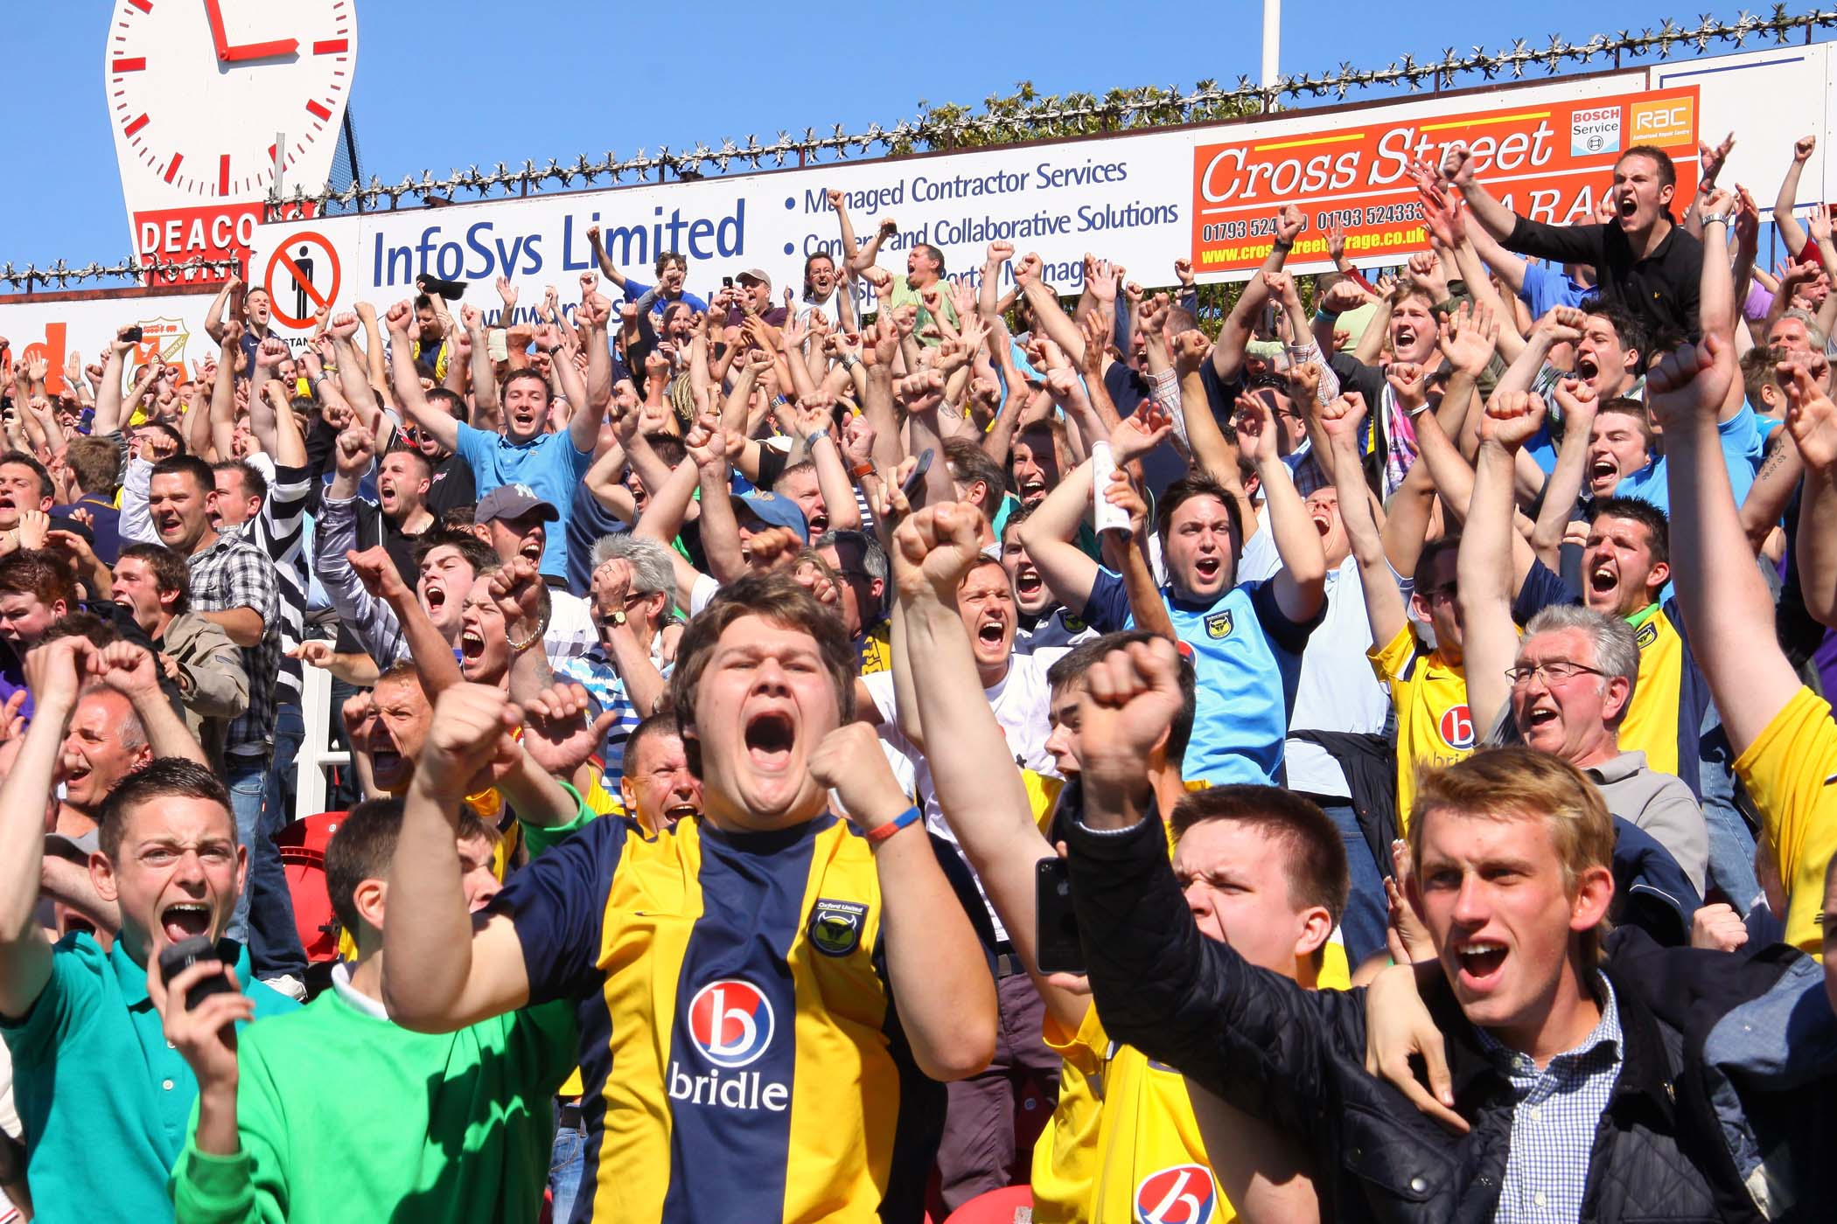
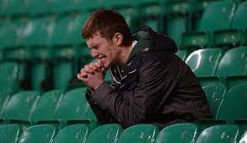
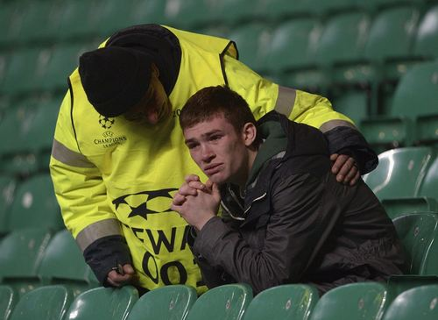
Argument 3: mood component of sports
Sport events can affect mood (positively and negatively) and individual behaviors
The impact of sports on mood has been showed to affect electoral behaviors, stock prices, domestic violence (among others). ((Joiner 2006, Edmans 2007, Card and Dahl 2011, Healy et al 2010, Fowler and Montagnes 2015, Busby et al. 2017, Potosky and Urbatsch 2016)
Gabriele Pinto
Nationalis moods, football and attacks against immigrants: evidence from Germany – University of Turin – SIE 2022

Slide 17
Conceptual framework
Nationalism
Attitude against immigrants
Attacks against immigrants
Healthy Patriotic nationalism
positive
decreases
?
Sports
Morbid, Ethnic nationalism
negative
increases
Gabriele Pinto
Nationalis moods, football and attacks against immigrants: evidence from Germany – University of Turin – SIE 2022

Slide 18
Conceptual framework
Interaction between mood and ideologies
Sports
Mood
Nationalism
Attitude against immigrants
Attacks against immigrants
Healty Patriotic nationalism
Win
Positive
Patriotic, Inclusive, unitarian nationalist mood
positive
decreases
Loose
Identitarian, Exclusive, Nationalist mood
negative
Morbid, Ethnic nationalism
negative
increases
Gabriele Pinto
Nationalis moods, football and attacks against immigrants: evidence from Germany – University of Turin – SIE 2022

Slide 19
Empirical Application
Gabriele Pinto
Nationalis moods, football and attacks against immigrants: evidence from Germany – University of Turin – SIE 2022

Slide 20
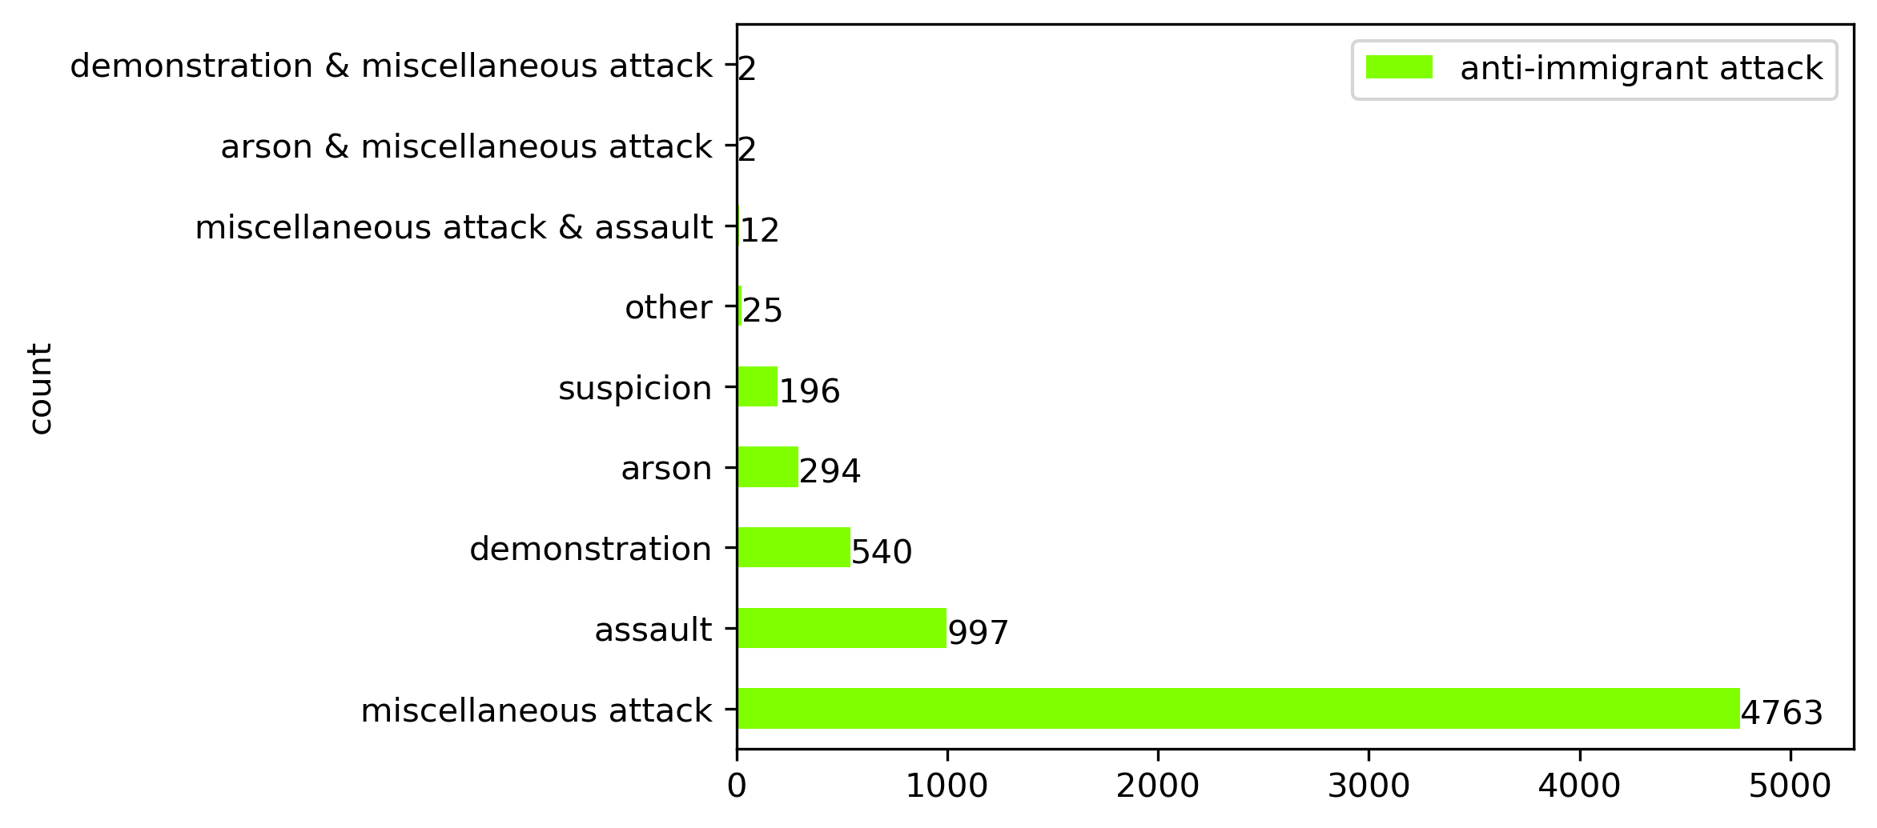
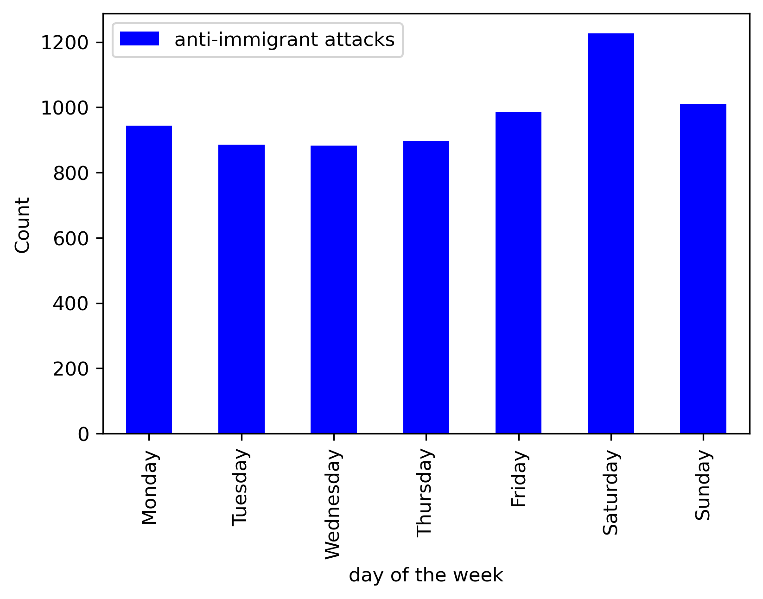
Data
Benček, D., & Strasheim, J. (2016). Refugees welcome? A dataset on anti-refugee violence in Germany. Research & Politics, 3(4), 2053168016679590.
Arvig Dataset
Calendar effects
outliers
Gabriele Pinto
Nationalis moods, football and attacks against immigrants: evidence from Germany – University of Turin – SIE 2022

Slide 21
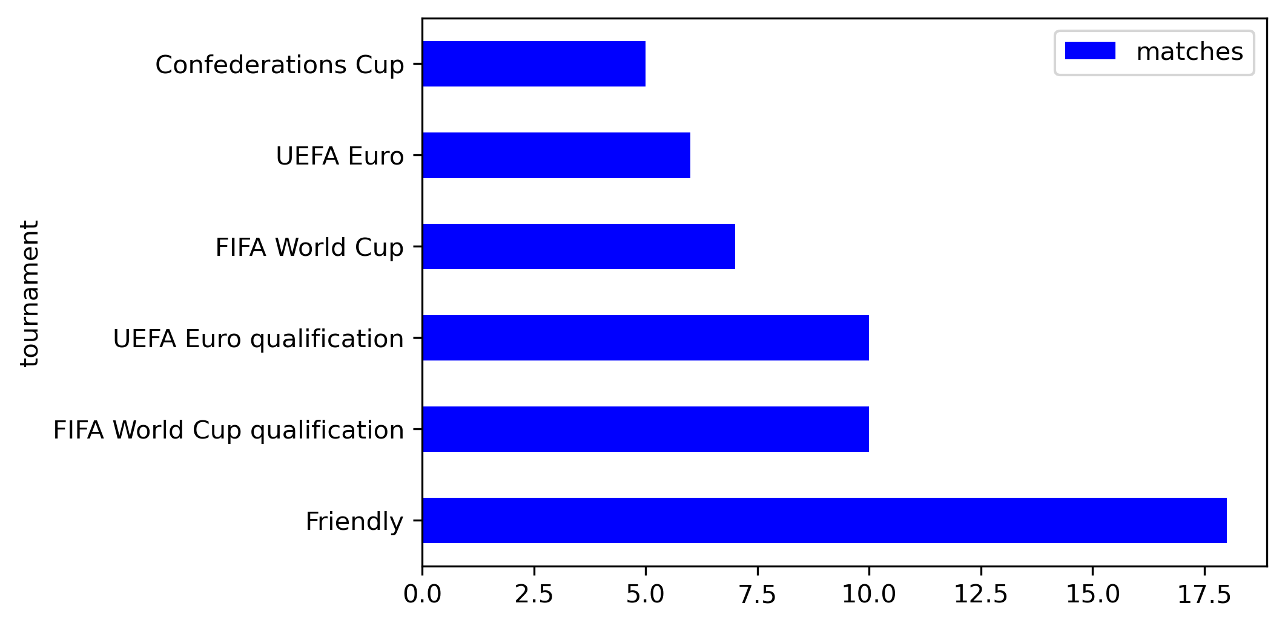
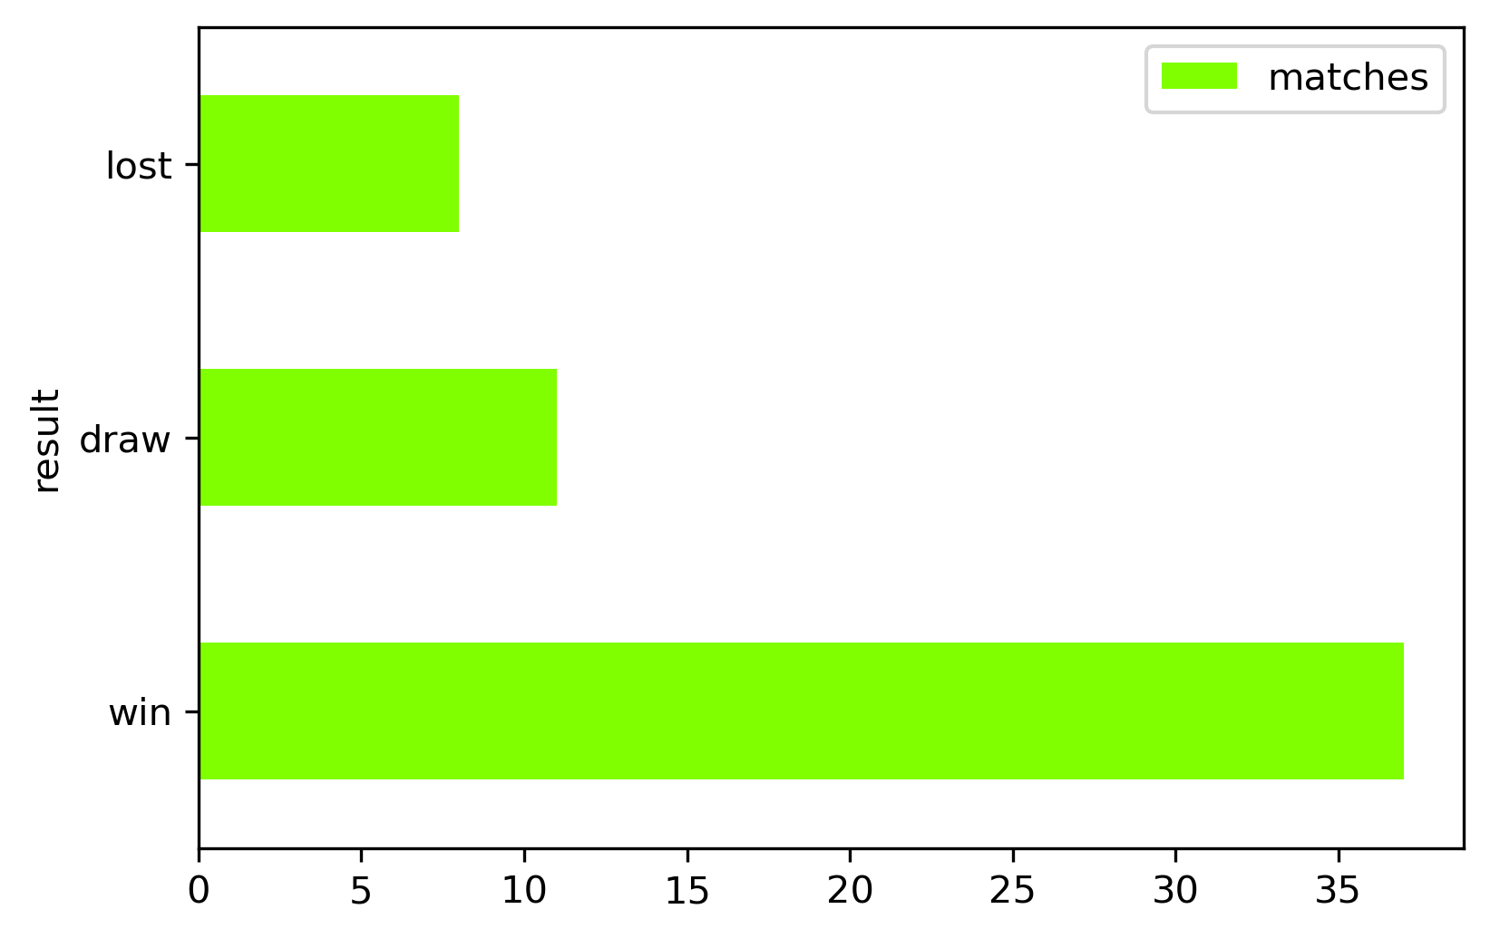
Data
Figure 2: Germany National team Soccer matches
Gabriele Pinto
Nationalis moods, football and attacks against immigrants: evidence from Germany – University of Turin – SIE 2022

Slide 22
Empirical Strategy
A Poisson count model (with all days in the sample)
An Event-Study Analysis (only looking at days closest to the match)
Gabriele Pinto
Nationalis moods, football and attacks against immigrants: evidence from Germany – University of Turin – SIE 2022

Slide 23
Count model
Attacks | Date | Match | Post Match | Post win | Post loss
5 | 11 oct | - | 0 | 0 | 0
8 | 12 oct | - | 0 | 0 | 0
15 | 13 oct | Germany vs Finland 2-0 | 0 | 0 | 0
12 | 14 oct | - | 1 | 1 | 0
8 | 15 oct | - | 1 | 1 | 0
4 | 16 oct | - | 0 | 0 | 0
10 | 17 oct | - | 0 | 0 | 0
Attacks | Date | Match | Post Match | Post win | Post loss
5 | 11 oct | - | 0 | 0 | 0
8 | 12 oct | - | 0 | 0 | 0
15 | 13 oct | Germany vs Finland 1-2 | 0 | 0 | 0
12 | 14 oct | - | 1 | 0 | 1
8 | 15 oct | - | 1 | 0 | 1
4 | 16 oct | - | 0 | 0 | 0
10 | 17 oct | - | 0 | 0 | 0
Attacks | Date | Match | Post Match | Post win | Post loss
5 | 11 oct | - | 0 | 0 | 0
8 | 12 oct | - | 0 | 0 | 0
15 | 13 oct | - | 0 | 0 | 0
12 | 14 oct | - | 0 | 0 | 0
8 | 15 oct | - | 0 | 0 | 0
4 | 16 oct | - | 0 | 0 | 0
10 | 17 oct | - | 0 | 0 | 0
Exogeneity assumption lies on random assignment of the date of the match
+ day of the week, month, year fixed effects (because matches take place mostly on Sundays)
2 days window
Gabriele Pinto
Nationalis moods, football and attacks against immigrants: evidence from Germany – University of Turin – SIE 2022

Slide 24
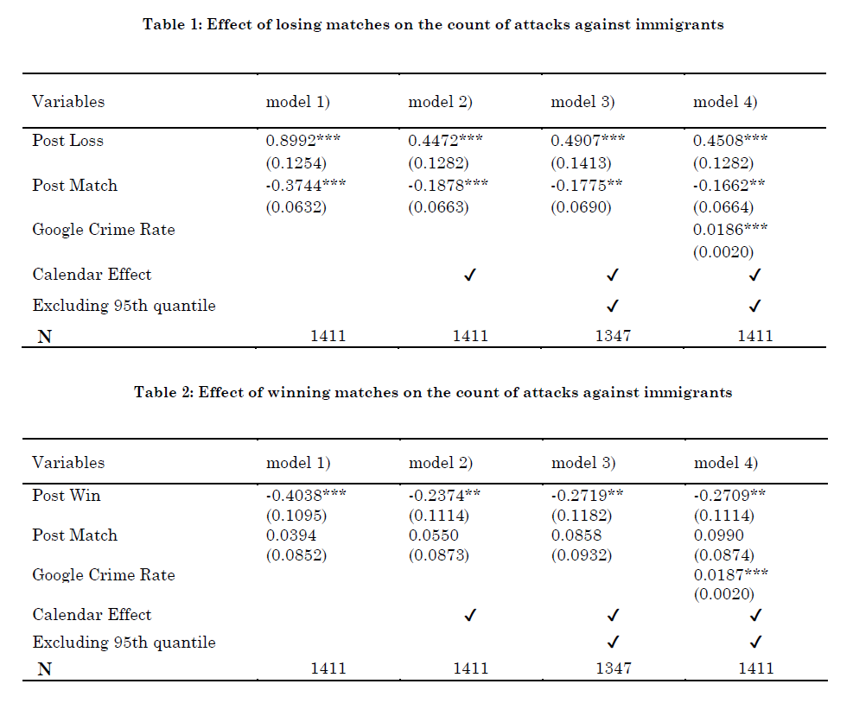
Baseline Results
Translating the coefficient (diff in log expected counts) shows that when Germany loose we expect an average of 7-8 attacks (compared to a mean of 4,8).
Gabriele Pinto
Nationalis moods, football and attacks against immigrants: evidence from Germany – University of Turin – SIE 2022

Slide 25
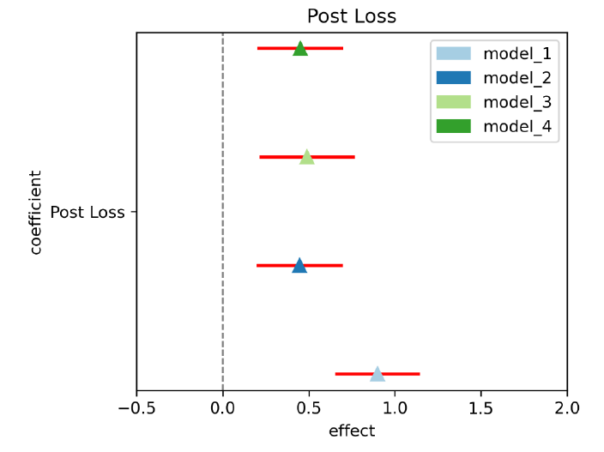
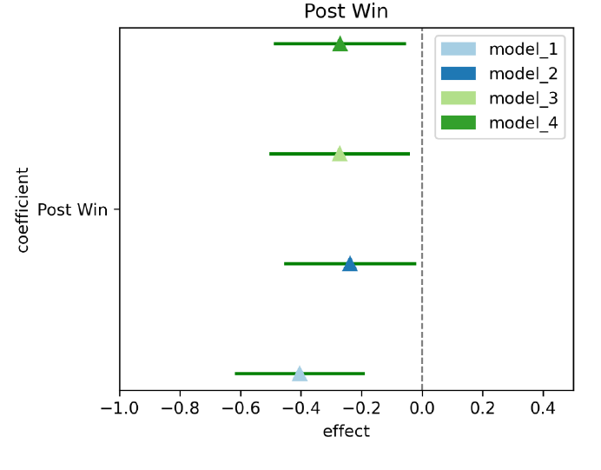
Coefficient Plots
Gabriele Pinto
Nationalis moods, football and attacks against immigrants: evidence from Germany – University of Turin – SIE 2022

Slide 26
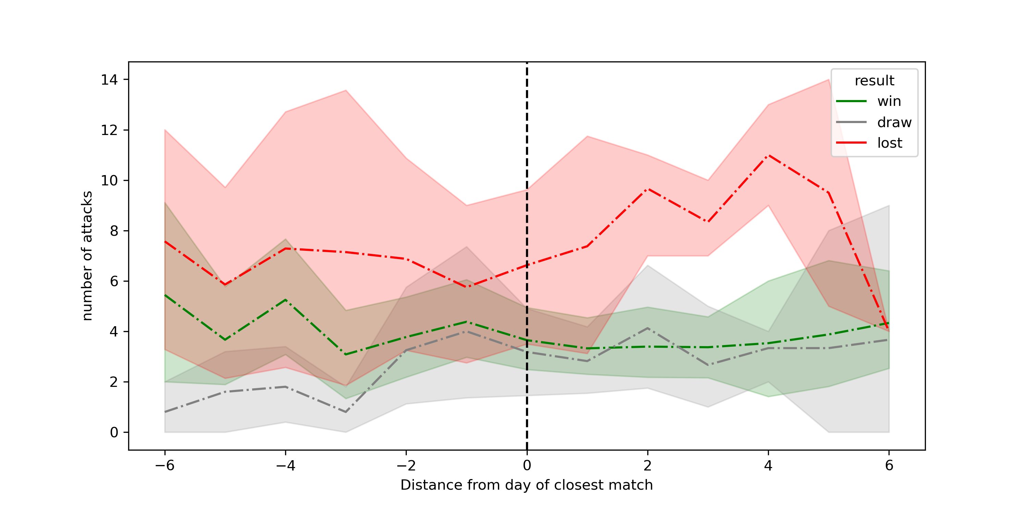
Event-Study Analysis
Gabriele Pinto
Nationalis moods, football and attacks against immigrants: evidence from Germany – University of Turin – SIE 2022

Slide 27
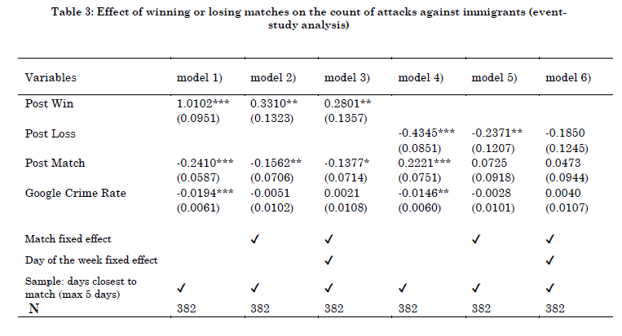
Event-Study Analysis
Gabriele Pinto
Nationalis moods, football and attacks against immigrants: evidence from Germany – University of Turin – SIE 2022

Slide 28
Robustness and Mechanisms
Excluding demonstration
Alchool consumption and controlling for other crimes
City of attacks
Gabriele Pinto
Nationalis moods, football and attacks against immigrants: evidence from Germany – University of Turin – SIE 2022

Slide 29
Mechanisms
nationalism
Anti-immigrant attitudes
Hate crimes
Gabriele Pinto
Nationalis moods, football and attacks against immigrants: evidence from Germany – University of Turin – SIE 2022

Slide 30
Relationship between Nationalism and Immigrants
Sports
Mood
Nationalism
Attitude against immigrants
Attacks against immigrants
Win
Positive
Patriotic, Inclusive, unitarian nationalist mood
positive
decreases
Loose
Identitarian, Exclusive, Nationalist mood
negative
negative
increases
Gabriele Pinto
Nationalis moods, football and attacks against immigrants: evidence from Germany – University of Turin – SIE 2022

Slide 31
Mechanisms
European Social Survey
Attitude against immigrants
Is (country) made a worse or a better place to live by people coming to live here from other countries? Score from 0 (worse place to live) to 10 (better place to live)
2. Mood
Taking all things together, how happy would you say you are ? (on a scale from 0 to 10)
We compare answers of different respondents before and after matches of their national team.
as in De Petris et al. 2020 - AER
Gabriele Pinto
Nationalis moods, football and attacks against immigrants: evidence from Germany – University of Turin – SIE 2022

Slide 32
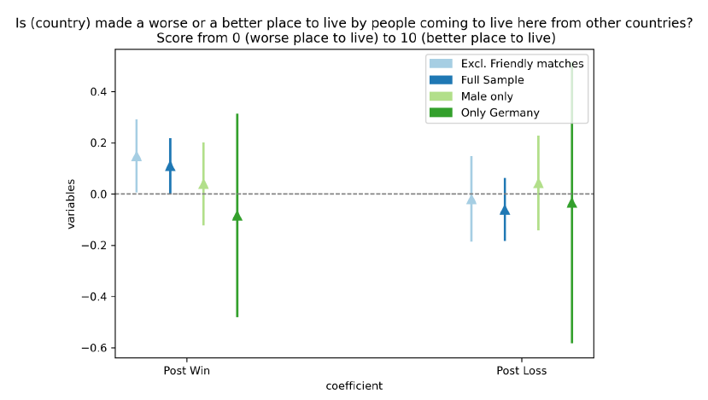
Effect on attitudes 1
Gabriele Pinto
Nationalis moods, football and attacks against immigrants: evidence from Germany – University of Turin – SIE 2022

Slide 33
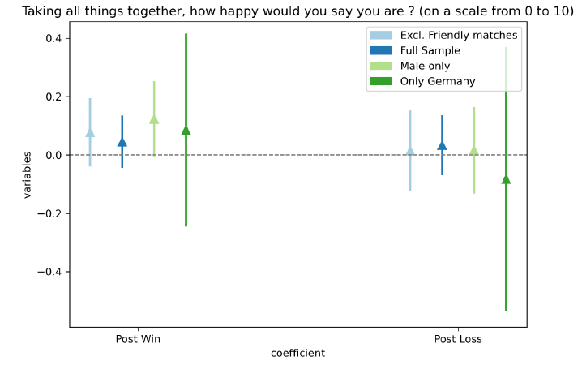
Effect on attitudes 2
But… statistical issues (small sample)
Gabriele Pinto
Nationalis moods, football and attacks against immigrants: evidence from Germany – University of Turin – SIE 2022

Slide 34
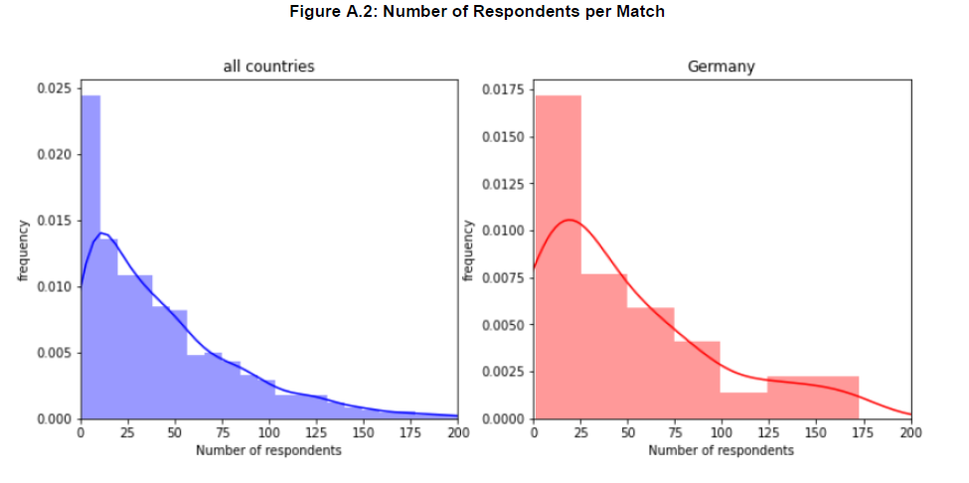
Distribution of the ESS sample
Gabriele Pinto
Nationalis moods, football and attacks against immigrants: evidence from Germany – University of Turin – SIE 2022

Slide 35
Limitations
Very difficult to model “persistence” over time (spill-over from one match to another, cumulative “euphoria”…etc).
Using lags might helps – but does not solve the problem
Our coefficients might be biased by assuming an erroneous functional form – not clear in which direction
No economics in this paper, no demand, no supply. Is there any econ interpretation ?
Short term
Gabriele Pinto
Nationalis moods, football and attacks against immigrants: evidence from Germany – University of Turin – SIE 2022

Slide 36
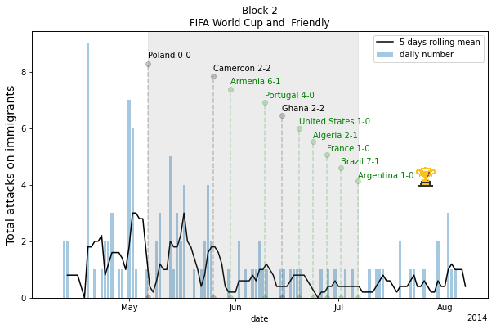
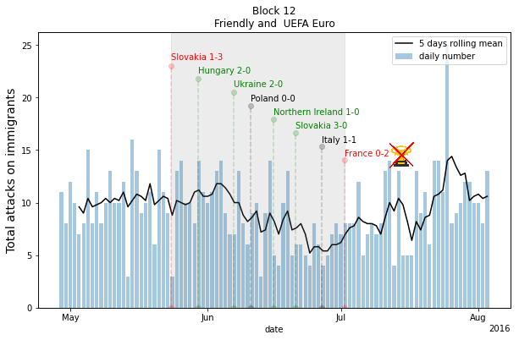
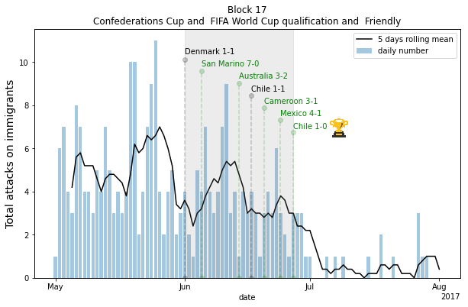
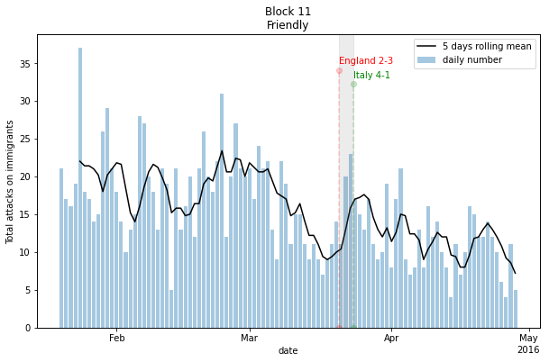
Longer term
We have only looked at the effects in the 2 days after the match. What about cumulative effect and more longer term effect ?
Figure 9
Gabriele Pinto
Nationalis moods, football and attacks against immigrants: evidence from Germany – University of Turin – SIE 2022

Slide 37
But…
Does the overall reasoning make sense? We have some anecdotal evidence from the last European Cup
Gabriele Pinto
Nationalis moods, football and attacks against immigrants: evidence from Germany – University of Turin – SIE 2022

Slide 38
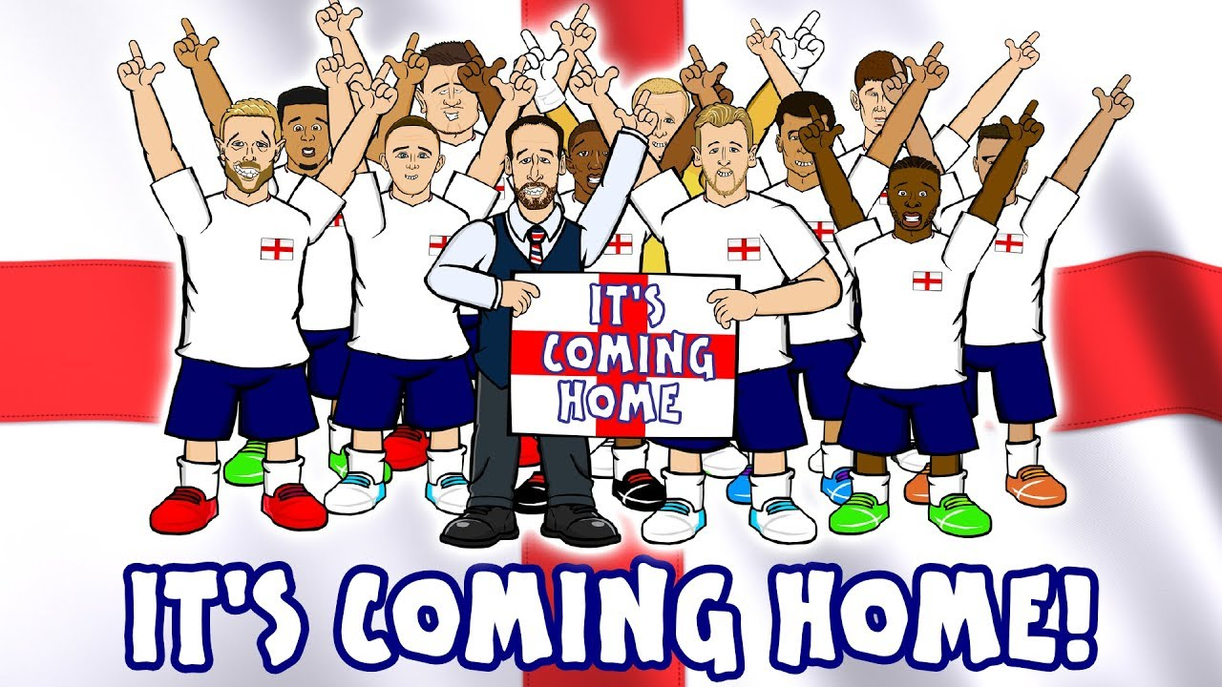
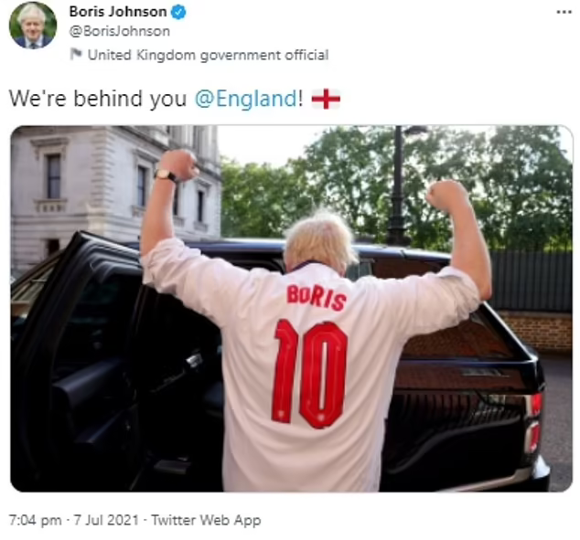
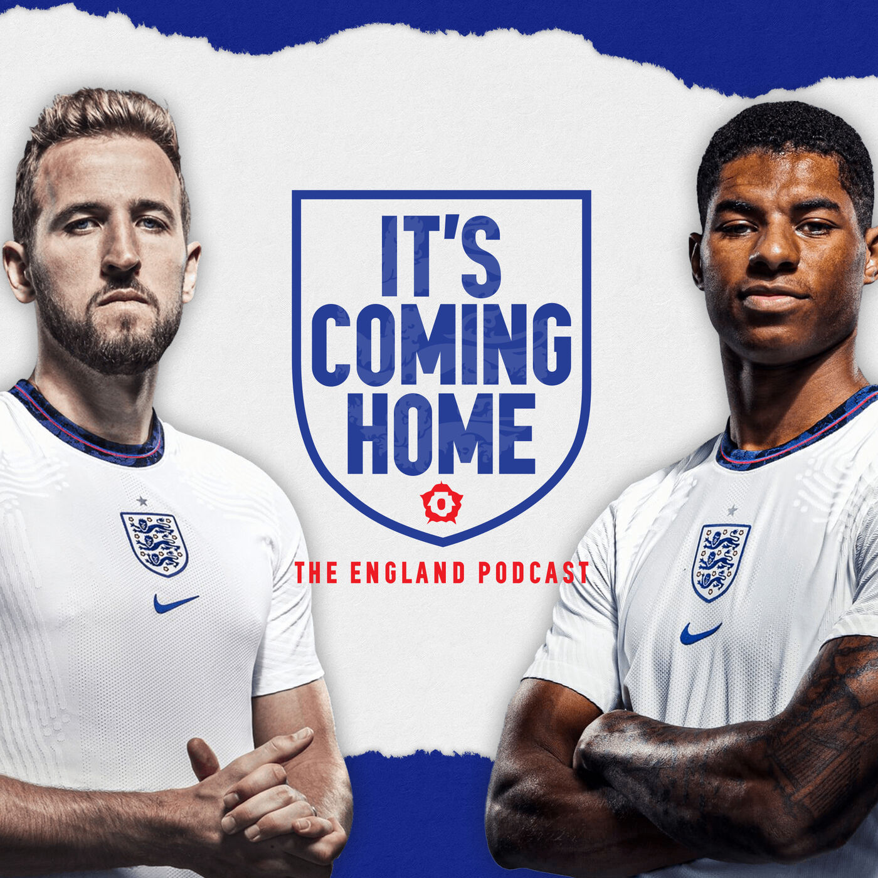
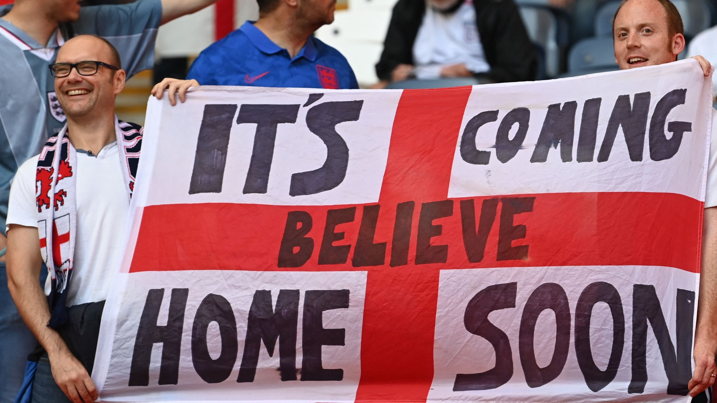
England: EURO 2021
Gabriele Pinto
Nationalis moods, football and attacks against immigrants: evidence from Germany – University of Turin – SIE 2022

Slide 39
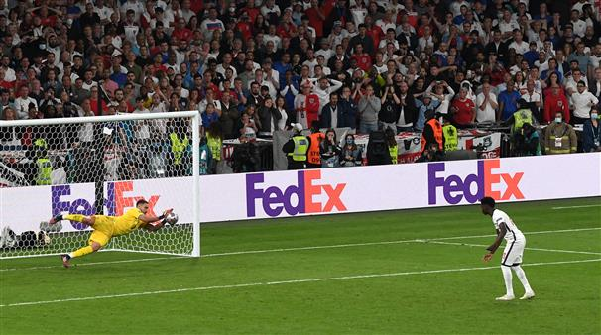
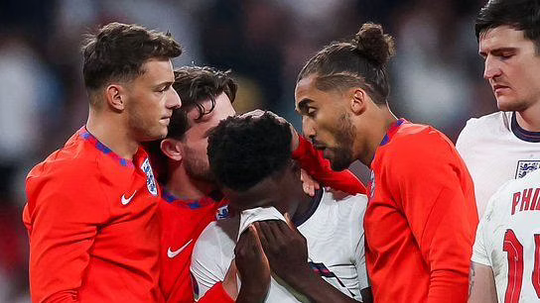
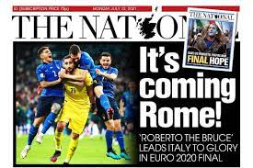
England: EURO 2021
Gabriele Pinto
Nationalis moods, football and attacks against immigrants: evidence from Germany – University of Turin – SIE 2022

Slide 40
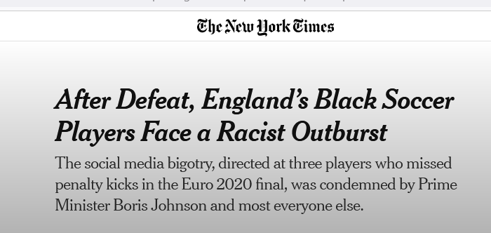
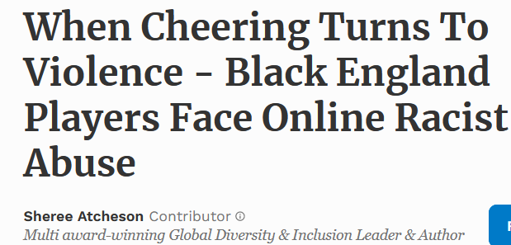
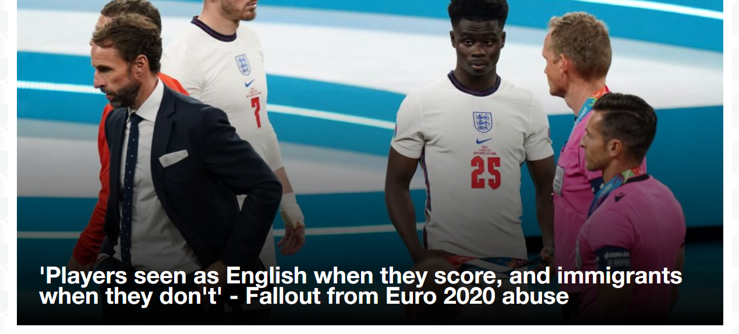
Gabriele Pinto
Nationalis moods, football and attacks against immigrants: evidence from Germany – University of Turin – SIE 2022

Slide 41
Conclusion
Thanks for your attention!
Feedbacks are very much appreciated
Banal Sports nationalism matters.
The impact of sports nationalism on anti-immigrant attitudes (and behaviors) depends on the result of matches..
Nationalism and xenophobia are not thought of as stemming from unadulterated ideology, but rather from a multi-dimensional construct of attitude, behaviors, and mood states
Email: gabriele.pinto@uniroma1.it
Twitter: @gabrieleaopinto
Slides: www.gabrielepinto.com
Gabriele Pinto
Nationalis moods, football and attacks against immigrants: evidence from Germany – University of Turin – SIE 2022

Slide 42
Thanks for your attention!
Feedbacks are very much appreciated
Gabriele Pinto
Email: gabriele.pinto@uniroma1.it
Twitter: @gabrieleaopinto
Slides: www.gabrielepinto.com
Gabriele Pinto
Nationalis moods, football and attacks against immigrants: evidence from Germany – University of Turin – SIE 2022

Slide 43
Robustness and Mechanisms
Excluding demonstration
Alchool consumption and controlling for other crimes
City of attacks
Gabriele Pinto
Nationalis moods, football and attacks against immigrants: evidence from Germany – University of Turin – SIE 2022

Slide 44
Excluding Demonstration
Gabriele Pinto
Nationalis moods, football and attacks against immigrants: evidence from Germany – University of Turin – SIE 2022

Slide 45
Baseline results: excluding demonstration
Gabriele Pinto
Nationalis moods, football and attacks against immigrants: evidence from Germany – University of Turin – SIE 2022

Slide 46
Baseline results: excluding demonstration
No effect!
Gabriele Pinto
Nationalis moods, football and attacks against immigrants: evidence from Germany – University of Turin – SIE 2022

Slide 47
Controlling for other crimes and alcohol consumption
Gabriele Pinto
Nationalis moods, football and attacks against immigrants: evidence from Germany – University of Turin – SIE 2022

Slide 48
Controlling for other crimes
Alcohol consumption is the interviewing variable that links football matches to violent crime rise (Ivandić et al., 2021; Kirby et al., 2014; Trendl et al., 2021)
Nationalism
Sports
Anger
attitudes
Violence
Mood
Testosterone
Slight differences in our framework. They look at few hours after the match, we look at days after the match (can alcohol effect persists in the days after?).
A TEST: is there a general increase in crime against immigrants compared to other crimes (e.g. other types of violence?)
but, we do not have data on daily crimes in Germany. We try to use a proxy: the daily google trend index of “polizei”.
Validation of the Proxy on a yearly scale
Gabriele Pinto
Nationalis moods, football and attacks against immigrants: evidence from Germany – University of Turin – SIE 2022

Slide 49
Controlling for other crimes
Official statistics on crime (Federal ministry of interior)
Google Trend index for the word “Polizei”
Gabriele Pinto
Nationalis moods, football and attacks against immigrants: evidence from Germany – University of Turin – SIE 2022

Slide 50
Controlling for other crimes
Gabriele Pinto
Nationalis moods, football and attacks against immigrants: evidence from Germany – University of Turin – SIE 2022

Slide 51
Controlling for other crimes
Positive coefficient, but does not alter much our coefficient of interest
Gabriele Pinto
Nationalis moods, football and attacks against immigrants: evidence from Germany – University of Turin – SIE 2022

Slide 52
City of attack
Hooliganism ? Etc…
No correlation at all between location of the match (city/stadium) and attacks nearby.
Gabriele Pinto
Nationalis moods, football and attacks against immigrants: evidence from Germany – University of Turin – SIE 2022

Slide 53
Day-2 | Post-Match | Post-Loss | Post-Win
No match | 0 | 0 | 0
Win | 1 | 1 | 0
Loss | 1 | 0 | 1
Draw | 1 | 0 | 0

