Slide 1
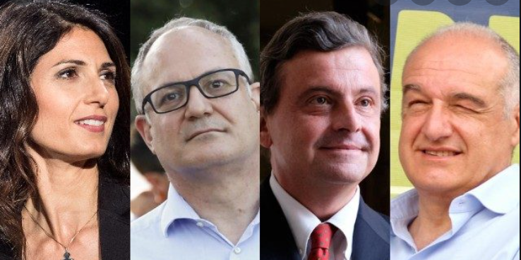



The informational effect of candidates’ traits on voter behavior: Results from an experiment for the October 2021 municipal elections in Rome
Gabriele Pinto
Emma Galli
Giampaolo Garzarelli
Department of Economics and Social Sciences,
European Public Choice Society Meeting
Braga, Portugal,
March 13, 2022

Slide 2
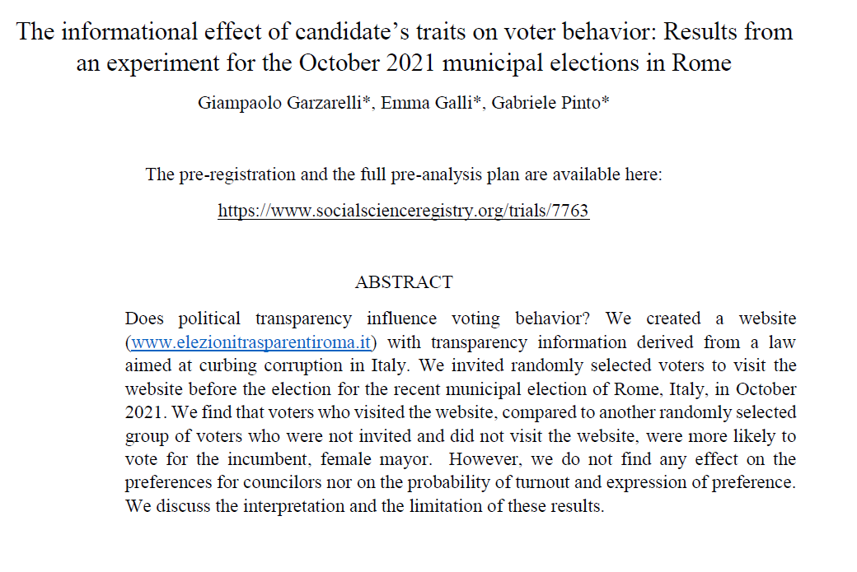
THE STUDY
Period:
October 2021, Elections for the municipality of Rome (Italy)
Method:
Web-based experiment
PRELIMINARY RESULTS*

Slide 3
The IMPACT OF INFORMATION ON VOTERS

Slide 4
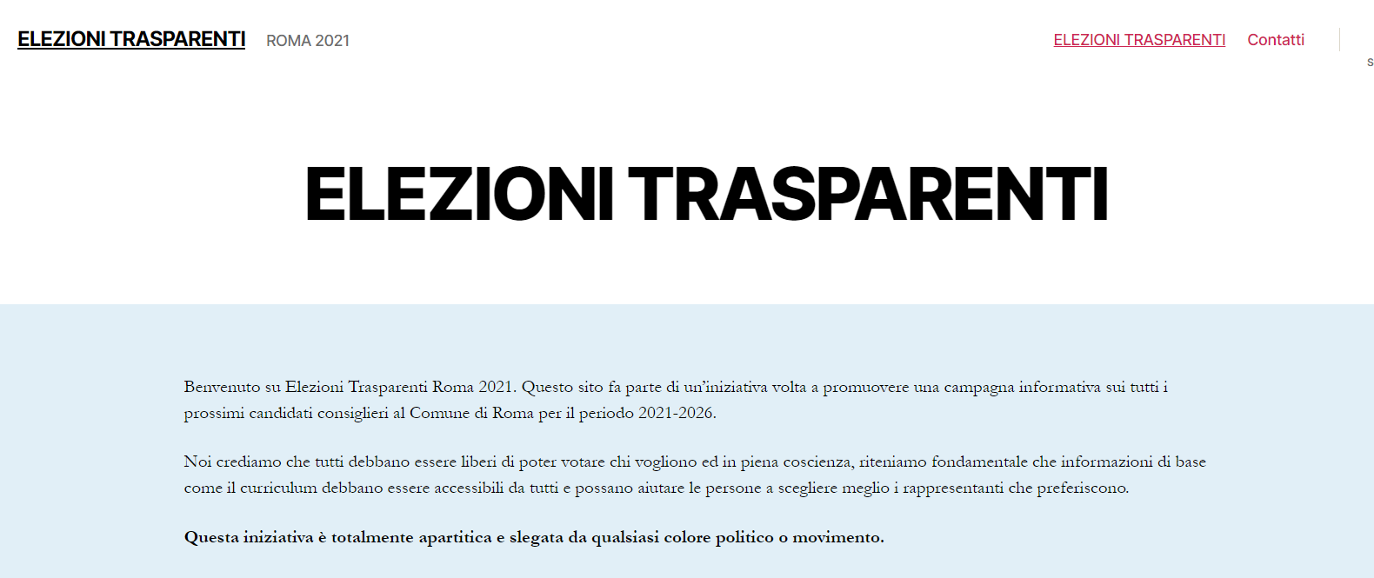
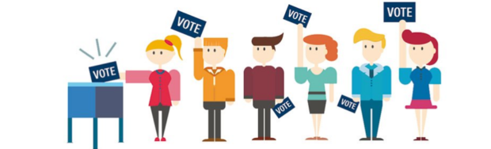
INFORMATION TREATMENT
VOTERS
(online panel)
Curriculum vitae
criminal record certificate and
previous political experience.
Transparency information derived from a law to curb corruption
The message
website (www.elezionitrasparentiroma.it) with information about candidates for the 2021 Municipality Elections of Rome.
The medium

Slide 5

RESULTS
Does information affect voter’s choices ? Null results.
EXCEPT:
Treated voters are significantly more likelihood to vote for the incumbent mayor (Virginia Raggi, of the Five Star Movement).
How can we interpret this ?

Slide 6
Let’s take a step back….in 2013

Slide 7
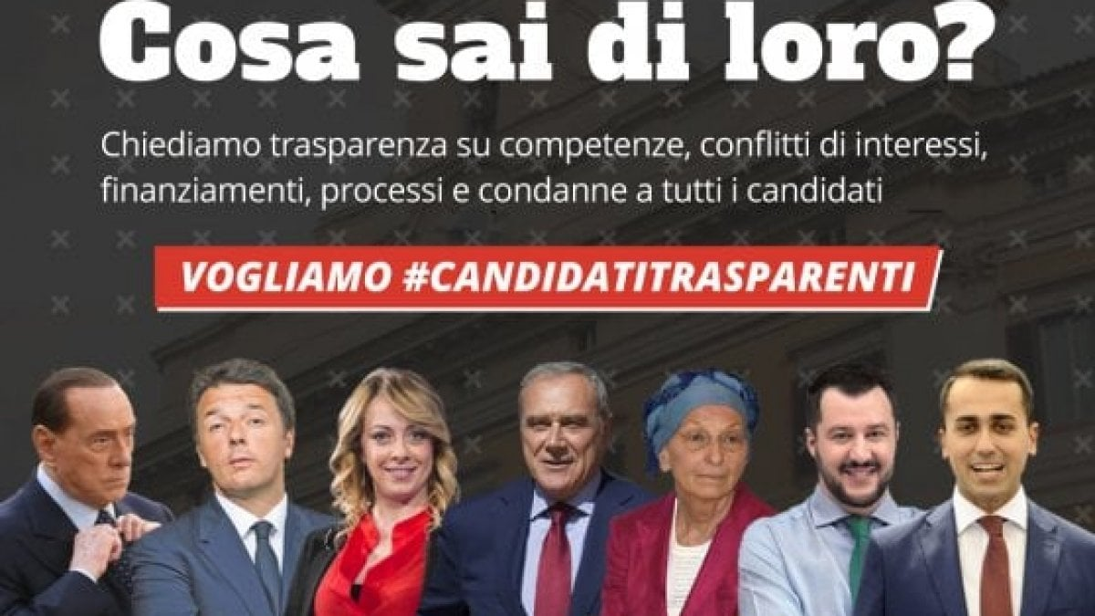
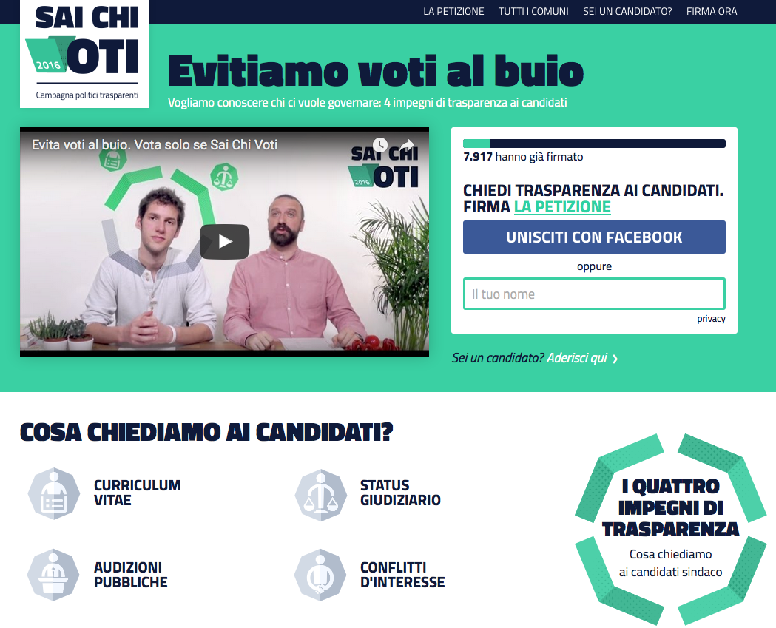
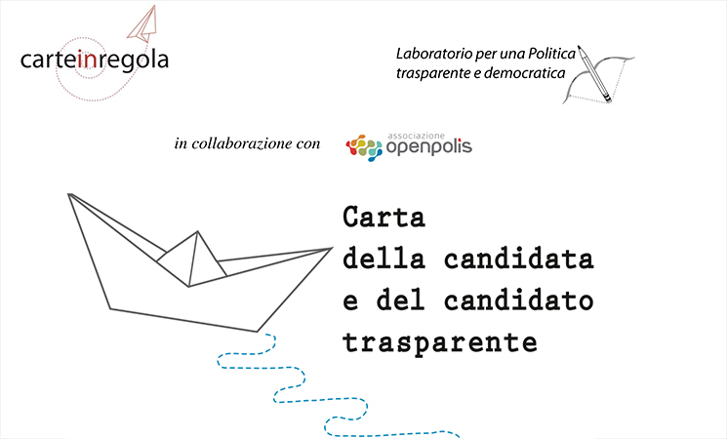
POLITICAL TRANSPARENCY CAMPAIGN IN ITALY

Slide 8
POLITICAL TRANSPARENCY CAMPAIGN IN ITALY
WHAT DO YOU KNOW ABOUT THEM?
AVOID VOTE IN THE DARK!
we ask for transparency on competences, conflicts of interest, financing, trials and convictions of all candidates
WE WANT #TRANSPARENT CANDIDATES
What we ask to candidates
CURRICULUM VITAE
Criminal record
Public Audition
Conflict of interests

Slide 9
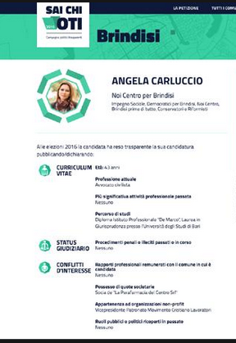
A WEBSITE WHERE VOTERS CAN see candidate’s cards

Slide 10
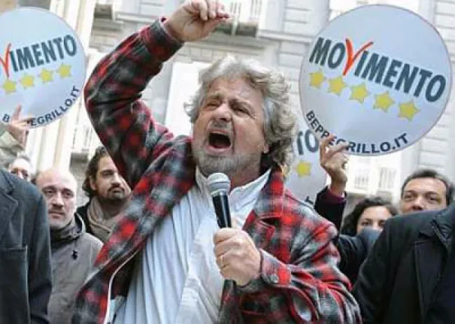
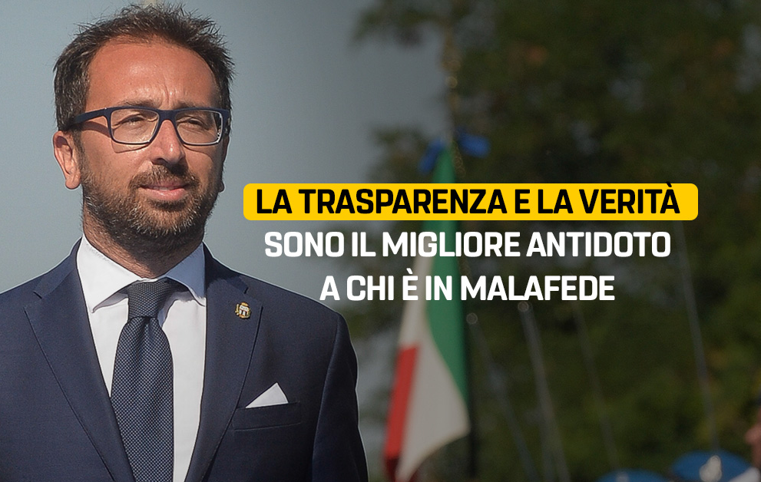
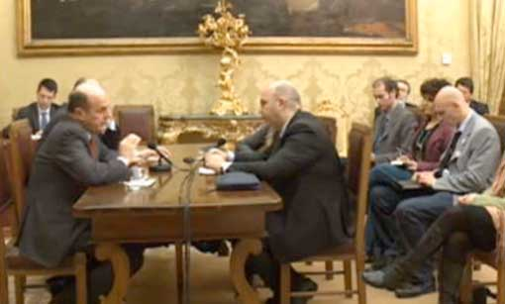
POLITICAL TRANSPARENCY CAMPAIGN IN ITALY
The Five Star Movement” put the issue of political transparency at the forefront of its populist stance against corrupted political elites.
When the “Five Star Movement” entered first in the parliament after the election of 2013 required (for the first and last time of Italian history) to publicly stream on the internet the consultations for the formation of the new government

Slide 11
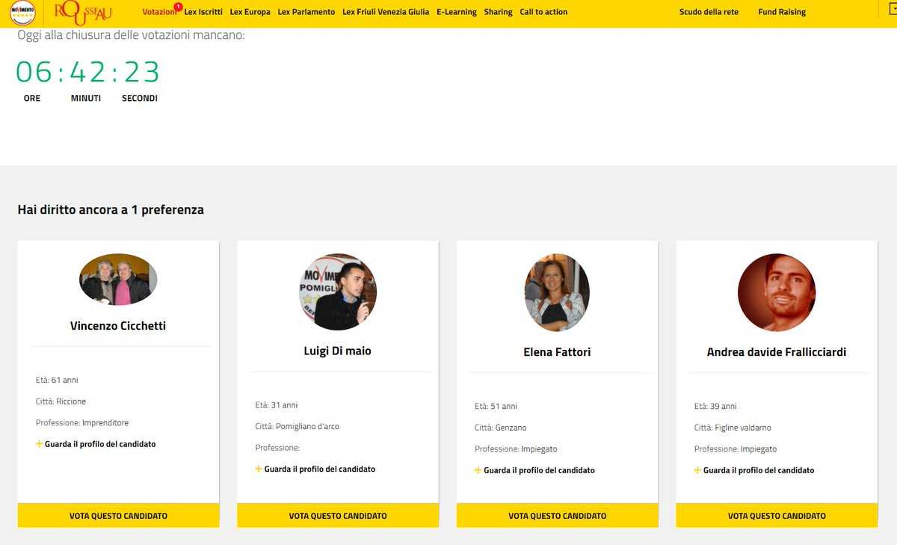
POLITICAL TRANSPARENCY CAMPAIGN IN ITALY
The selection of the candidates for the first election of the five star movement where made on a web-platform where party-members selected candidates (among hundreds) based on simple report cards
Now currently ministry of foreign affairs!!

Slide 12
The Italian Wave of Transparency
Adoption of a number of law to increase transparency in public administration and…Politics!

Slide 13
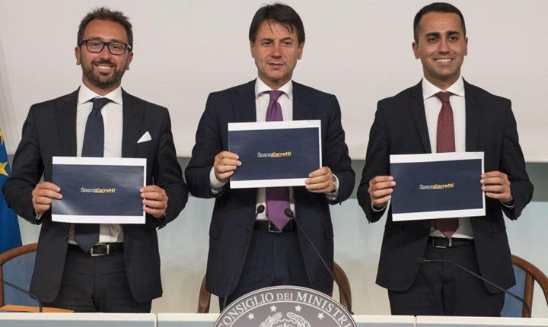

A LAW FOR POLITICAL TRANSPARENCY
Legge spazzacorrotti (corrupt-sweaper) , L. 9 gennaio 2019
Measures for the contrast of crimes against the public administration, as well as in the matter of prescription of the crime and in the matter of transparency of political parties and movements
Norms against corruption
Increase political transparency
(to prevent corruption?)
Pubblication of curriculum vitae and criminal records of ALL candidates

Slide 14
PUBBLICATION OF curriculum vitae
Art.1 (14) :
By the fourteenth day before the date of elections (...) the political parties and movements (...) are obliged to publish, on their website or, for the lists referred to in the aforementioned first sentence of paragraph 11, on the website of the party or political movement ( ...) the curriculum vitae of each candidate (...) and the relative certificate of the criminal record
Art.1 paragraph 15:
Pubblication on the website of the Ministry of the Interior or the municipality / region in which the elections are held

Slide 15
How can we explain demand for political transparency ?

Slide 16

A “BANAl” model of POLITICAL ACCOUNTABILITY
VOTERS
GOOD
POLITICIANS
BAD
POLITICIANS
e.g.: incompetent, corrupted, etc…

Slide 17




HOW DOES TRANSPARENCY AFFECTS POLITICAL SELECTION ?
… delegate
POLITICIANS
Re-Elect
VOTERS
Poor and opaque information on who are the politicians and what they do
Evaluate results
Not elected
Doing good
Doing bad (e.g corruption)

Slide 18
HOW DOES TRANSPARENCY AFFECTS POLITICAL SELECTION ?
...delegate
POLITICIANS
Re-Elect
X
VOTERS
Mechanisms
Deterrence (bad politicians do not run)
Poor and opaque information on who are the politicians and what they do
Evaluate results
IF WE INCREASE TRASPARENCY
Doing good
Doing bad (e.g. corruption)

Slide 19
HOW DOES TRANSPARENCY AFFECTS POLITICAL SELECTION ?
...delegate
POLITICIANS
Re-Elect
VOTERS
Mechanisms
Deterrence (bad politicians do not run)
Influence on vote choices (better-informed voters make better choices)
Poor and opaque information on who are the politicians and what they do
Evaluate Results
Not elected
IF WE INCREASE TRANSPARENCY
Doing bad (e.g. corruption)
Doing good

Slide 20
HOW DOES TRANSPARENCY AFFECTS POLITICAL SELECTION ?
...delegate
POLITICIANS
Re-Elect
VOTERS
Mechanisms
Deterrence (bad politicians do not run)
Influence on vote choices (better-informed voters make better choices)
Valutano i risultati
Not elected
Both mechanisms might be relevant, BUT, we focus on the second !
Doing good
Doing bad (e.g. corruption)

Slide 21

MECHANISM
Influence on vote choices (better-informed voters make better choices)
Transparency
Political Selection
Quality of politicians
More competent politicians and less corruption
Better informed voters make different choices
(necessary – but not sufficient – condition is that transparency impact voters’ choices)

Slide 22
RESEARCH QUESTION
Does political transparency affect voters’ choices?

Slide 23
The eXPERIMENT

Slide 24
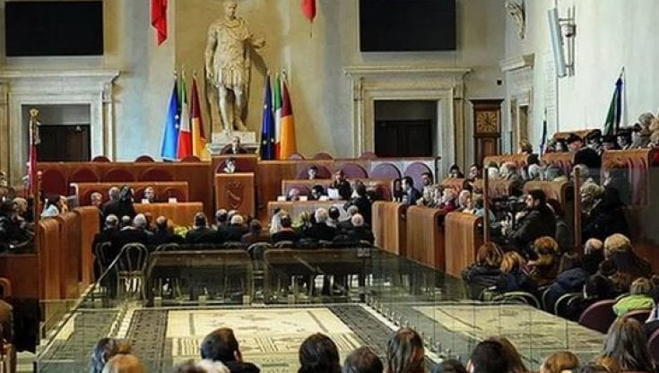
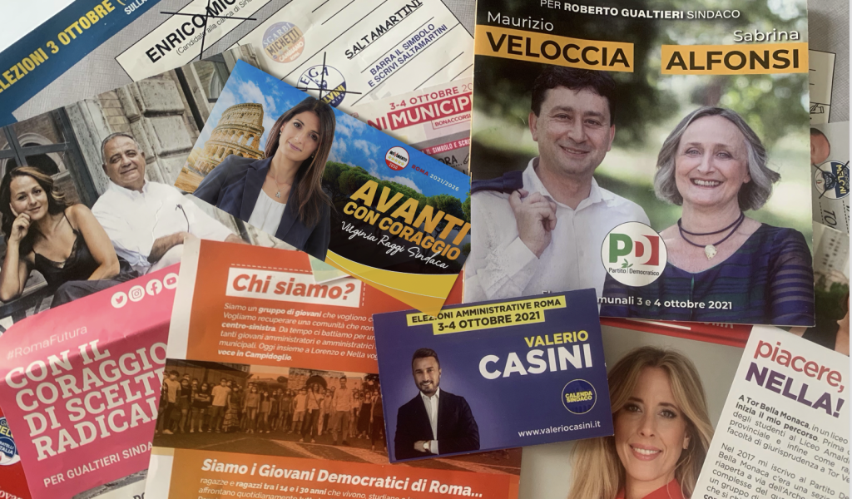
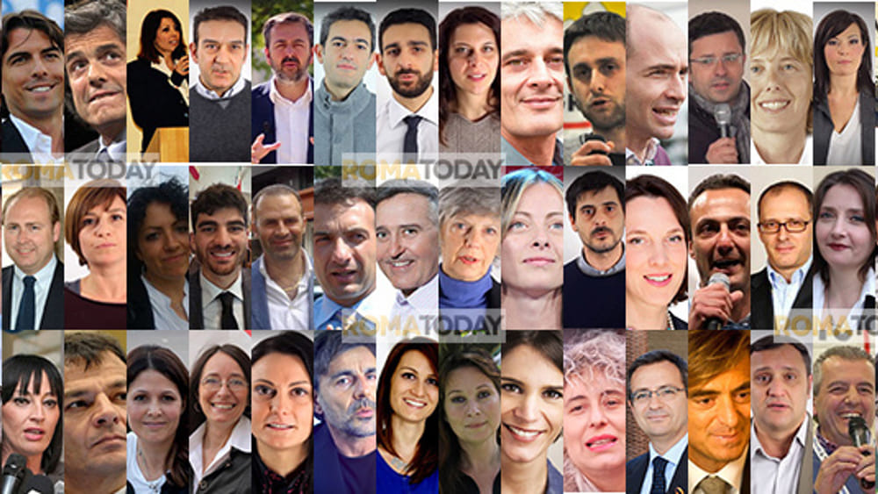
Context
Rome 2021 elections.
22 mayor candidates (38 lists)
1646 councillor candidates (members of the municipal candidates) running for 48 spots.
Voters can express 1vote for the mayor and 2 preferences for councillors

Slide 25
RESEARCH QUESTION
Information on candidates (the website)
Does political transparency
affect voters’ choices?
Candidates and characteristics of candidates voted
How can we estimate a causal effect ?
Experimental design with random informational treatment

Slide 26
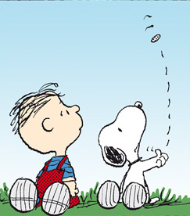


Few days before election
Days of elections
After the elections
Random sampling of treatment and control group
VOTERS
Endline questionnaire
Who you voted?
Visit the website
TREATMENT
Fill baseline questionnaire
CONTROL
Do not visit the website

Slide 27
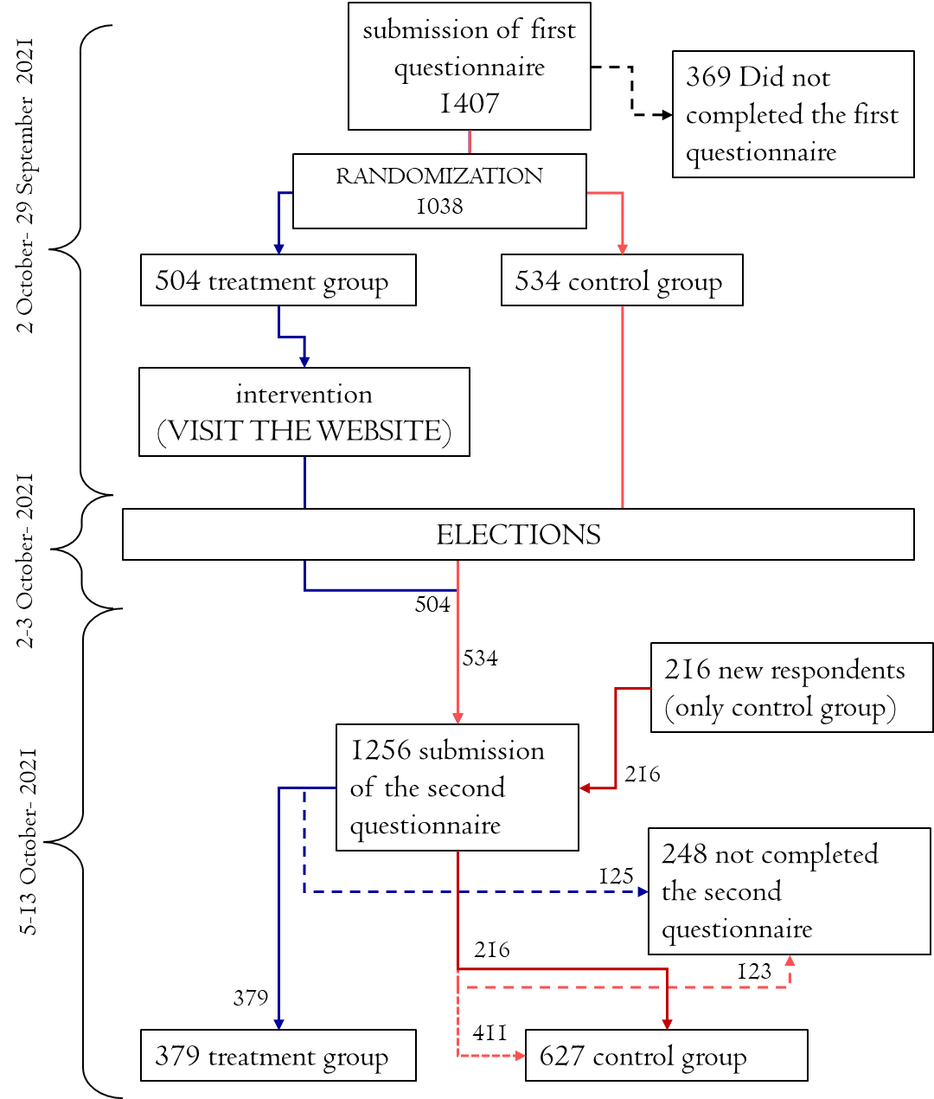
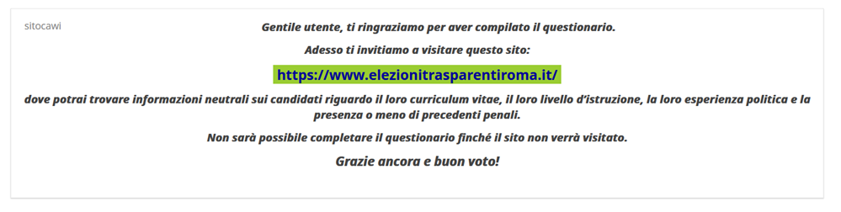
Figure 5: Flow-Chart of the Experiment
Figure 3: Screenshot of the message inviting respondents to visit the website
Dear user, thank you for completing the survey. Now we invite you to visit this site: https://www.elezionitrasparentiroma.it/ On the site you will find neutral information on candidates regarding their curriculum vitae, level of education, their political experience, and whether or not they have a criminal record. The information was produced by the candidates themselves under Law 3 of 9 January 2019. It will not be possible to complete the questionnaire until the site is visited. Thanks again and good vote!

Slide 28
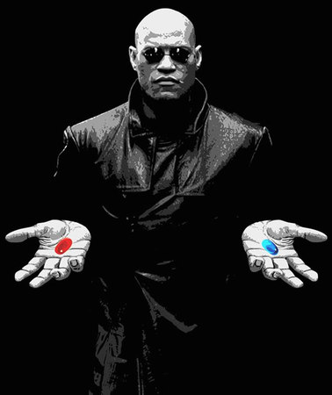
THE TREATMENT
We do not show them the website
We let them visit the website
www.elezionitrasparentiroma.it

Slide 29
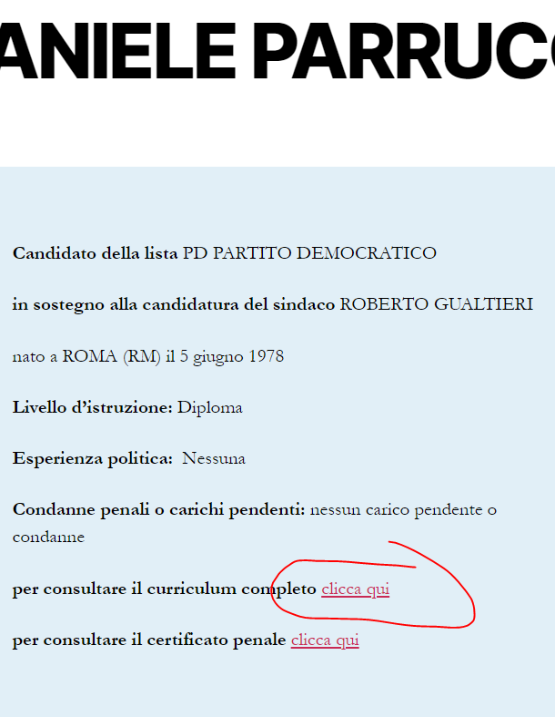
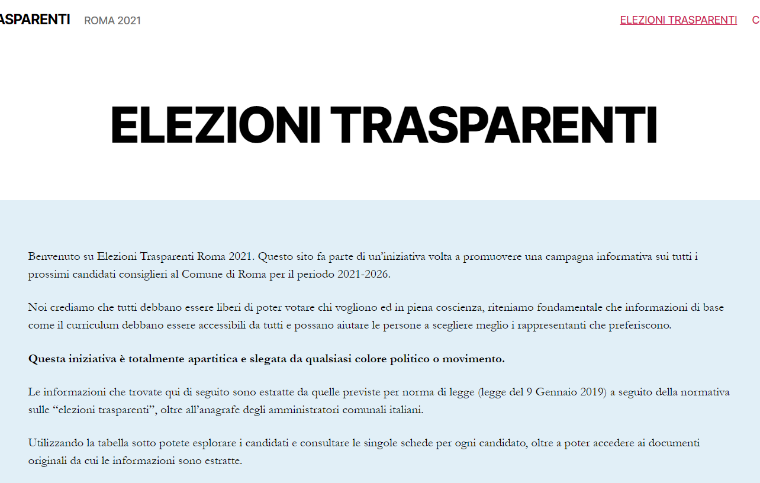
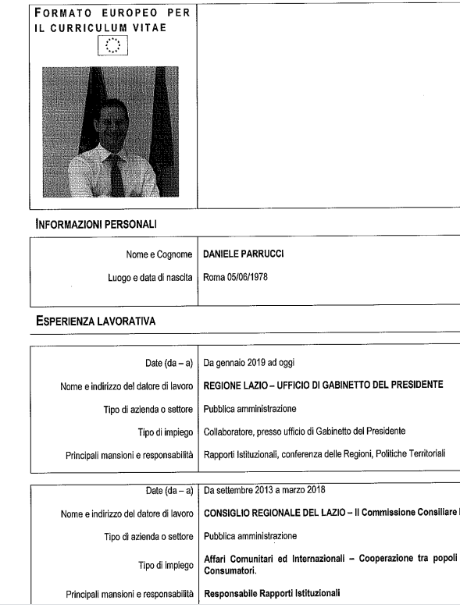
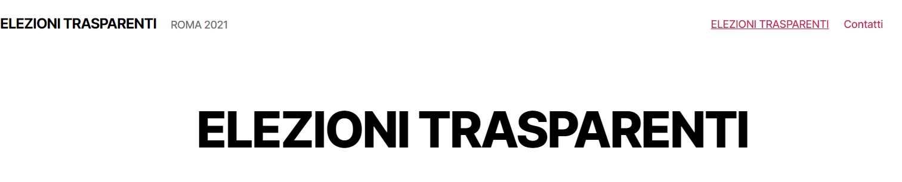
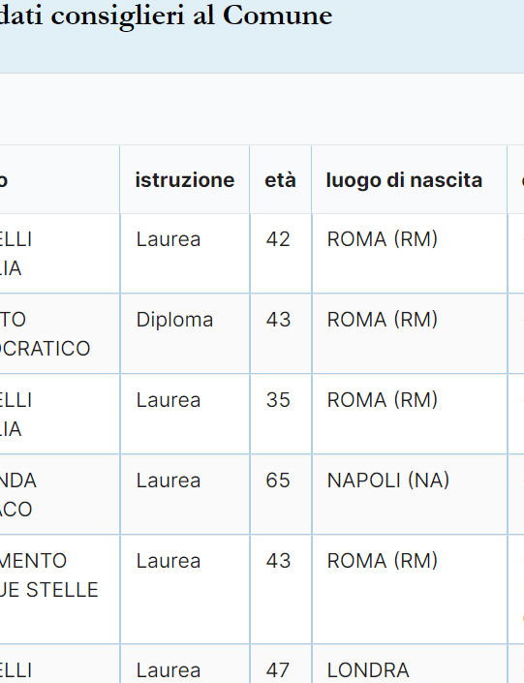
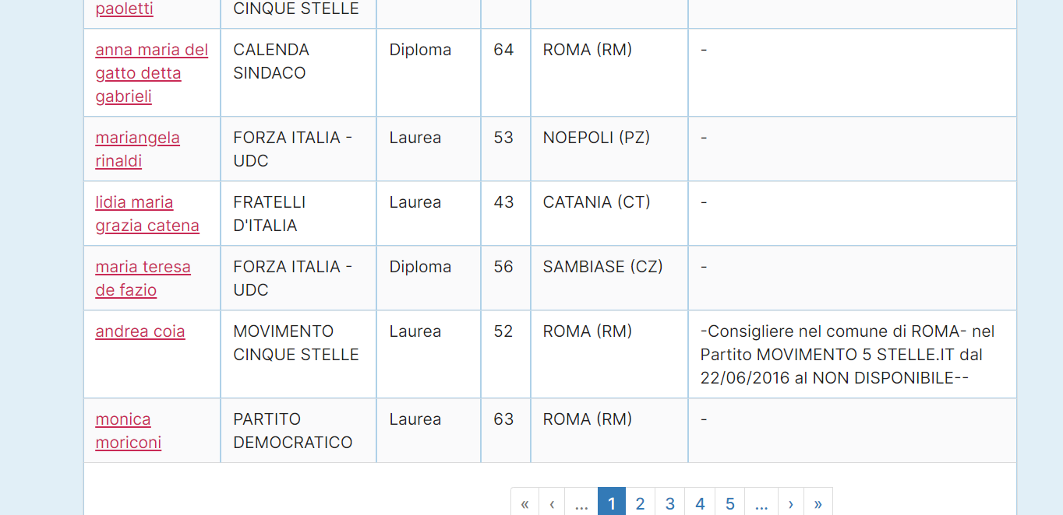
THE WEBSITE
A website where visitor can easily inspect informations about all candidates (mayor and counsellor, more than 1400)

Slide 30
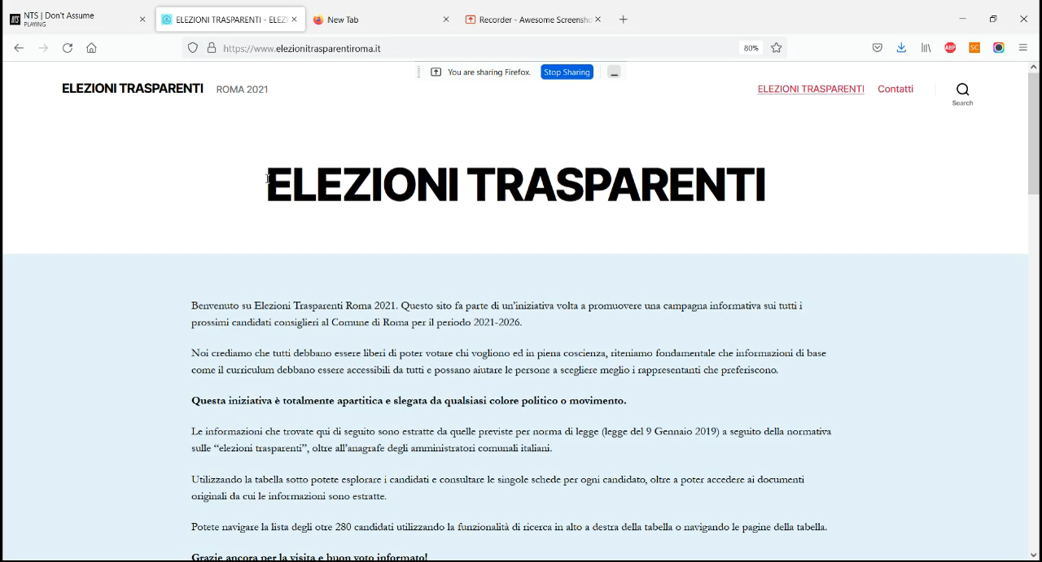

Slide 31
AFTER ?
After having collected respondents’ vote choices we compared differences between treatment and control group.

Slide 32
BALANCE TESTS

Slide 33
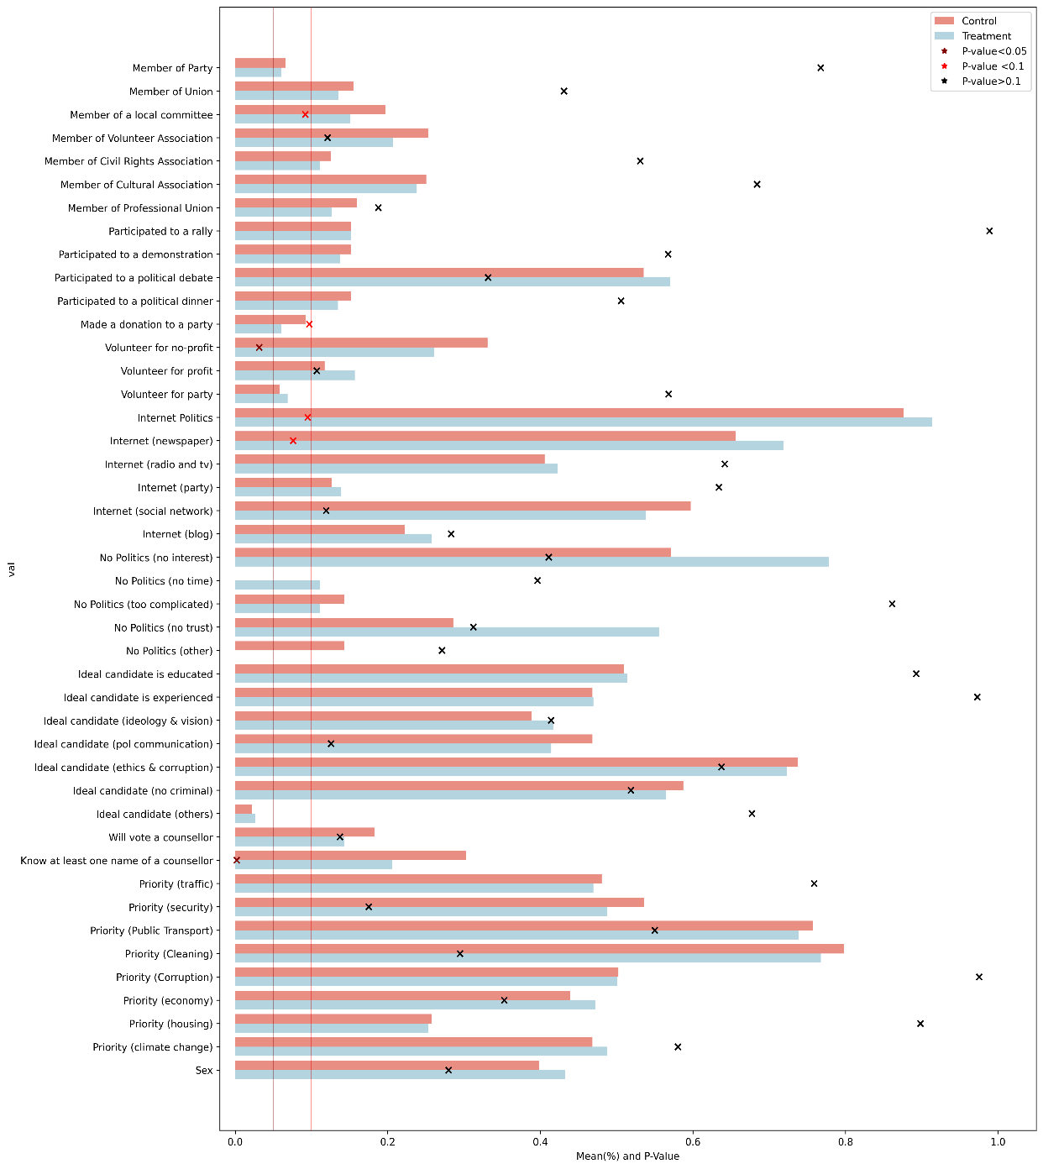

Slide 35
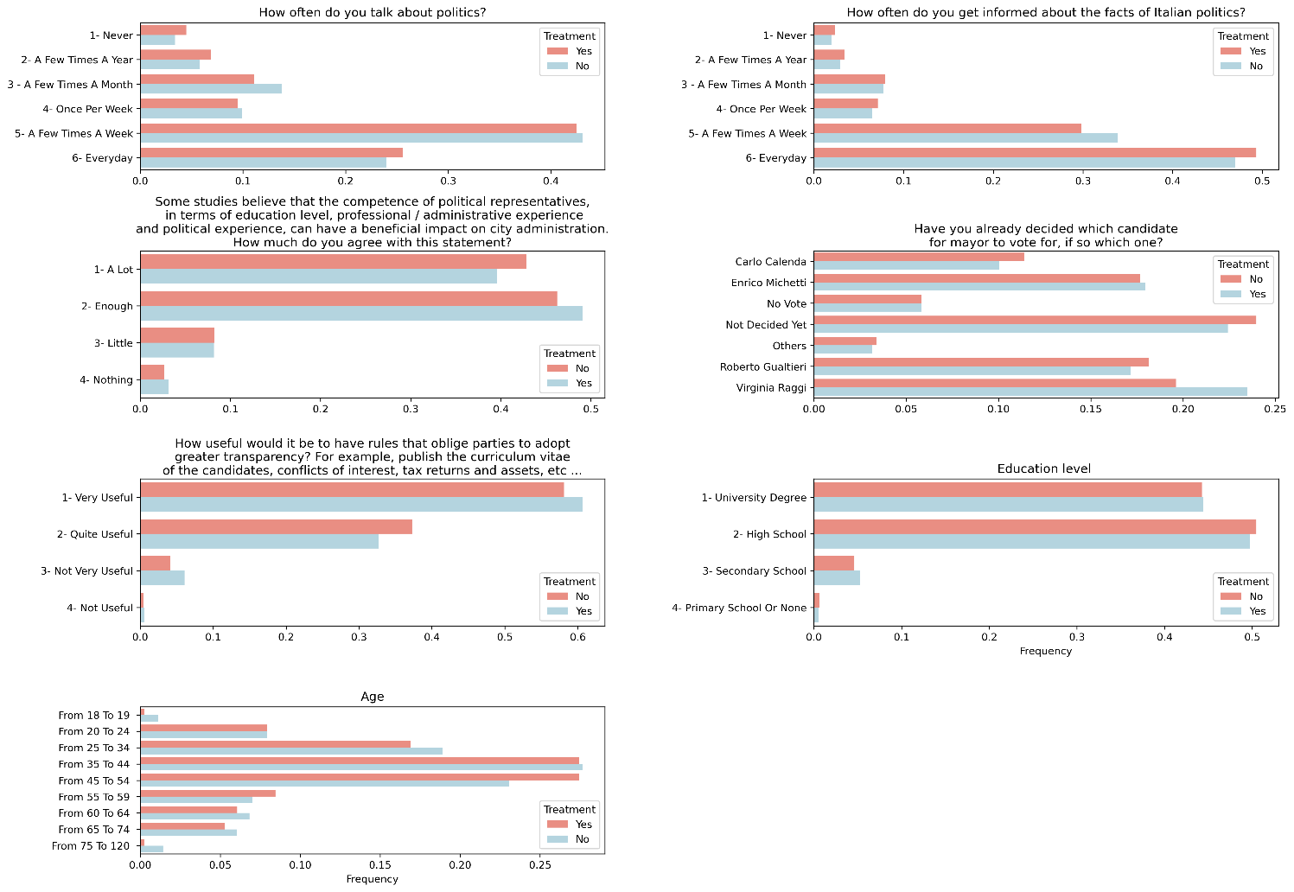

Slide 36
RESULTS

Slide 37
OUTCOME VARIABLES
Based on pre-registered hypothesis
Turnout
Casting of a preference vote
Valence characteristics of candidates (mayor and counsellor)
  Political experience
  Education Level
  Male / Female

Slide 38
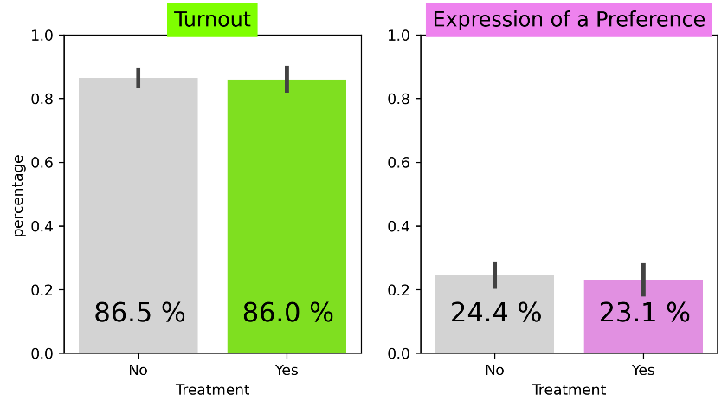
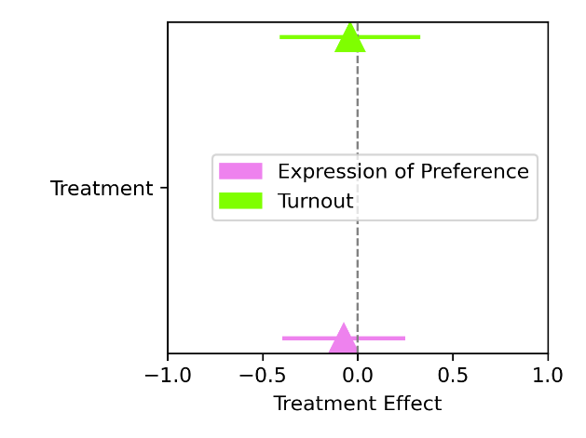
Figure 11: treatment effect on turnout and expression of a preference vote

Slide 39
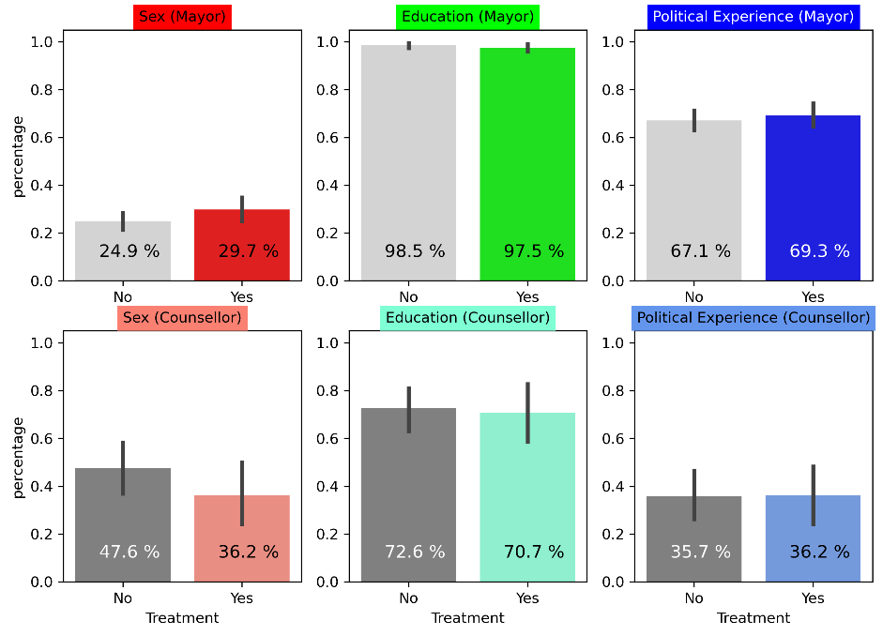
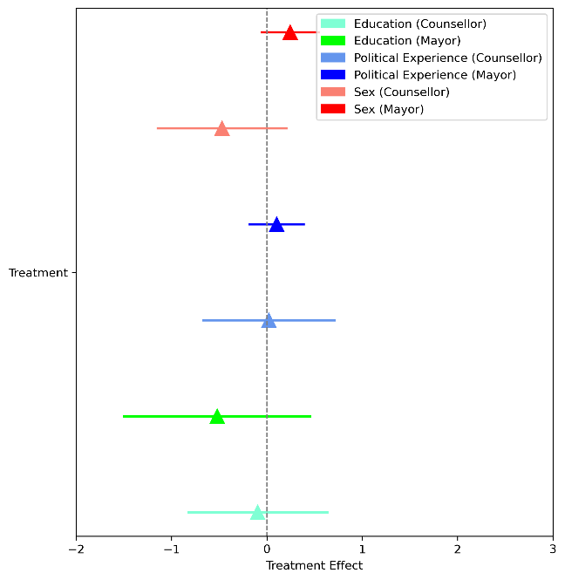
Figure 12: treatment effect on characteristics of voted candidate
MAYOR
COUNSELLOR

Slide 40
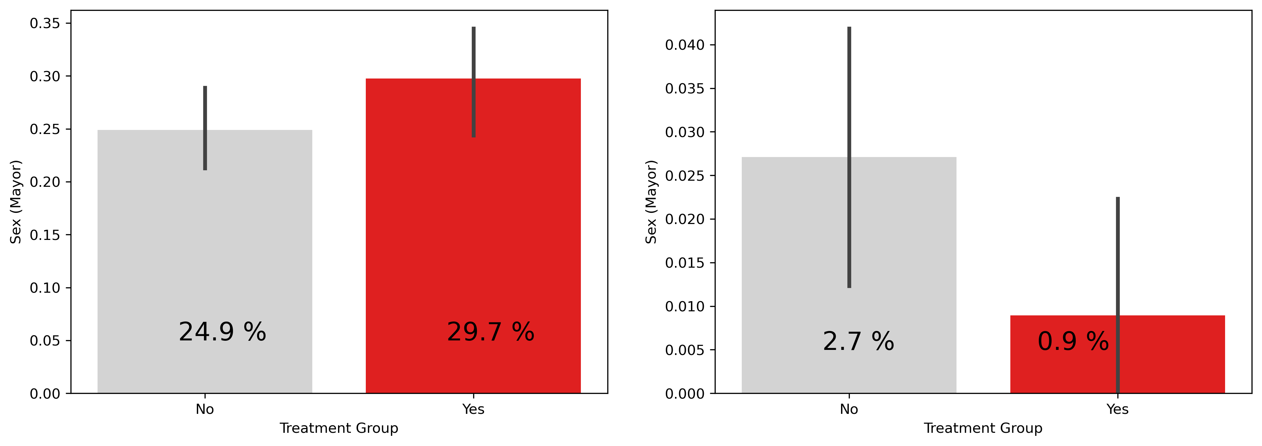
4 candidates got 95% of the votes. Only one female: Virginia Raggi.
ALL CANDIDATES
EXCLUDING MAIN CANDIDATES
MAYOR

Slide 41



EFFECT ON THE FOUR MAIN CANDIDATES
LEFT POPULIST LIBERAL RIGHT

Slide 42
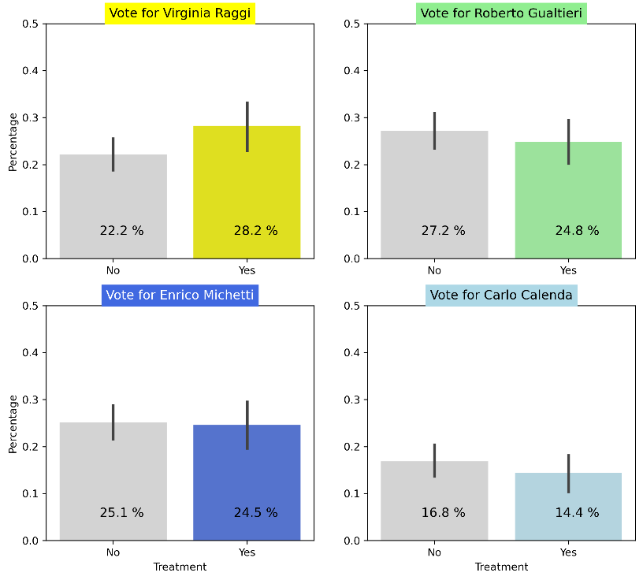
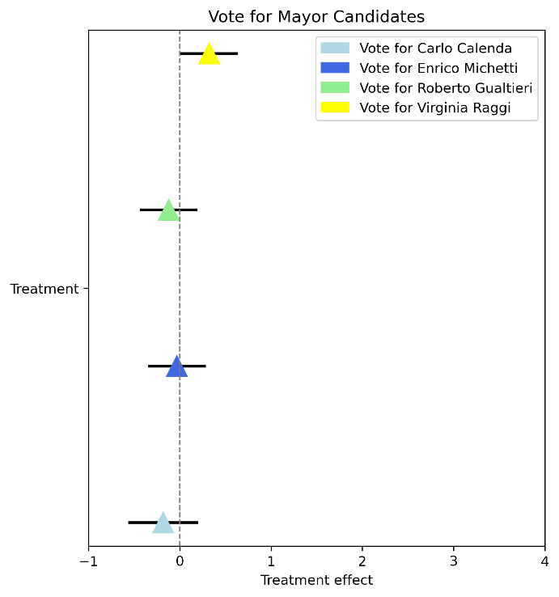
Figure 13:treatment effect on mayor preference vote

Slide 43
CONTROL FOR PRIOR INTENTION TO VOTE
Table A- 5: robustness test (mayor votes)

Slide 44
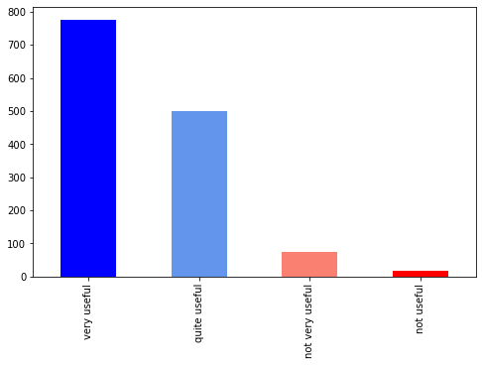
Demand for transparency
How useful would it be to have rules that oblige parties to adopt greater transparency? For example, publish the curriculum vitae of the candidates, conflicts of interest, tax returns and assets, etc ...

Slide 45

Website VISITE
We tracked the visit of respondents using google analytics… and we found that

Slide 46
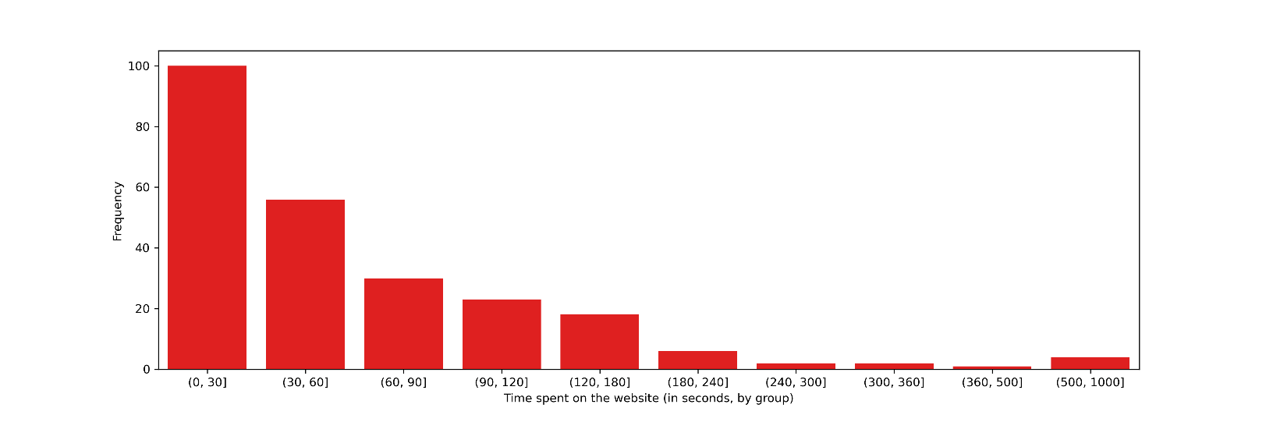
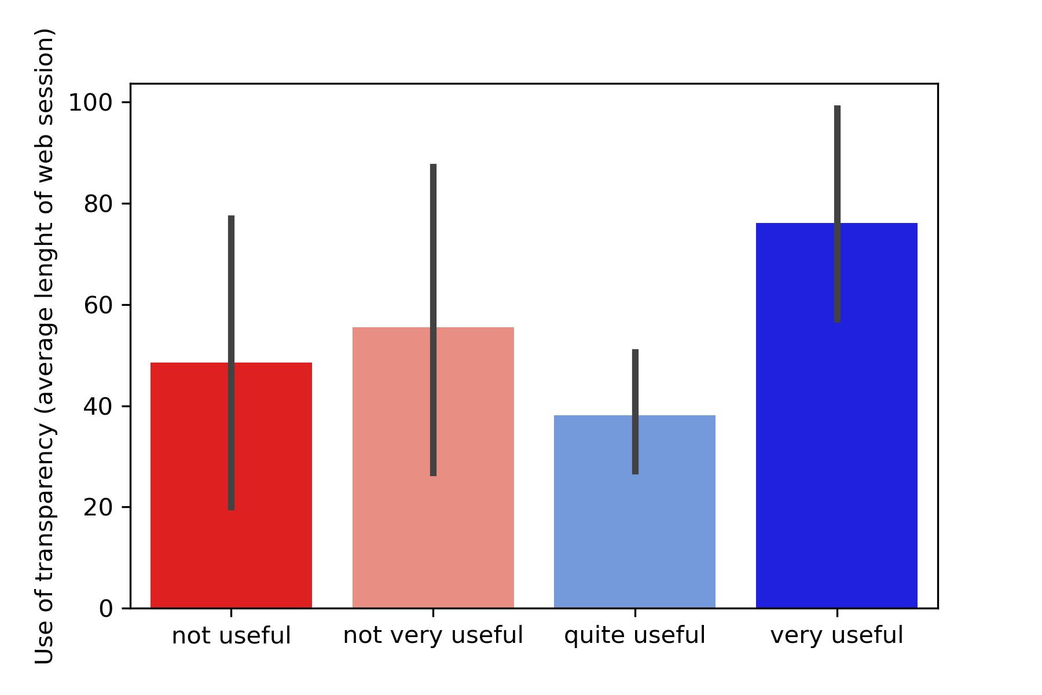
Length of the visit (average = 72 seconds, median = 41 sec)
Length of the visit and demand for transparency

Slide 47
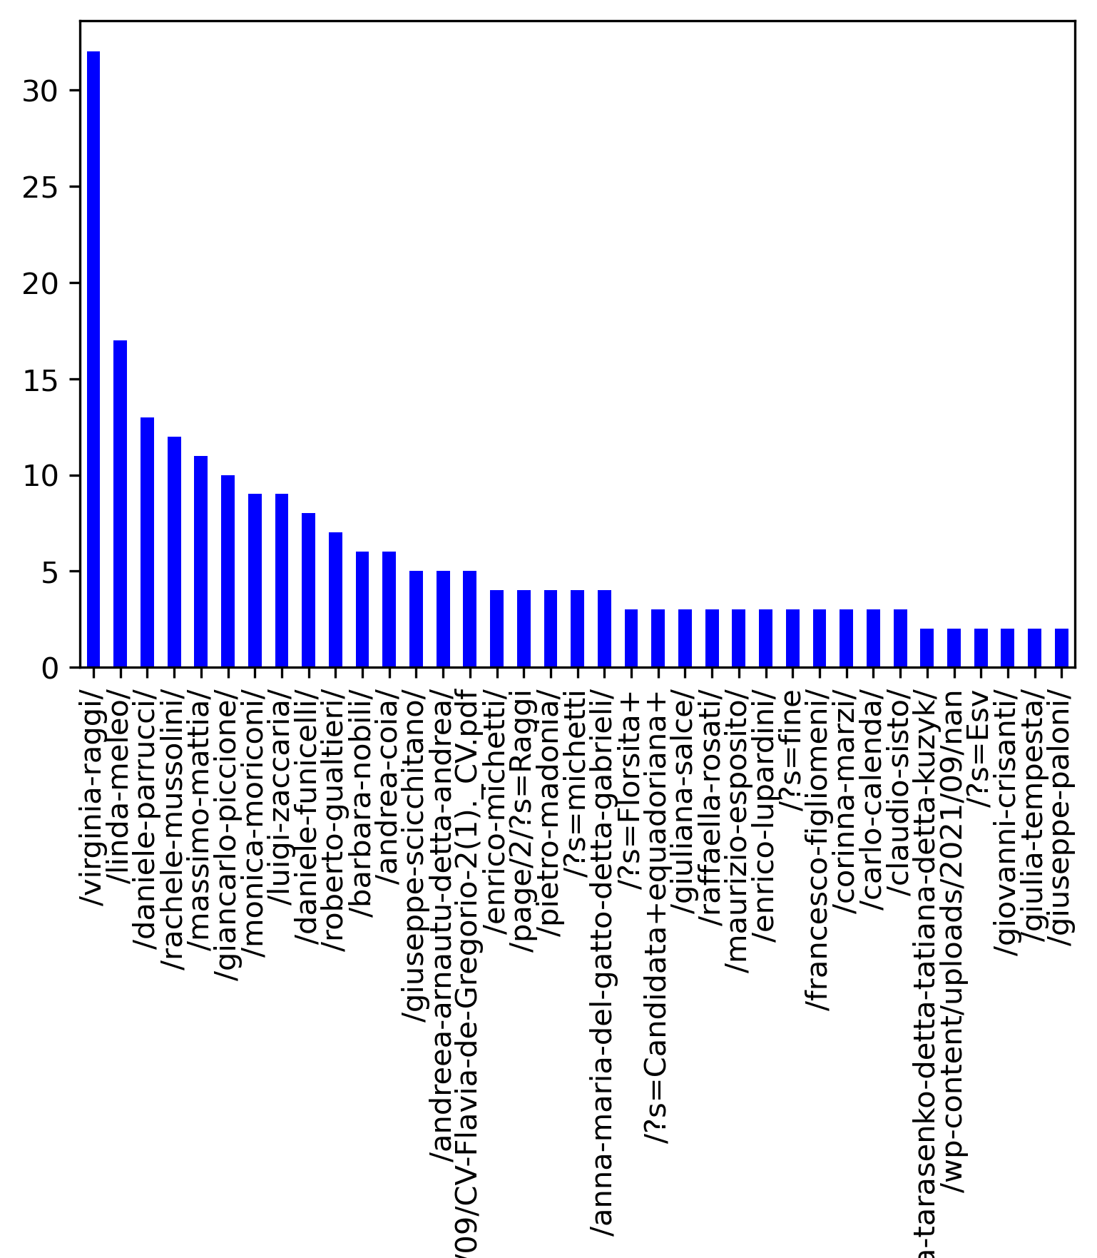
Most visited webpages
Virginia raggi was the most visited webpage

Slide 48
SUMMING UP
 | TURNOUT | PREFERENCE VOTES | EDUCATION | Istruzione | SEX | Sesso | EXPERIENCE |  | Voto FOR FIVE STAR MOVEMENT | Voto for INCUMEBENT
 |  |  | Counsellor | Mayor | Counsellor | Mayor | Counsellor | Mayor
EFFECT | = | = | = | = | - | + | = | = | + | +
NULL EFFECT | NEGATIVE EFFECT | POSITIVE EFFECT
NON SEPARABLE EFFECT
WOMEN CANDIDATE=FIVE STAR MOVEMENT CANDIDATE = INCUMBENT
Limited interpretation!

Slide 49

INTERPRETATION
How can we interpret those results?
- Politicization of transparency ? E.g. Transparency is a partisan issue
- Virginia Raggi is considered a less-corrupted candidates? (gender bias in corruption perception)
- Others?

Slide 50

POINT OF STRENGHT
The first study that evaluate the impact of political transparency in Italy
Realistic
The campaign (and the website) mimics real campaigns organized by civil organization who tried to use transparency as a mean of influence on politics. The information set is taken from compulsory transparency requirements
Causality
Internal validity

Slide 51


LIMITATIONS
Interpretation of the results
  Non-separable effects. Politicization of transparency?
Representativness of the sample (external validity)
  Over-representation of citizens who use internet and are interested in politics. Still, the original policy is targeted only at citizens who use internet.
Statistical Power
  type 1 error (councillor) . Only 20% of voters cast a preference vote.
Other channels
    Deterrence, role of media, civil society, parties.. Etc…

Slide 52
Other channels

Slide 53




OTHER STAKEHOLDERS
Parties
Civil Society
POLITICIANS
Transparency
VOTERS
MEDIA

Slide 54
Representativness of the sample (external validity)

Slide 55
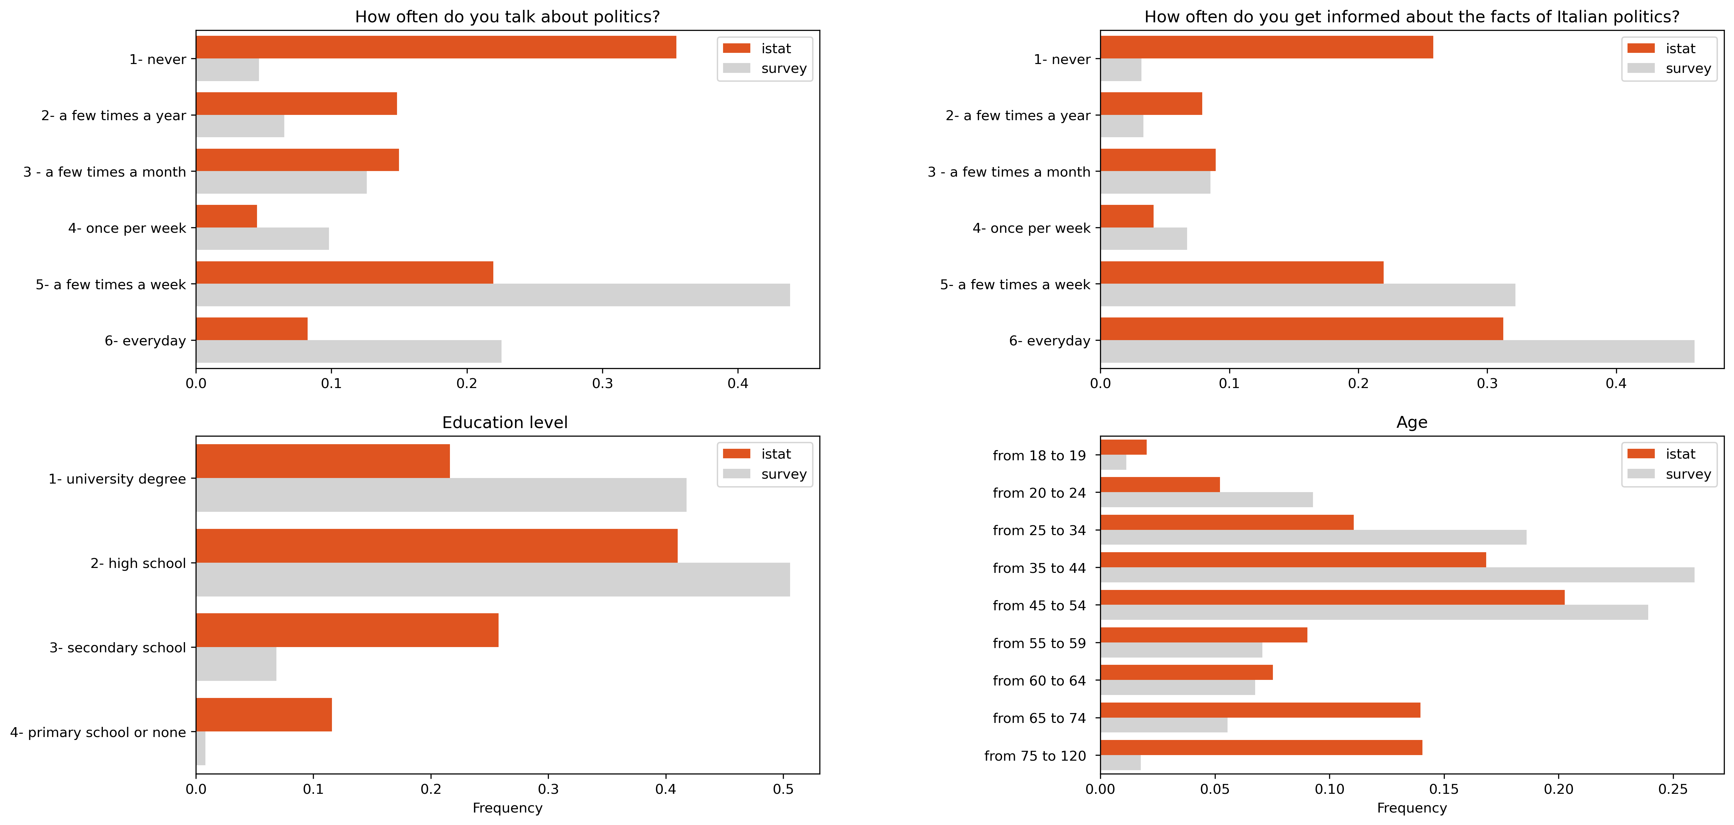
Representativness of the sample

Slide 56
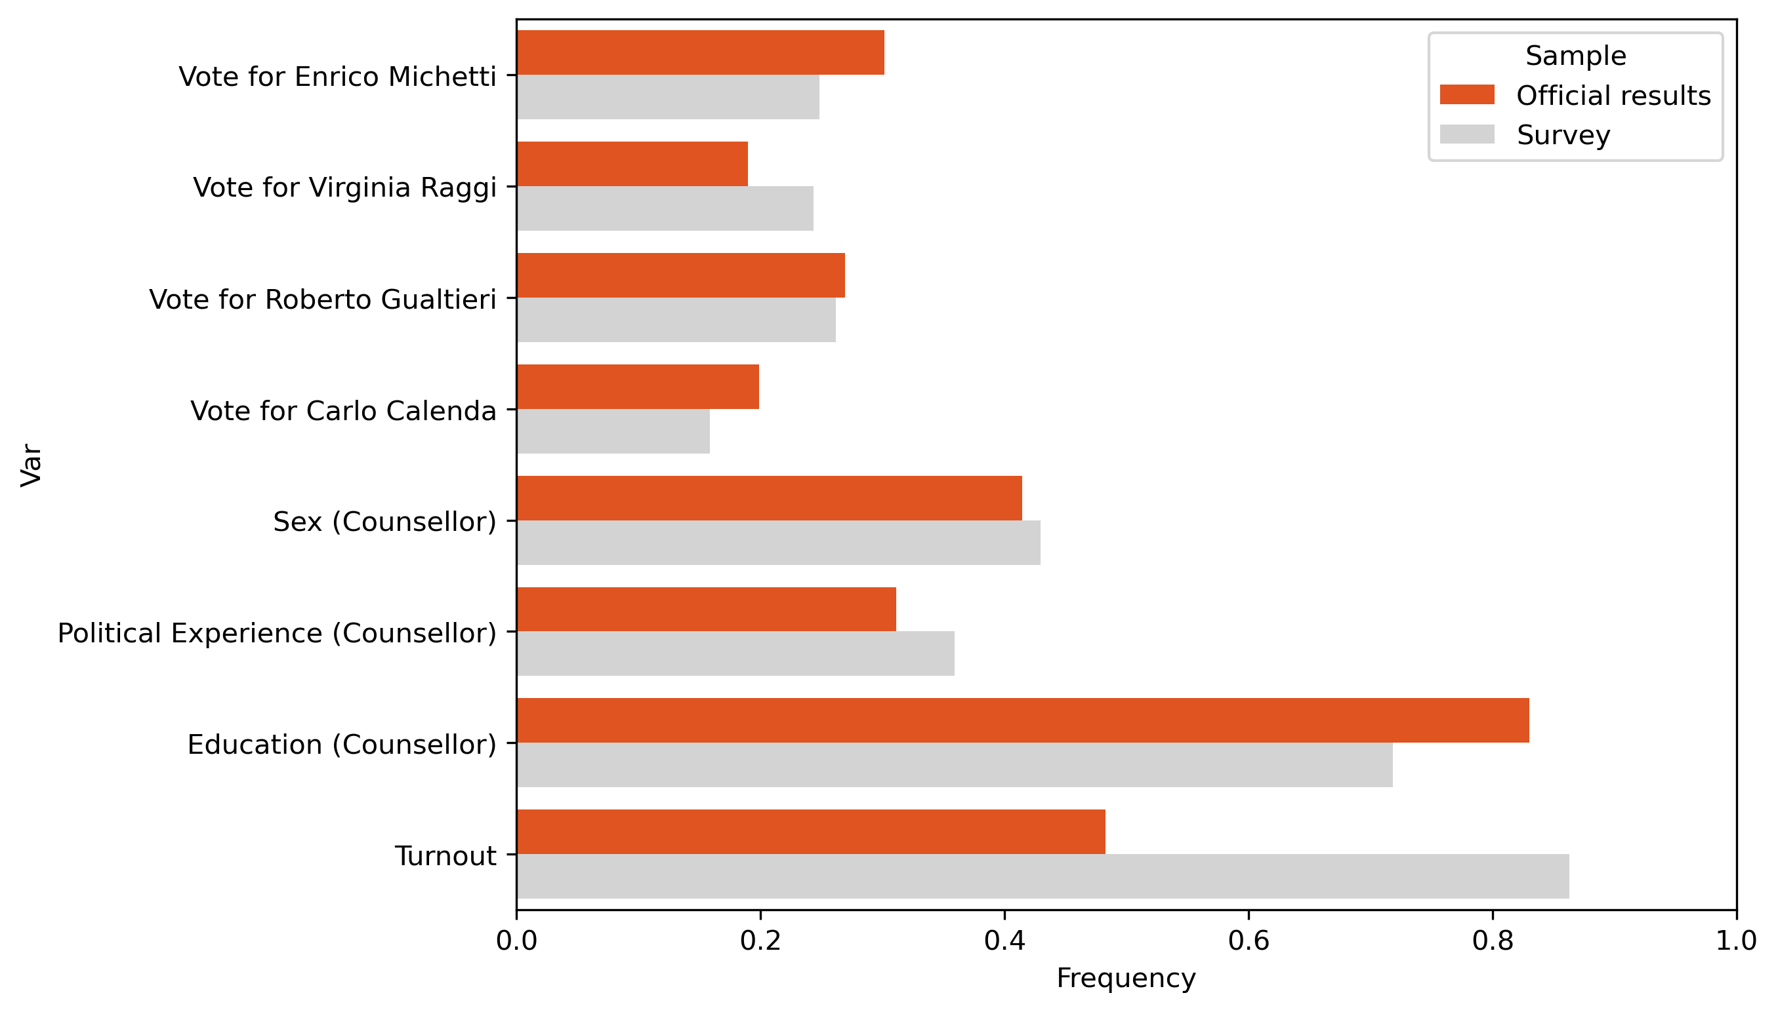
Representativness of the sample
Significant differences in turnout

Slide 57
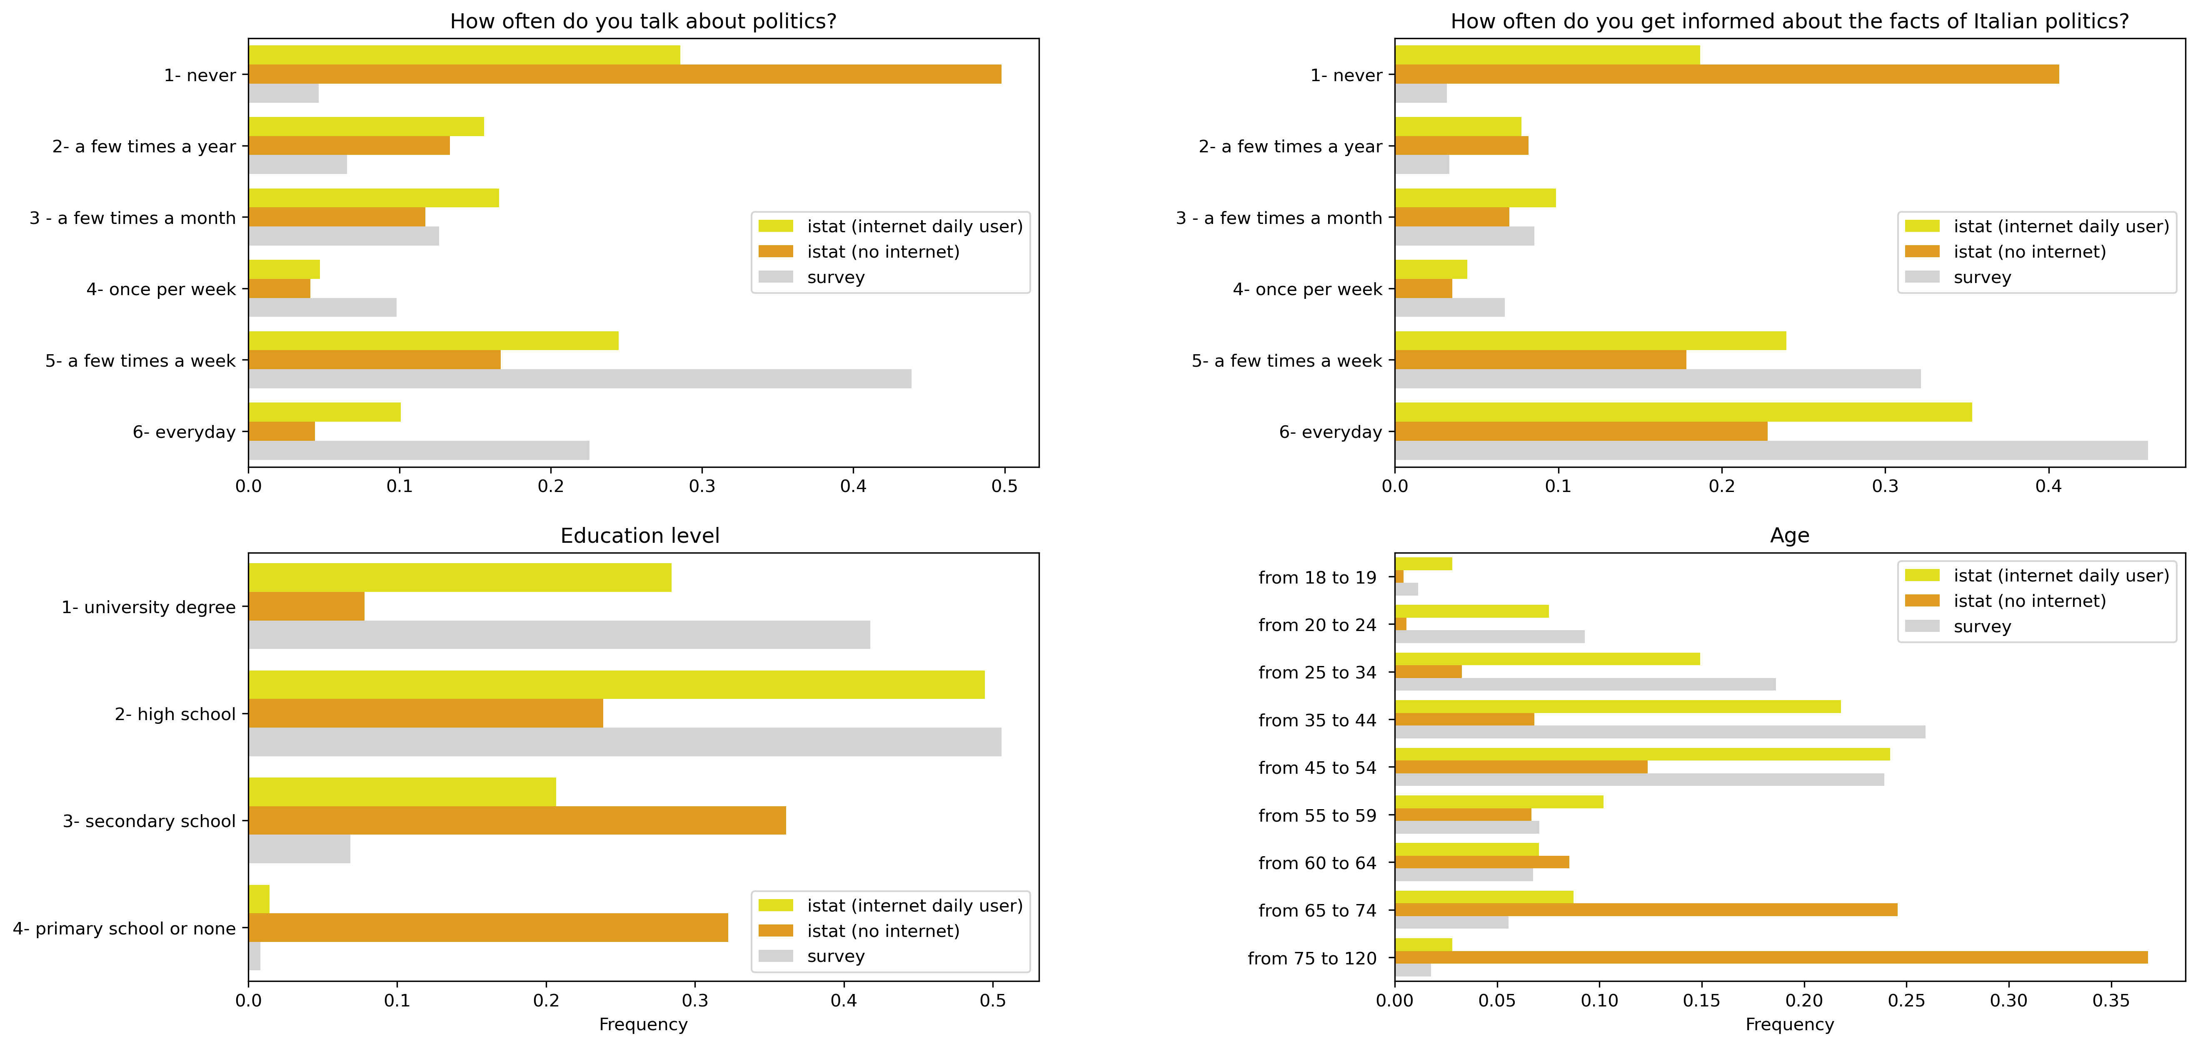
But…If we restrict the sample to people who use internet the differences are significantly smaller!

Slide 58
CONCLUSIONS
Survey and “observational” anecdotes show popular support for political transparency initiatives despite…
Uncertainty on the effectiveness of transparency in influencing voter’s choices (we find mostly null results).
Politicization of transparency might be an important channel trough which transparency affects politics

Slide 59

Slides here:
Personal page: www.gabrielepinto.it
Email: gabriele.pinto@uniroma1.it
Twitter: @gabrieleaopinto

Slide 60
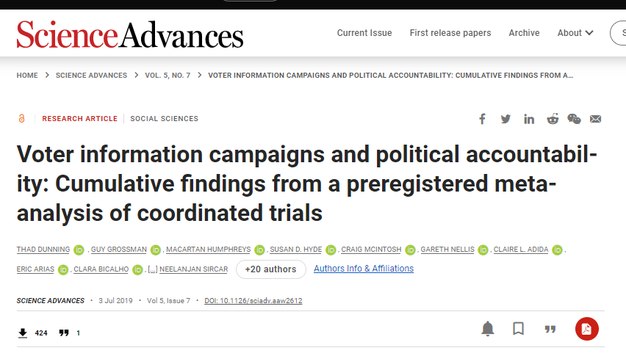
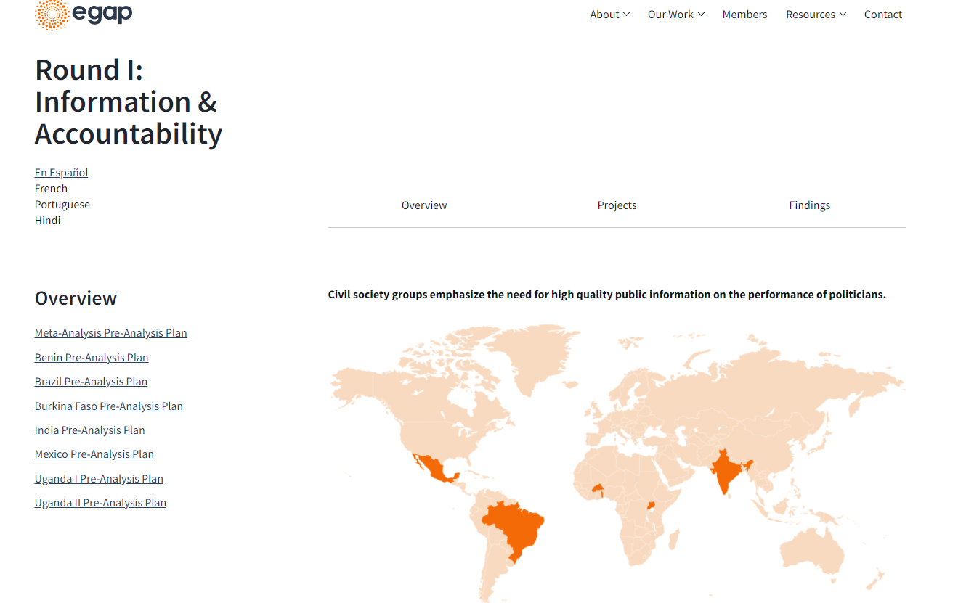
Experimental LITERATURE on THE effect of information on accountability
Metaketa Initiative 1 – Information and Accountability (8 esperimenti coordinati in vari paesi del mondo)
Small or null effects of information on voter behaviour
Contraddicting evidence (World Bank Review 2016)
GAP TO FILL
  Most experiments are run in developing countries
  Information regarding «performance» of politicians. Mostly based on «sanctioning model» rather than «selection model».
  «ad hoc» campaign
OUR EXPERIMENT
  Experiment in a developed country (Italy)
  Context with many candidates “Selection model”
  Mimics real campaign

Slide 61
LITERATURE / OUR CONTRIBUTION
1 - these characteristics (education, work, and political experience) can impact voter behavior since voters can use these traits as shortcuts to evaluate candidates (Campbell & Cowley, 2014; Mechtel, 2014).
2 - the information we provide is very basic: it does not require any kind of political sophistication.
3- we can evaluate the impact on candidates with no experience (and no performance..).
4- Low search cost (Redlawsk, 2004) a simple and lean website.
5- the information set is taken from the recently introduced compulsory transparency requirements introduced by a Law against corruption (“Legge spazzacorrotti”). This latter point ensures the non-partisanship of information.
6- the informational campaign we organized mimics some real examples of the campaign organized by civil society in Italy. We thus replicate previous realistic cases where civil society organizations used political transparency to influence elections.

Slide 62
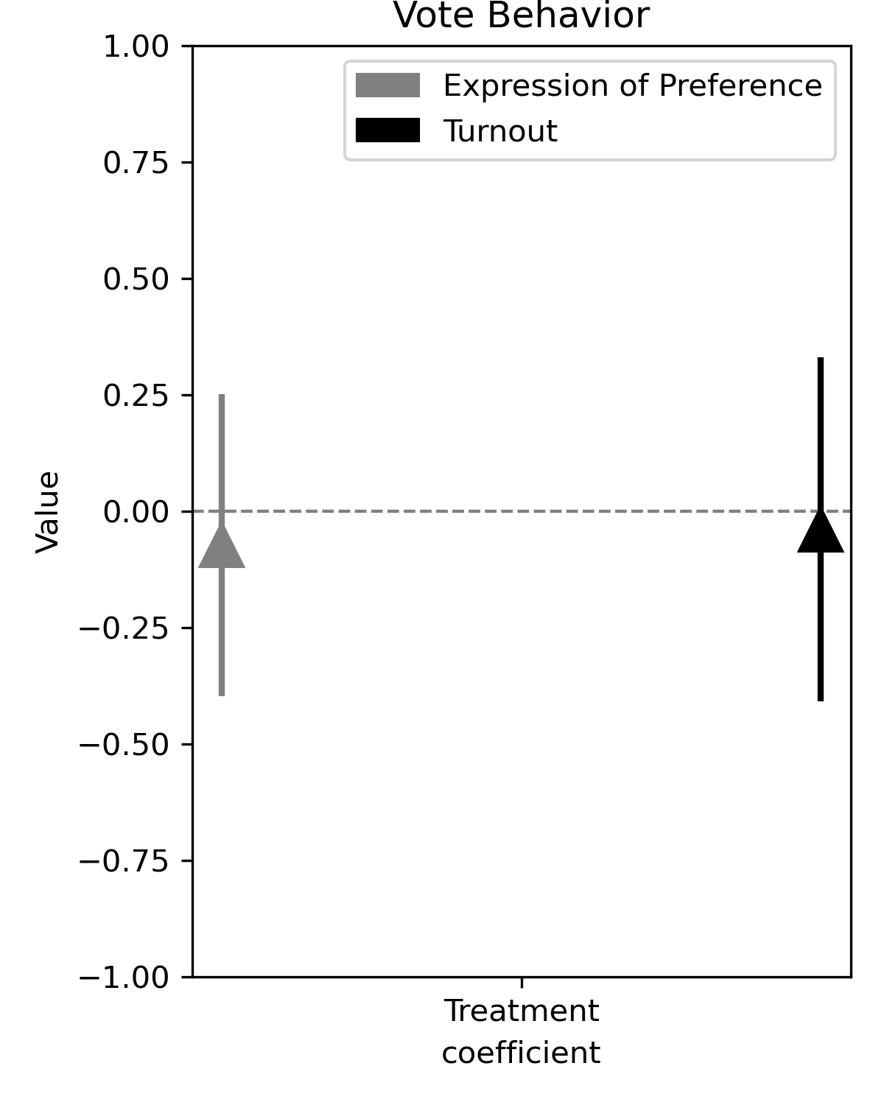
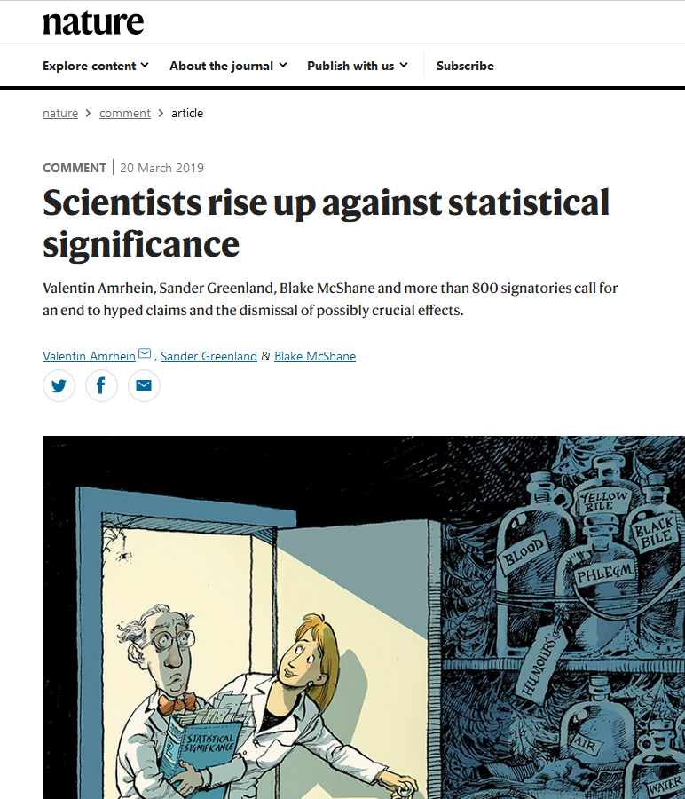
RISULTATI 1
Coefficiente
Medio (-0.10)
Se l’intervallo di confidenza si “incrocia” con la linea dello zero, non possiamo rifiutare l’ipotesi nulla che il coefficiente è diverso da zero→non c’è nessun effetto
Intervallo di confidenza 95%
Attenzione a l’interpretazione delle ipotesi e degli intervalli di confidenza
https://www.nature.com/articles/d41586-019-00857-9
Linea dello zero

Slide 63
STATISTICAL POWER

Slide 64
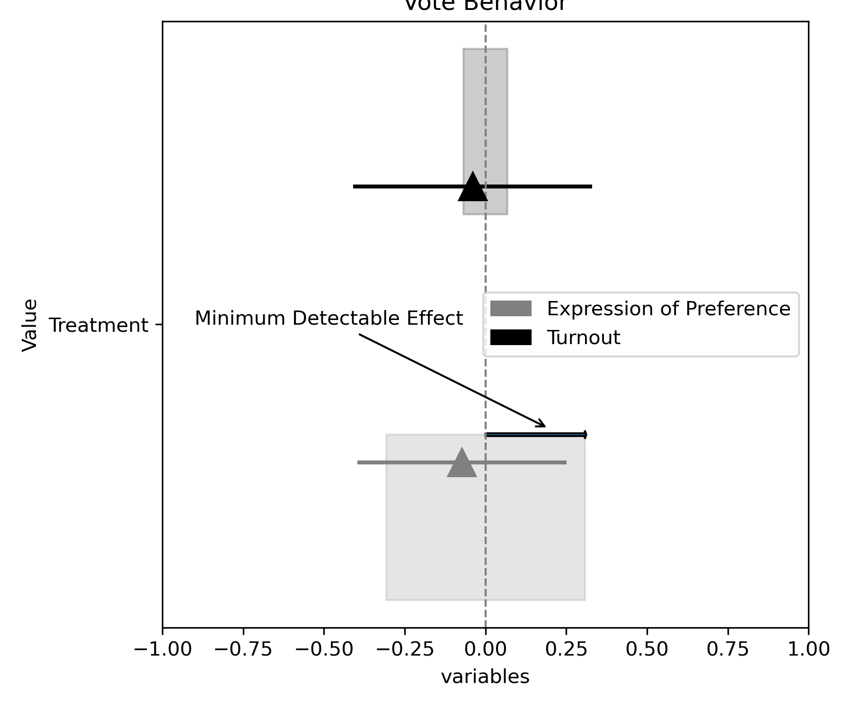

Slide 65
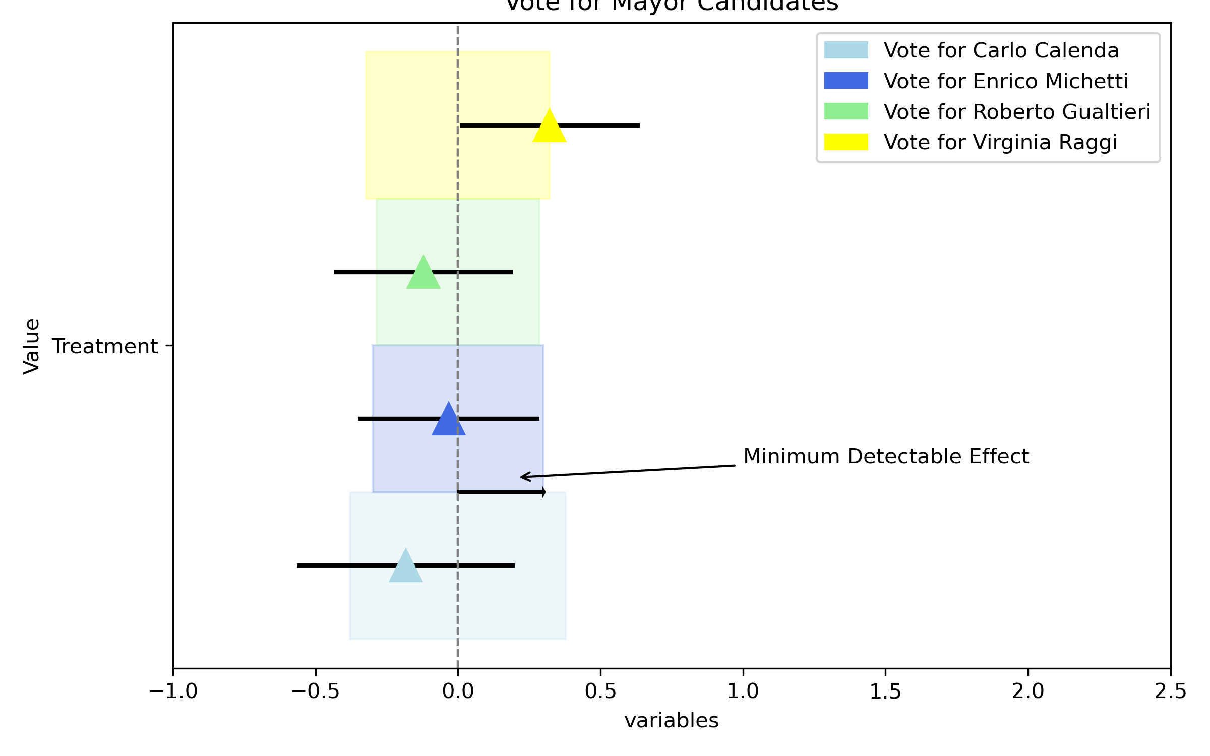

Slide 66
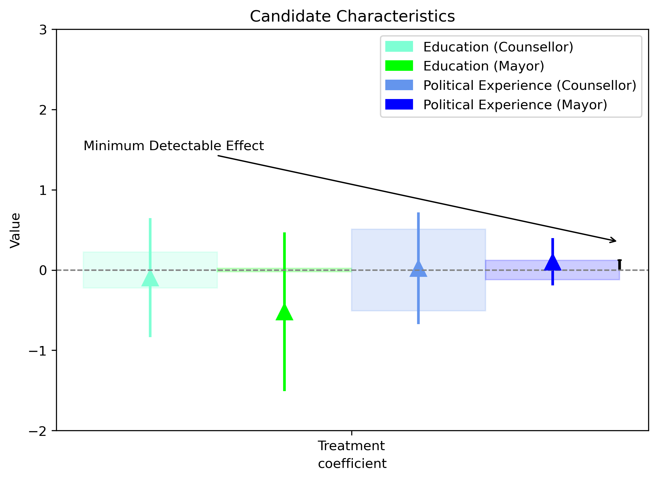

Slide 67
references
Ashworth, S. (2012). Electoral Accountability: Recent Theoretical and Empirical Work. Annual Review of Political Science, 15(1), 183–201. https://doi.org/10.1146/annurev-polisci-031710-103823
Bank, W. (2016). Making Politics Work for Development: Harnessing Transparency and Citizen Engagement. The World Bank.
Bhandari, A., Larreguy, H., & Marshall, J. (n.d.). Able and Mostly Willing: An Empirical Anatomy of Information’s Effect on Voter-Driven Accountability in Senegal. American Journal of Political Science, n/a(n/a). https://doi.org/https://doi.org/10.1111/ajps.12591
Brennan, J. (2016). Against democracy. Princeton University Press.
Campbell, R., & Cowley, P. (2014). What Voters Want: Reactions to Candidate Characteristics in a Survey Experiment. Political Studies, 62(4), 745–765. https://doi.org/10.1111/1467-9248.12048
Caplan, B. (2011). The Myth of the Rational Voter: Why Democracies Choose Bad Policies-New Edition. Princeton University Press.
Dunning, T., Grossman, G., Humphreys, M., Hyde, S. D., McIntosh, C., Nellis, G., Adida, C. L., Arias, E., Bicalho, C., Boas, T. C., & others. (2019). Voter information campaigns and political accountability: Cumulative findings from a preregistered meta-analysis of coordinated trials. Science Advances, 5(7), eaaw2612.
Fearon, J. D. (1999). Electoral Accountability and the Control of POLITICIANSans: Selecting Good Types versus Sanctioning Poor Performance. In A. Przeworski, S. C. Stokes, & B. Manin (Eds.), Democracy, Accountability, and Representation (pp. 55–97). Cambridge University Press. https://doi.org/10.1017/CBO9781139175104.003
Grossman, G., Michelitch, K., & Prato, C. (2020). The Effect of Sustained Transparency on Electoral Accountability.
International, T. (2021). Corruption Perceptions Index 2020. https://images.transparencycdn.org/images/CPI2020_Report_EN_0802-WEB-1_2021-02-08-103053.pdf
Leiser, D., & Shemesh, Y. (2018). How we misunderstand economics and why it matters: The psychology of bias, distortion and conspiracy. Routledge London and New York.
McGee, R., & Gaventa, J. (2011). Shifting Power? Assessing the Impact of Transparency and Accountability Initiatives. IDS Working Papers, 2011(383), 1–39. https://doi.org/https://doi.org/10.1111/j.2040-0209.2011.00383\_2.x
Mechtel, M. (2014). It’s the occupation, stupid! Explaining candidates’ success in low-information elections. European Journal of Political Economy, 33, 53–70.
Pande, R. (2011). Can Informed Voters Enforce Better Governance? Experiments in Low Income Democracies. Annual Review of Economics, 3, 215–237.
Pande, R., Banerjee, A., Green, D., & McManus, J. (2014). Are Poor Voters Indifferent to Whether Elected Leaders are Criminal or Corrupt? A Vignette Experiment in Rural India. Political Communications, 31, 391–407.
Pande, R., Banerjee, A., & Walton, M. (2012). Delhi’s Slum-Dwellers: Deprivation, Preferences, and Political Engagement among the Urban Poor. International Growth Center.

