Slide 1
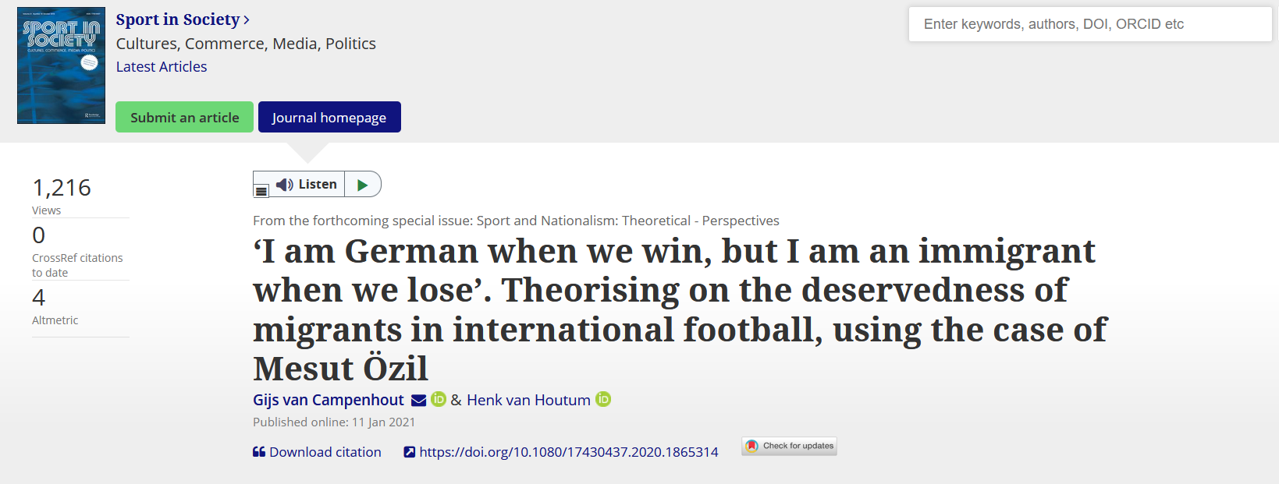

Slide 2
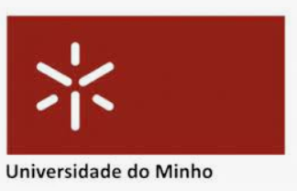
Nationalist moods, football, and attacks against immigrants: evidence from Germany
Gabriele Pinto, PhD student Sapienza University of Rome Department of Social Sciences and Economics
Braga, Portugal, 12 March 2022, Universidad do Minho
European Public Choice Society Meeting

Slide 3
The Contribution
A conceptual framework to understand the relationship between nationalism and attitude against immigrants
An empirical evidence of the relationship between sports nationalism and attacks against immigrants

Slide 4
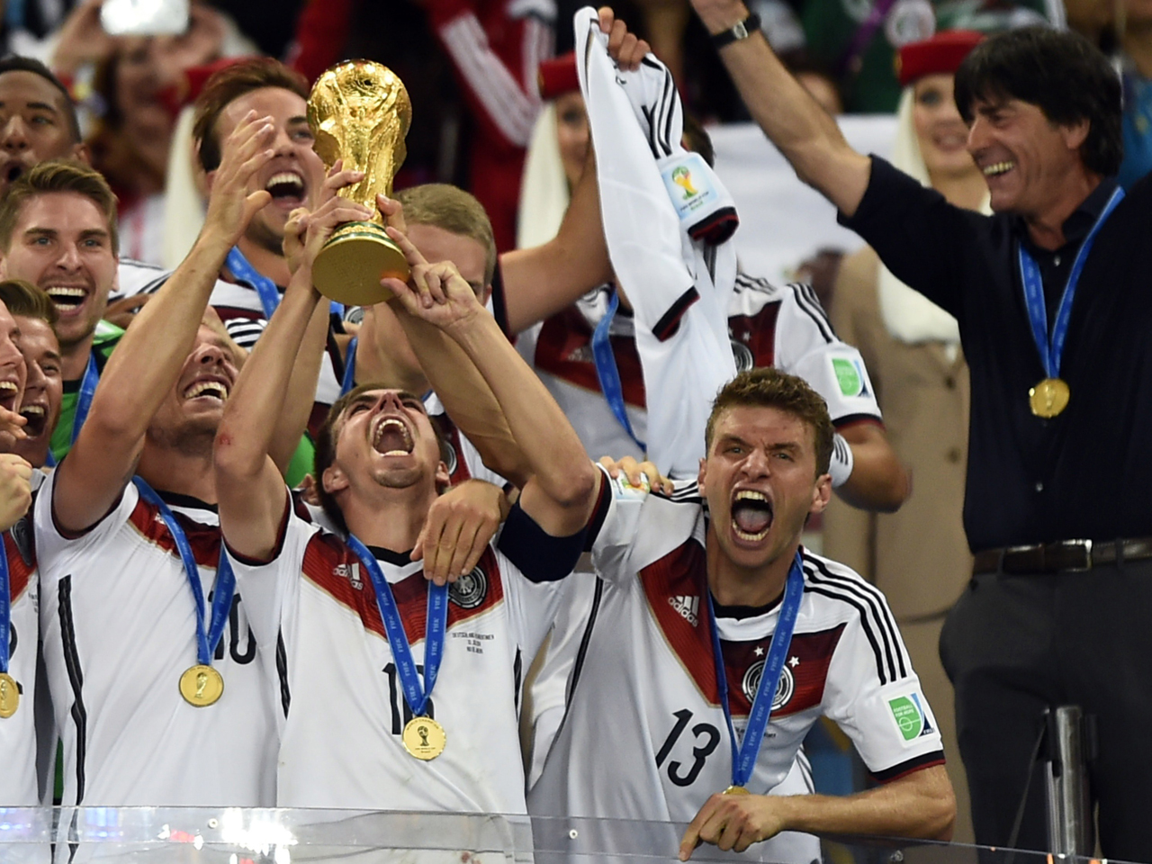
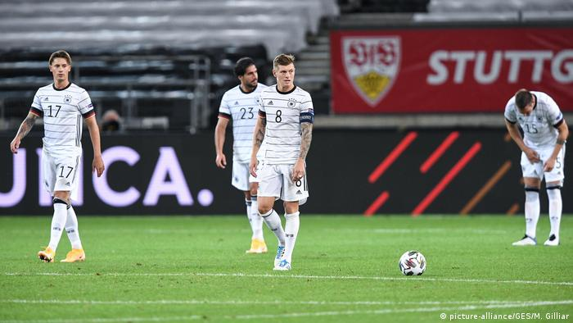
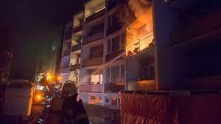
Empirical results
…In the days after a match of the German National team, if
Germany wins
Germany loose
Attacks on immigrants decreases
Attacks on immigrants increases

Slide 6
Outline of today’s presentation
The conceptual framework
Why nationalism is important
The traditional relationship
Healty Vs Morbid nationalism: a critique
Further considerations
A new conceptual framework
The empirical application
Data Description
Empirical Strategy
Robustness
Mechanisms
Conclusions

Slide 7
Why we need nationalism?
…We need something to feel “we are all in this together”
(Derbyshire 2019, Financial times)
…In the end “we are all nationalist today” (Wimmer 2019, Foreign Affairs)
And …“we cannot defeat nationalism”
(Walt 2019, Foreign Policy)

Slide 8
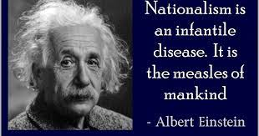
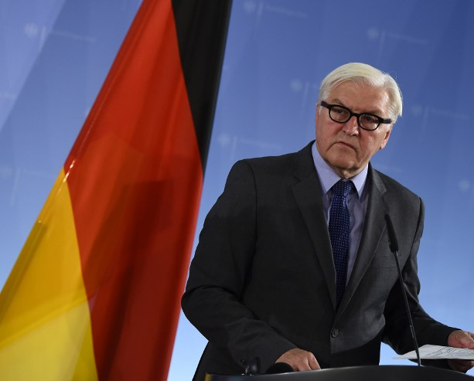
But…
Nationalism has a bad reputation…
Nationalism is an ideological poison. F.W.Steinmeier (President of Germany)
…the big problems of nationalism is that it fuels discrimination, xenophobia, conflicts and even wars!

Slide 9
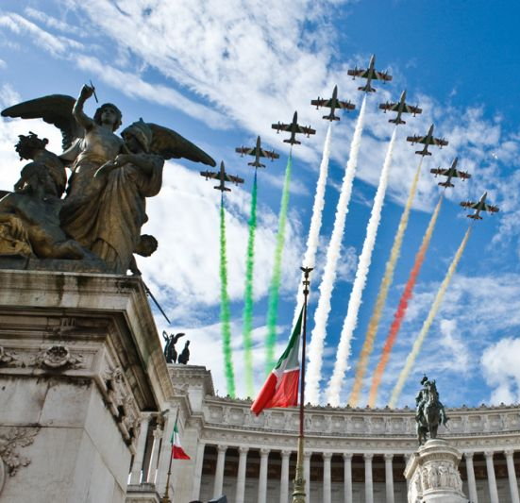
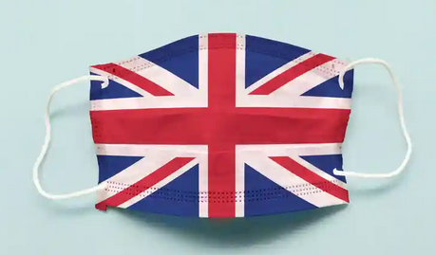
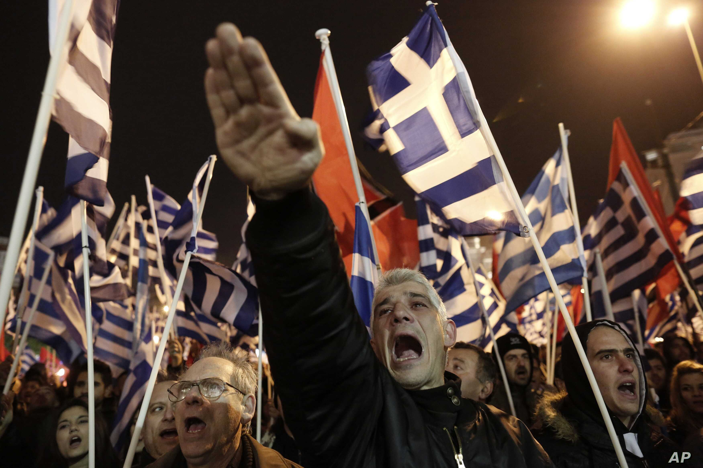
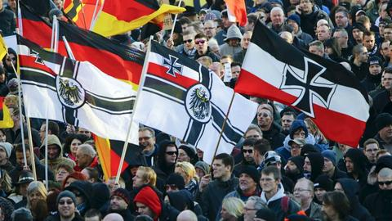
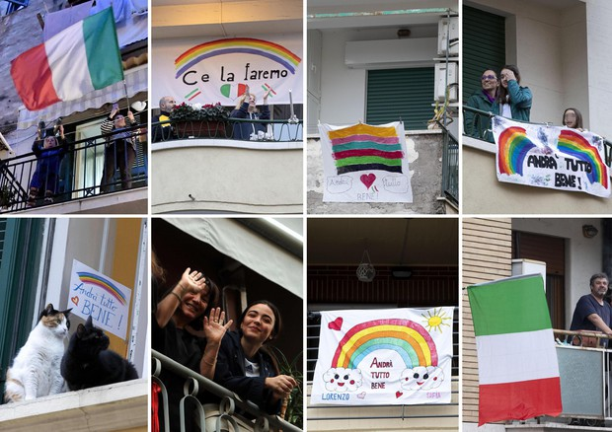
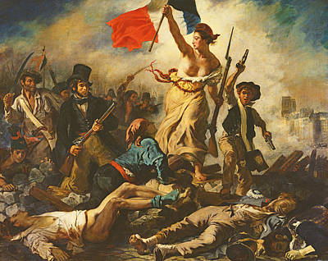
Conventional explanation: there are different types of nationalism
Healthy Nationalism
(Patriotic, Constitutional, etc…)
Morbid Nationalism
(Ethnic, Defensive, etc..)

Slide 10
SPORTS NATIONALISM
…decreases ethnic identification and violence within African countries
(Depetris-Chauvin et al. 2020)
…increases aggression between countries
(Bertoli 2017)
Increase inter-group frictions
Decrease intra-group frictions…but…
TAKEAWAY
sports nationalism might boost national unity at the cost of animosity towards foreigners
Puzzle: what about immigrants ? Are they considered part of the “group” or not ?...depends on the type of nationalism (Heinrich 2018)

Slide 11
Relationship between Nationalism and Immigrants
Nationalism
Attitude against immigrants
Attacks against immigrants
Healthy Patriotic nationalism
positive
decreases
?
Sports
Morbid, Ethnic nationalism
negative
increases

Slide 12
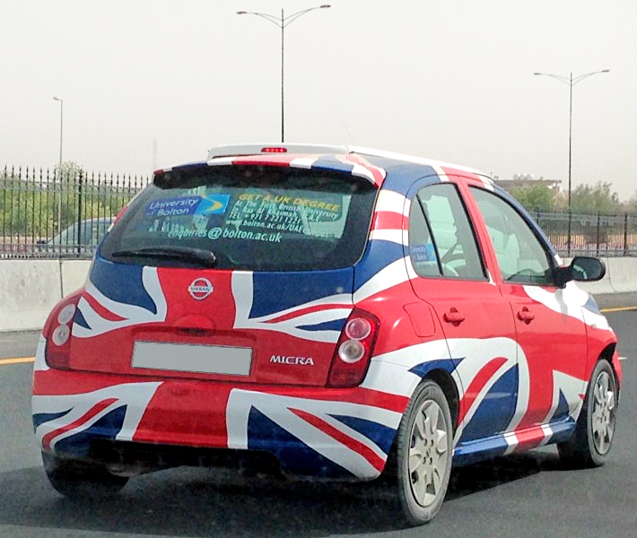
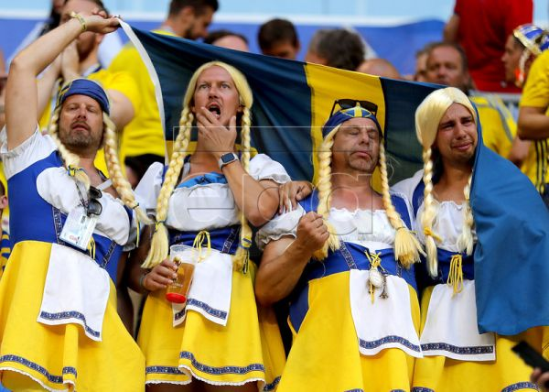
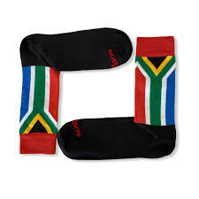
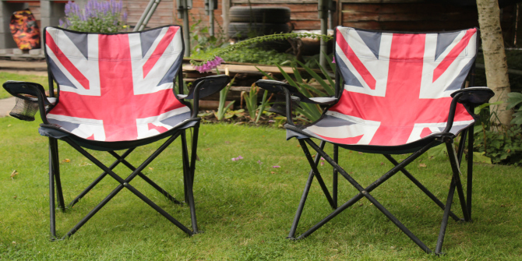
Conventional explanation: there are different types of nationalism
Healthy Nationalism
(Patriotic, Constitutional, etc…)
Morbid Nationalism
(Ethnic, Defensive, etc..)
Banal Nationalism

Slide 13
But… sports nationalism is a serious thing
“…It seems that soccer tournaments create those relationships: people gathered together in pubs and living rooms, a whole country suddenly caring about the same event. A World Cup is the sort of common project that otherwise barely exists in modern societies…”
Simon Kuper

Slide 14
Relationship between Nationalism and Immigrants
Nationalism
Attitude against immigrants
Attacks against immigrants
Healthy Patriotic nationalism
positive
decreases
?
Sports
Morbid, Ethnic nationalism
negative
increases

Slide 15
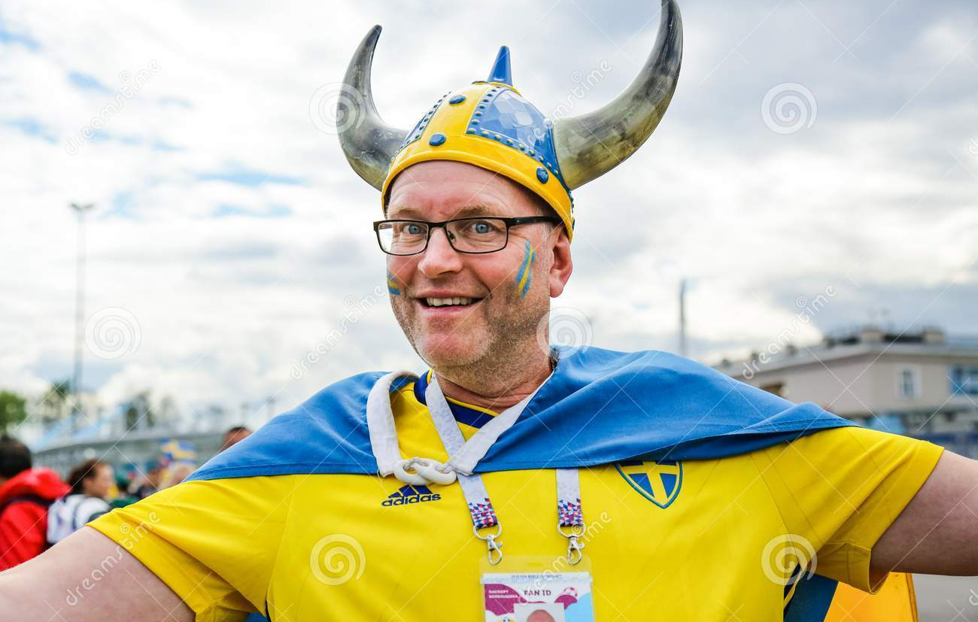
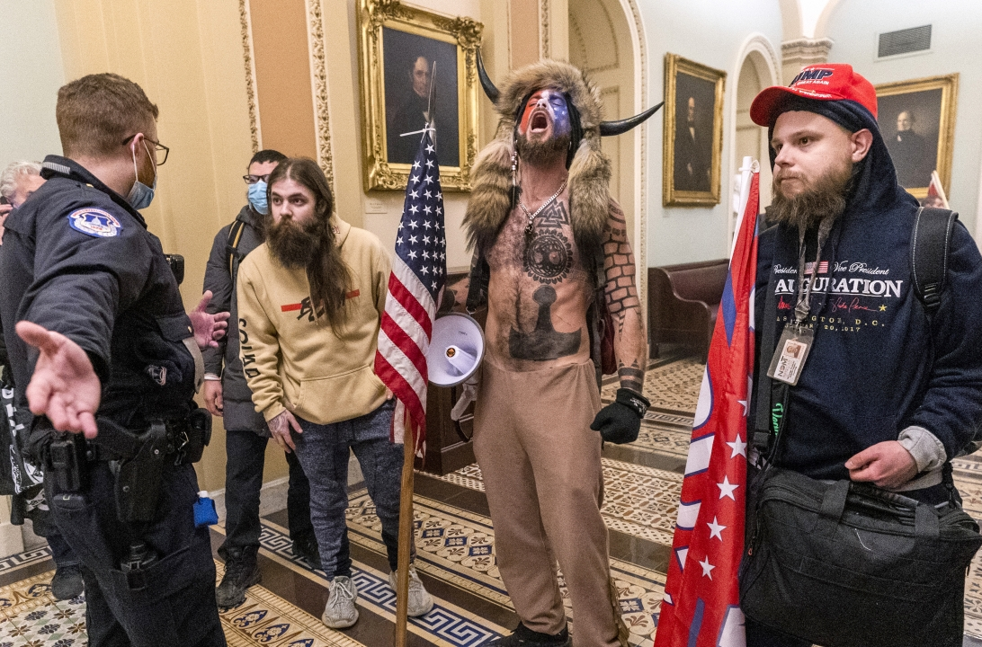
FIRST ARGUMENT
Healthy and Morbid Nationalisms are brothers rather than distant cousins
(Wimmer 2019, Foreign Affairs)

Slide 16
SECOND ARGUMENT
Happy mood enhances satisfaction with national issues
(Schwarz and al. 1987)
“Feel-good” factor
(Kavetsos 2011, Kavetsos and Szymanski 2012, Hallman et al. 2013, Stieger et al. 2015, Heere 2016, Meier 2018)
Anger enhances stereotyping and discrimination (Fiske 1998)
Fear, Anger and voting for the far-right and attitude against immigrants (Mc Dermott 2016, Vasilopoulous 2018)
Mood states affects attitude against immigrants and xenophobia (

Slide 17
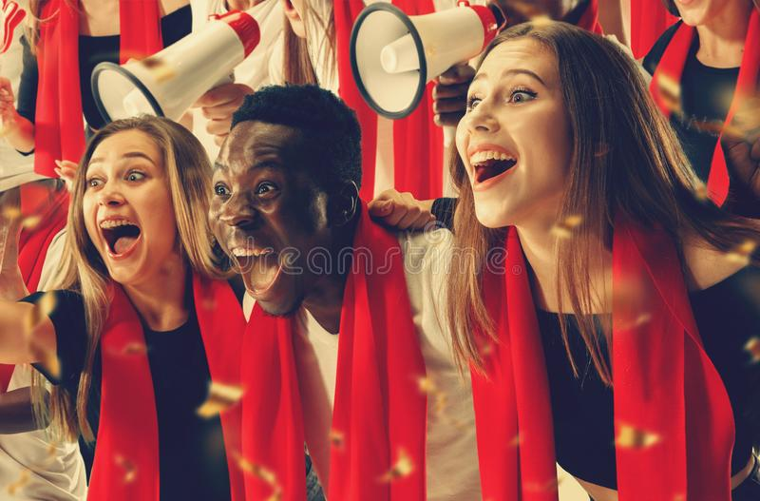
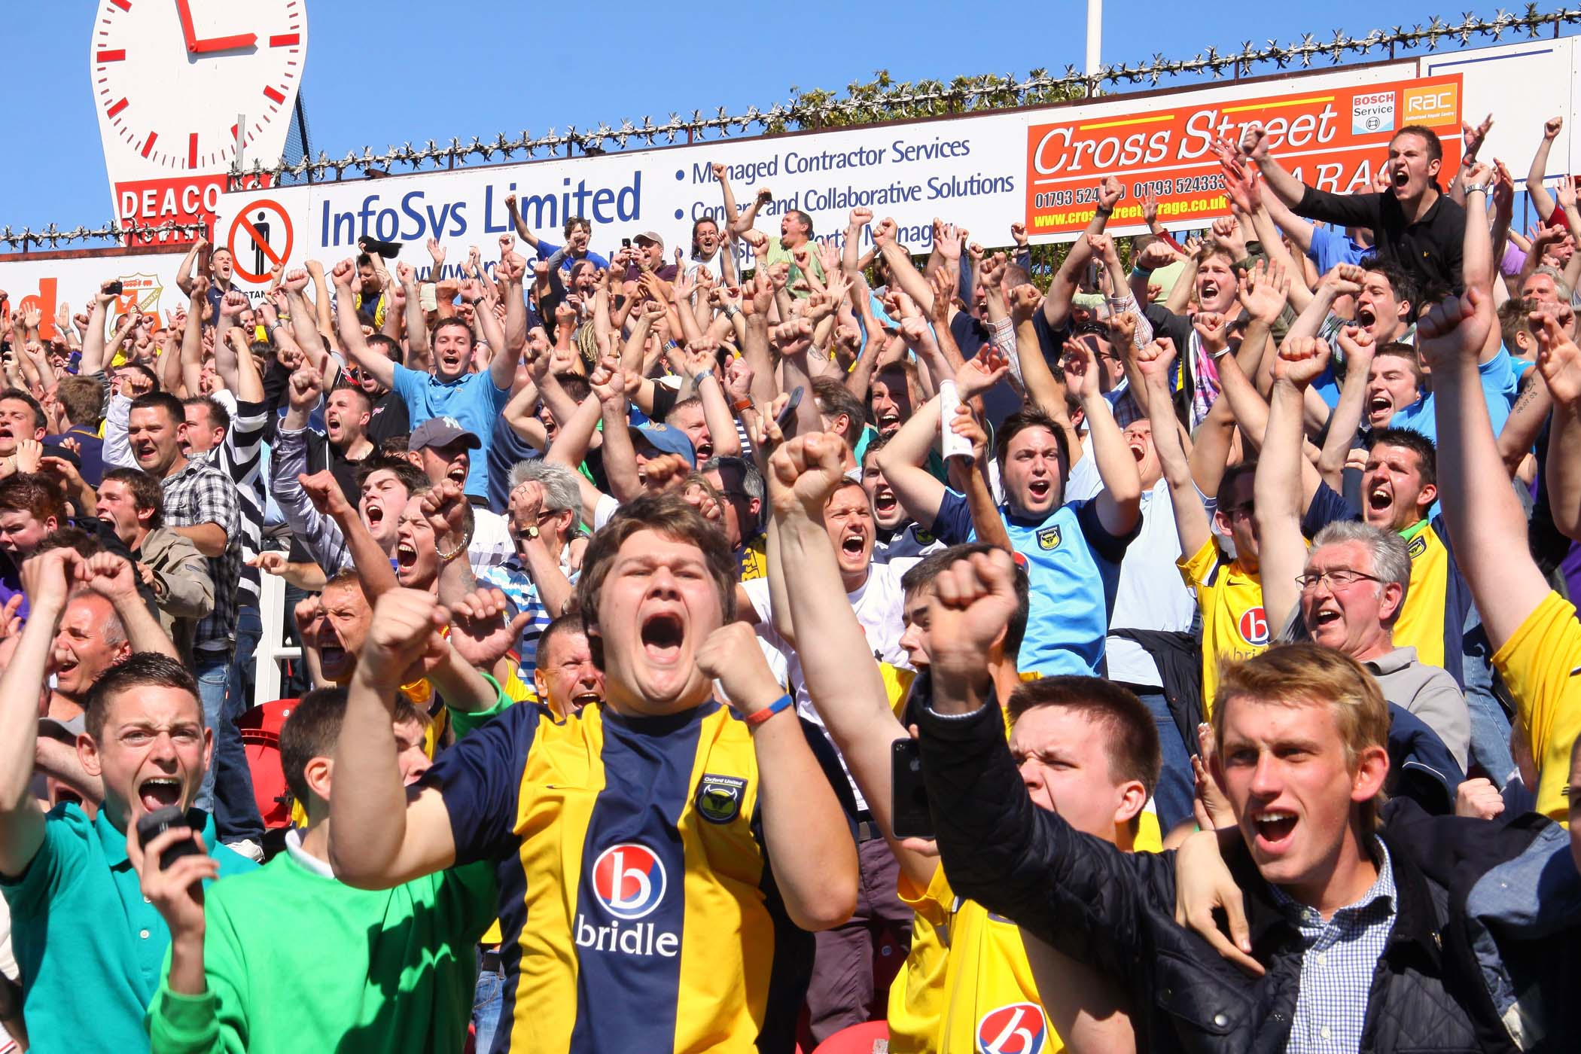
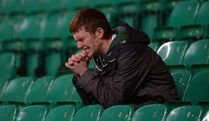
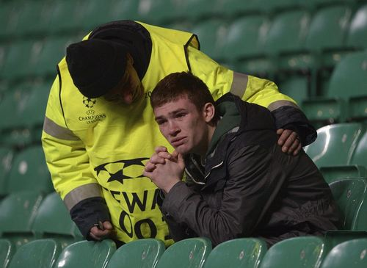
THIRD ARGUMENT
Sport events can affect mood (positively and negatively) and individual behaviors
The impact of sports on mood has been showed to affect electoral behaviors, stock prices, domestic violence (among others). ((Joiner 2006, Edmans 2007, Card and Dahl 2011, Healy et al 2010, Fowler and Montagnes 2015, Busby et al. 2017, Potosky and Urbatsch 2016)

Slide 18
Relationship between Nationalism and Immigrants
Nationalism
Attitude against immigrants
Attacks against immigrants
Healthy Patriotic nationalism
positive
decreases
?
Sports
Morbid, Ethnic nationalism
negative
increases

Slide 19
Relationship between Nationalism and Immigrants
Interaction between mood and ideologies
Sports
Mood
Nationalism
Attitude against immigrants
Attacks against immigrants
Healty Patriotic nationalism
Win
Positive
Patriotic, Inclusive, unitarian nationalist mood
positive
decreases
Loose
Identitarian, Exclusive, Nationalist mood
negative
Morbid, Ethnic nationalism
negative
increases

Slide 20
EMPIRICAL APPLICATION
z

Slide 21
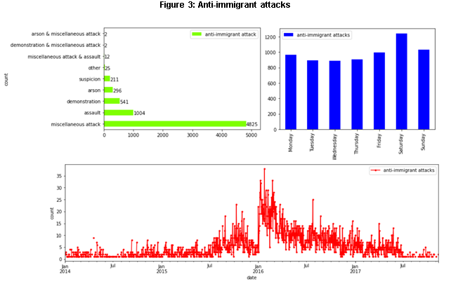
Data
Benček, D., & Strasheim, J. (2016). Refugees welcome? A dataset on anti-refugee violence in Germany. Research & Politics, 3(4), 2053168016679590.
Arvig Dataset
Calendar effects
outliers

Slide 22
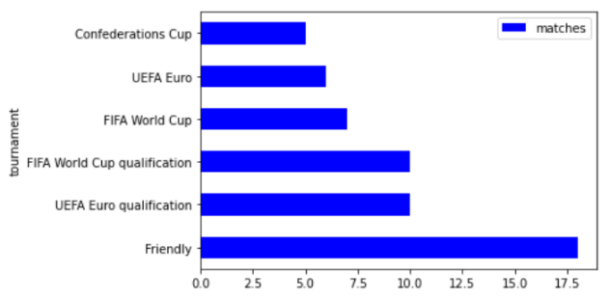
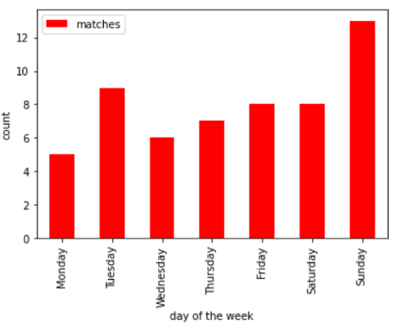
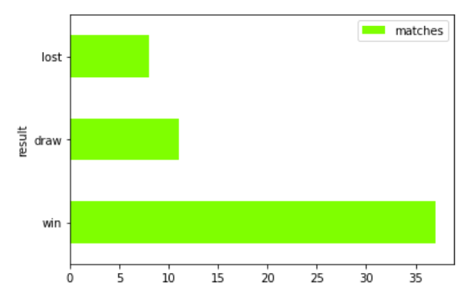
Data
Figure 2: Germany National team Soccer matches

Slide 23
Data
Attacks | Date | Match | Post Match | Post win | Post loss
5 | 11 oct | - | 0 | 0 | 0
8 | 12 oct | - | 0 | 0 | 0
15 | 13 oct | Germany vs Finland 2-0 | 0 | 0 | 0
12 | 14 oct | - | 1 | 1 | 0
8 | 15 oct | - | 1 | 1 | 0
4 | 16 oct | - | 0 | 0 | 0
10 | 17 oct | - | 0 | 0 | 0
Attacks | Date | Match | Post Match | Post win | Post loss
5 | 11 oct | - | 0 | 0 | 0
8 | 12 oct | - | 0 | 0 | 0
15 | 13 oct | Germany vs Finland 1-2 | 0 | 0 | 0
12 | 14 oct | - | 1 | 0 | 1
8 | 15 oct | - | 1 | 0 | 1
4 | 16 oct | - | 0 | 0 | 0
10 | 17 oct | - | 0 | 0 | 0
Attacks | Date | Match | Post Match | Post win | Post loss
5 | 11 oct | - | 0 | 0 | 0
8 | 12 oct | - | 0 | 0 | 0
15 | 13 oct | - | 0 | 0 | 0
12 | 14 oct | - | 0 | 0 | 0
8 | 15 oct | - | 0 | 0 | 0
4 | 16 oct | - | 0 | 0 | 0
10 | 17 oct | - | 0 | 0 | 0
Exogeneity assumption lies on random assignment of the date of the match
+ day of the week, month, year fixed effects (because matches take place mostly on Sundays)
2 days window

Slide 24
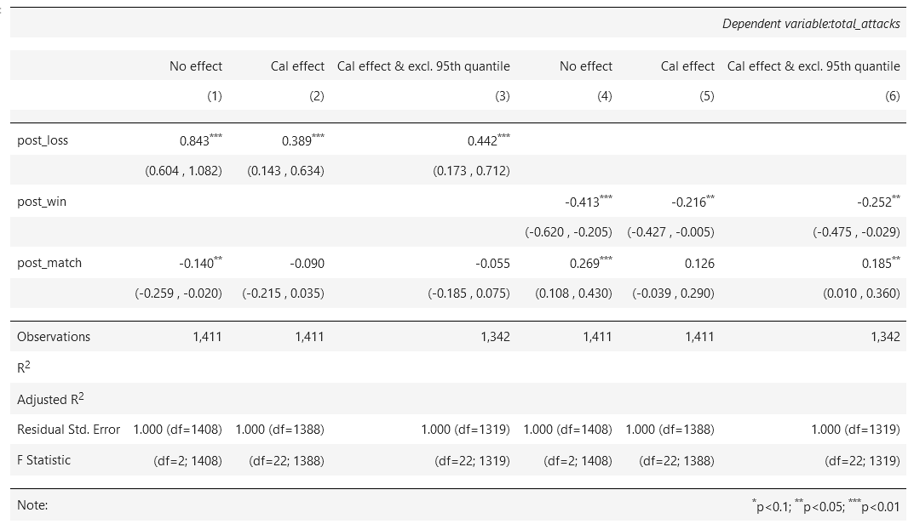
Baseline Results: Poisson
Results table 1 and 2
Table 1: Poisson regression results

Slide 25
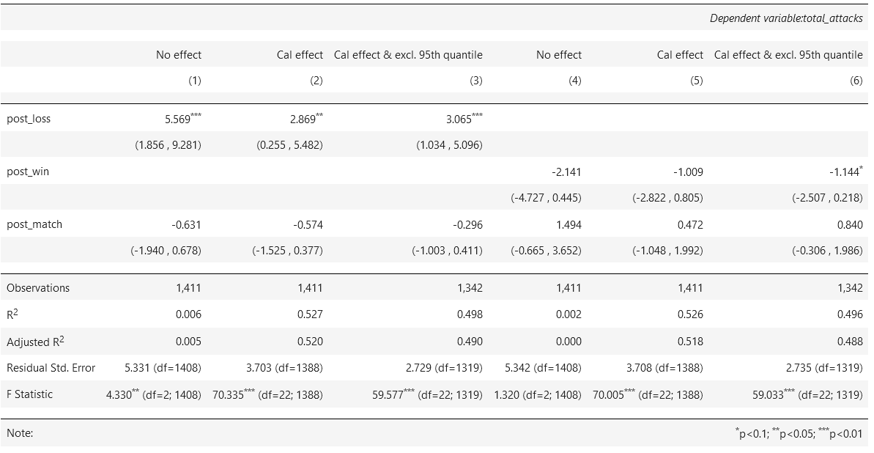
Baseline Results: OLS
Table 2: OLS regression results

Slide 26
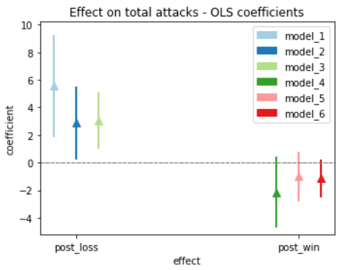
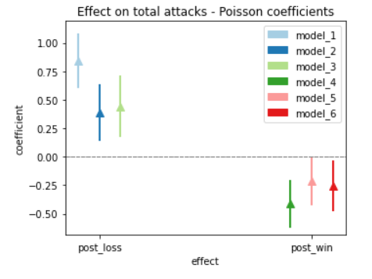
Baseline results
Figure 6: Regression coefficients plot

Slide 27
Robustness and Mechanisms
Excluding demonstration
Alchool consumption and controlling for other crimes
City of attacks

Slide 28
Excluding Demonstration
z

Slide 29
Baseline results: excluding demonstration

Slide 30
Baseline results: exclude demonstrations

Slide 31
Controlling for other crimes and alcohol consumption
z

Slide 32
Controlling for other crimes
Alcohol consumption is the interviewing variable that links football matches to violent crime rise (Ivandić et al., 2021; Kirby et al., 2014; Trendl et al., 2021)
Nationalism
Sports
Anger
attitudes
Violence
Mood
Testosterone
Slight differences in our framework. They look at few hours after the match, we look at days after the match (can alcohol effect persists in the days after?).
A TEST: is there a general increase in crime against immigrants compared to other crimes (e.g. other types of violence?)
but, we do not have data on daily crimes in Germany. We try to use a proxy: the daily google trend index of “polizei”.
Validation of the Proxy on a yearly scale

Slide 33
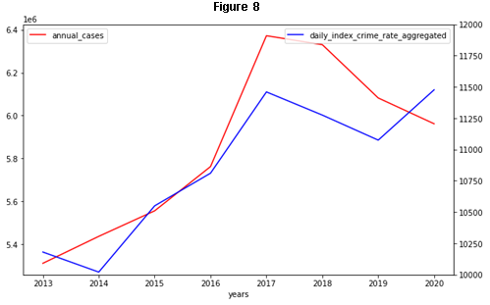
Controlling for other crimes
Official statistics on crime (Federal ministry of interior)
Google Trend index for the word “Polizei”

Slide 34
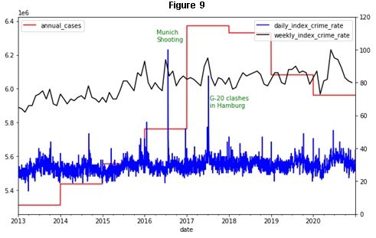
Controlling for other crimes

Slide 35
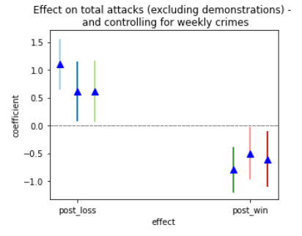
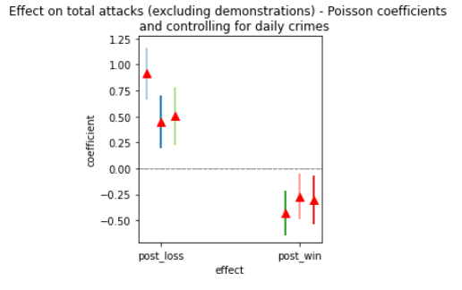
Controlling for other crimes
Figure 10

Slide 36
City of Attacks
z

Slide 37
City of attack
Hooliganism ? Etc…
No correlation at all between location of the match (city/stadium) and attacks nearby.

Slide 38
Mechanisms
z

Slide 39
Relationship between Nationalism and Immigrants
Sports
Mood
Nationalism
Attitude against immigrants
Attacks against immigrants
Win
Positive
Patriotic, Inclusive, unitarian nationalist mood
positive
decreases
Loose
Identitarian, Exclusive, Nationalist mood
negative
negative
increases

Slide 40
Mechanisms
European Social Survey
Attitude against immigrants
Is (country) made a worse or a better place to live by people coming to live here from other countries? Score from 0 (worse place to live) to 10 (better place to live)
2. Mood
Taking all things together, how happy would you say you are ? (on a scale from 0 to 10)
We compare answers of different respondents before and after matches of their national team.
as in De Petris et al. 2020

Slide 41
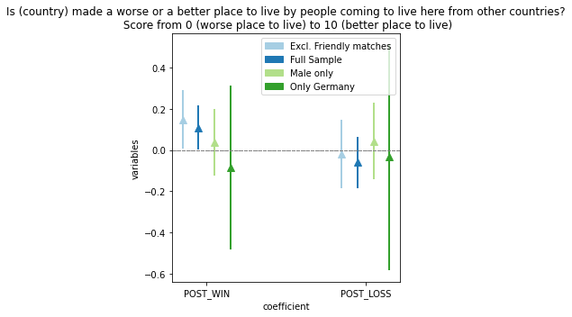
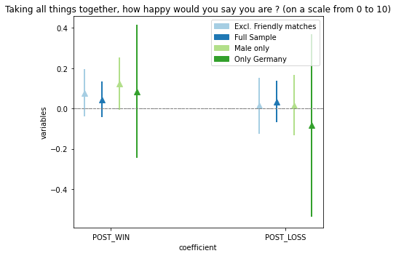
Mechanisms
Figure 7
Figure 8
But… statistical issues (small sample)

Slide 42
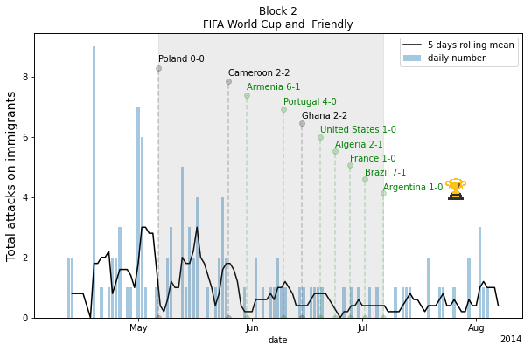
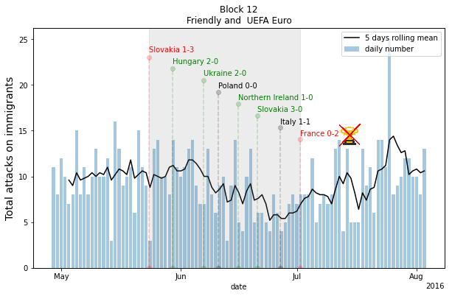
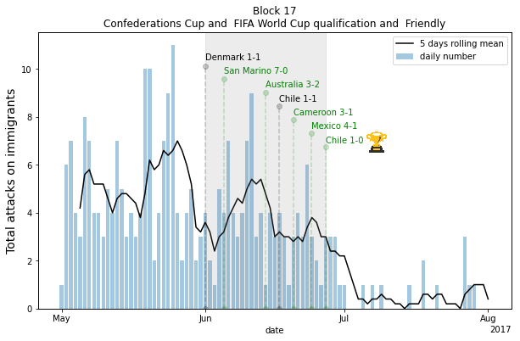
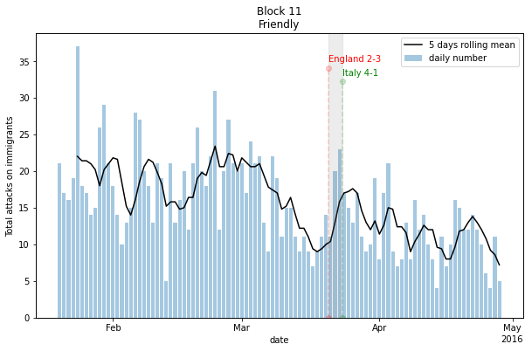
Longer term
We have only looked at the effects in the 2 days after the match. What about cumulative effect and more longer term effect ?
Figure 9

Slide 43
Conclusion
Banal Sports nationalism matters.
The impact of sports nationalism on anti-immigrant attitudes (and behaviors) depends on the result of matches..
Nationalism and xenophobia are not thought of as stemming from unadulterated ideology, but rather from a multi-dimensional construct of attitude, behaviors, and mood states

Slide 44
ONE LAST ANECDOTE
z

Slide 45
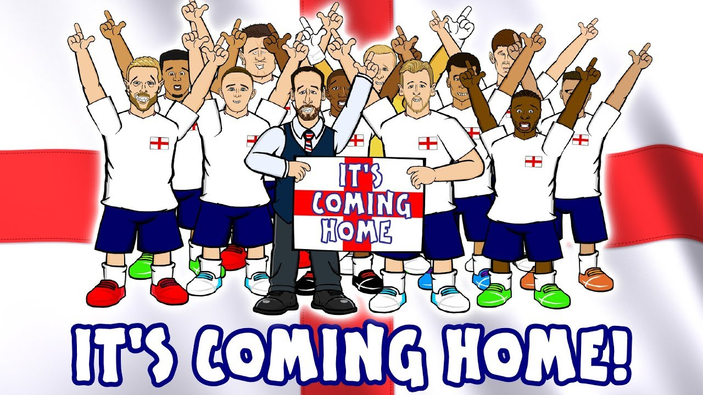
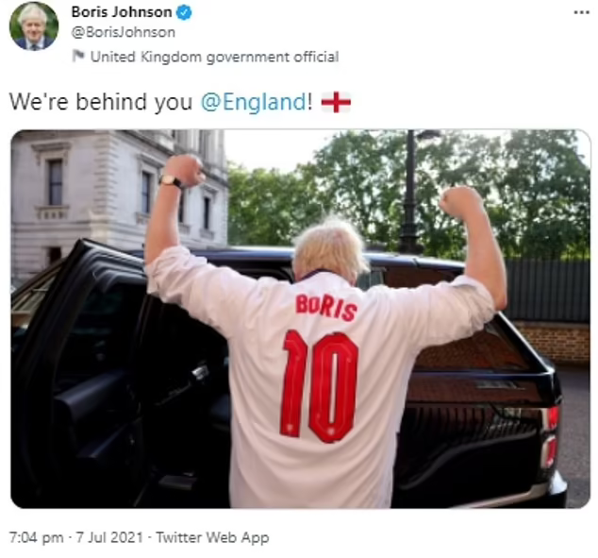
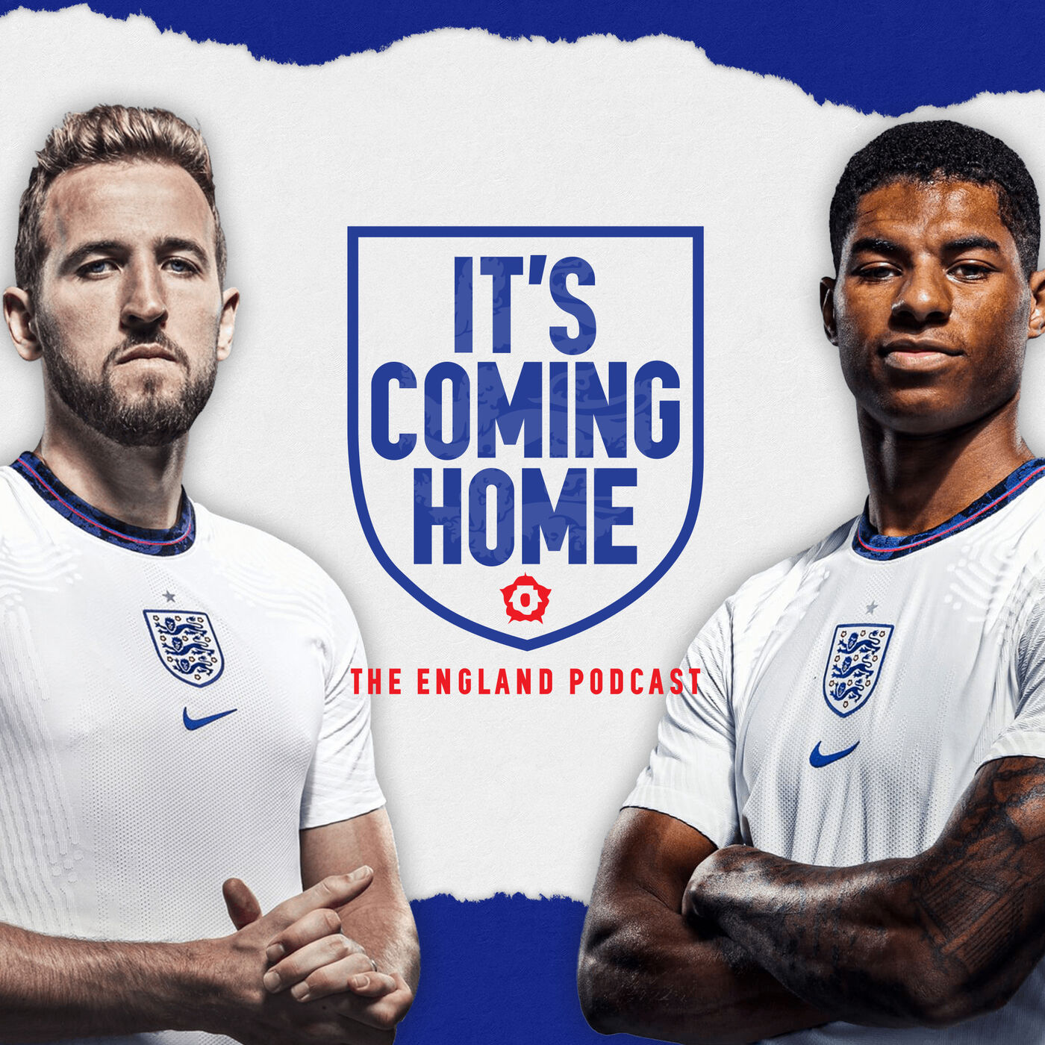
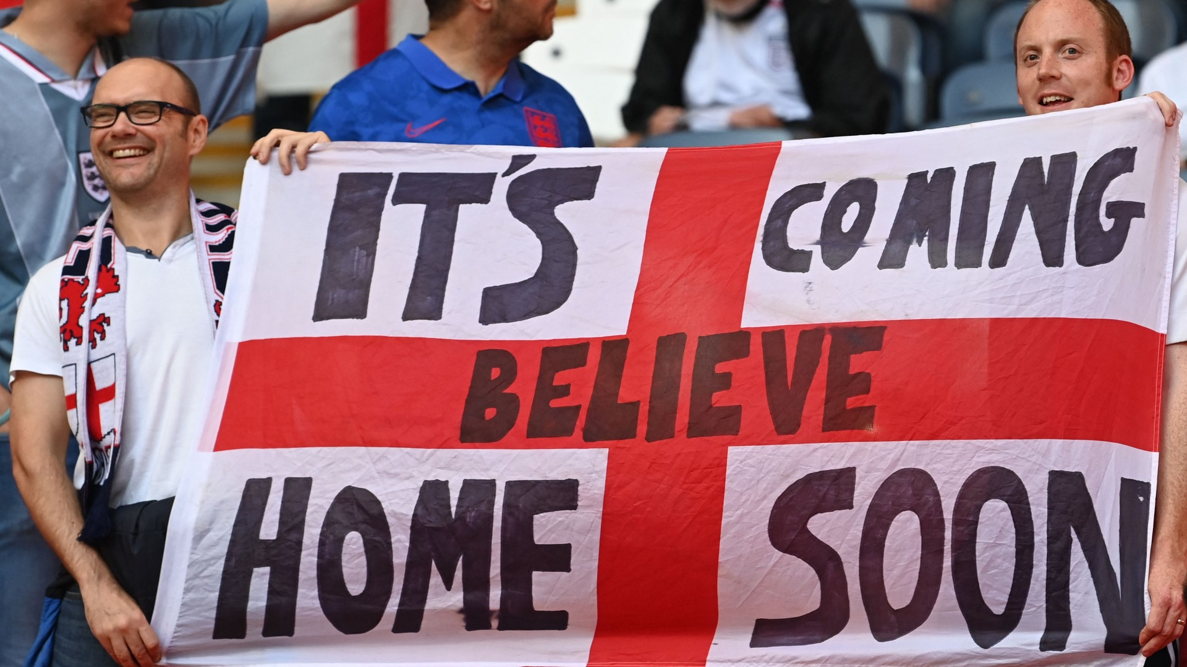
England: EURO 2021

Slide 46
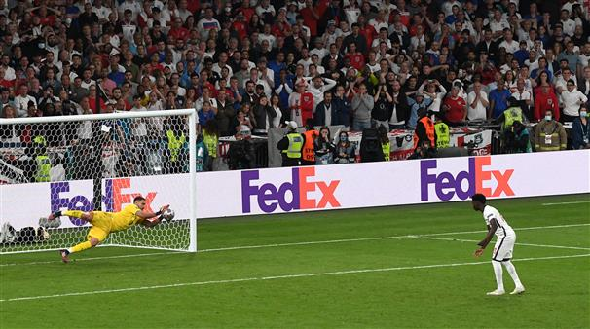
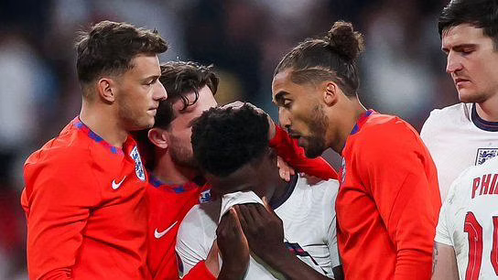
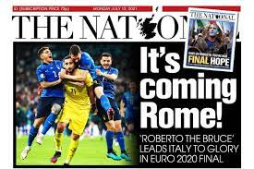
England: EURO 2021

Slide 47
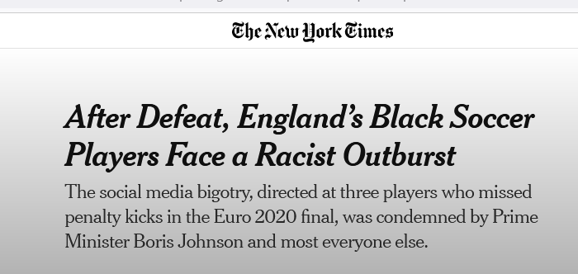
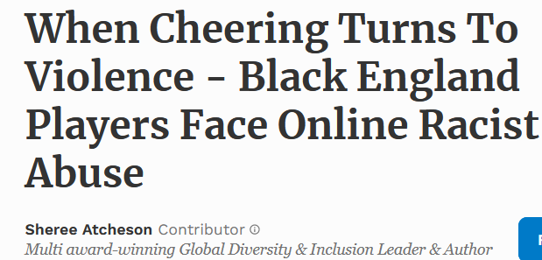

Slide 48
Thanks for your attention!
Feedbacks are very much appreciated

Slide 49
Day-2 | Post-Match | Post-Loss | Post-Win
No match | 0 | 0 | 0
Win | 1 | 1 | 0
Loss | 1 | 0 | 1
Draw | 1 | 0 | 0

